Slide 1
Surface Albedo Measurements at UNR
29 July 2013
By Pat Arnott

Slide 2
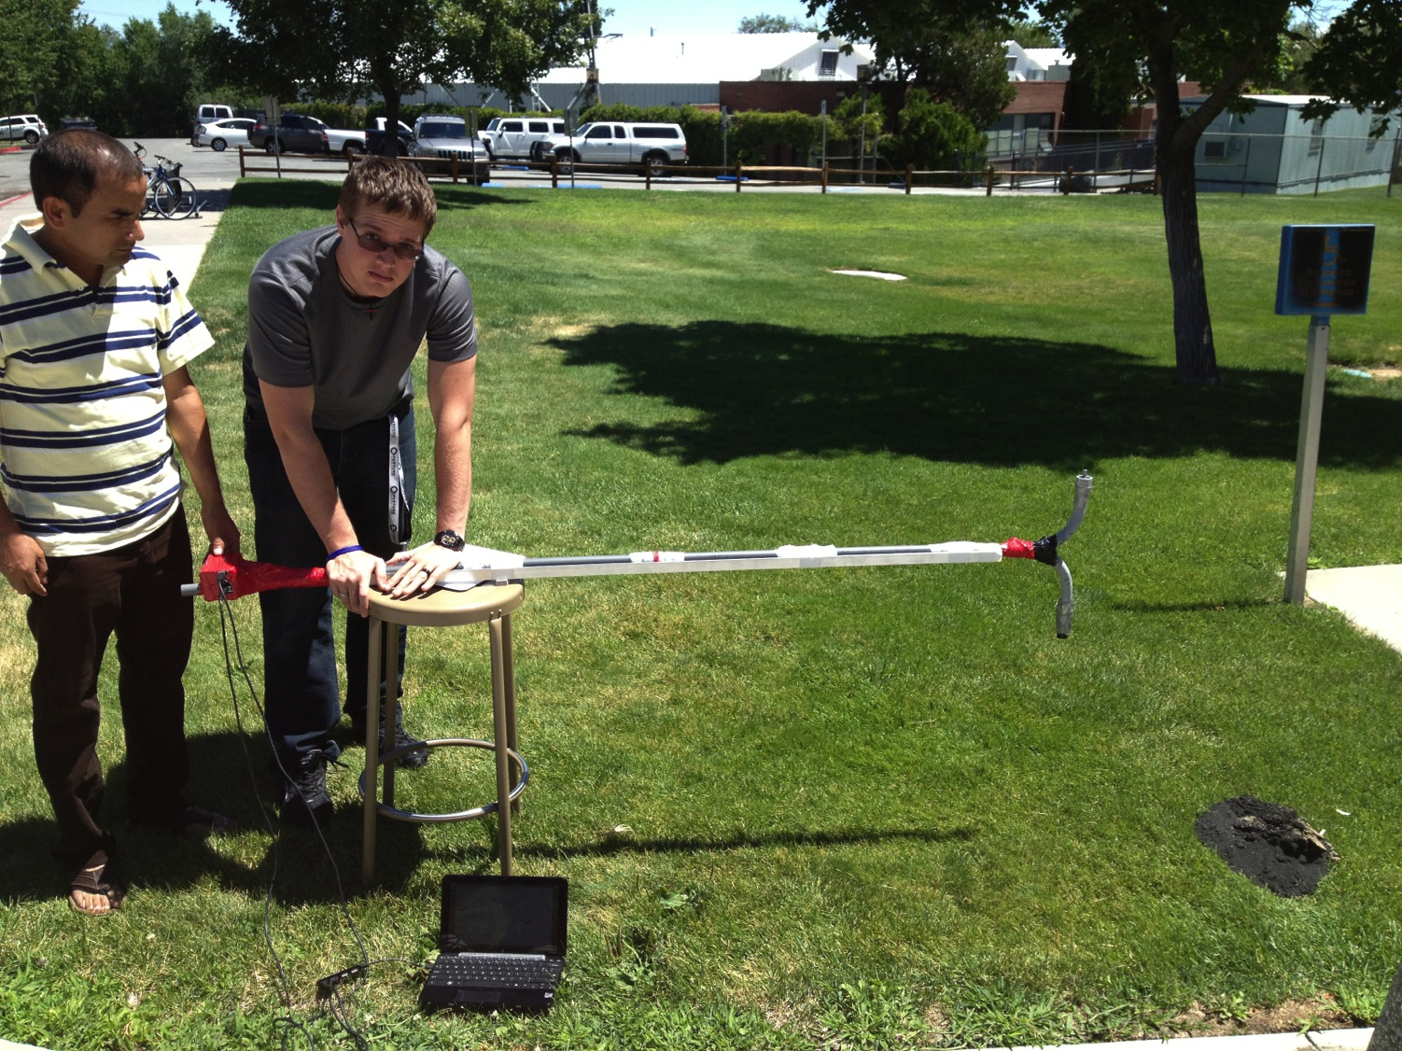
Bryan steadies the albedo measuring device
Irradiance sensor
(looks up)
Radiance sensor
(looks down)
Computer to read spectrometer data.
Spectrometers are at Dambar’s left hand.

Slide 3
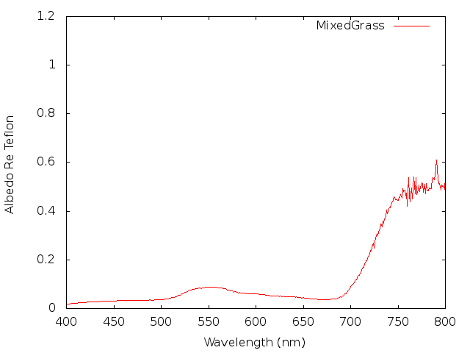
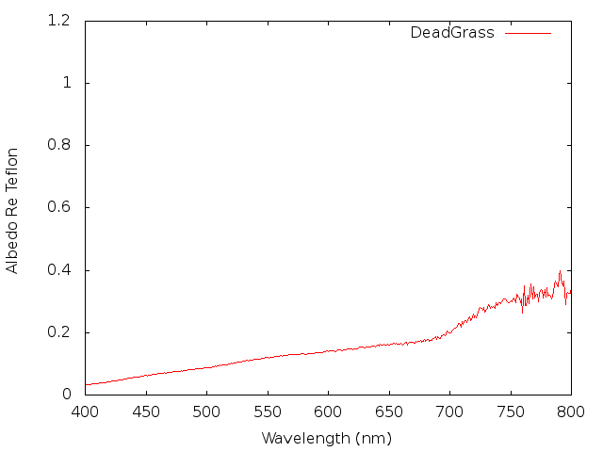
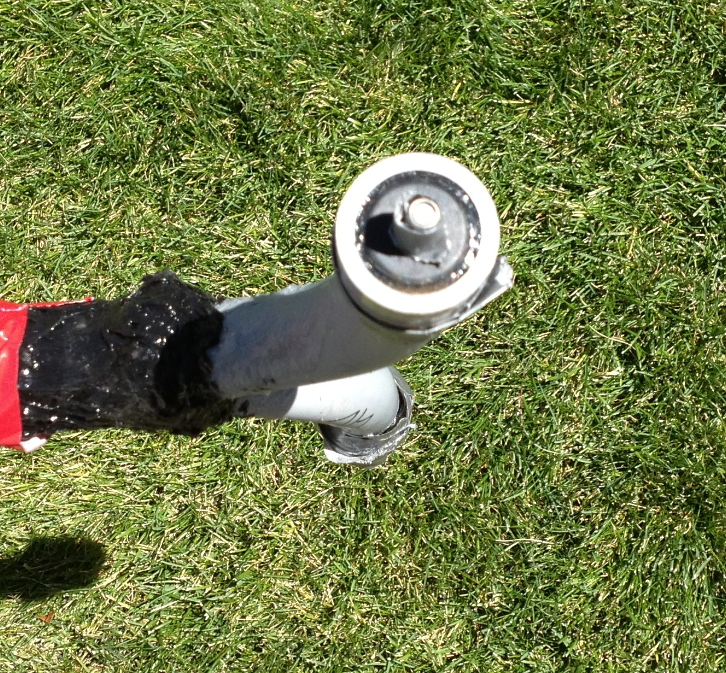
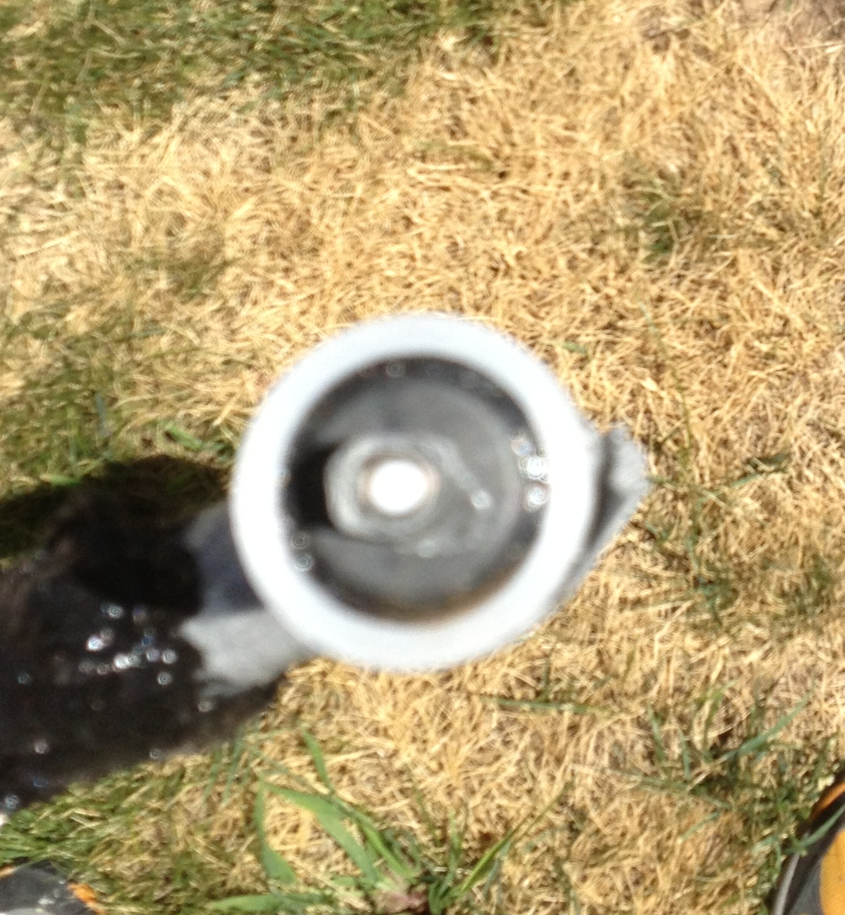
Spectral Albedo of Dead and Live Grass
Mixed greener grass has a peak at around 550 nm (green color).
Mixed greener grass is likely taller and may cast more shadows, making it darker.
Dead grass reflects more visible light (from 400 nm to 700 nm) but absorbs
more infrared (above 700 nm).

Slide 4
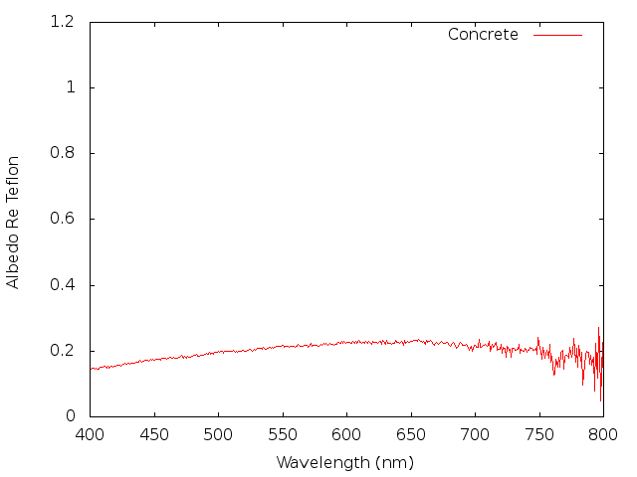
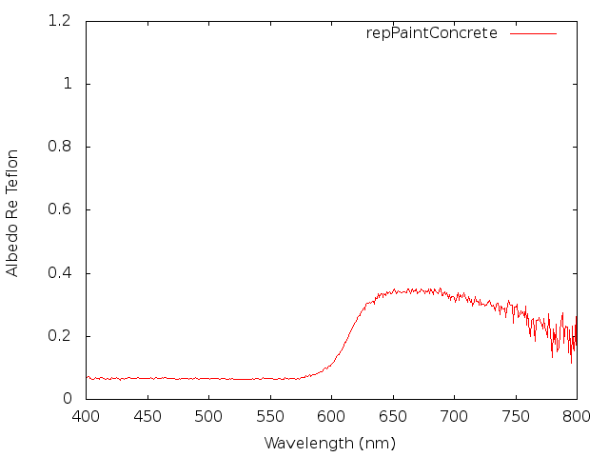
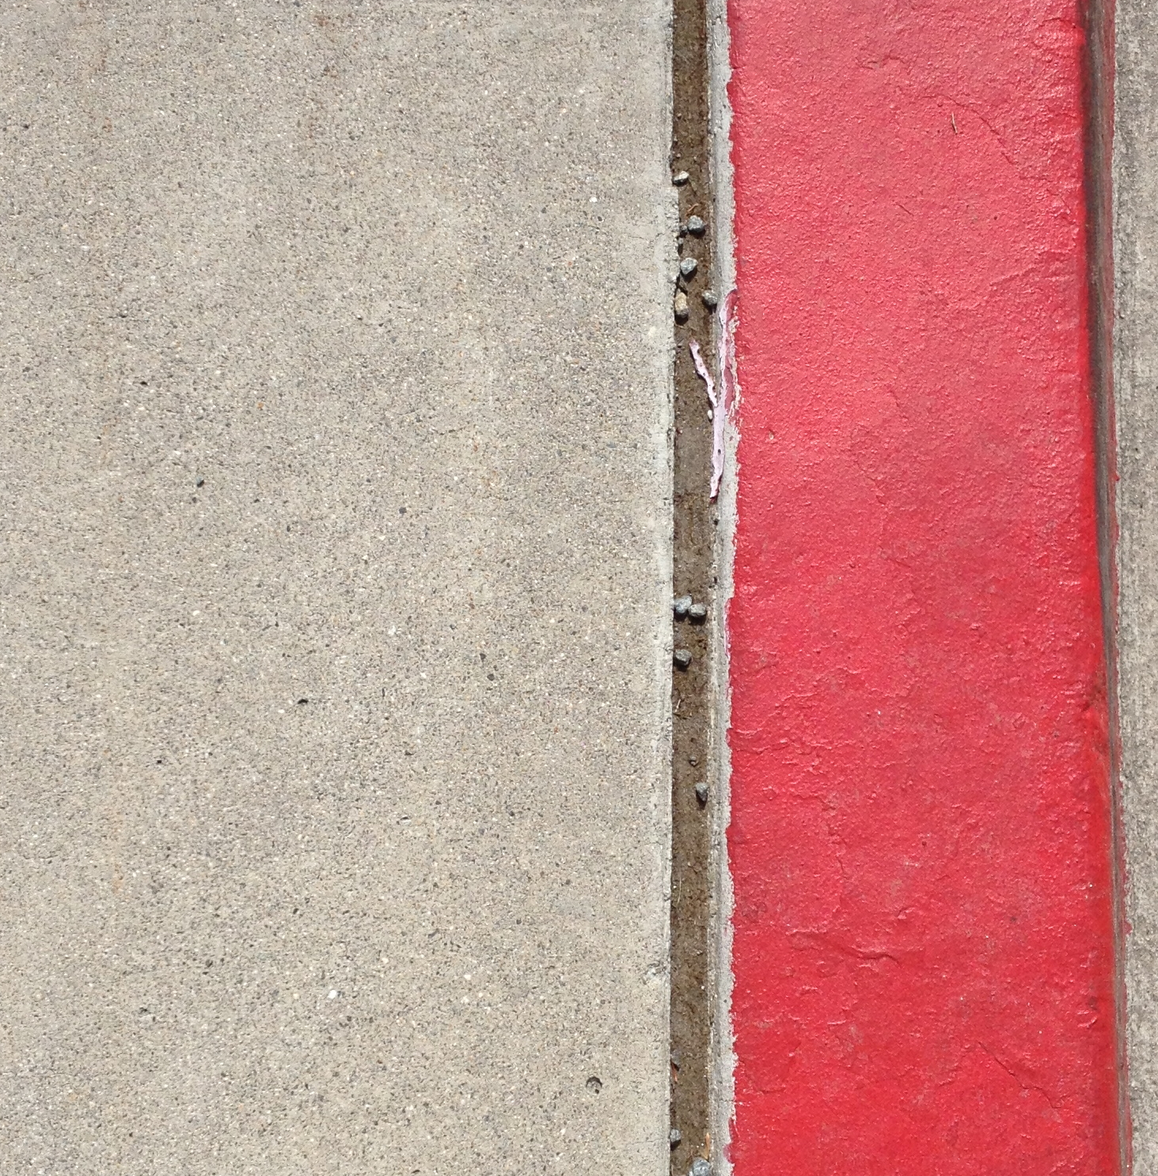
Concrete and Red Painted Concrete
Strong absorption
below 600 nm!
Red painted concrete may
overall absorb more light
than unpainted concrete.
Red painted concrete may
be warmer than unpainted
concrete.

Slide 5
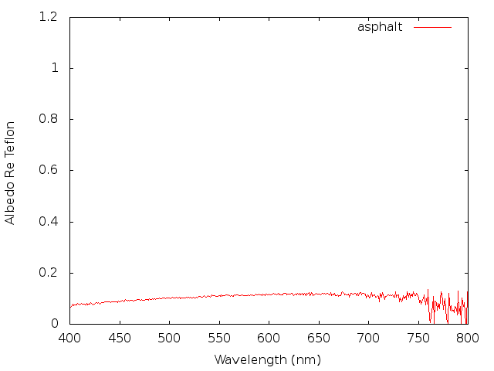
Concrete and Asphalt Comparison
The spectral albedo of concrete is higher than that for asphalt.
We would expect asphalt to be warmer than concrete on a sunny day.

