Slide 1
How to read data into Excel and make a publication quality graph: One pathway.
Raw data is comma separated values with a time and light intensity column. The text in this file is shown here in red, though yours will be black text.
time_seconds,LightIntensity_Lux
0.100624,200.70
0.101176,200.77
0.101736,200.68
0.102288,200.84
0.102840,200.84
0.103392,200.82
0.103944,200.63
0.104496,200.75
0.105048,200.61
0.105600,200.67
0.106152,200.75
… (and so on)

Slide 2
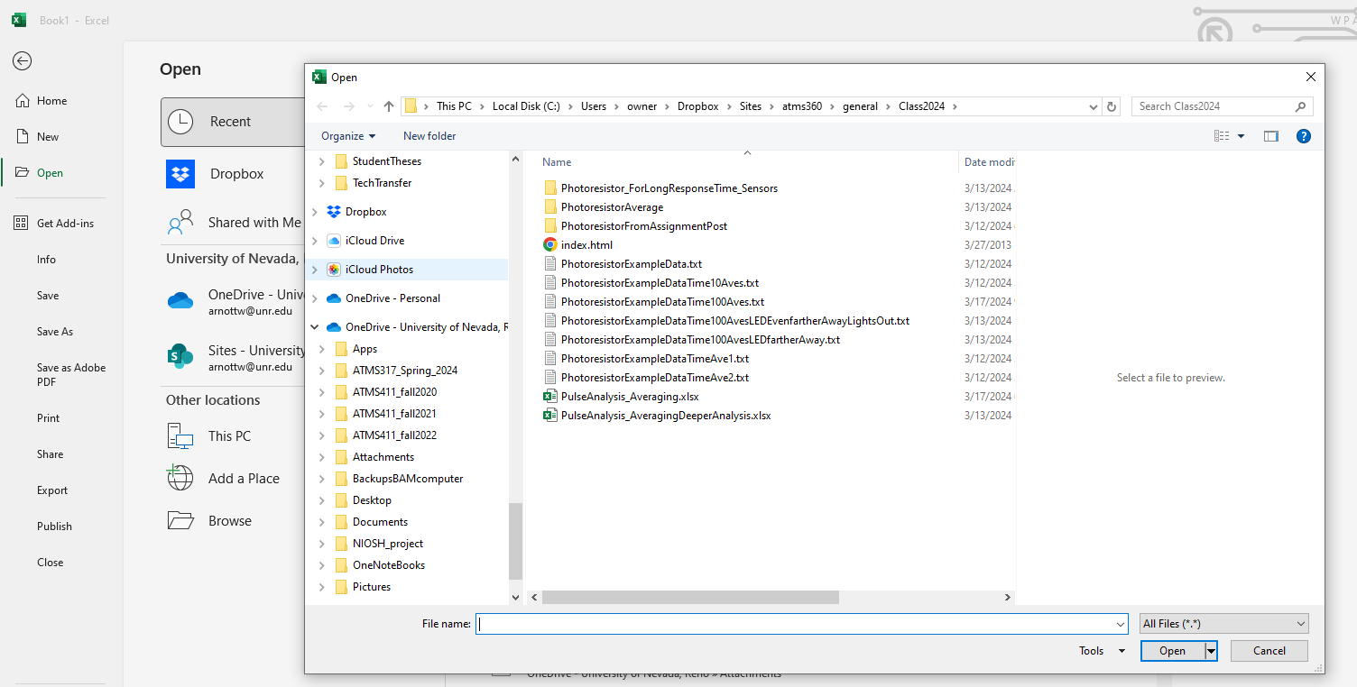
From the File menu the sequence is File:Open:Browse:All Files (*.*):your file. In this example the file named PhotoresistorExampleDataTime100Aves.txt was used. Yours will be different.

Slide 3
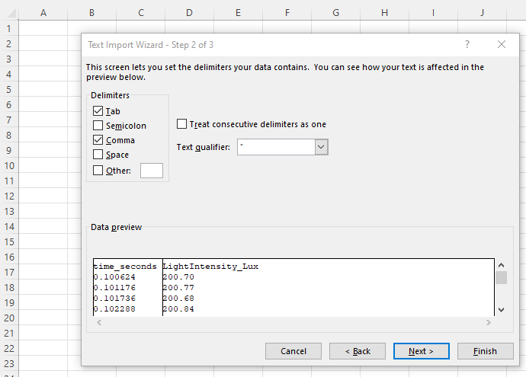
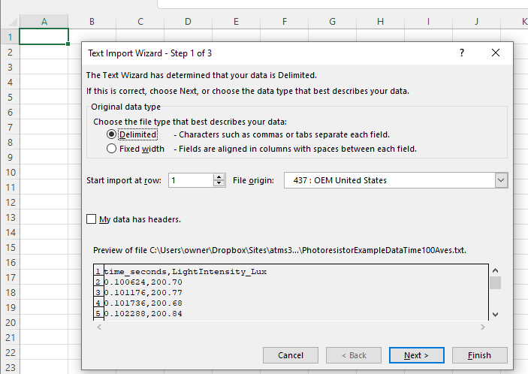
After clicking on your file, do steps 1-3. 1. Click on cell A1 if it’s not highlighted with a green box. 2. Click Next for the figure on the left. 3. Click Comma and then Next for the figure on the right.

Slide 4
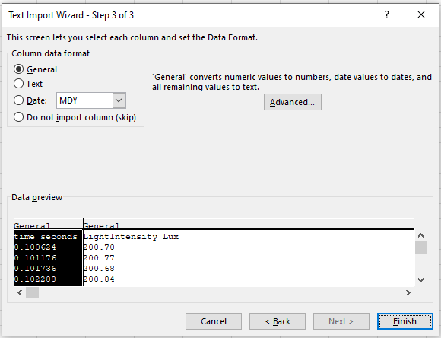
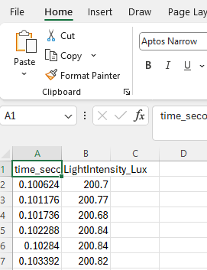
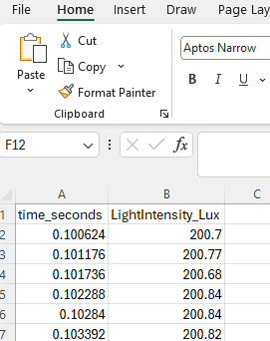
From left to right, after clicking Finish, the data will look like the next image. Put your cursor on the first red line exactly between A and B, and double click. That will resize cell A1 to fit. Do the same thing with the second red line. Your data will look like the third image.
NOTE: The filename will still be YourFile.txt, will be of file type text, indicated by the .txt ending. This will be changed next.
Data View After Justifying
Data View:

Slide 5
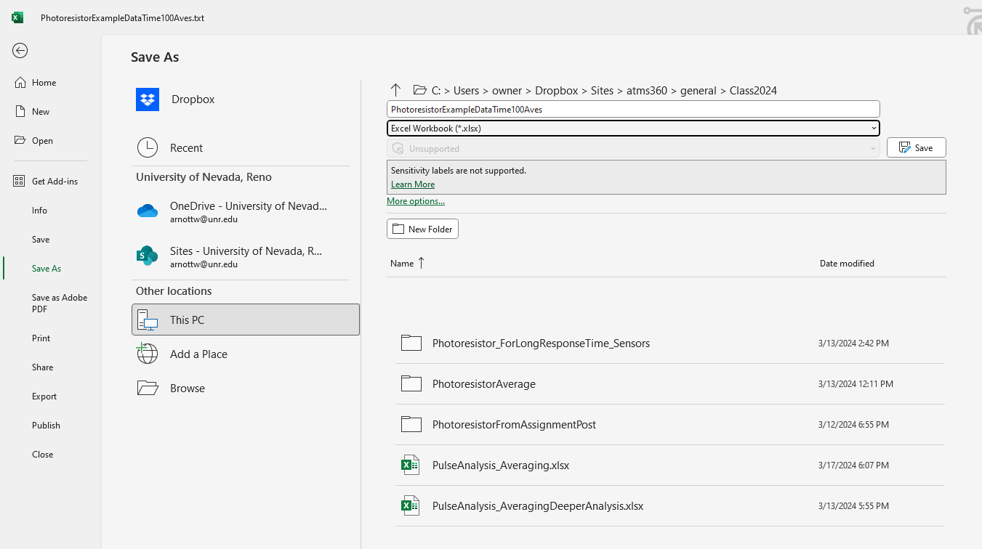
Save the file in Excel Workbook (*.xlsx) format, the native format for Excel. The sequence is File:Save As:Excel Workbook (*.xlsx) where * is your filename. If needed, click Browse to put the file in a different folder.
If needed

Slide 6
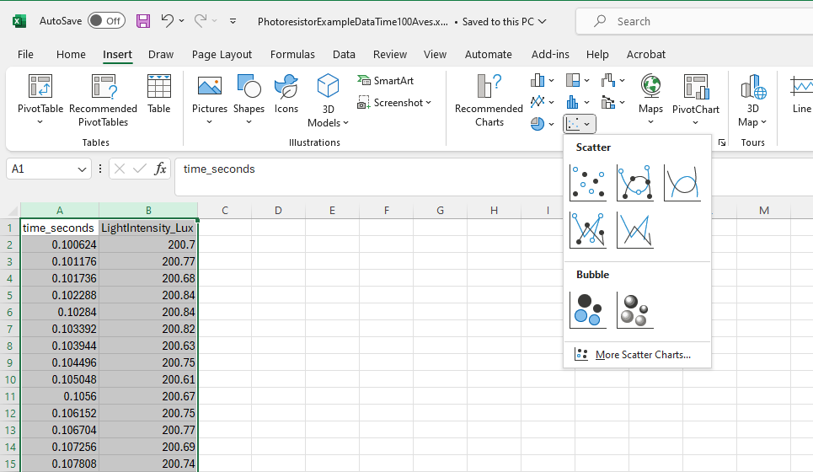
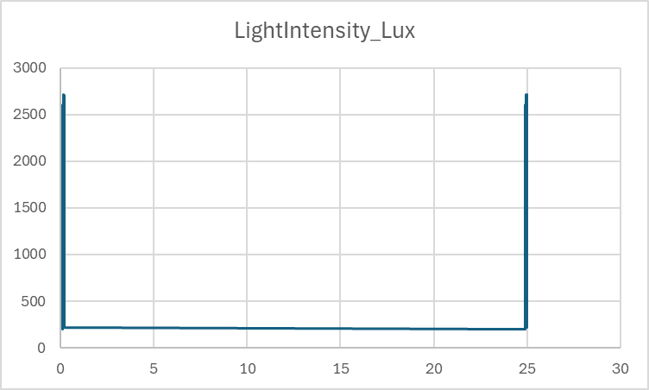
To make a graph, the sequence is: Insert: click on A: hold the shift key down and click on B: click on Scatter: Click on the the indicated graph type. This graph will appear in this page as indicated below.

Slide 7
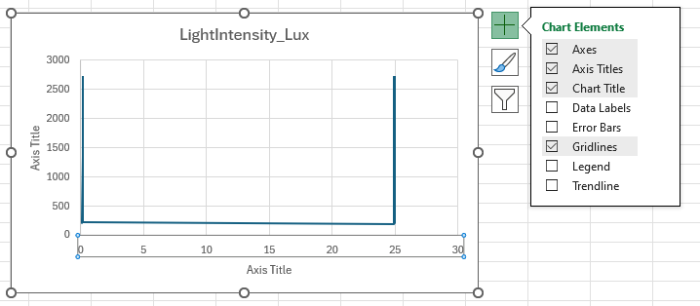
To add axis titles, left click your mouse on the 20 (or any other number on that axis) and the + symbol will appear. Click on Axis Titles. Then the Axis Titles will appear. Double click on the horizontal axis and replace it with Time (seconds). Double click on the vertical axis and replace it with Light Intensity (Lux).

Slide 8
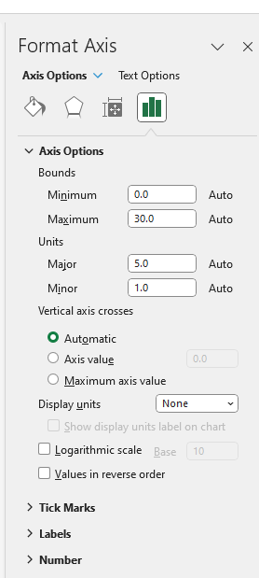
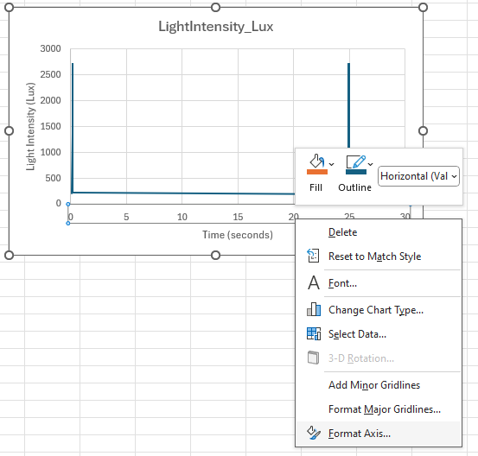
To show one of the measurements in detail, right click on the 20 on the horizontal axis (or any other number) and click on the option at the bottom, Format Axis… . This brings up the menu on the right. Click on the far right button to bring up Axis Options. Change the Bounds Minimum and Maximum until one of your events is shown in detail.

Slide 9
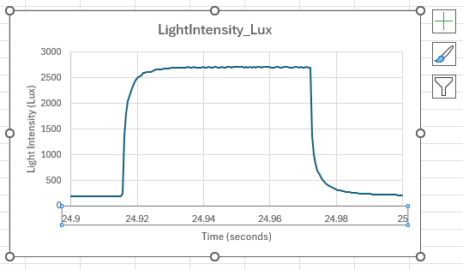
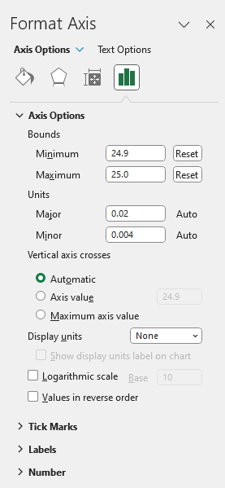
The result should be like the graph on the left. The Bounds for this graph are shown under Axis Options on the right. Your graph and Bounds may by different. After completing the curve fit of the data, the steps needed to make a publication quality graph will be provided.

Slide 10
Create publication quality graphs
Large dark fonts that are visible from 10 feet away from your monitor.
Color choices and line types (solid or dashed) that are easy to identify.
Frame around the entire plot.
Tick marks on the plot, usually facing inside.
Note that right clicking on chart elements, like axis numbers, the interior of the plot, the exterior of the plot, the data curves, etc, allow you to change their properties.
This is a guide for the style I find most effective, you may find other styles that work better for your perspective or problems at hand.
The example used here was from a graph that has the model curves also.

Slide 11
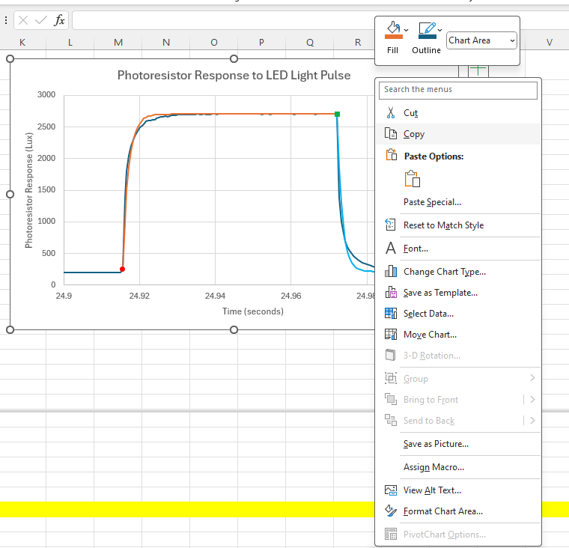
Make a Publication Quality Graph With the Following Steps
1. Right click here to bring up menu. 2. Click on Copy.

Slide 12
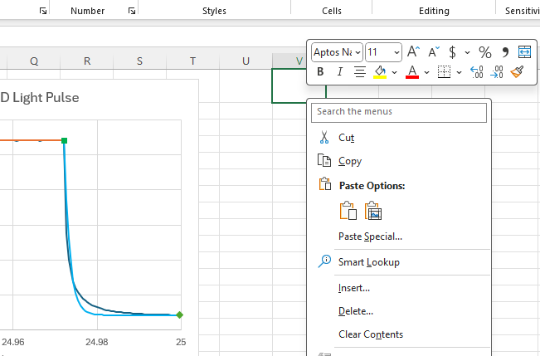
Make a copy of the graph
1. Click on cell V1 (or equivalent in your spreadsheet. 2. Right click on V1 to bring up the menu below. 3. Click on the red box below Paste Options: A copy of the graph should appear.
xxz

Slide 13
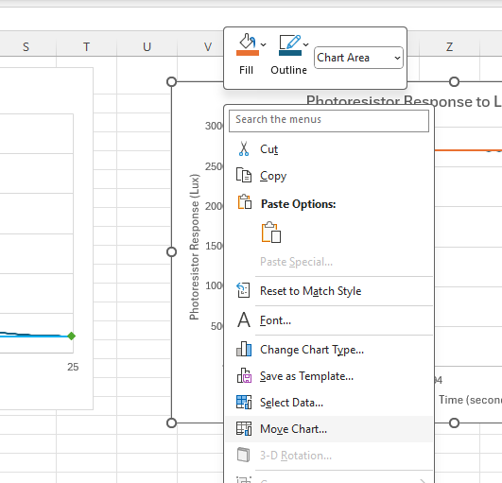
Make a copy of the graph
1. Right click here on the graph in an empty place above the graph and below the top. 2. Click on Move Chart…

Slide 14
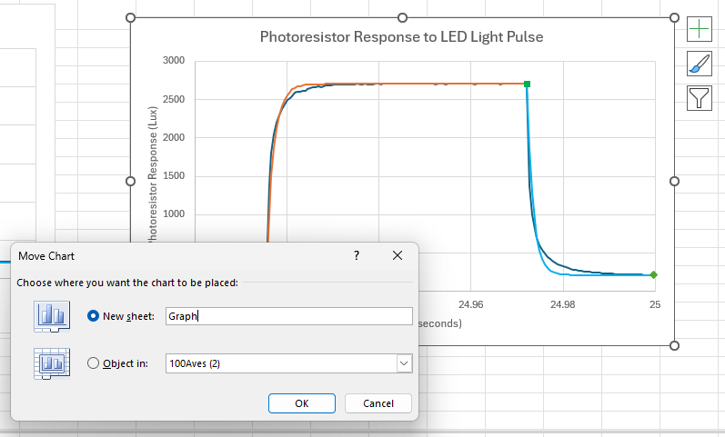
Move the graph to a new sheet
1. Click on New sheet: 2. Use a new name for the new sheet, example below is Graph. 3. The graph should be in its new sheet.

Slide 15
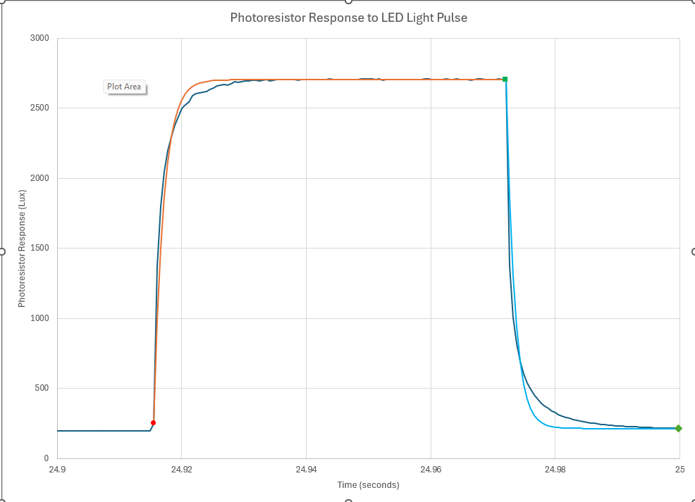
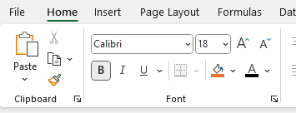
Here’s the graph in its own sheet. Change the default font size and all.
1. Click here on the graph in an empty place above the graph and below the top to select the entire graph. 2. Click the options on the right. The result is on the next page.

Slide 16
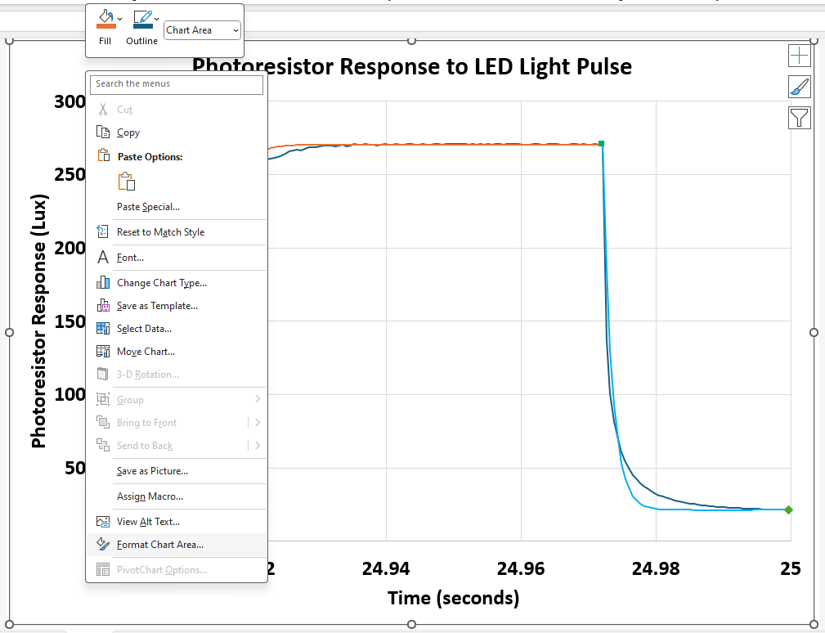
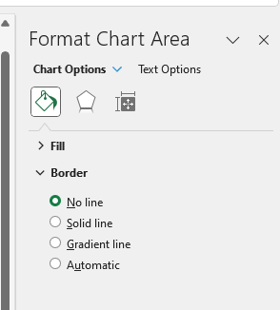
Get rid of the border around the outside.
1. Right click here on the graph in an empty place above the graph and below the top to select the entire graph. 2. Click the options on the right. The result is on the next slide.

Slide 17
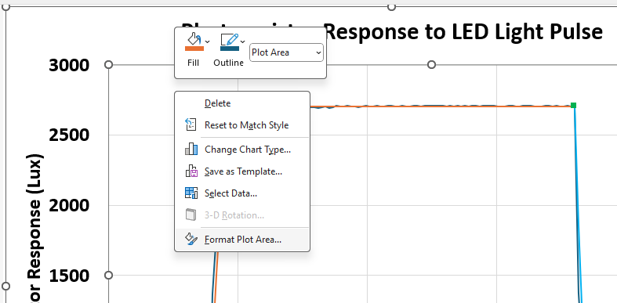
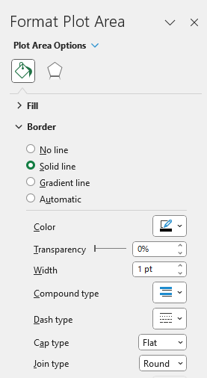
Add a border around the plot itself
1. Right click here in the graph area. 2. Click the options on the right. The result is on the next slide.

Slide 18
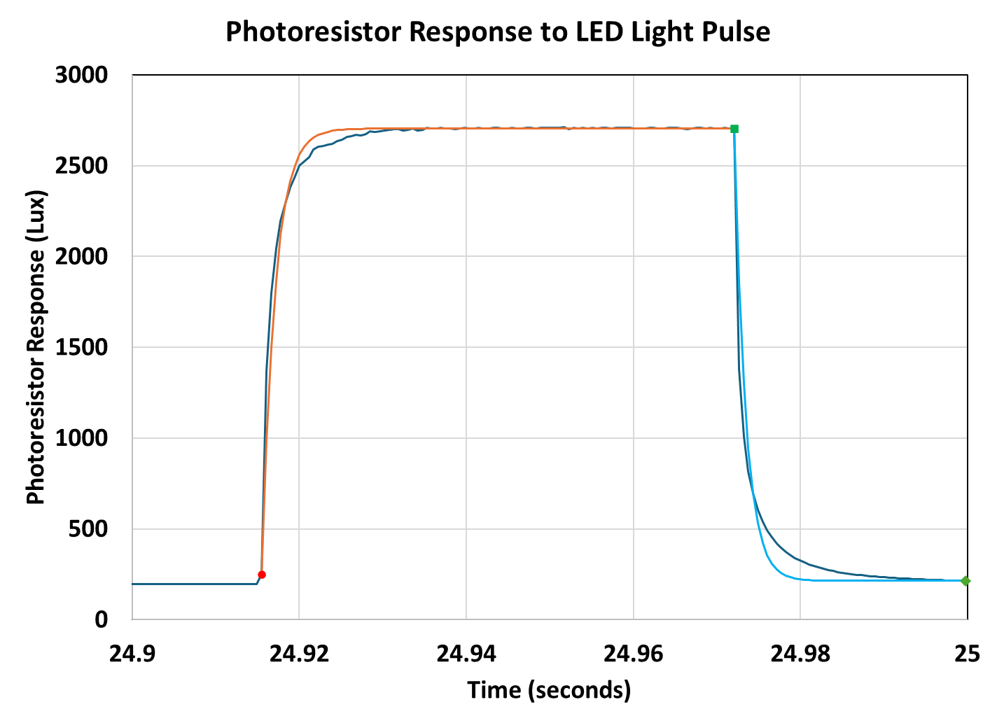
Get rid of the grid lines
1. Click on a horizontal grid line and delete. 2. Do the same for the vertical grid lines (delete them).

Slide 19
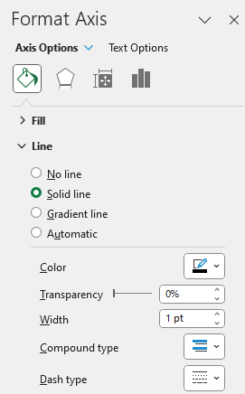
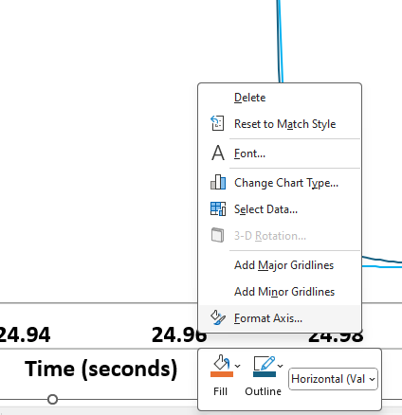
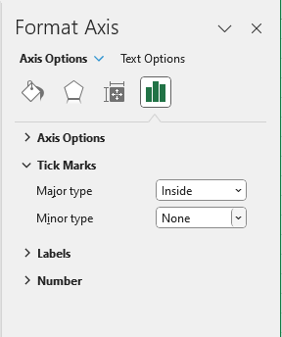
Make the axes 1 pt wide, black, and add tickmarks
1. Right click on one of the numbers on the horizontal axis to bring up the dialogue box. 2. Select Format Axis… 3. Make the settings shown for the axis line color and properties. 4. Then go to the tool on the right (3rd screen shot on this page.) 5. Tick Marks:Major type:Inside. 6. Do the same steps 1-5 for the vertical axis.

Slide 20
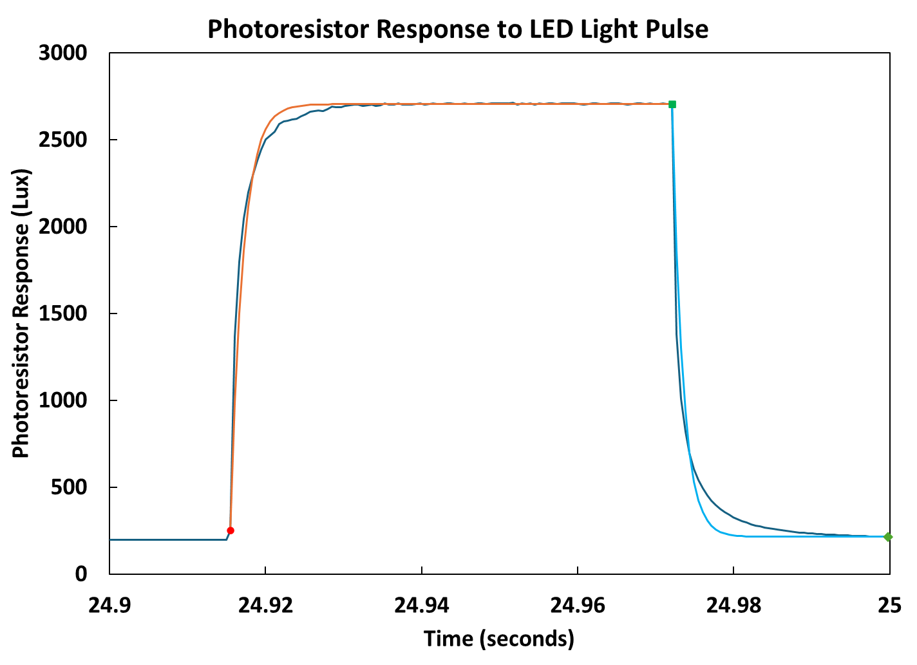
Adjust the plot to fill the entire canvas
1. Click on each axis in the middle and use the round handle to move the axis close to its closest ‘wall’, to use all of the graph space.

Slide 21
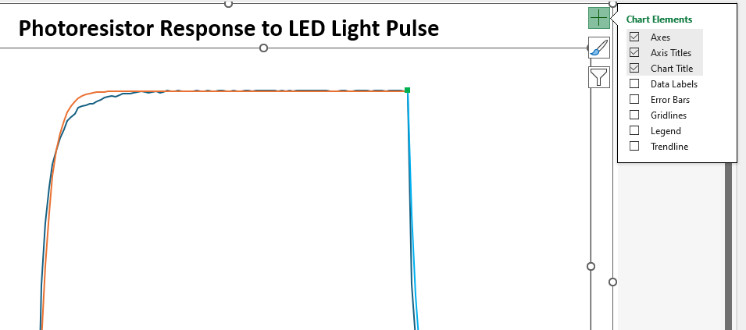
Adjust the plot to fill the entire canvas
1. Click in the middle of the chart to bring up the large green + in the upper right corner. 2. Click on legend to add it, and move it to a good spot.

Slide 22
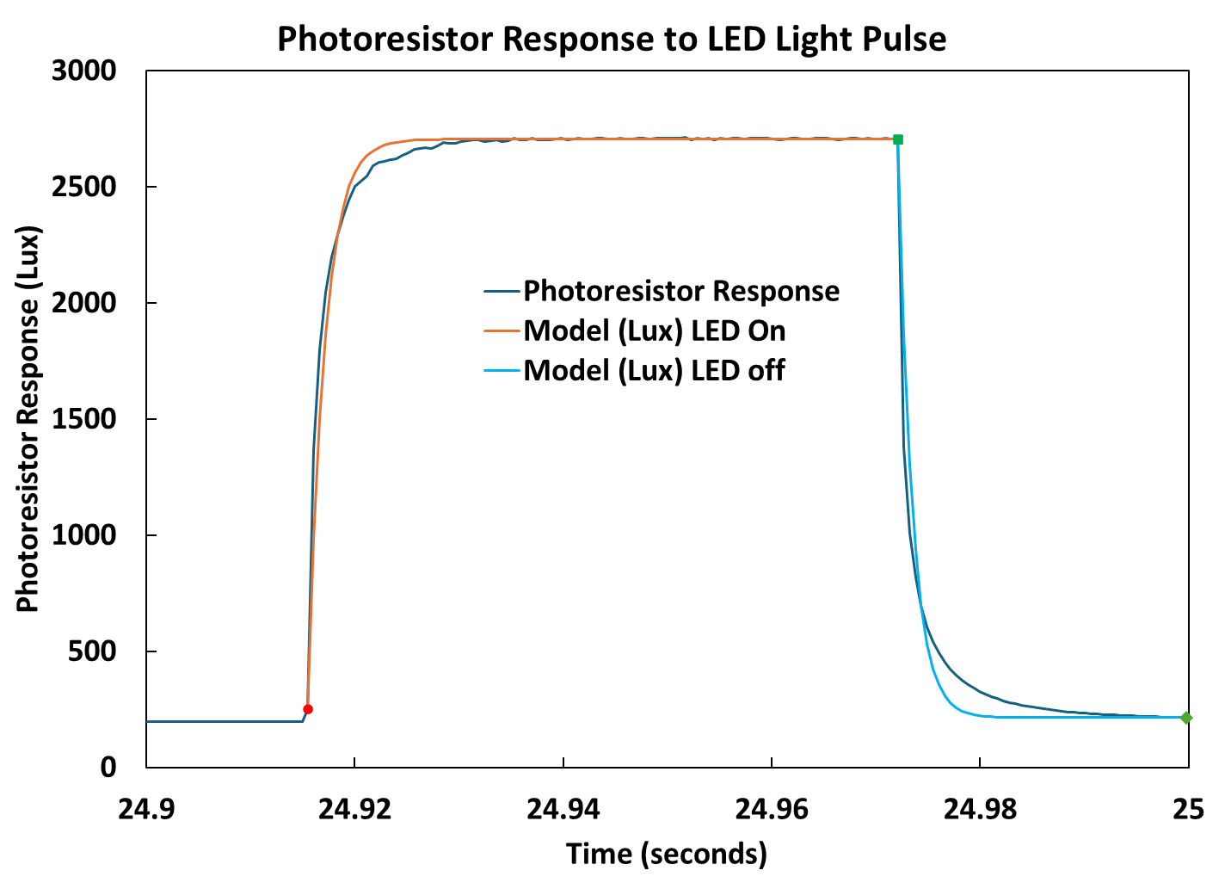
You made it! Congratulations!!

Slide 23
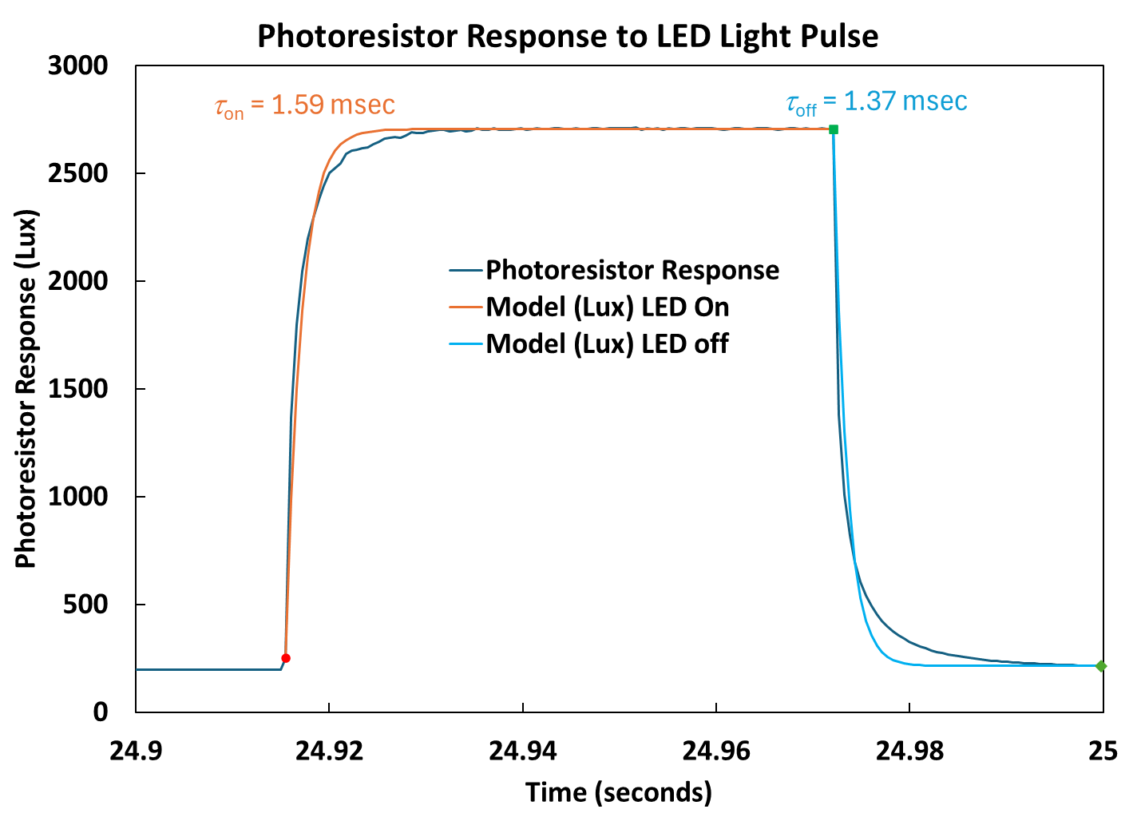
This version has the response time for the LED on and off included: Sequence is Insert:Text Box then drag a box where the text goes.

