Slide 1
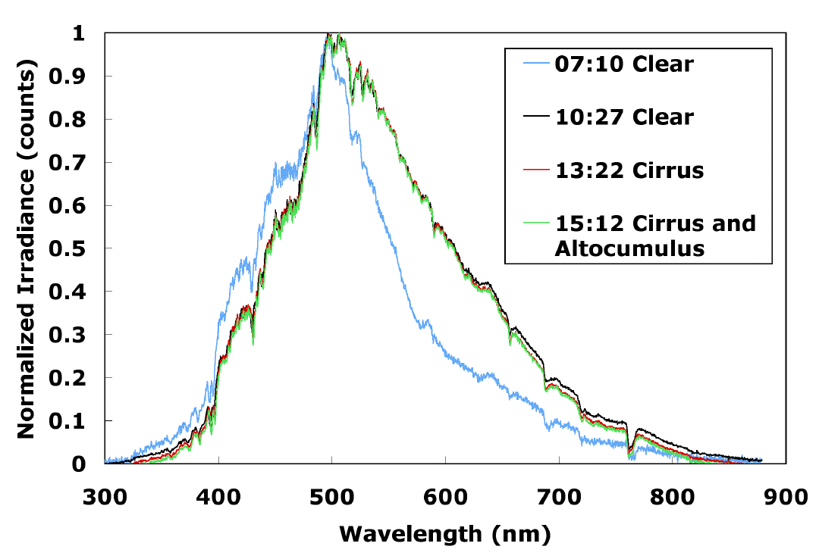
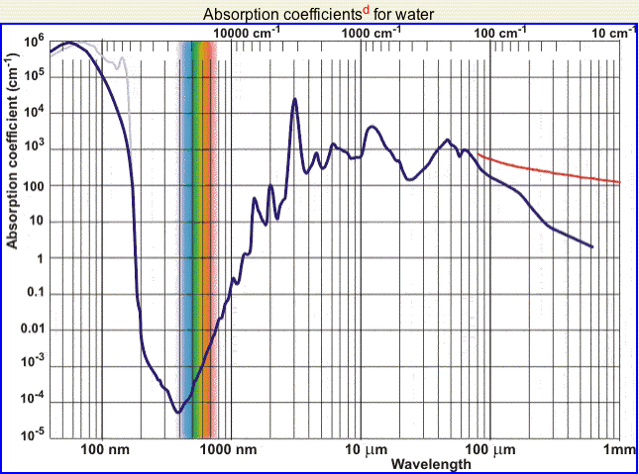
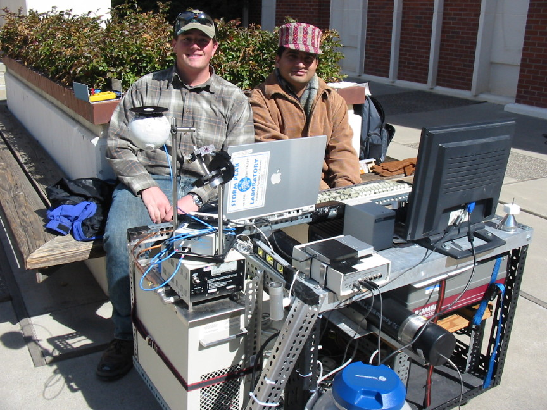
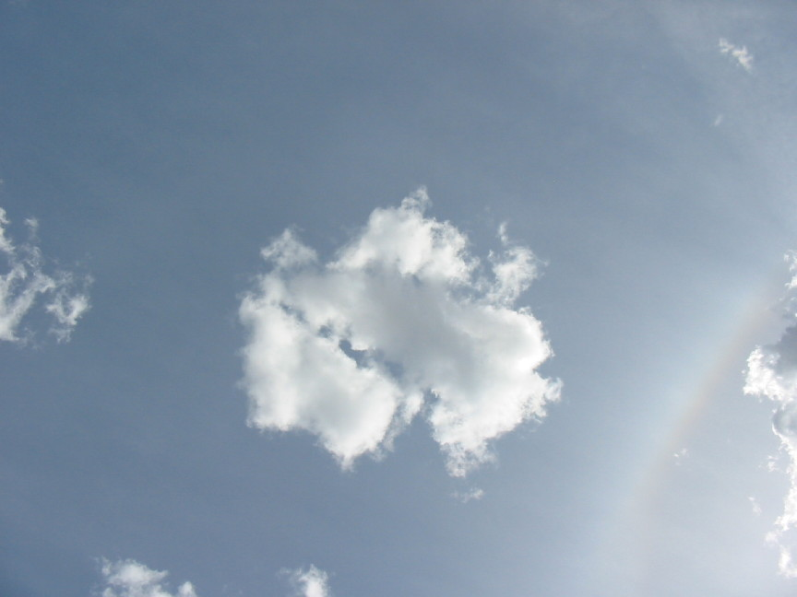
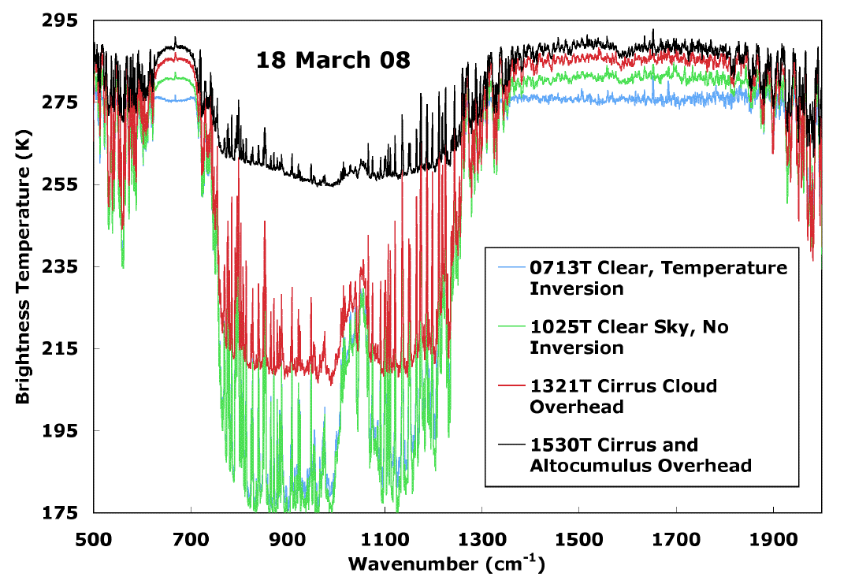
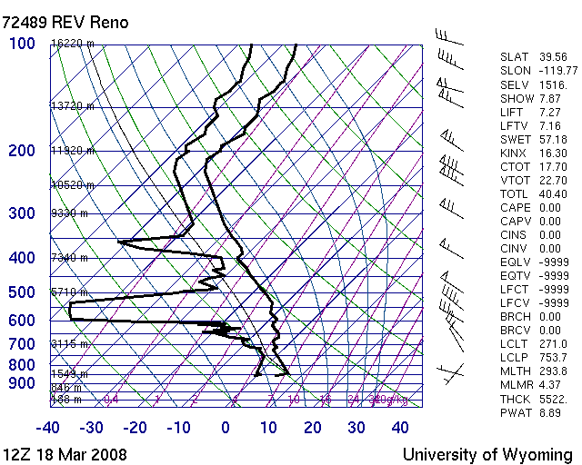
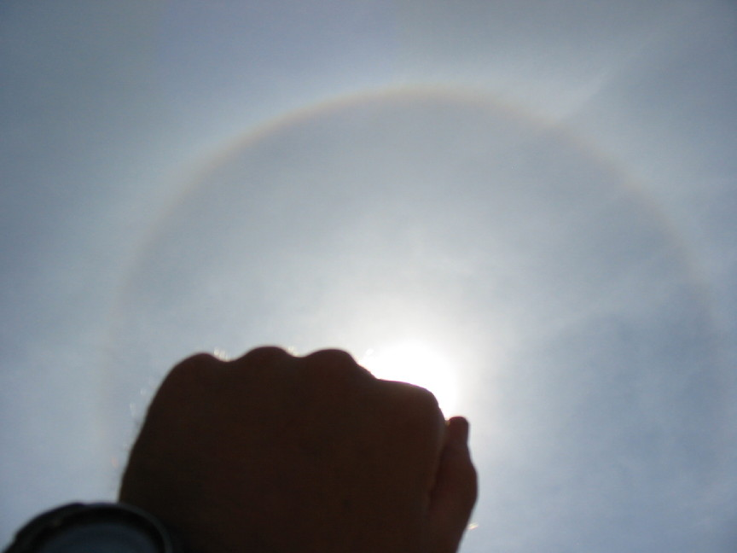
Chapter 4: Atmospheric Radiation Transfer

Slide 2
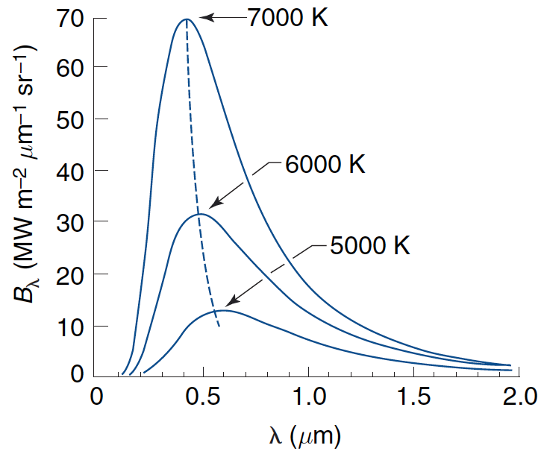
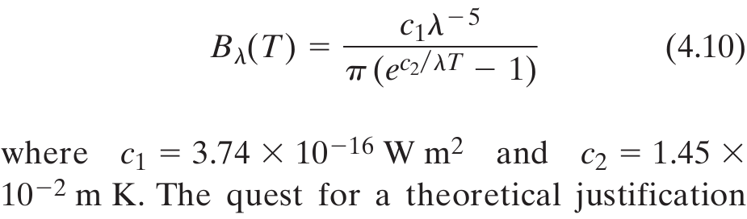
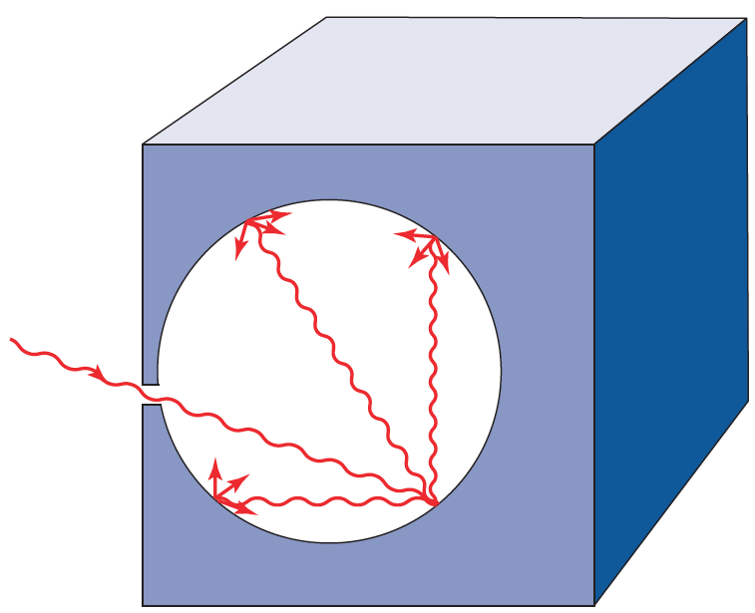
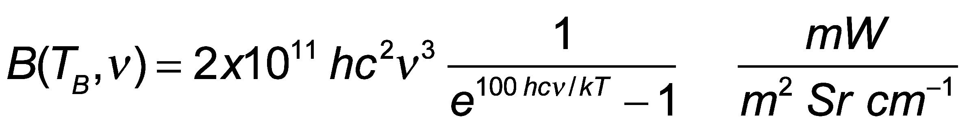
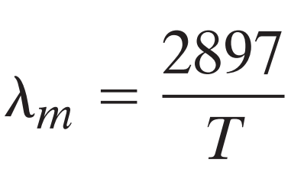
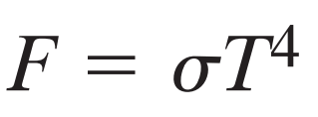
Planck’s Blackbody Function for Different Temperatures
Wavenumber distribution
Peak obeys Wien’s displacement ‘law’
Wavelength (μm) T (K)
Total irradiance
Stefan-Boltzmann ‘law’

Slide 3
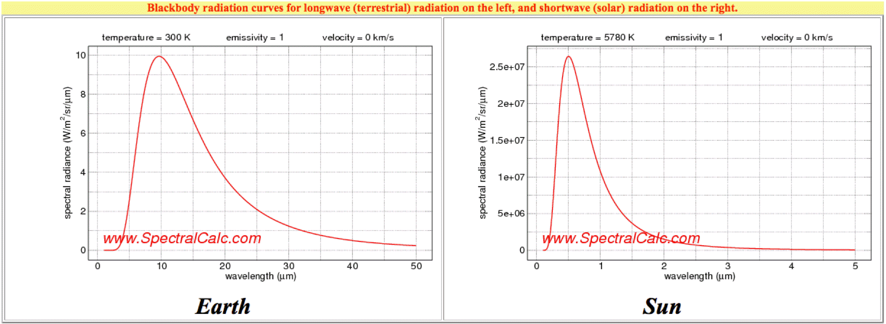
Earth and Sun Radiation from their ‘surfaces’

Slide 4
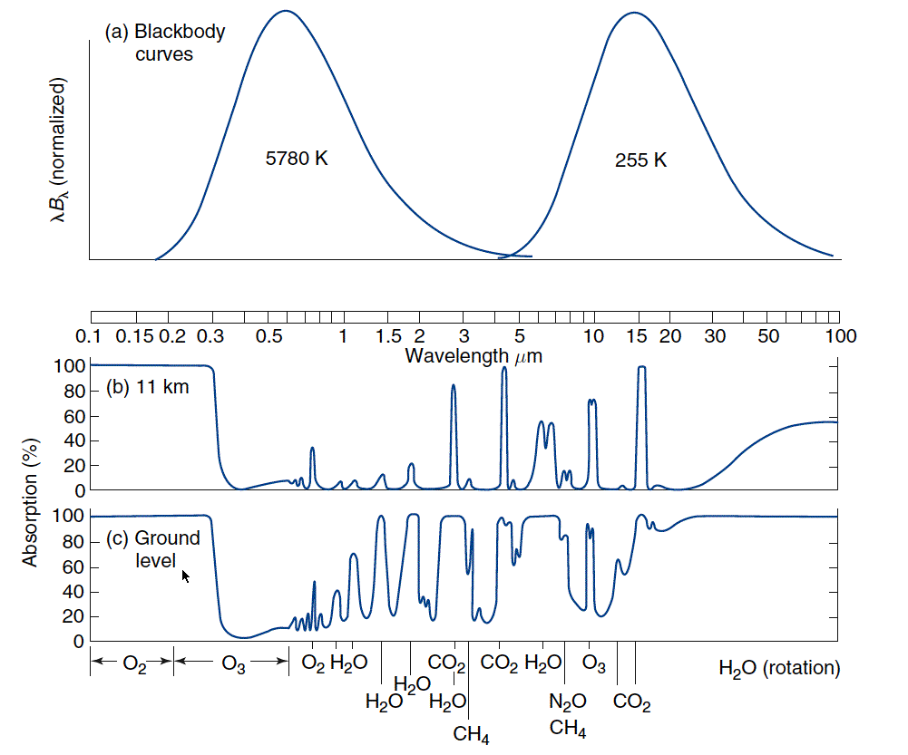
Sun and Earth Spectra and Atmospheric Windows
Sun
Earth
Visible Window
IR Dirty Window
Absorption only, not effects of Rayleigh Scattering by gases.

Slide 5
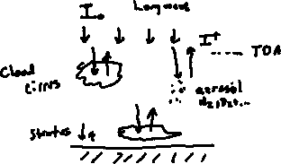
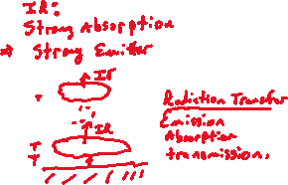
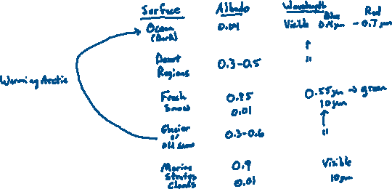
Albedo Discussion: Basic idea
1
2
3

Slide 6
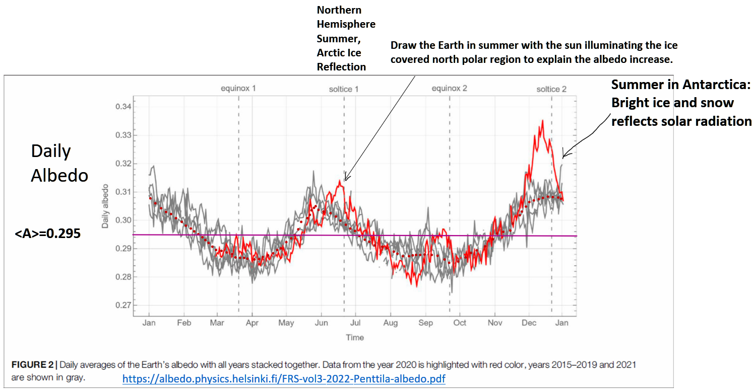
Daily Averaged Earth Albedo Measurements By the NOAA Satellite Located Between the Sun and Earth (Lagrange Point)

Slide 7
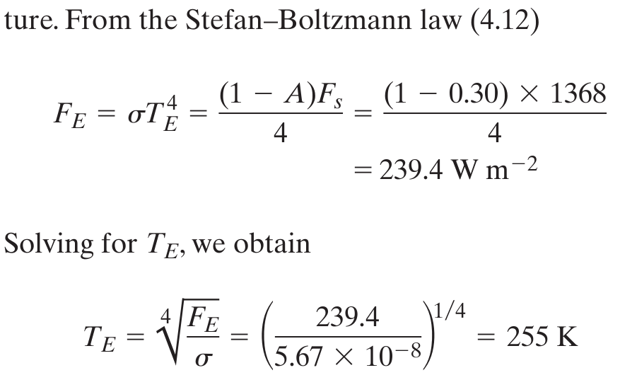
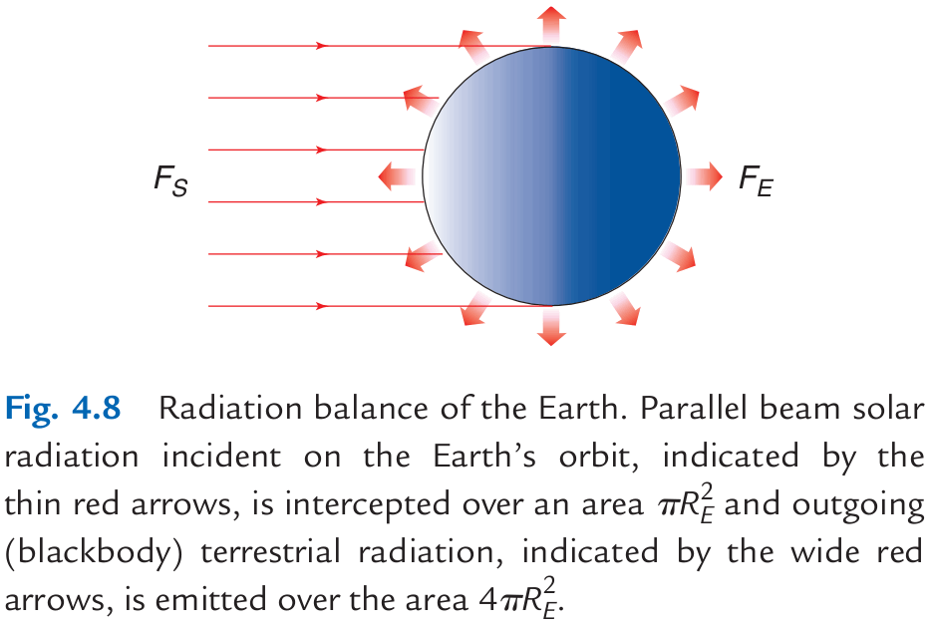
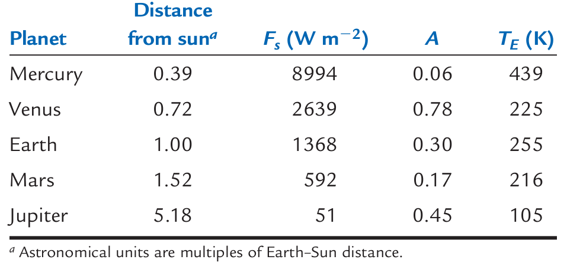
Astronomical Radiation Balance

Slide 8
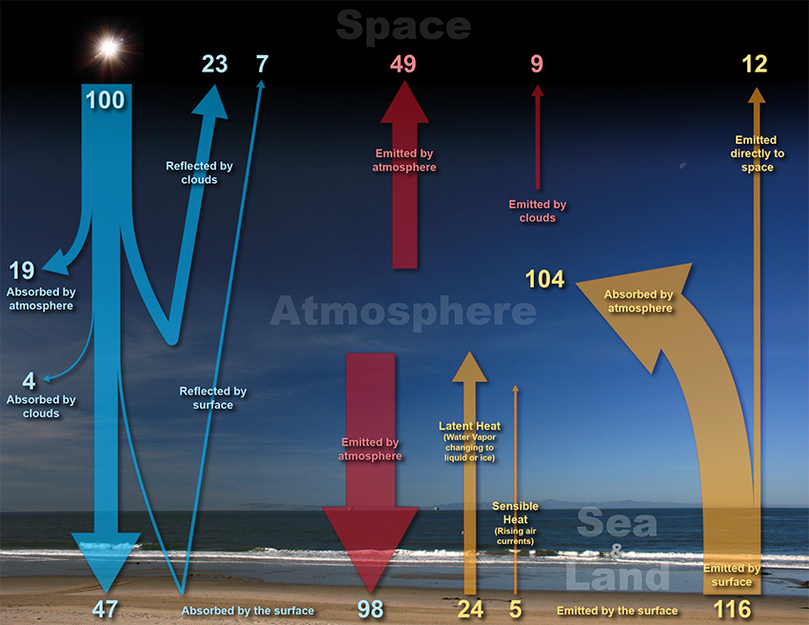
Global Energy Balance: Solar and Infrared Radiation
 |  |  |  |  |  | Top of Atmosphere: 100 units in and out. 70 units of solar radiation absorbed in the atmosphere and surface. 70 units of IR emitted.
 |  |  |  |  | Atmosphere: 156 units IR emitted up and down, 127 units IR and solar absorbed+24+5 units latent and sensible heat added for a total of 156 units
 |  |  |  |  |  |  | Surface: 47+98=145 units absorbed, 116+24+5 units leaving.

Slide 9
1 Layer Radiation Balance
NOTES: τ is solar transmission ε is long wave emissivity I₀=1368/4 W/m²=342 W/m²

Slide 10
1 Layer Atmosphere Model Shortwave Albedo = 0.3 Shortwave Transmissivity = 0.96

Slide 11
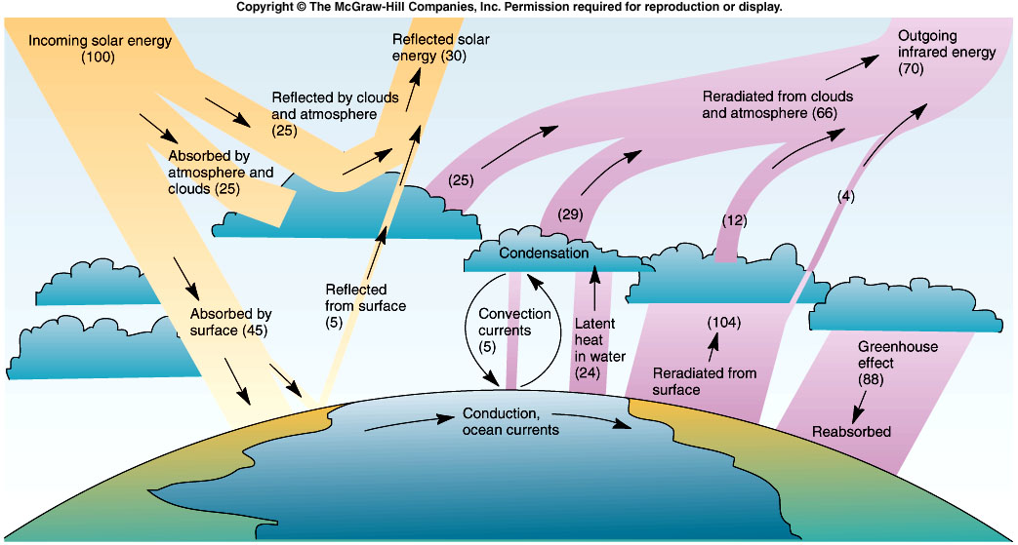
Global Energy Balance
Incoming = 45 +88 = 133
Outgoing = 104 + 24 + 5 = 133
From Cunningham & Cunningham, 2004, Fig. 9.2
Notes:
11

Slide 12
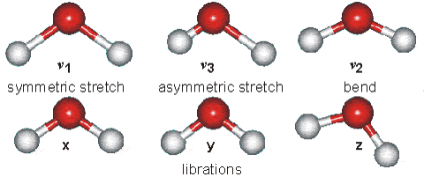
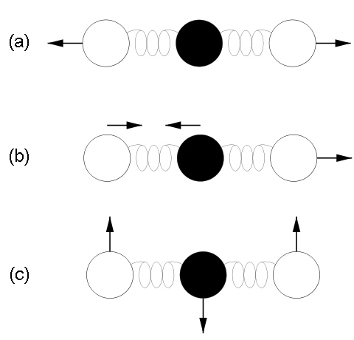



Some Energy States of Water Molecules
Atmospheric molecules lead very active ‘lives’ due to thermal and electromagnetic energy exchange, especially in the IR.
http://www.lsbu.ac.uk/water/vibrat.html
... of Carbon Dioxide Molecules
Vibration modes of carbon dioxide. Mode (a) is symmetric and results in no net displacement of the molecule's "center of charge", and is therefore not associated with the absorption of IR radiation. Modes (b) and (c) do displace the "center of charge", creating a "dipole moment", and therefore are modes that result from EM radiation absorption, and are thus responsible for making CO2 a greenhouse gas.
“15 um motion”

Slide 13
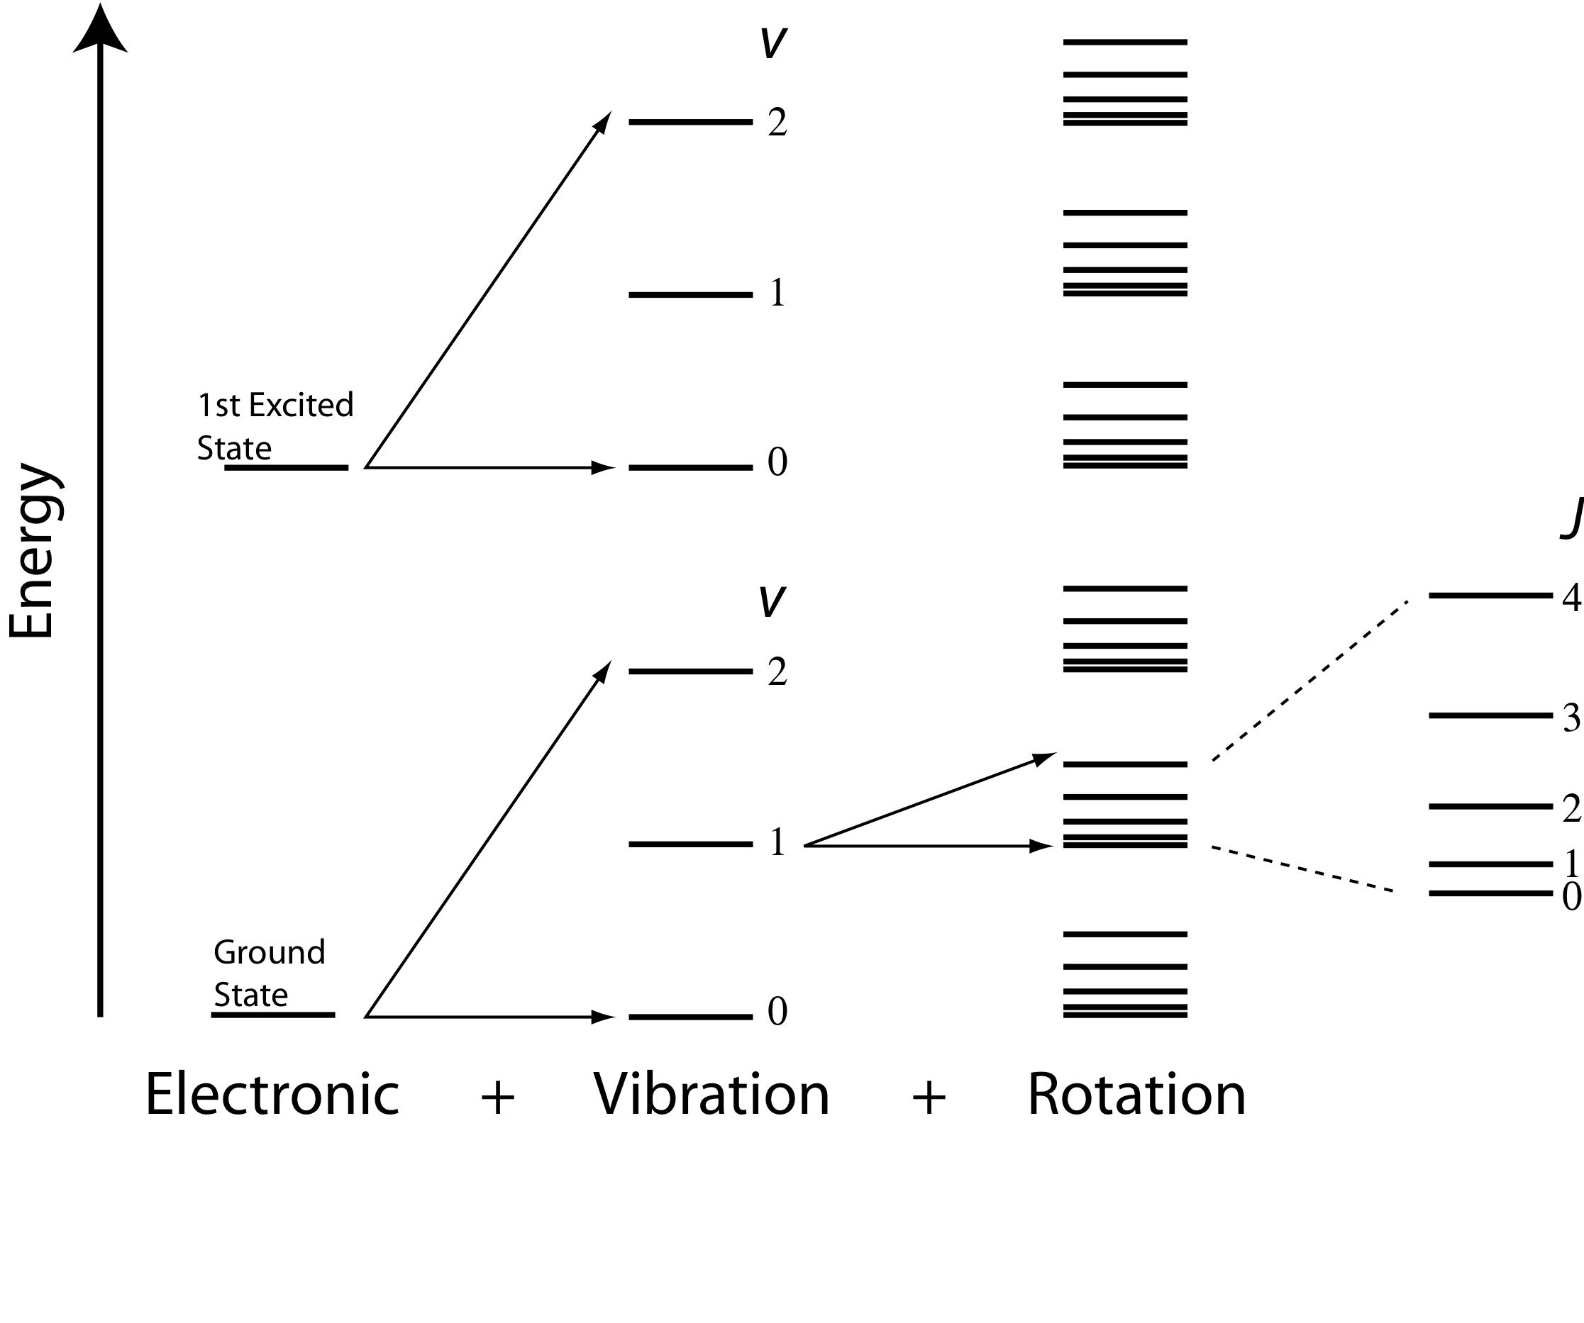
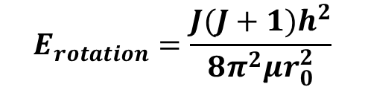
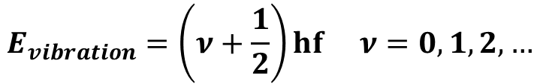
Energy Transitions in Molecules
$$E_{rotation}=\frac{J(J+1)h^{2}}{8π^{2}μr_{0}^{2}}$$
$$E_{vibration}=\left(ν+\frac{1}{2}\right)hf ν=0,1,2,…$$

Slide 14
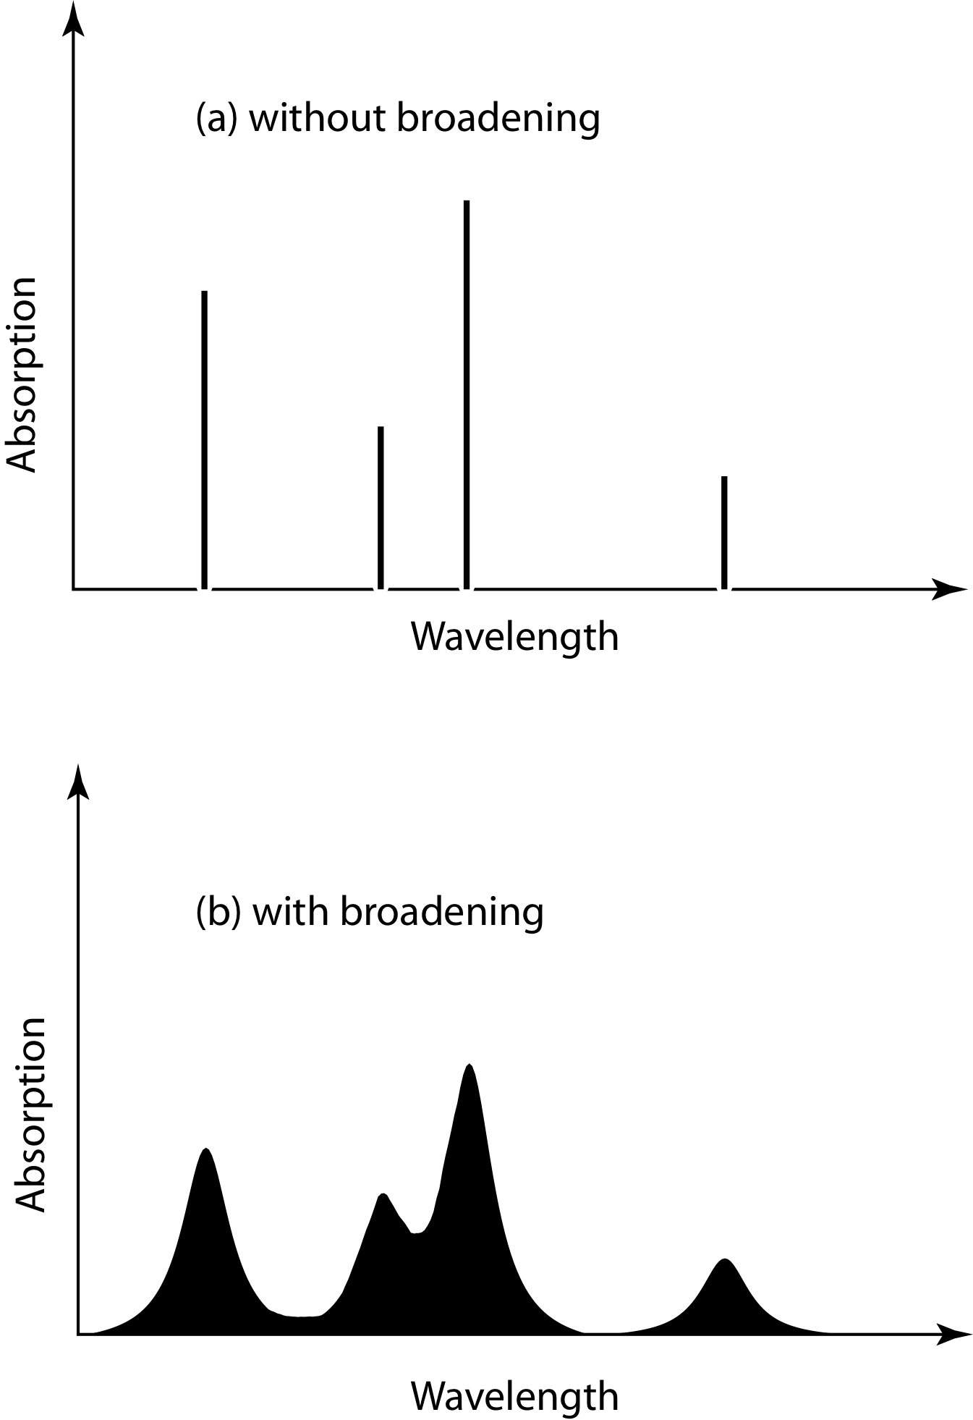
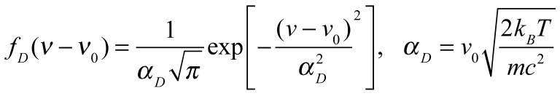
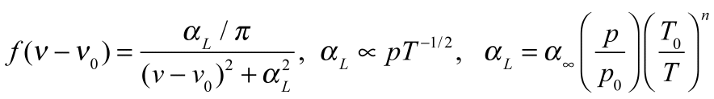
Line Broadening
Natural Broadening: Finite time, finite widths (Heisenberg is uncertain about widths, certain they are not infinitely narrow!)
Doppler Broadening:
Molecules with relative motions due to thermal energy ‘see’ doppler shifts of the light. Important in the mesosphere.
Pressure Broadening: Lorentz line shape
Molecular collisions distort energy levels for absorption and emission. Emperically determined (by measurement). Very important for the troposphere and lower stratosphere.
frequency
frequency

Slide 15
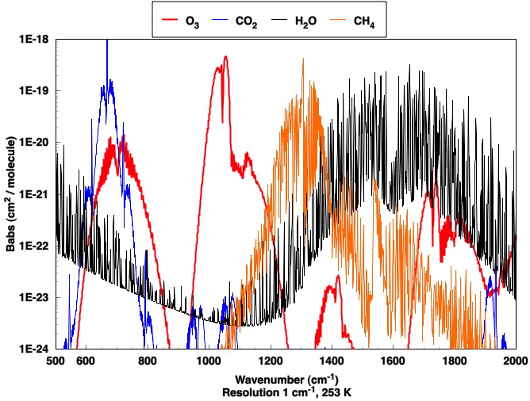
Absorption Per Molecule by Infrared Active Gases (Greenhouse Gases)
15 um
Window region
20 um
12.5 um
7.7 um
5 um

Slide 16
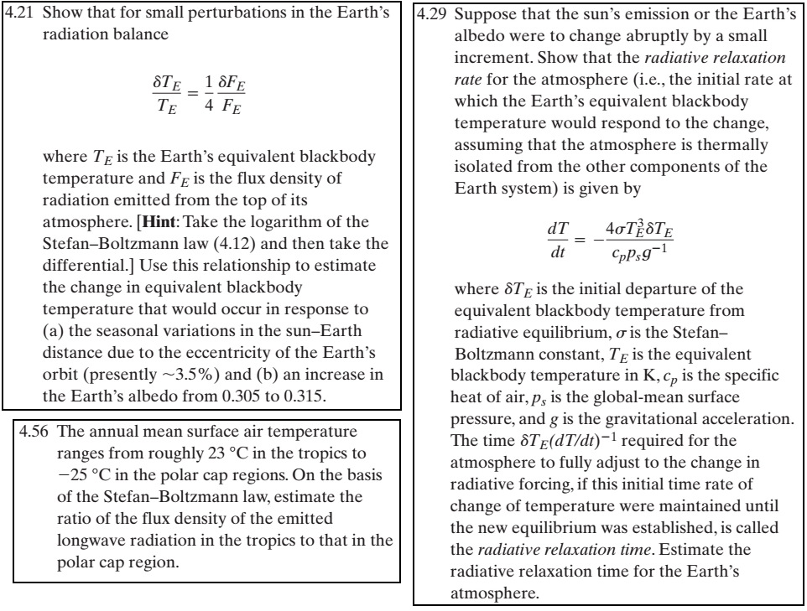
Problems 4-21 and 4-29:

Slide 17
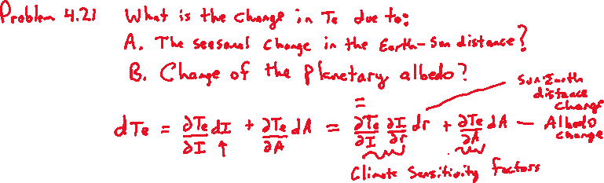
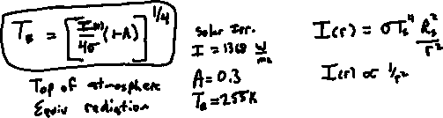
Problem 4-21

Slide 18
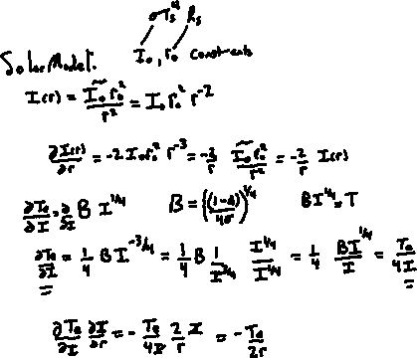

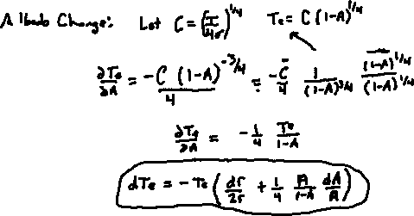
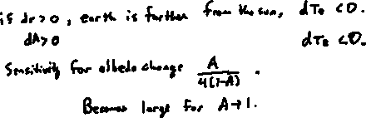
Derive the general equation for sensitivity
Derive the Albedo change part of the problem.
Derive the solar distance change part of the problem.
Putting it all together…
Interpretation

Slide 19
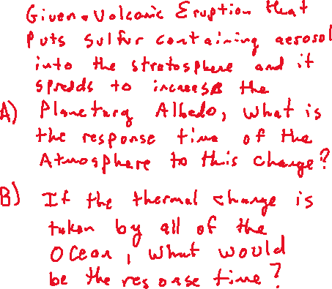
Problem 4-29, response time of the earth to sudden radiation balance changes.
Rephrase from the homework.

Slide 20
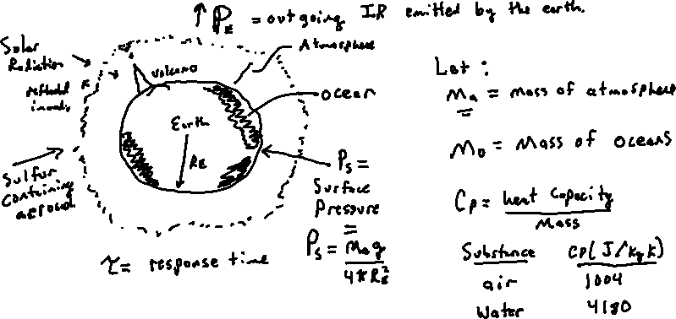
Explain the problem in terms of a picture and define useful variables.

Slide 21
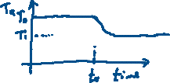
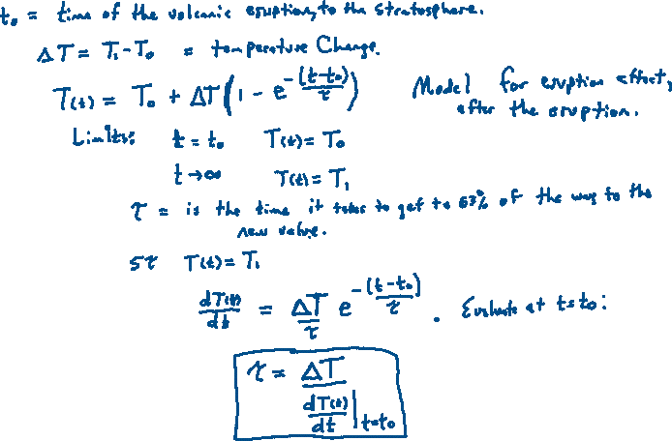
Define the response time
ΔT<0 here

Slide 22
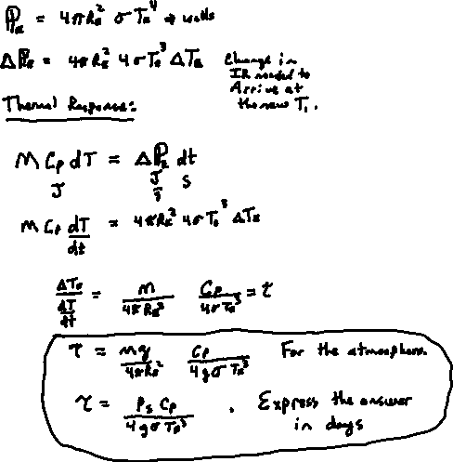
Thermal Response

Slide 23
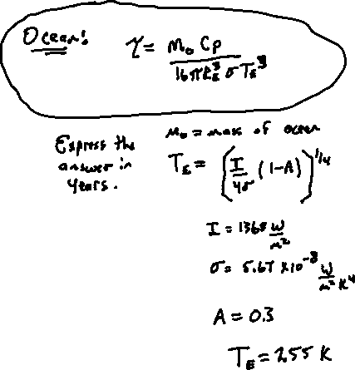
Ocean Response Time
For the sum of all oceans: Use this. Note: The immediate ocean response would likely be in the top boundary layer, and spread from their to the lower levels (and atmosphere). In general, since the atmosphere and ocean are coupled, the response will be part atmosphere and part ocean.

Slide 24
Blue and Red Skies: Rayleigh Scattering The scattering object is much smaller than the wavelength illuminating it.

Slide 25
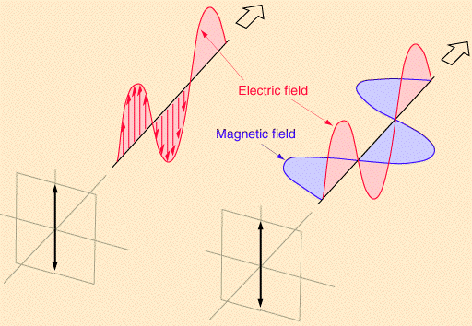
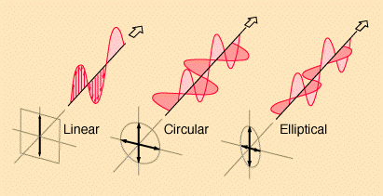
Polarization of Light
Wave/Photon boson: Polarization.
Linear Polarization: E-field in one direction.
Circular, elliptical polarization: E-Efield rotates due to phase difference between horizontal and vertical components.
From: http://hyperphysics.phy-astr.gsu.edu/hbase/phyopt/polclas.html

Slide 26
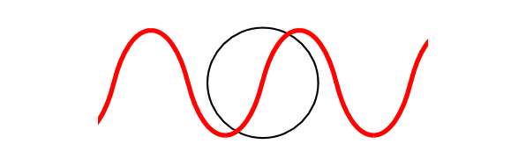
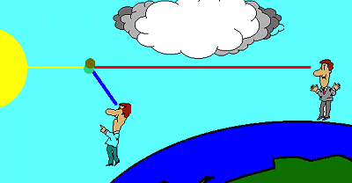
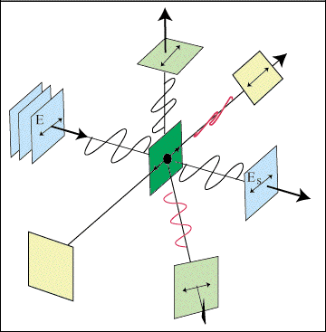

Angular Dependence of Rayleigh Scattering (dipole)
From:
http://qels.com/theory/rayleighscattering/mass.cfm
http://www.bo.astro.it/sait/spigolature/spigo402base.html
Horizontal E-field
Vertical E-field
Dipoles don’t radiate in the direction they are undergoing linear ocsillation.
From http://www.sparknotes.com/physics/optics/phenom/section3.rhtml

Slide 27




Selection Rules: Accelerated Charges are the Source, Sinks of Electromagnetic Radiation: Dipole Moment, p.
Selection rules specify the possible transitions among quantum levels due to absorption or emission of electromagnetic radiation. Incident electromagnetic radiation presents an oscillating electric field that interacts with a transition dipole p_{z}. A transition dipole moment is a transient dipolar polarization created by an interaction of electromagnetic radiation with a molecule. If p_{z} is zero then a transition is forbidden. The selection rule is a statement of when p_{z} is non-zero.
General
q
-q

Slide 28


Rayleigh Scattering Cross Section Per Raindrop and Rainfall Rate: Mismatch of diameter dependence
d=raindrop diameter m=complex refractive index λ=radar wavelength

Slide 29

SUNSET NEVADA

Slide 30


Rayleigh Scattering Light Scattering by Electric Dipoles
sunset
D = molecular diameter
= wavelength
D << λ

Slide 31




Light Scattering Basics (images from Wallace and Hobbs CH4).
Angular Distribution of scattered radiation (phase function)
x
Sphere, radius r, complex refractive index n=m_{r} + im_{i}
x
Dipole scattering
x
x
m_{r}=1.5
x
Q_{s}
x

Slide 32

Mie Theory for Absorbing and Scattering Spheres
Extinction is the sum of absorption and scattering.
The single scattering albedo is ω₀=Q_{sca}/Q_{ext}. The asymmetry parameter g. The probability of forward scatter is (1+g)/2. For backward scatter is (1-g)/2.
From Petty

Slide 33


Geometrical Optics: Interpret Most Atmospheric Optics from Raindrops and lawn sprinklers (from Wallace and Hobbs CH4)
Rainbow from raindrops
Primary Rainbow Angle: Angle of Minimum Deviation (turning point) for rays incident with 2 chords in raindrops.
Secondary Rainbow Angle: Angle of Minimum Deviation (turning point) for rays incident with 3 chords in raindrops.

Slide 34


Rainbow Optics
Θ = ?
scattering
angle
n_{r}
See http://www.philiplaven.com/p8e.html, and atmospheric optics.

Slide 35


Geometrical Optics: Rainbow (from Petty)
x
Angle of minimum deviation from the forward direction. Focusing or confluence of rays.
Distance x is also known as the impact parameter. (Height above the sphere center.)

Slide 36


Geometrical Optics: Interpret Most Atmospheric Optics from Ice Crystals (from Wallace and Hobbs CH4)
22 deg and 45 deg Halos from cirrus crystals of the column or rosette (combinations of columns) types. Both are angle of deviation phenomena like the rainbow. Crystal orientation important. 22 deg halo, more common, thumb rule to measure size of arc.

Slide 37

Size Parameter x Characterizes Scattering Regimes
Summary of Scattering Regimes: Note Particle Sizes
and wavelengths of radiation!!

Slide 38


Mie Phase Functions for Water Spheres
light in
Θ
scattered light
Radiation Patterns
Note the dipole character for small x
and the primary and secondary rainbows
for large x.

Slide 39


Mie Radar Backscatter Efficiency for Water and Ice Spheres
Non Rayleigh
strong backscatter by water drops
compared to that of ice!!
Rayleigh
WSR-88D NWS Doppler Radar

Slide 40


Venus: What’s going on here?

Slide 41


gray body
emitter

Slide 42


Earth Light: Spectrum of Outgoing Infrared Radiation
incoming solar
I_{TOA solar}
Earth
IR radiation emitted by
the Earth (red), the
atmosphere (orange),
and transmitted to space
after absorption by the
atmosphere (pink).
Yellow: Spectrum of infrared light going to space.
Pink Curve: Spectrum of light emitted by the surface.
Greenhouse gases reduce the amount of infrared radiation from the surface that gets to space.
From http://www.lib.utah.edu/services/prog/gould/1998/Figure_5.gif

Slide 43



Global Radiation Balance at Top of Atmosphere: 1 year of data from the NASA Earth Radiation Budget Experiment
Notes:
Absorbed solar mostly near equator.
IR emitted strong near Sahara desert.
Low outgoing IR (green patches) in central Africa, South America, etc, are due to persistent cumulonimbus.
Net radiation=Solar Absorbed – Outgoing IR; surplus near the equator, deficit over Sahara desert and polar regions.

Slide 44
NOTES: τ is solar transmission ε is long wave emissivity I₀=1368/4 W/m²=342 W/m²

Slide 45
1 Layer Atmosphere Model Shortwave Albedo = 0.3 Shortwave Transmissivity = 0.96

Slide 46
Absorption by Infrared Active Gases (Greenhouse Gases)
15 um
Window region
20 um
12.5 um
7.7 um
5 um

Slide 47
Global Energy Balance
Incoming = 45 +88 = 133
Outgoing = 104 + 24 + 5 = 133
From Cunningham & Cunningham, 2004, Fig. 9.2
Notes:
47

Slide 48

Top of the Atmosphere Solar Radiation:

Slide 49

SOLAR SPECTRUM:
TOP OF THE ATMOSPHERE

Slide 50

SOLAR SPECTRUM:
TOP OF THE ATMOSPHERE AND AT THE SURFACE

Slide 51

SOLAR SPECTRUM:
Effects of Rayleigh (gas) scattering, O₂ and N₂.

Slide 52

SOLAR SPECTRUM:
Effects of Rayleigh (gas) scattering, O₂ and N₂,
And effects of extinction by aerosol particles.

Slide 53

SOLAR SPECTRUM:
Effects of gaseous absorption.

Slide 54



Absorption by Gases: Solar Radiation Penetration Depth
radiation makes it to the surface

Slide 55
Sun and Earth Spectra and Atmospheric Windows
Sun
Earth
Visible Window
IR Dirty Window
Absorption only, not effects of Rayleigh Scattering by gases.

Slide 56
Some Energy States of Water Molecules
Atmospheric molecules lead very active ‘lives’ due to thermal and electromagnetic energy exchange.
http://www.lsbu.ac.uk/water/vibrat.html
... of Carbon Dioxide Molecules
Vibration modes of carbon dioxide. Mode (a) is symmetric and results in no net displacement of the molecule's "center of charge", and is therefore not associated with the absorption of IR radiation. Modes (b) and (c) do displace the "center of charge", creating a "dipole moment", and therefore are modes that result from EM radiation absorption, and are thus responsible for making CO2 a greenhouse gas.
“15 um motion”

Slide 57
Energy Transitions in Molecules
$$E_{rotation}=\frac{J(J+1)h^{2}}{8π^{2}μr_{0}^{2}}$$
$$E_{vibration}=\left(ν+\frac{1}{2}\right)hf ν=0,1,2,…$$

Slide 58
Line Broadening
Natural Broadening: Finite time, finite widths (Heisenberg is uncertain about widths, certain they are not infinitely narrow!)
Doppler Broadening:
Molecules with relative motions due to thermal energy ‘see’ doppler shifts of the light. Important in the mesosphere.
Pressure Broadening: Lorentz line shape
Molecular collisions distort energy levels for absorption and emission. Emperically determined (by measurement). Very important for the troposphere and lower stratosphere.
frequency
frequency

Slide 59








Individual Absorption Lines Are Pressure and Doppler Broadened (absorb more radiation as a result).
gas absorption cross section
S = absorption strength
ν₀=wavenumber of absorption peak
0.5 ≤ N ≤ 1

Slide 60

Heating Rate = Divergence of the Net Flux

Slide 61

DOWNWELLING FTIR Radiance at UNR: Atmospheric IR Window
13 microns
8 microns

Slide 62

DEFINITION OF THE BRIGHTNESS TEMPERATURE T_{B}
Measured Radiance at wavenumber v
=
Theoretical Radiance of a Black Body at temperature T_{B}

Slide 63
FTIR Brightness Temperatures

Slide 64


Atmosphere Emission Measurements, Downwelling Radiance
Notes:
Wavelength range for CO₂, H₂0, O₃, CH₄.
Envelope blackbody curves.
Monster inversion in Barrow.
Water vapor makes the tropical window dirty.

Slide 65

Ideal Weighting Function W_{i}: Where in the atmosphere the main contribution to the radiation at wavenumber ν_{i} comes from.
real with overlap
almost
ideal
ideal

Slide 66


Downwelling Intensity Emitted by the Atmosphere to the Detector (Radiance)
μ=cosθ
z
dz
emissivity=β_{abs}dz/cosθ
θ
B[T(z)]
blackbody
radiance,
T = temperature.
θ
ftir
emission
transmission
weighting
function

Slide 67

Weighting Functions for Satellite Remote Sensing using the strong CO₂ absorption near 15.4 um. (from Wallace and Hobbs, 2nd edition)

Slide 68


Slide 69

Electromagnetic Penetration Depth for Water and Ice

Slide 70
Mie Radar Backscatter Efficiency for Water and Ice Spheres
Non Rayleigh
strong backscatter by water drops
compared to that of ice!!
Rayleigh
WSR-88D NWS Doppler Radar

