Slide 1
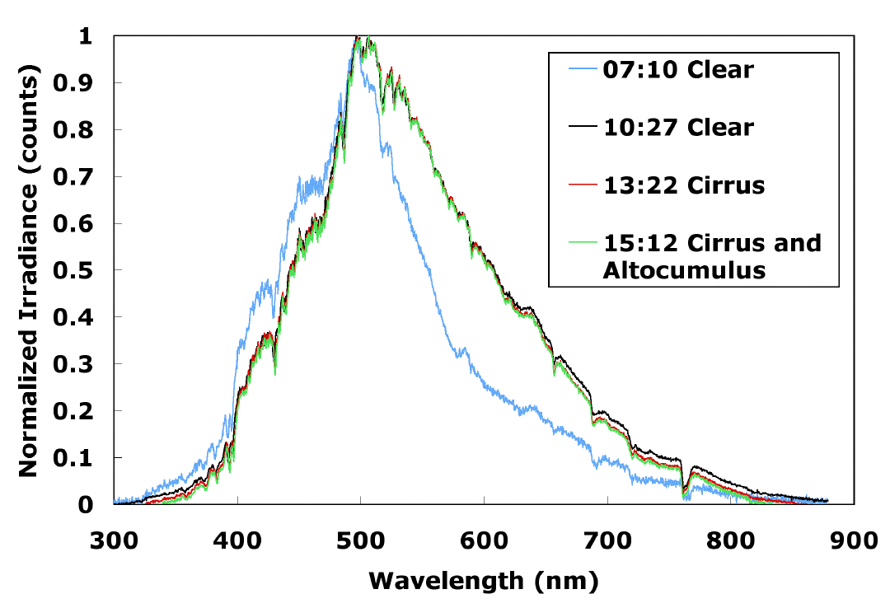
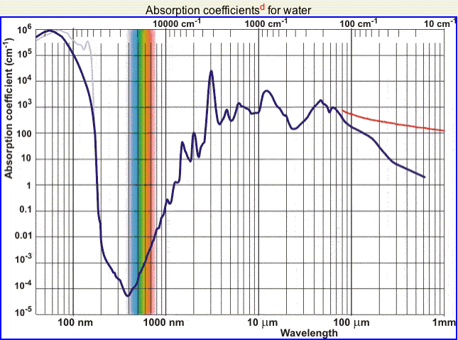
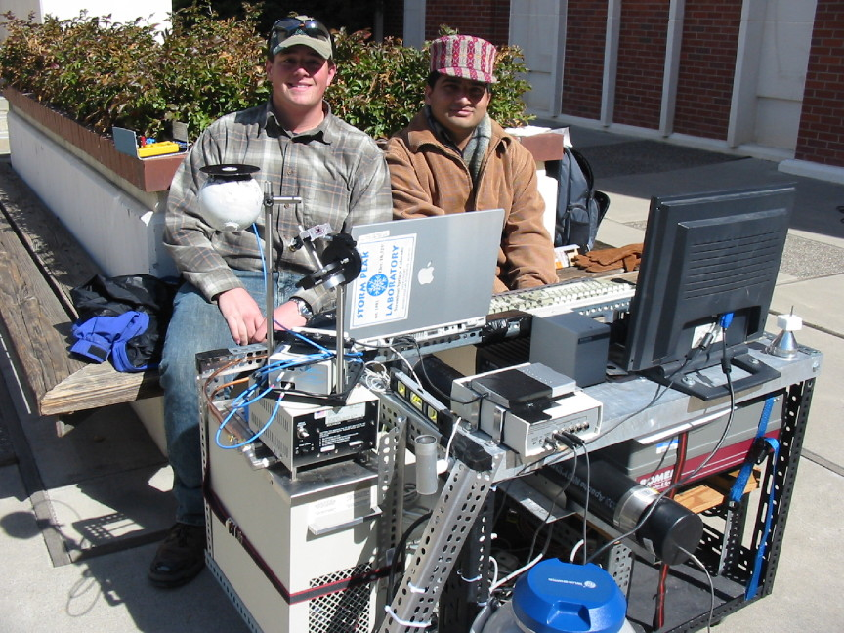
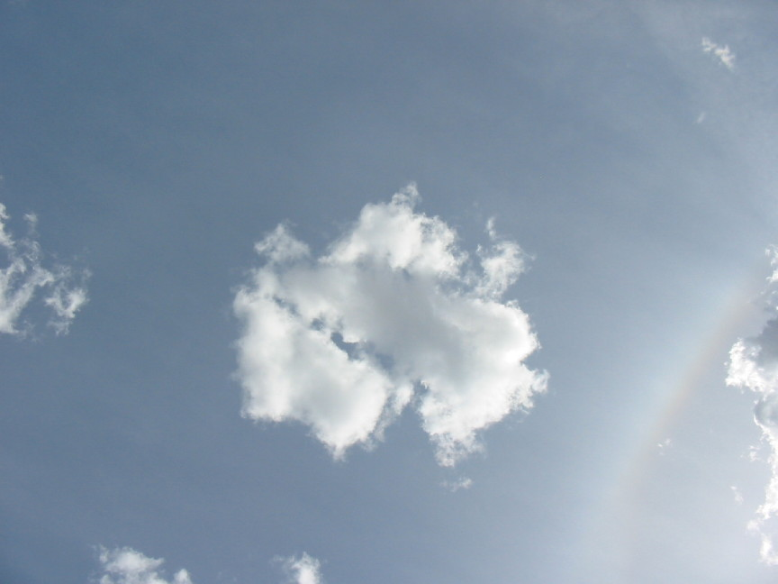
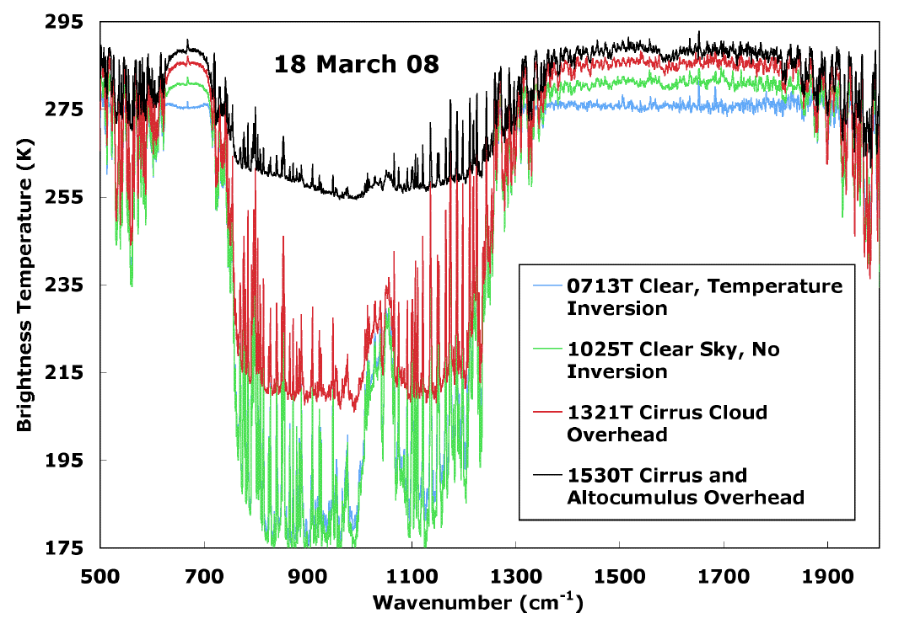
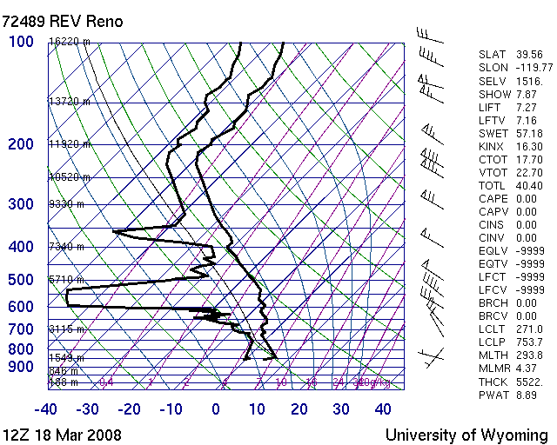
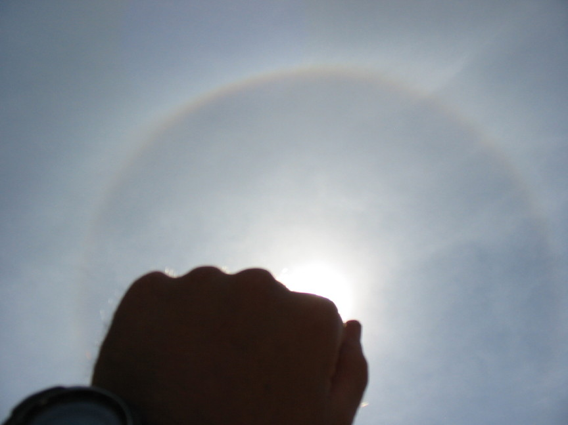
Chapter 4: Atmospheric Radiation Transfer

Slide 2
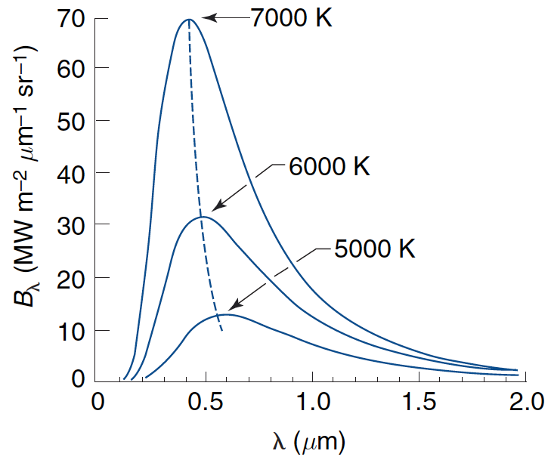
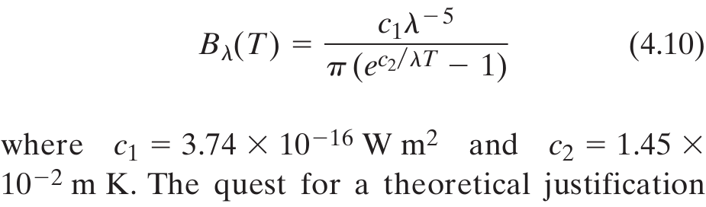
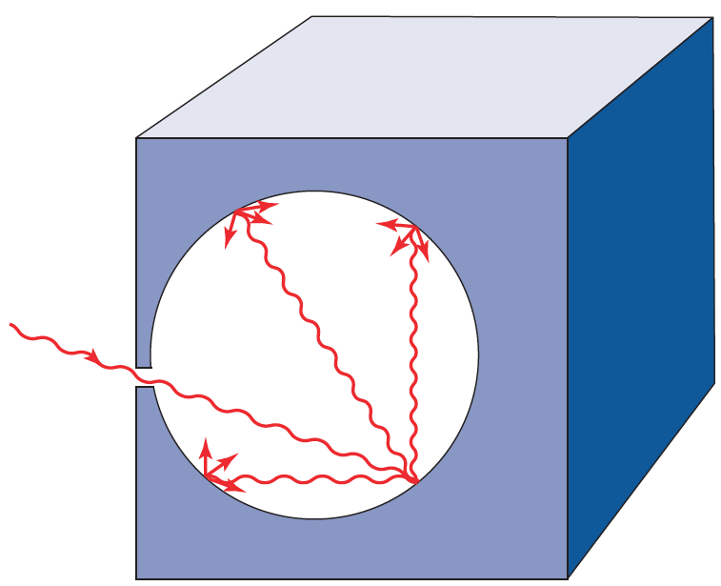
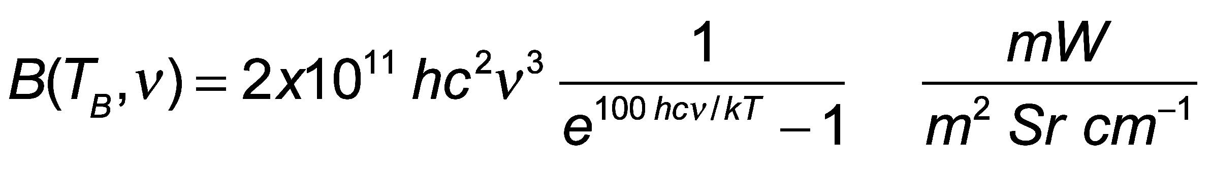
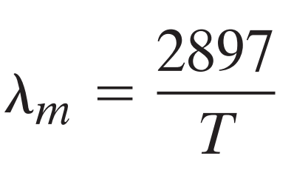
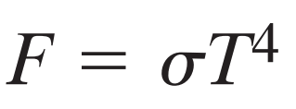
Planck’s Blackbody Function for Different Temperatures
Wavenumber distribution
Peak obeys Wien’s displacement ‘law’
Wavelength (μm)
T (K)
Total irradiance
Stefan-Boltzmann ‘law’

Slide 3
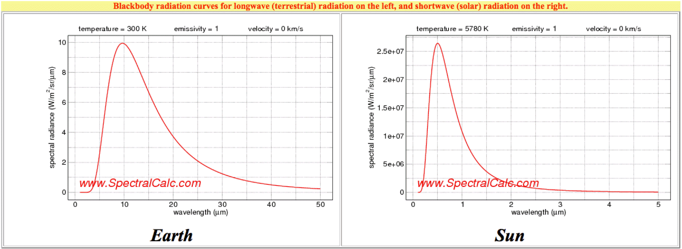
Earth and Sun Radiation from their ‘surfaces’

Slide 4
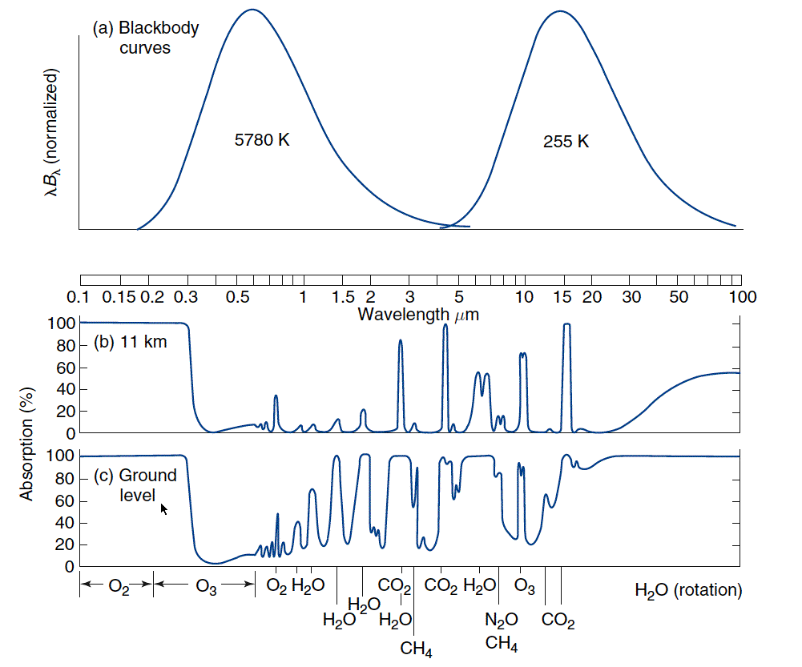
Sun and Earth Spectra and Atmospheric Windows
Sun
Earth
Visible Window
IR Dirty Window
Absorption only, not effects of Rayleigh Scattering by gases.

Slide 5
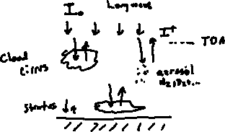
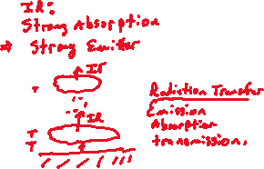
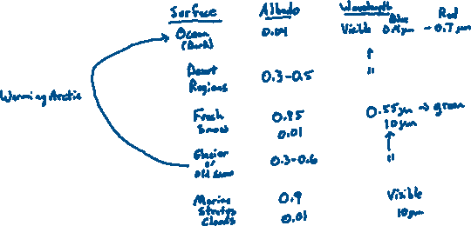
Albedo Discussion: Basic idea
1
2
3

Slide 6
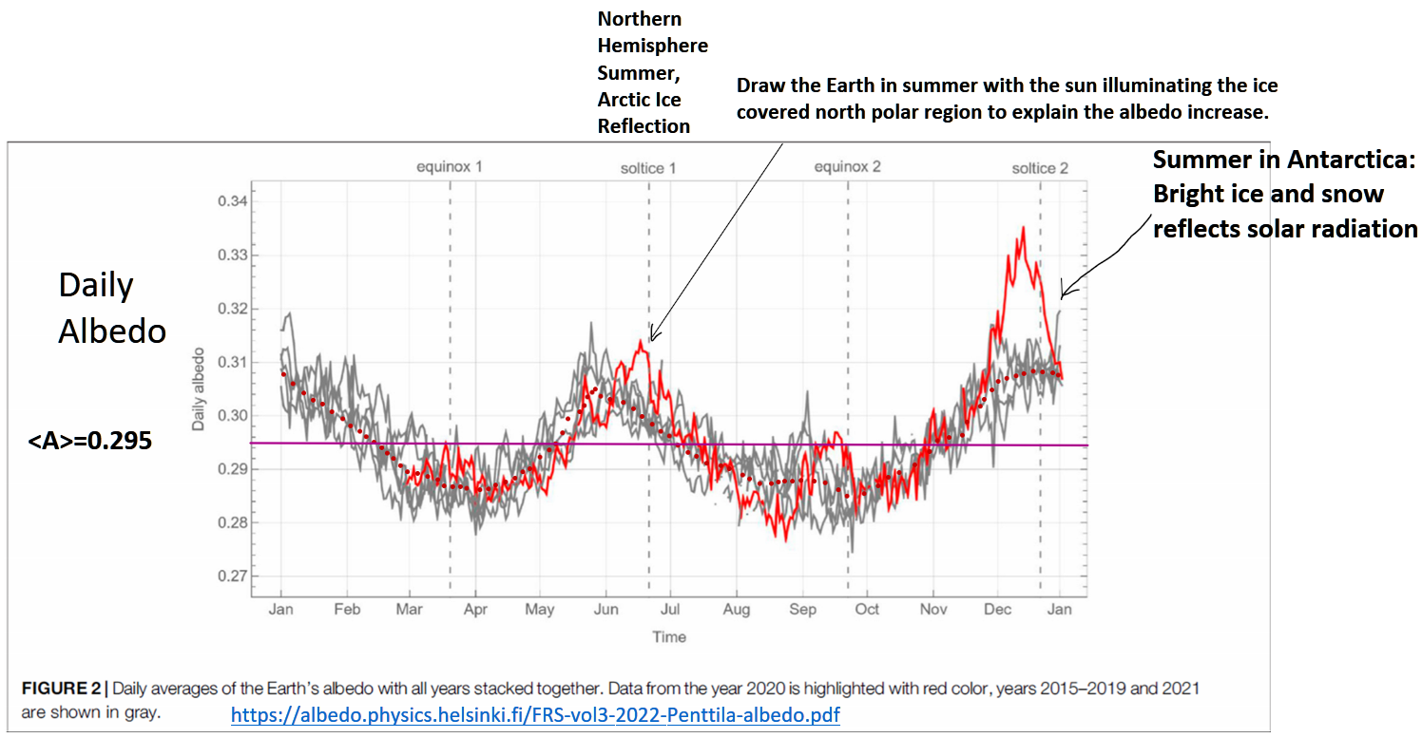
Daily Averaged Earth Albedo Measurements By the NOAA Satellite Located Between the Sun and Earth (Lagrange Point)

Slide 7
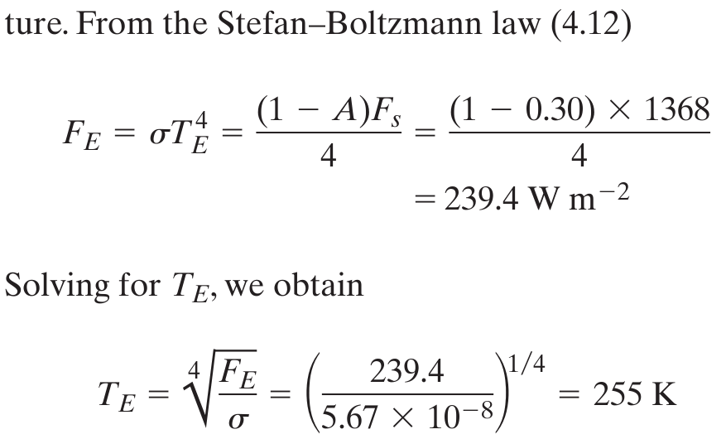
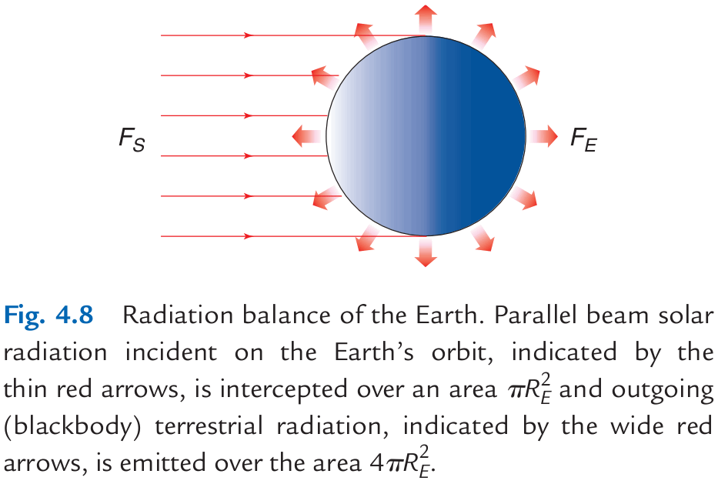
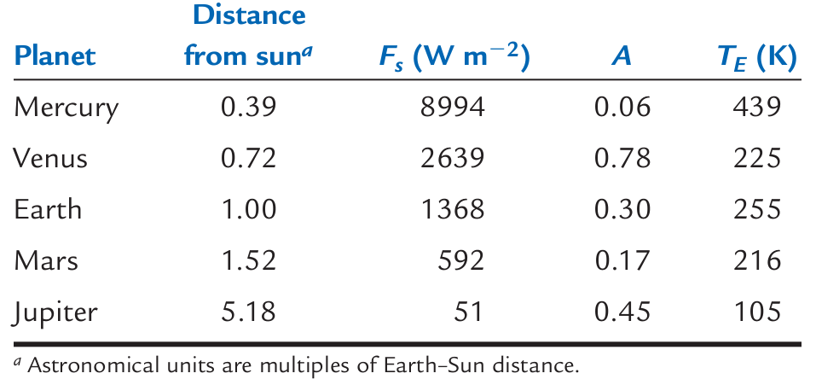
Astronomical Radiation Balance

Slide 8
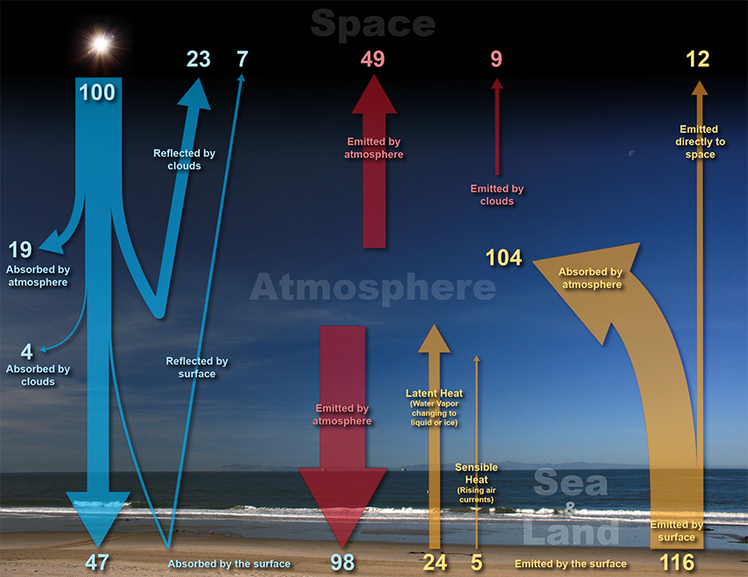
Global Energy Balance: Solar and Infrared Radiation
 |  |  |  |  |  | Top of Atmosphere: 100 units in and out. 70 units of solar radiation absorbed in the atmosphere and surface. 70 units of IR emitted.
 |  |  |  |  | Atmosphere: 156 units IR emitted up and down, 127 units IR and solar absorbed+24+5 units latent and sensible heat added for a total of 156 units
 |  |  |  |  |  |  | Surface: 47+98=145 units absorbed, 116+24+5 units leaving.

Slide 9
1 Layer Radiation Balance
NOTES:
τ is solar transmission
ε is long wave emissivity
I₀=1368/4 W/m²=342 W/m²

Slide 10
1 Layer Atmosphere Model
Shortwave Albedo = 0.3 Shortwave Transmissivity = 0.96

Slide 11
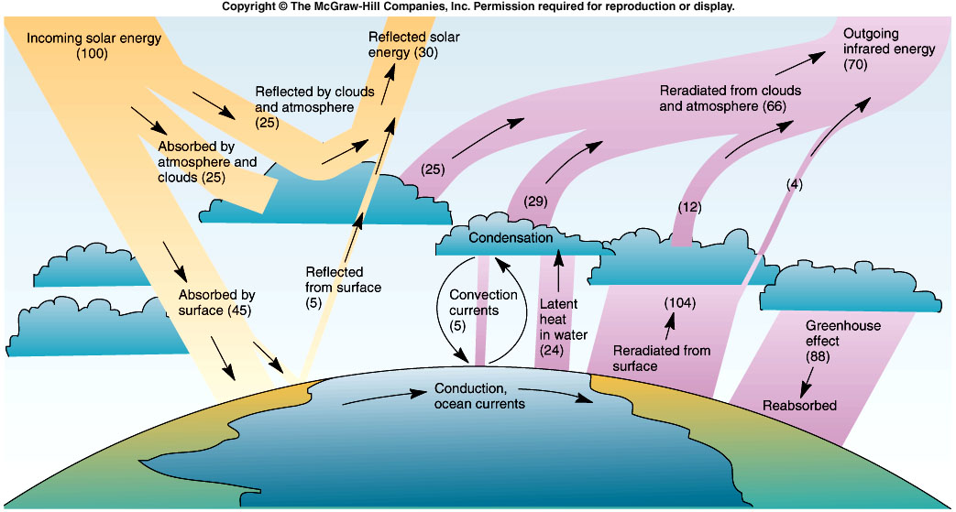
Global Energy Balance
Incoming = 45 +88 = 133
Outgoing = 104 + 24 + 5 = 133
From Cunningham & Cunningham, 2004, Fig. 9.2
Notes:
11

Slide 12
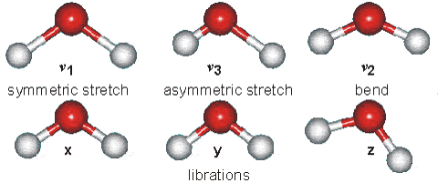
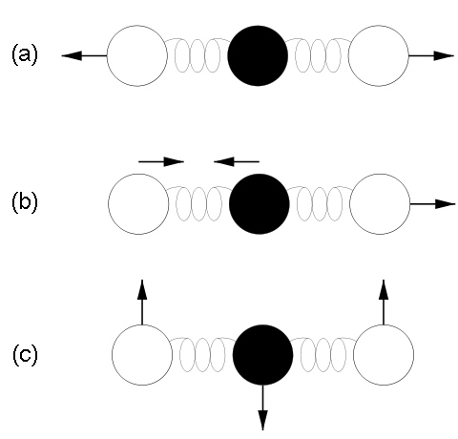



Some Energy States of Water Molecules
Atmospheric molecules lead very active ‘lives’ due to thermal and electromagnetic energy exchange, especially in the IR.
http://www.lsbu.ac.uk/water/vibrat.html
... of Carbon Dioxide Molecules
Vibration modes of carbon dioxide. Mode (a) is symmetric and results in no net displacement of the molecule's "center of charge", and is therefore not associated with the absorption of IR radiation. Modes (b) and (c) do displace the "center of charge", creating a "dipole moment", and therefore are modes that result from EM radiation absorption, and are thus responsible for making CO2 a greenhouse gas.
“15 um motion”

Slide 13
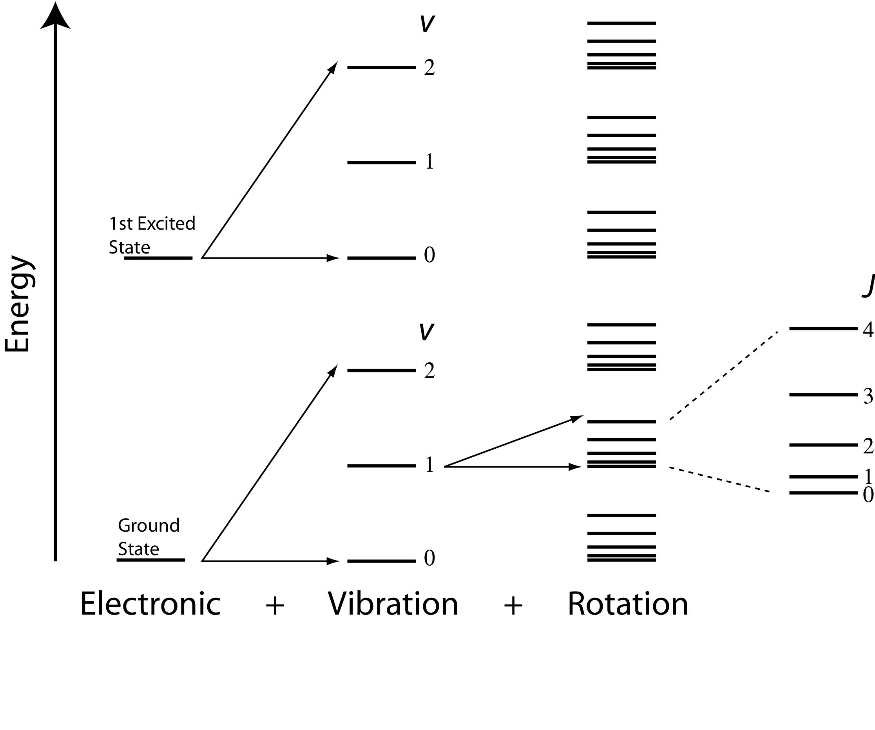
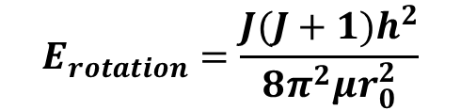
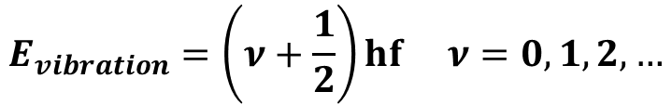
Energy Transitions in Molecules
$$E_{rotation}=\frac{J(J+1)h^{2}}{8π^{2}μr_{0}^{2}}$$
$$E_{vibration}=\left(ν+\frac{1}{2}\right)hf ν=0,1,2,…$$

Slide 14
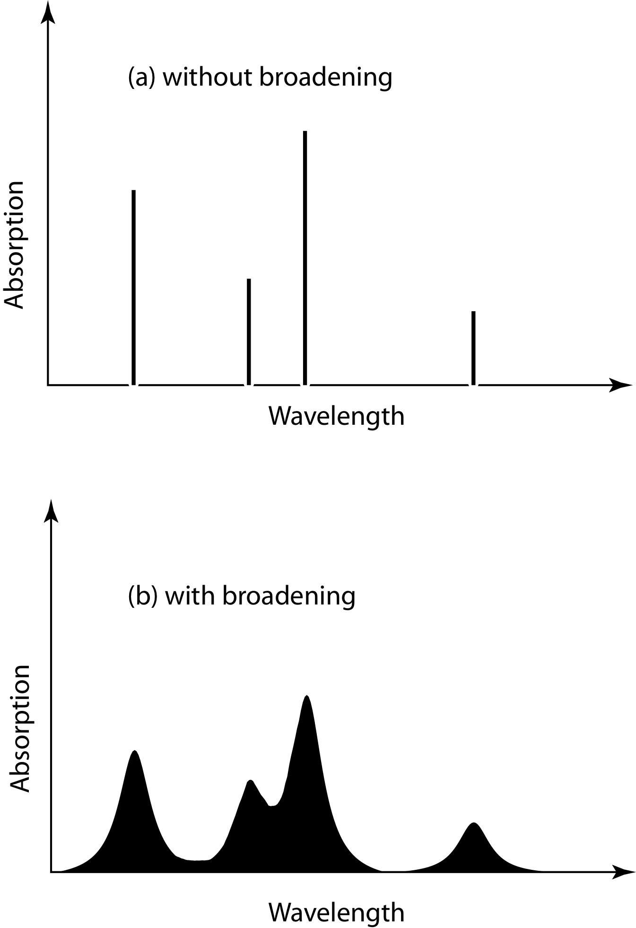
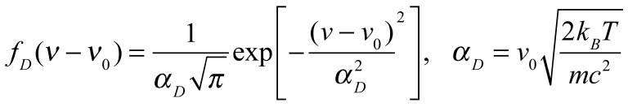
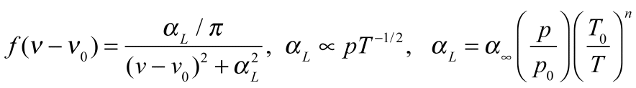
Line Broadening
Natural Broadening:
Finite time, finite widths (Heisenberg is uncertain about widths, certain they are not infinitely narrow!)
Doppler Broadening:
Molecules with relative motions due to thermal energy ‘see’ doppler shifts of the light. Important in the mesosphere.
Pressure Broadening: Lorentz line shape
Molecular collisions distort energy levels for absorption and emission. Emperically determined (by measurement). Very important for the troposphere and lower stratosphere.
frequency
frequency

Slide 15
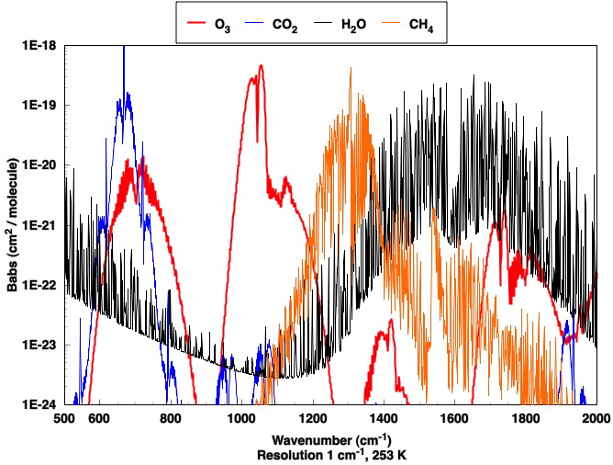
Absorption Per Molecule by Infrared Active Gases (Greenhouse Gases)
15 um
Window region
20 um
12.5 um
7.7 um
5 um

Slide 16
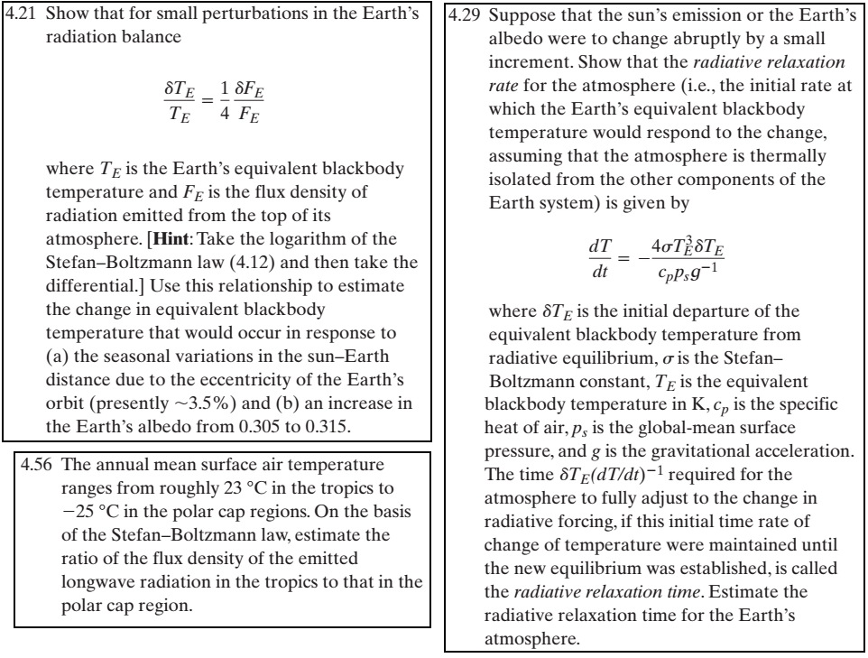
Problems 4-21 and 4-29:

Slide 17
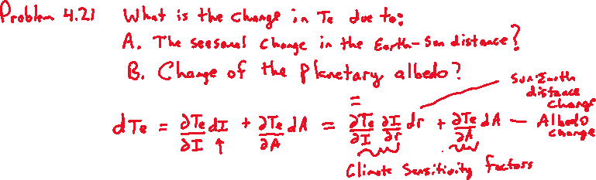
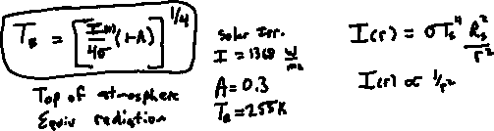
Problem 4-21

Slide 18
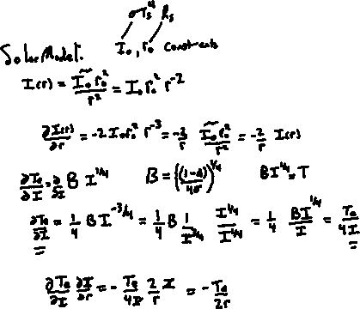

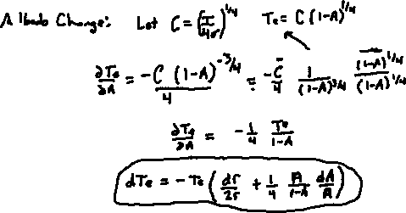
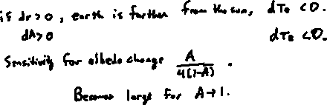
Derive the general equation for sensitivity
Derive the Albedo change part of the problem.
Derive the solar distance change part of the problem.
Putting it all
together…
Interpretation

Slide 19
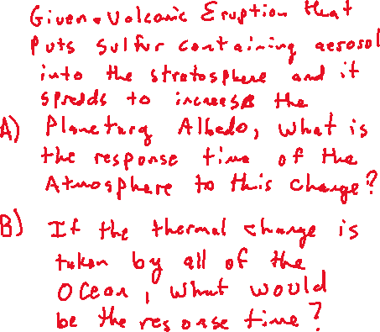
Problem 4-29, response time of the earth to sudden radiation balance changes.
Rephrase from the homework.

Slide 20
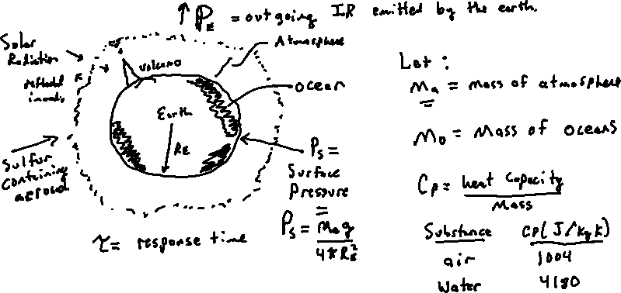
Explain the problem in terms of a picture and define useful variables.

Slide 21
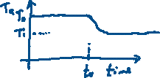
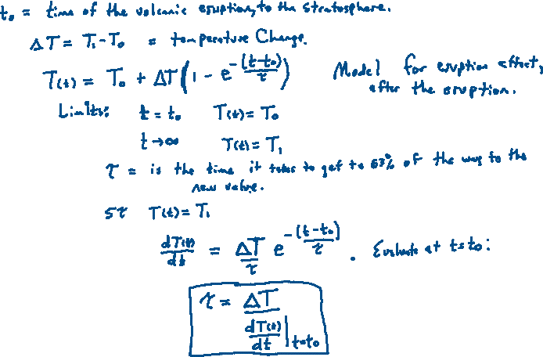
Define the response time
ΔT<0 here

Slide 22
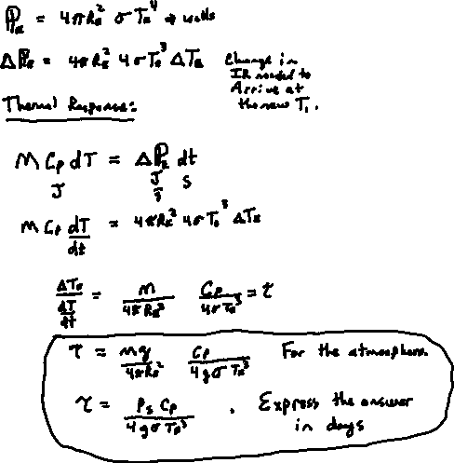
Thermal Response

Slide 23
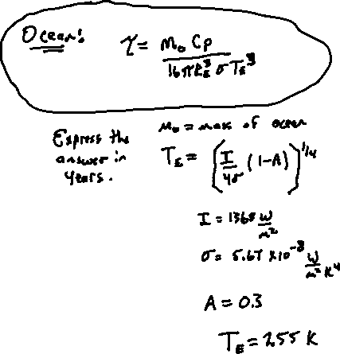
Ocean Response Time
For the sum of all
oceans: Use this.
Note: The immediate
ocean response would likely
be in the top boundary layer,
and spread from their to the
lower levels (and atmosphere).
In general, since the atmosphere and ocean
are coupled, the response will be part
atmosphere and part ocean.

Slide 24
Blue and Red Skies: Rayleigh Scattering
The scattering object is much smaller than the wavelength illuminating it.

Slide 25
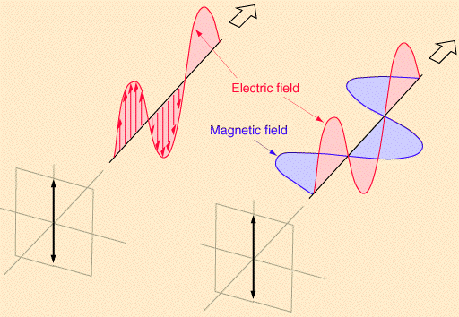
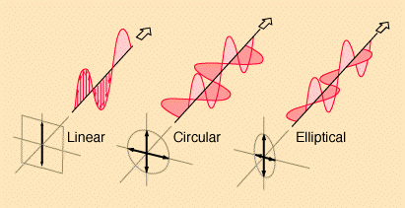
Polarization of Light
Wave/Photon boson: Polarization.
Linear Polarization: E-field in one direction.
Circular, elliptical polarization: E-Efield rotates due to phase difference between horizontal and vertical components.
From: http://hyperphysics.phy-astr.gsu.edu/hbase/phyopt/polclas.html

Slide 26
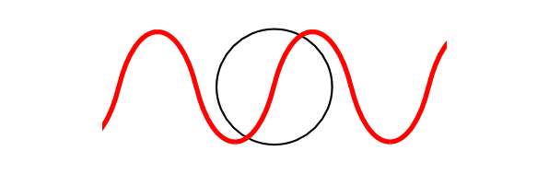
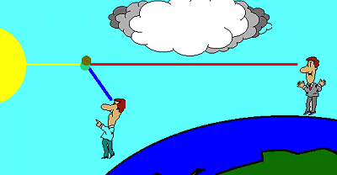
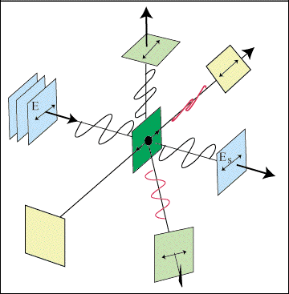

Angular Dependence of Rayleigh Scattering (dipole)
From:
http://qels.com/theory/rayleighscattering/mass.cfm
http://www.bo.astro.it/sait/spigolature/spigo402base.html
Horizontal E-field
Vertical E-field
Dipoles don’t radiate in the direction they are undergoing linear ocsillation.
From http://www.sparknotes.com/physics/optics/phenom/section3.rhtml

Slide 27




Selection Rules: Accelerated Charges are the Source, Sinks of Electromagnetic Radiation: Dipole Moment, p.
Selection rules specify the possible transitions among quantum levels due to absorption or emission of electromagnetic radiation. Incident electromagnetic radiation presents an oscillating electric field that interacts with a transition dipole p_{z}. A transition dipole moment is a transient dipolar polarization created by an interaction of electromagnetic radiation with a molecule. If p_{z} is zero then a transition is forbidden. The selection rule is a statement of when p_{z} is non-zero.
General
q
-q

Slide 28


Rayleigh Scattering Cross Section Per Raindrop and Rainfall Rate: Mismatch of diameter dependence
d=raindrop diameter
m=complex refractive index
λ=radar wavelength

Slide 29

SUNSET NEVADA

Slide 30


Rayleigh Scattering
Light Scattering by Electric Dipoles
sunset
D = molecular diameter
= wavelength
D << λ

Slide 31
General Features of
Scattering and Absorption of Light in the Atmosphere by Particles

Slide 32




Light Scattering Basics (images from Wallace and Hobbs CH4).
Angular Distribution of scattered radiation (phase function)
x
Sphere, radius r, complex refractive index n=m_{r} + im_{i}
x
Dipole scattering
x
x
m_{r}=1.5
x
Q_{s}
x

Slide 33

Mie Theory for Absorbing and Scattering Spheres
Extinction is the sum of absorption and scattering.
The single scattering albedo is ω₀=Q_{sca}/Q_{ext}.
The asymmetry parameter g. The probability of forward scatter is (1+g)/2. For backward scatter is (1-g)/2.
From Petty

Slide 34


Geometrical Optics: Interpret Most Atmospheric Optics from Raindrops and lawn sprinklers (from Wallace and Hobbs CH4)
Rainbow from raindrops
Primary Rainbow Angle: Angle of Minimum Deviation (turning point) for rays incident with 2 chords in raindrops.
Secondary Rainbow Angle: Angle of Minimum Deviation (turning point) for rays incident with 3 chords in raindrops.

Slide 35


Rainbow Optics
Θ = ?
scattering
angle
n_{r}
See http://www.philiplaven.com/p8e.html, and atmospheric optics.

Slide 36


Geometrical Optics: Rainbow (from Petty)
x
Angle of minimum deviation from the forward direction. Focusing or confluence of rays.
Distance x is also known as the impact parameter. (Height above the sphere center.)

Slide 37


Geometrical Optics: Interpret Most Atmospheric Optics from Ice Crystals (from Wallace and Hobbs CH4)
22 deg and 45 deg Halos from cirrus crystals of the column or rosette (combinations of columns) types. Both are angle of deviation phenomena like the rainbow. Crystal orientation important. 22 deg halo, more common, thumb rule to measure size of arc.

Slide 38

Size Parameter x Characterizes Scattering Regimes
Summary of Scattering Regimes: Note Particle Sizes
and wavelengths of radiation!!

Slide 39


Mie Phase Functions for Water Spheres
light in
Θ
scattered light
Radiation Patterns
Note the dipole character for small x
and the primary and secondary rainbows
for large x.

Slide 40


Mie Radar Backscatter Efficiency for Water and Ice Spheres
Non Rayleigh
strong backscatter by water drops
compared to that of ice!!
Rayleigh
WSR-88D NWS Doppler Radar

Slide 41

Solar Radiation Transfer by Clouds: A typical partly cloudy day on south campus at UNR
Direct beam
Diffuse
Irradiance Detector

Slide 42
Solar Radiation Transfer by Clouds: A typical partly cloudy day on south campus at UNR
Direct beam
Diffuse
The probability of solar radiation to be back scattered by the ground back to the sky is increased greatly when fresh snow has fallen.
FRESH SNOW
Irradiance Detector

Slide 43


Example of downwelling Irradiance Maxima During Partly Cloudy Conditions When The Direct Beam of Sunlight Sneaks through an opening in the clouds. Maxima are enhanced by high ground albedo.
UNR Weather Station Data
No snow was on the ground
https://wrcc.dri.edu/cgi-bin/rawMAIN2.pl?nvunrc

Slide 44

Aerosol Optical Cross Sections and Coefficients
Optical power removed by ext=abs+sca.
extinction = absorption + scattering
I₀ (W/m²)
P_{ext} (W) = I₀ σ_{ext}
P_{abs} (W) = I₀ σ_{abs}
P_{sca} (W) = I₀ σ_{sca}
abs
sca
x << 1 Rayleigh Regime
x >> 1 Geometrical Optics Regime and very weak absorption
$$σ_{sca}≈\frac{πd^{2}}{2}≈σ_{ext}$$
Cloud droplets: d ≈ 30 μm
= 0.55 μm (green light)
$$x=\frac{πd}{λ}=171$$
d = particle diameter
m = complex refractive index
λ = wavelength

Slide 45
Aerosol Optical Cross Sections and Coefficients
Optical power removed by ext=abs+sca.
extinction = absorption + scattering
I₀ (W/m²)
P_{ext} (W) = I₀ σ_{ext}
P_{abs} (W) = I₀ σ_{abs}
P_{sca} (W) = I₀ σ_{sca}
abs
sca
Sunlight I₀
Cloud
droplets
L
Diffuse
(scattered)
Diffuse
(scattered)
Direct
beam
(no extinction)

Slide 46
Aerosol Optical Cross Sections and Coefficients
Optical power removed by ext=abs+sca.
extinction = absorption + scattering
I₀ (W/m²)
P_{ext} (W) = I₀ σ_{ext}
P_{abs} (W) = I₀ σ_{abs}
P_{sca} (W) = I₀ σ_{sca}
abs
sca
Sunlight I₀
N=# Cloud droplets / Volume
D=Cloud droplet diameter
Scattering cross section of 1
σ_{sca}=π D²/2≈ σ_{ext} [m²]
σ_{abs}≈0
Scattering coefficient of N
β_{sca}=N σ_{sca}≈ β_{ext} [m⁻¹]
Scattering optical depth
τ_{sca}= β_{sca}L ≈ τ_{ext} [none]
Direct Beam Irradiance at ground
I = I₀ exp(- τ_{ext}) (sneaky light)
Cloud
droplets
L
Diffuse
(scattered)
Diffuse
(scattered)
Direct
beam
(no extinction)

Slide 47

Cloud Optical Depth Measurements In Oklahoma (from Barnard and Long 2004). Data for high cloud fractions (few broken cloud regions where the sky above is visible) and for water droplet containing clouds. Retrieval algorithm only valid for surface albedo below 0.3

Slide 48

High Altitude Locations: Snow and Glacier Impacts on the Downwelling Solar Radiation
Atmospheric Brown Clouds in the Himalayas: first two years of continuous observations at the Nepal Climate Observatory-Pyramid (5079 m)
Bonasoni et al 2010 ACP

Slide 49
High Altitude Locations: Snow and Glacier Impacts on the Downwelling Solar Radiation
Atmospheric Brown Clouds in the Himalayas: first two years of continuous observations at the Nepal Climate Observatory-Pyramid (5079 m)
Bonasoni et al 2010 ACP
Partly cloudy is the white region.

Slide 50

1 D model of downwelling shortwave radiation measured at the surface, as a function of cloud optical depth τ and surface albedo A.

Slide 51




Asymmetry Parameter of Scattering, g. -1<g<1
n_{r}=1.33
λ=0.6328
D=20 um
g=0.874
I_{s}(θ)
θ
I₀
Scattering phase
function for a
cloud droplet:
Strong forward
scattering.
$$I_{s}\left(θ\right)=I_{0}\left(\frac{dσ_{sca}}{dΩ}\right) \\ σ_{sca}=\int{\left(\frac{dσ_{sca}}{dΩ}\right)dΩ} \\ g=\frac{\int{\left(\frac{dσ_{sca}}{dΩ}\right)\cos\left(θ\right)dΩ}}{σ_{sca}}$$

Slide 52
Scattering Relationships: Example and the Asymmetry Parameter g
Here P↓↓=3/4. P↓↑=1/4.
P↓↓+ P↓↑ = 1.
incoming
photons
back scattered
photon
g≡ P↓↓ - P↓↑ in 1-D.
g = P↓↓ - (1- P↓↓ )
Solving,
P↓↓=(1+g)/2 = P↑↑
P↓↑=(1-g)/2 = P↓↑
particle
forward scattered
photons

Slide 53







Special Case: No Absorption, Single Scatter Albedo = 1.
Reflection and Transmission Coefficients, R and T.
R≡I↑(TOA)/ I₀
I↓(TOA)≡I₀
Top of Atmosphere TOA
τ_{ext}
T≡I↓(gnd) / I₀
ground level, gnd
ground is a totally absorbing surface to start with.
$P_{↓↑} ,$ or
$$P_{↓↓}$$
$$T=\frac{1}{1+τ_{ext} P_{↓↑}}$$
$$P_{↓↑}$$
Probability that a down going photon is backscattered,or is forward scattered
$$P_{↓↓}$$
$$R=1−T=\frac{τ_{ext} P_{↓↑}}{1+τ_{ext} P_{↓↑}}$$
$$P_{↓↓}+P_{↓↑}=1$$

Slide 54



Energy Conservation for the Conservative Case
I↓(0)≡I₀
R
T²A_{g}
T²A_{g}RA_{g}
T²A_{g}(RA_{g})²
T²A_{g}(RA_{g})^{n}
TA_{g}
TA_{g}RA_{g}
TA_{g}RA_{g}RA_{g}
T(A_{g}R)^{n}
TA_{g} (A_{g}R)^{n}
T
TA_{g}R
TA_{g}RA_{g}R
ground has reflectance, (or albedo) = A_{g}.
General Relationship:
R_{total}= R+T²A_{g} /(1- A_{g}R)
T_{total} = T / (1- A_{g}R)
Energy Conservation:
In to system = Out of system
= R_{total} + A_{gnd} = 1
(can show with algebra)
Total Absorption by Ground, A_{gnd}
A_{gnd}= (In_{gnd} - Out_{gnd})/I₀
A_{gnd} = T_{total} (1- A_{g})
Can show with algebra, or by inspection
$$T_{Total}=T_{Diffuse}+T_{Direct}$$
$$T_{Diffuse}=T_{Total}−T_{Direct}$$
$$T_{Direct}=e^{−τ_{ext}}$$

Slide 55
High Altitude Locations: Snow and Glacier Impacts on the Downwelling Solar Radiation

Slide 56
1 D model of downwelling shortwave radiation measured at the surface, as a function of cloud optical depth τ and surface albedo A.

Slide 57
Additional Topics

Slide 58


Venus: What’s going on here?

Slide 59


gray body
emitter

Slide 60


Earth Light: Spectrum of Outgoing Infrared Radiation
incoming solar
I_{TOA solar}
Earth
IR radiation emitted by
the Earth (red), the
atmosphere (orange),
and transmitted to space
after absorption by the
atmosphere (pink).
Yellow: Spectrum of infrared light going to space.
Pink Curve: Spectrum of light emitted by the surface.
Greenhouse gases reduce the amount of infrared radiation from the surface that gets to space.
From http://www.lib.utah.edu/services/prog/gould/1998/Figure_5.gif

Slide 61



Global Radiation Balance at Top of Atmosphere: 1 year of data from the NASA Earth Radiation Budget Experiment
Notes:
Absorbed solar mostly near equator.
IR emitted strong near Sahara desert.
Low outgoing IR (green patches) in central Africa,
South America, etc, are due to persistent
cumulonimbus.
Net radiation=Solar Absorbed – Outgoing IR;
surplus near the equator, deficit over Sahara
desert and polar regions.

Slide 62
NOTES:
τ is solar transmission
ε is long wave emissivity
I₀=1368/4 W/m²=342 W/m²

Slide 63
1 Layer Atmosphere Model
Shortwave Albedo = 0.3 Shortwave Transmissivity = 0.96

Slide 64
Absorption by Infrared Active Gases (Greenhouse Gases)
15 um
Window region
20 um
12.5 um
7.7 um
5 um

Slide 65
Global Energy Balance
Incoming = 45 +88 = 133
Outgoing = 104 + 24 + 5 = 133
From Cunningham & Cunningham, 2004, Fig. 9.2
Notes:
65

Slide 66

Top of the Atmosphere Solar Radiation:

Slide 67

SOLAR SPECTRUM:
TOP OF THE ATMOSPHERE

Slide 68

SOLAR SPECTRUM:
TOP OF THE ATMOSPHERE AND AT THE SURFACE

Slide 69

SOLAR SPECTRUM:
Effects of Rayleigh (gas) scattering, O₂ and N₂.

Slide 70

SOLAR SPECTRUM:
Effects of Rayleigh (gas) scattering, O₂ and N₂,
And effects of extinction by aerosol particles.

Slide 71

SOLAR SPECTRUM:
Effects of gaseous absorption.

Slide 72



Absorption by Gases: Solar Radiation Penetration Depth
radiation makes it to the surface

Slide 73
Sun and Earth Spectra and Atmospheric Windows
Sun
Earth
Visible Window
IR Dirty Window
Absorption only, not effects of Rayleigh Scattering by gases.

Slide 74
Some Energy States of Water Molecules
Atmospheric molecules lead very active ‘lives’ due to thermal and electromagnetic energy exchange.
http://www.lsbu.ac.uk/water/vibrat.html
... of Carbon Dioxide Molecules
Vibration modes of carbon dioxide. Mode (a) is symmetric and results in no net displacement of the molecule's "center of charge", and is therefore not associated with the absorption of IR radiation. Modes (b) and (c) do displace the "center of charge", creating a "dipole moment", and therefore are modes that result from EM radiation absorption, and are thus responsible for making CO2 a greenhouse gas.
“15 um motion”

Slide 75
Energy Transitions in Molecules
$$E_{rotation}=\frac{J(J+1)h^{2}}{8π^{2}μr_{0}^{2}}$$
$$E_{vibration}=\left(ν+\frac{1}{2}\right)hf ν=0,1,2,…$$

Slide 76
Line Broadening
Natural Broadening:
Finite time, finite widths (Heisenberg is uncertain about widths, certain they are not infinitely narrow!)
Doppler Broadening:
Molecules with relative motions due to thermal energy ‘see’ doppler shifts of the light. Important in the mesosphere.
Pressure Broadening: Lorentz line shape
Molecular collisions distort energy levels for absorption and emission. Emperically determined (by measurement). Very important for the troposphere and lower stratosphere.
frequency
frequency

Slide 77








Individual Absorption Lines Are Pressure and Doppler Broadened (absorb more radiation as a result).
gas absorption cross section
S = absorption strength
ν₀=wavenumber of absorption peak
0.5 ≤ N ≤ 1

Slide 78

Heating Rate = Divergence of the Net Flux

Slide 79

DOWNWELLING FTIR Radiance at UNR: Atmospheric IR Window
13 microns
8 microns

Slide 80

DEFINITION OF THE BRIGHTNESS TEMPERATURE
T_{B}
Measured Radiance at wavenumber v
=
Theoretical Radiance of a Black Body at temperature T_{B}

Slide 81
FTIR Brightness Temperatures

Slide 82


Atmosphere Emission Measurements, Downwelling Radiance
Notes:
Wavelength range for CO₂, H₂0, O₃, CH₄.
Envelope blackbody curves.
Monster inversion in Barrow.
Water vapor makes the tropical window dirty.

Slide 83

Ideal Weighting Function W_{i}: Where in the atmosphere the main contribution to the radiation at wavenumber ν_{i} comes from.
real
with
overlap
almost
ideal
ideal

Slide 84


Downwelling Intensity Emitted by the Atmosphere to the Detector (Radiance)
μ=cosθ
z
dz
emissivity=β_{abs}dz/cosθ
θ
B[T(z)]
blackbody
radiance,
T = temperature.
θ
ftir
emission
transmission
weighting
function

Slide 85

Weighting Functions for Satellite Remote Sensing using the strong CO₂ absorption near 15.4 um. (from Wallace and Hobbs, 2nd edition)

Slide 86


Slide 87

Electromagnetic Penetration Depth for Water and Ice

Slide 88
Mie Radar Backscatter Efficiency for Water and Ice Spheres
Non Rayleigh
strong backscatter by water drops
compared to that of ice!!
Rayleigh
WSR-88D NWS Doppler Radar

