Slide 1
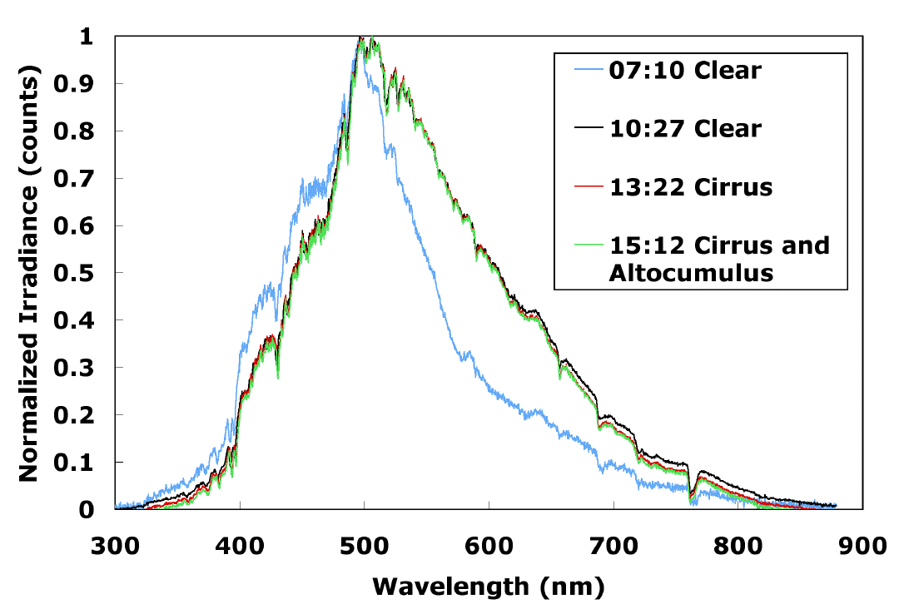
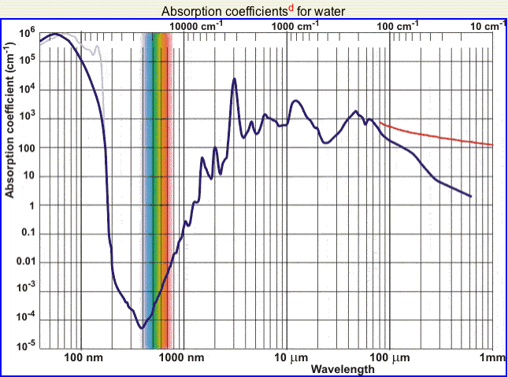
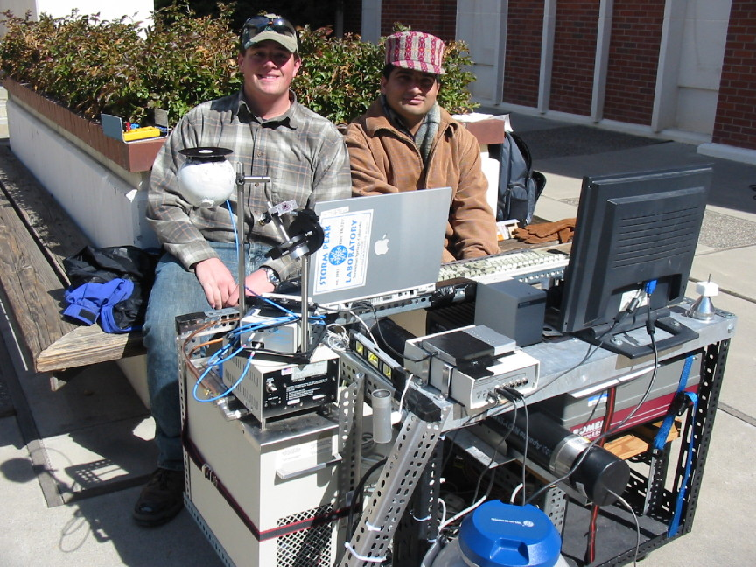
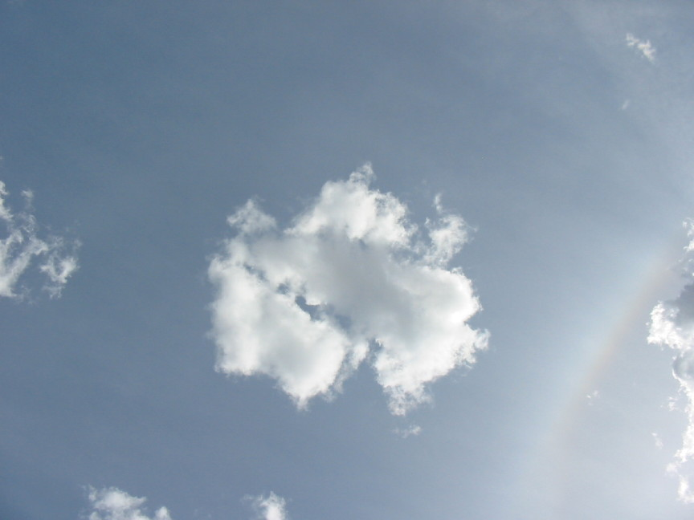
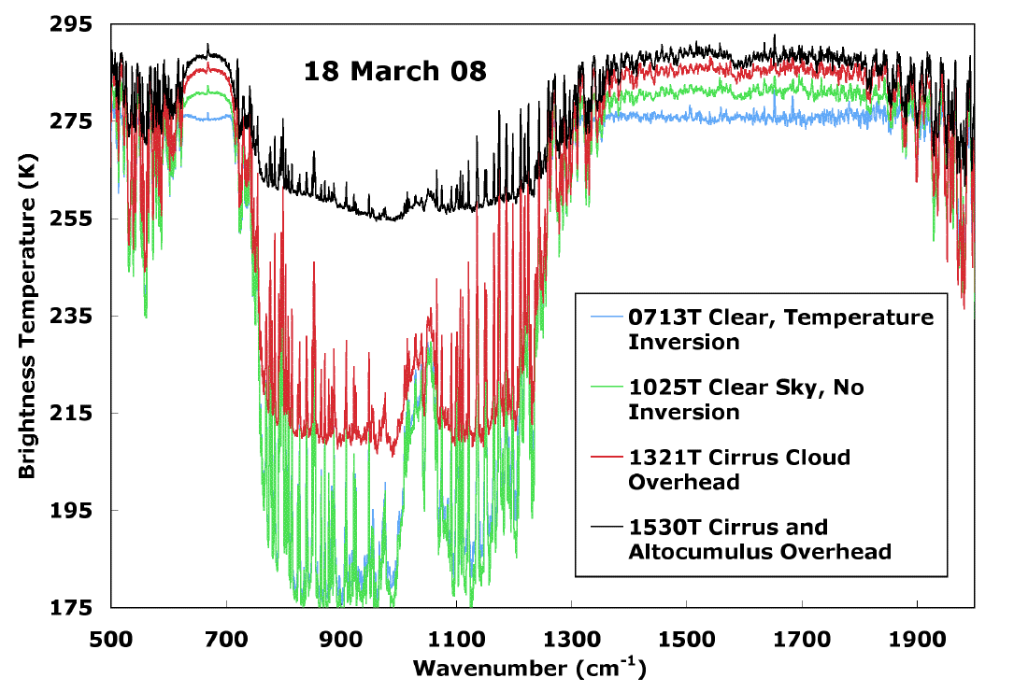
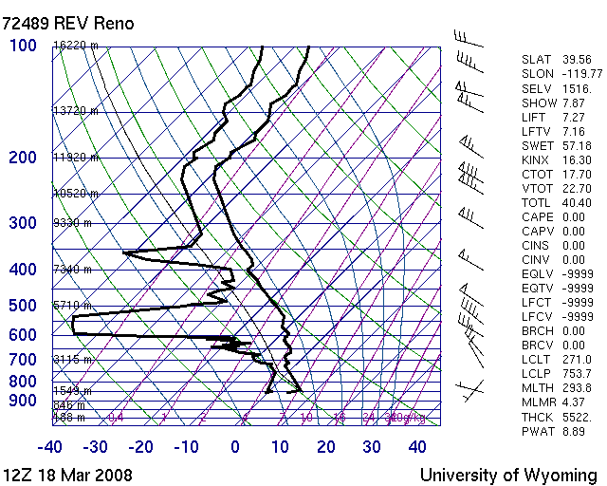
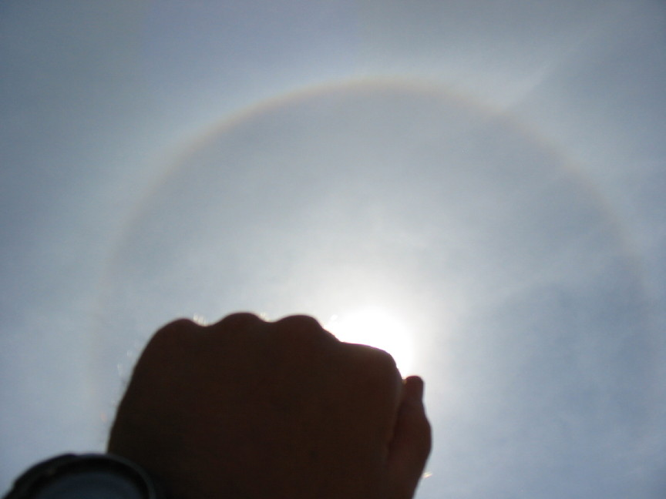
Chapter 4: Atmospheric Radiation Transfer

Slide 2
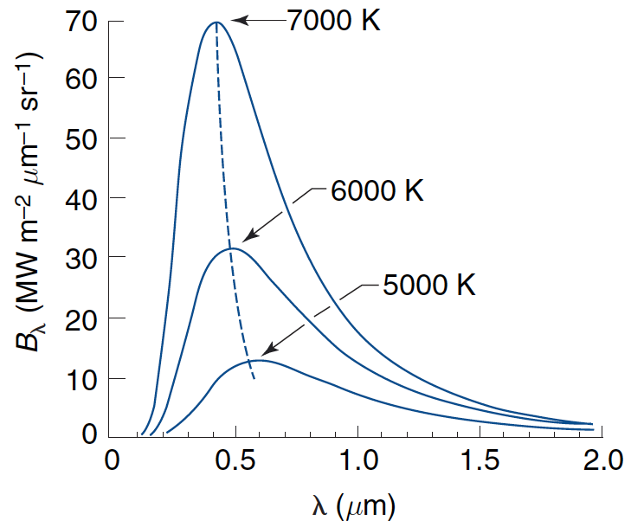
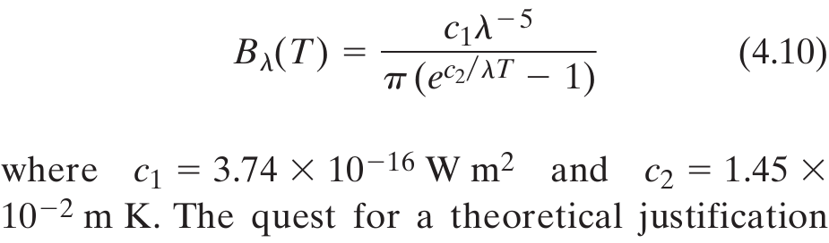
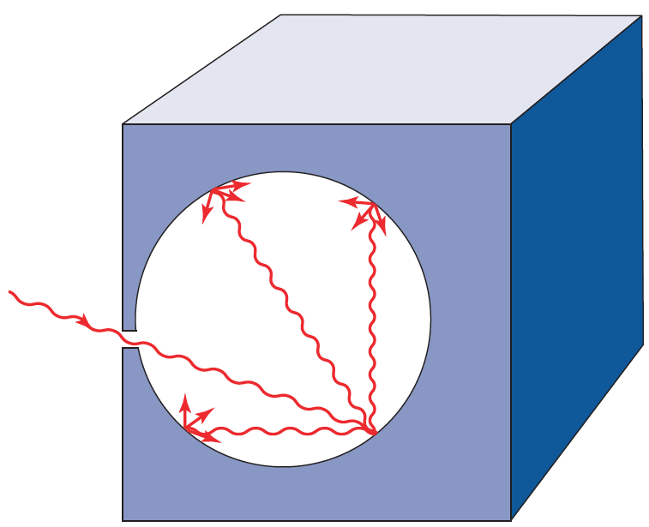
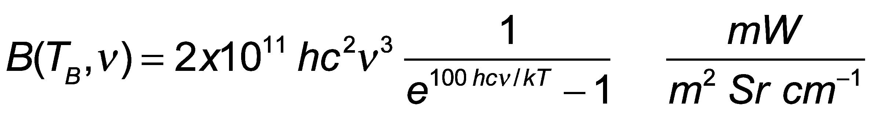
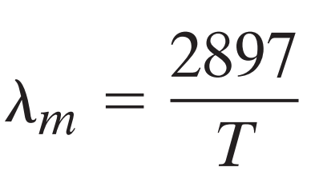
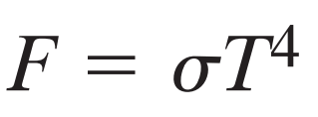
Planck’s Blackbody Function for Different Temperatures
Wavenumber distribution
Peak obeys Wien’s displacement ‘law’
Wavelength (μm) T (K)
Total irradiance
Stefan-Boltzmann ‘law’

Slide 3
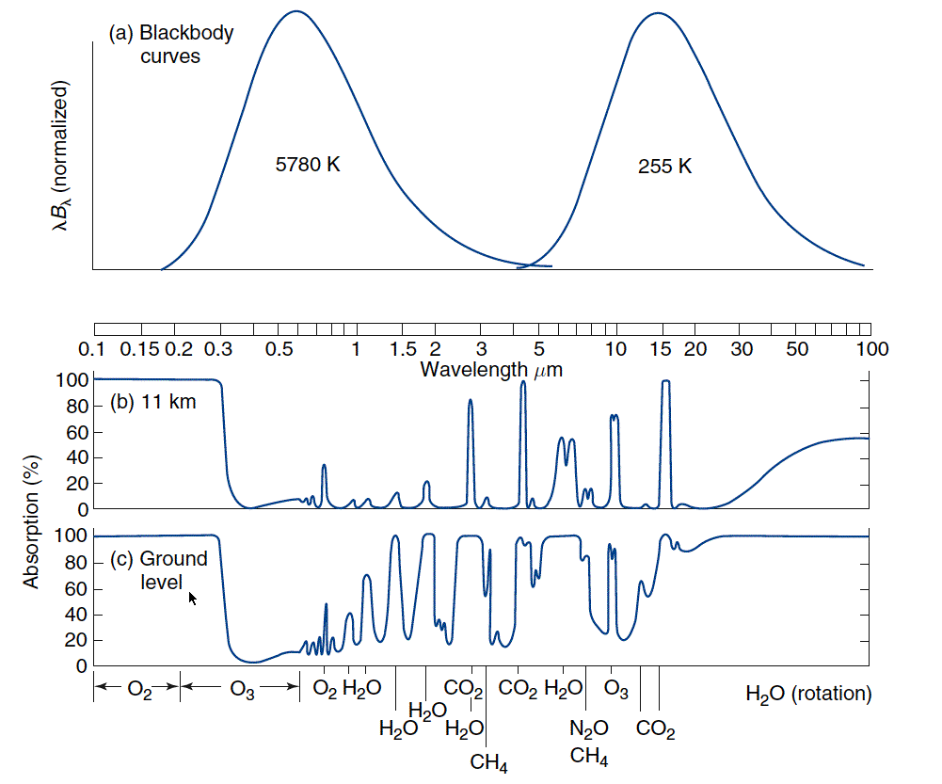
Sun and Earth Spectra and Atmospheric Windows
Sun
Earth
Visible Window
IR Dirty Window
Absorption only, not effects of Rayleigh Scattering by gases.

Slide 4
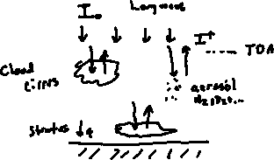
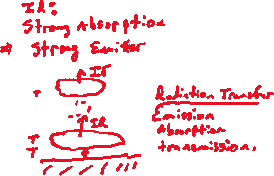
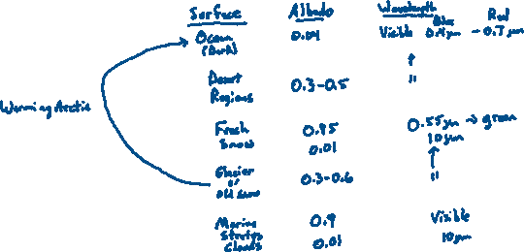
Albedo Discussion: Basic idea
1
2
3

Slide 5
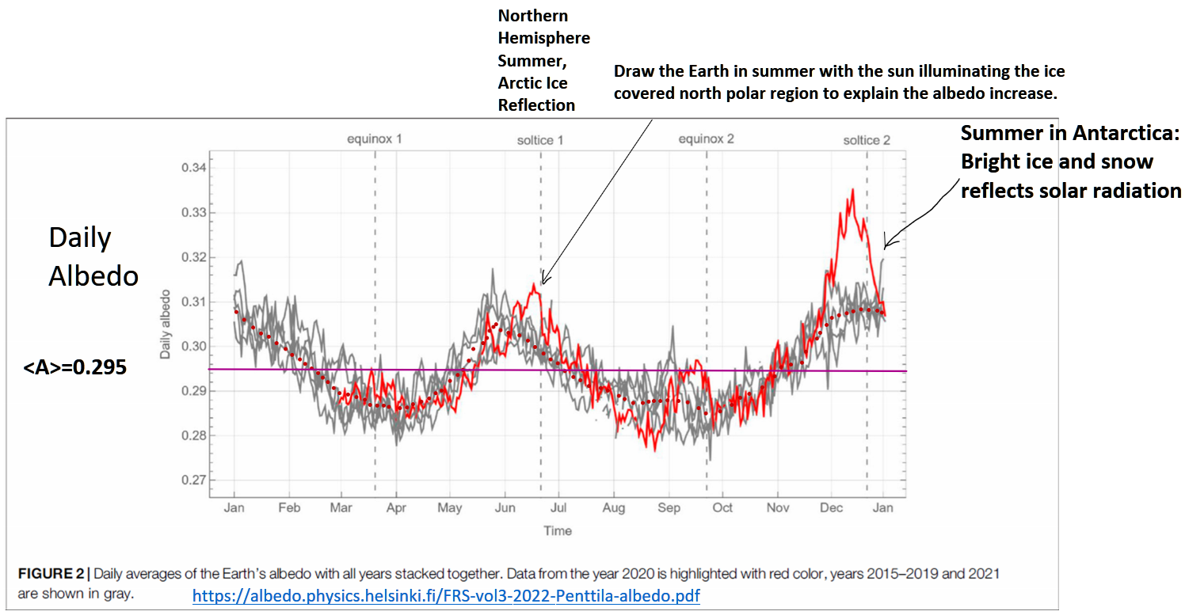
Daily Averaged Earth Albedo Measurements By the NOAA Satellite Located Between the Sun and Earth (Lagrange Point)

Slide 6
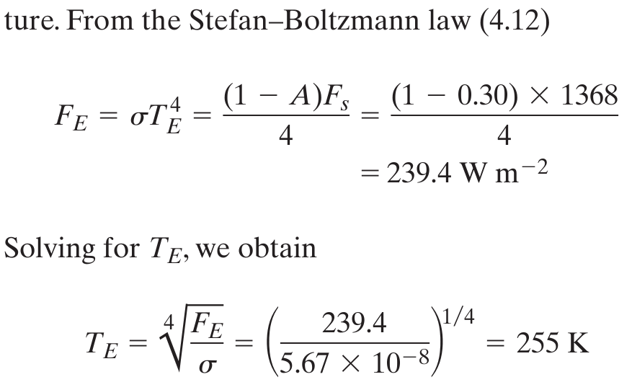
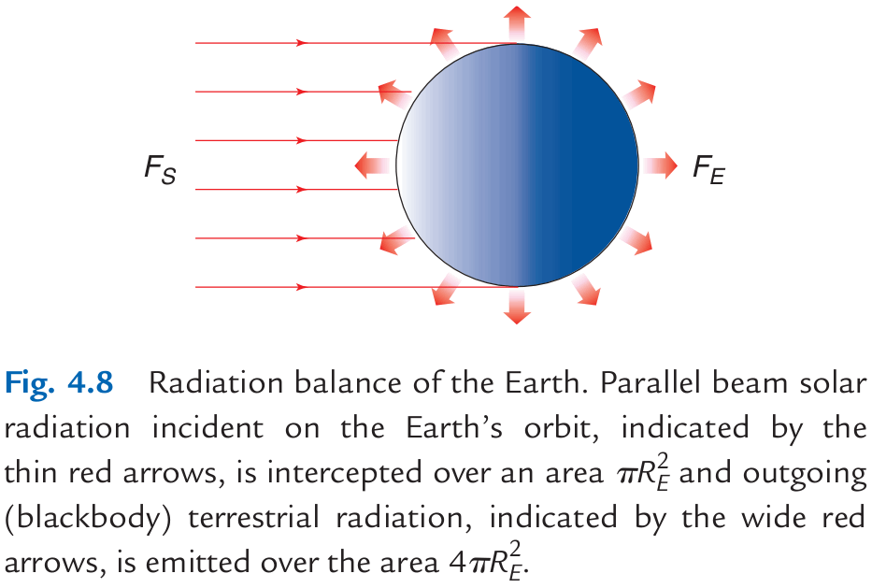
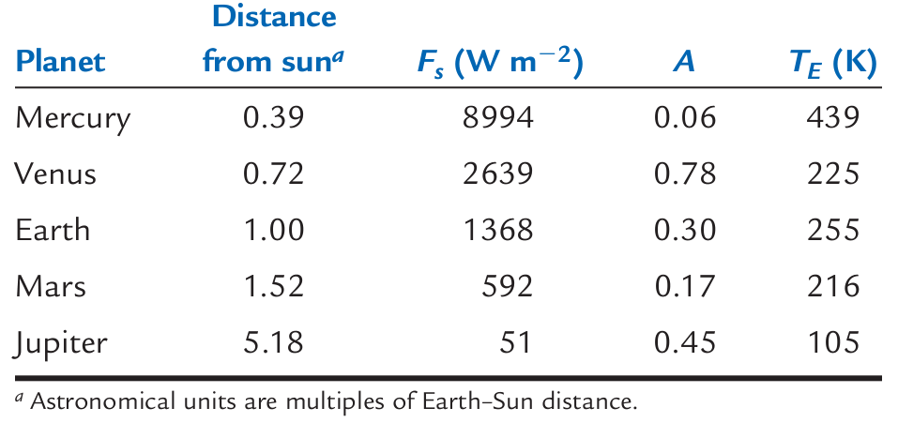
Astronomical Radiation Balance

Slide 7
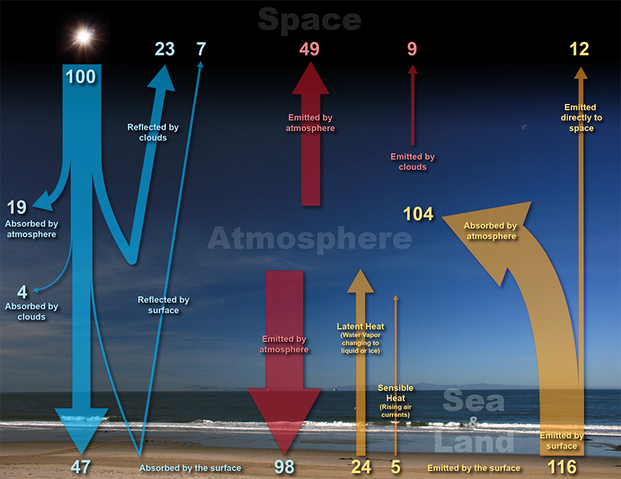
Global Energy Balance: Solar and Infrared Radiation
 |  |  |  |  |  | Top of Atmosphere: 100 units in and out. 70 units of solar radiation absorbed in the atmosphere and surface. 70 units of IR emitted.
 |  |  |  |  | Atmosphere: 156 units IR emitted up and down, 127 units IR and solar absorbed+24+5 units latent and sensible heat added for a total of 156 units
 |  |  |  |  |  |  | Surface: 47+98=145 units absorbed, 116+24+5 units leaving.

Slide 8
1 Layer Radiation Balance
NOTES: τ is solar transmission ε is long wave emissivity I₀=1368/4 W/m²=342 W/m²

Slide 9
1 Layer Atmosphere Model Shortwave Albedo = 0.3 Shortwave Transmissivity = 0.96

Slide 10
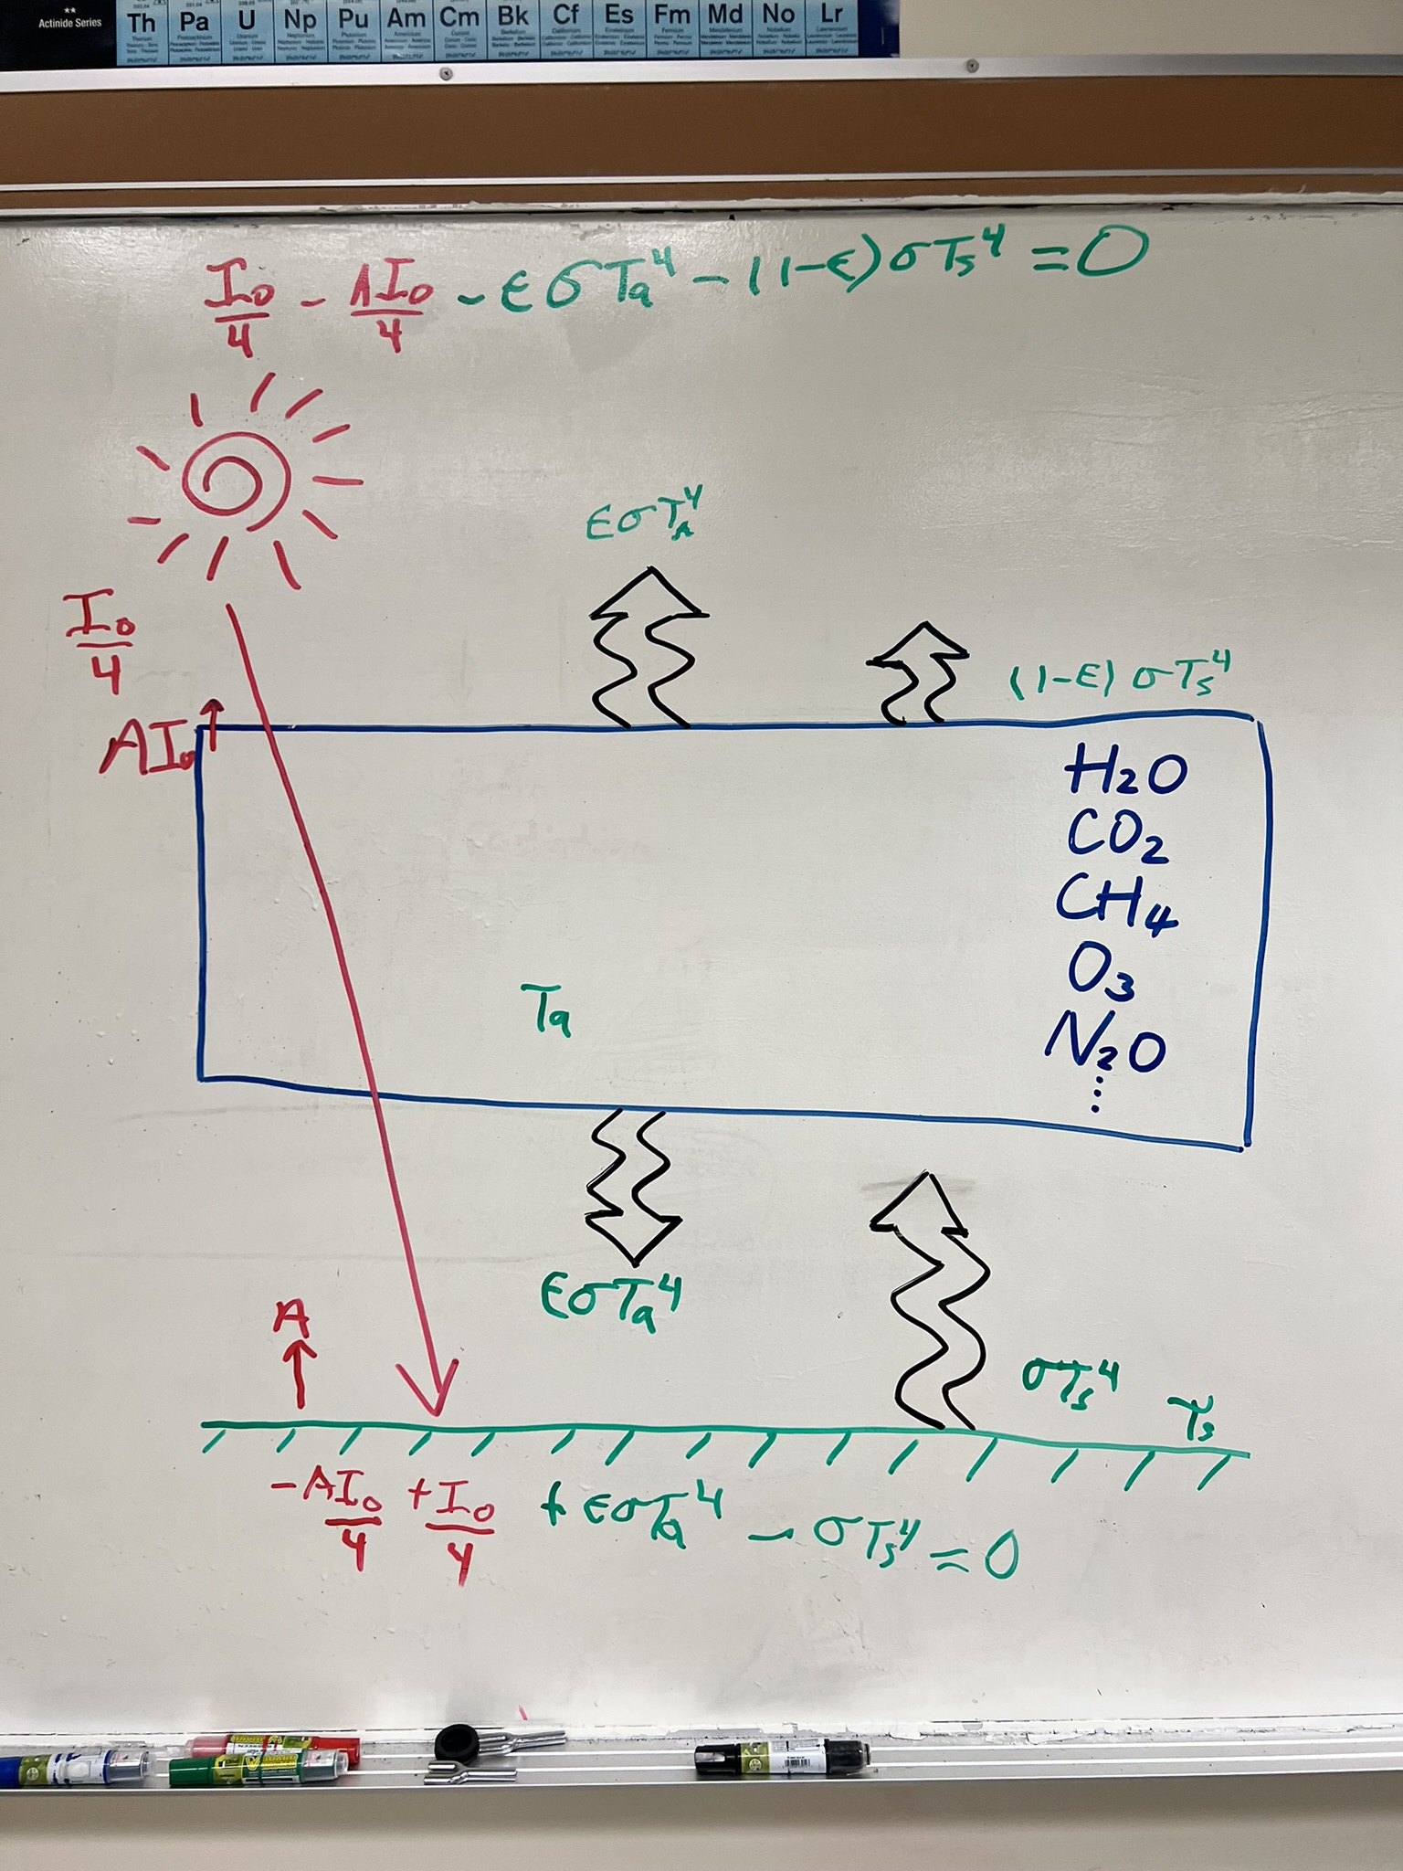
Radiation Balance for a 1 Layer Atmosphere. Some of the infrared active gases are listed.

Slide 11
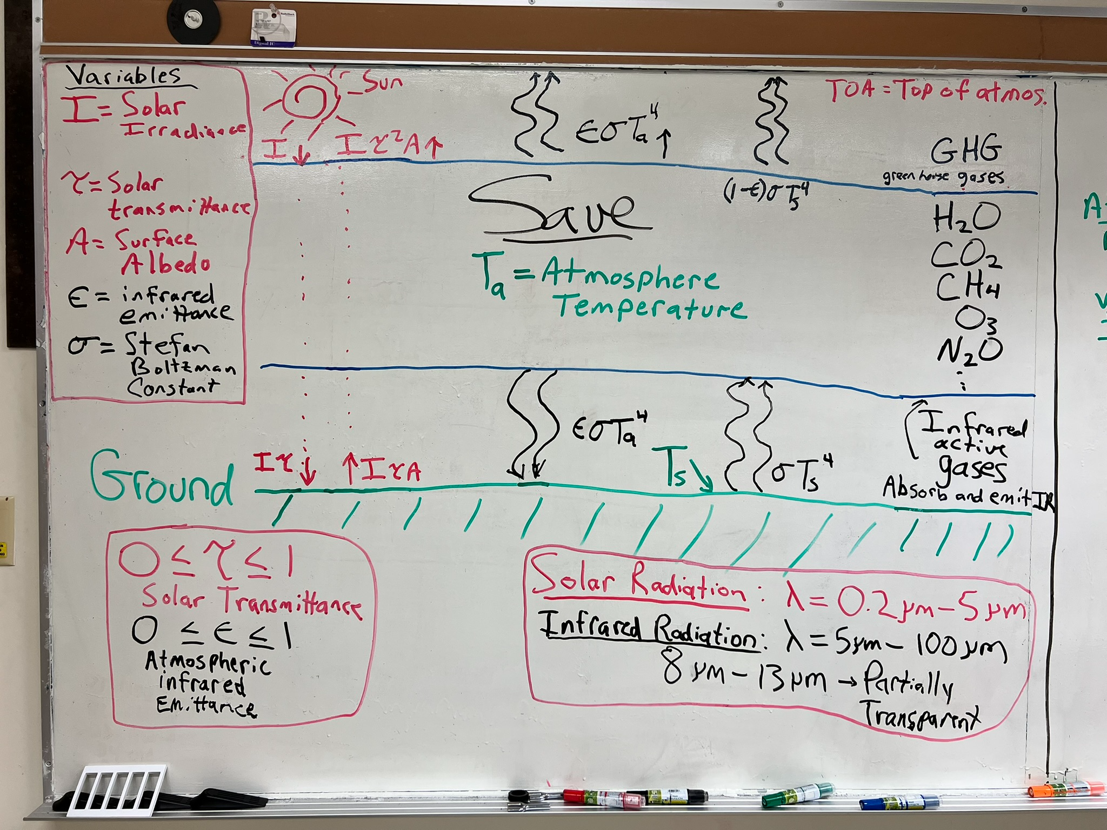
1 Layer Atmosphere Model

Slide 12
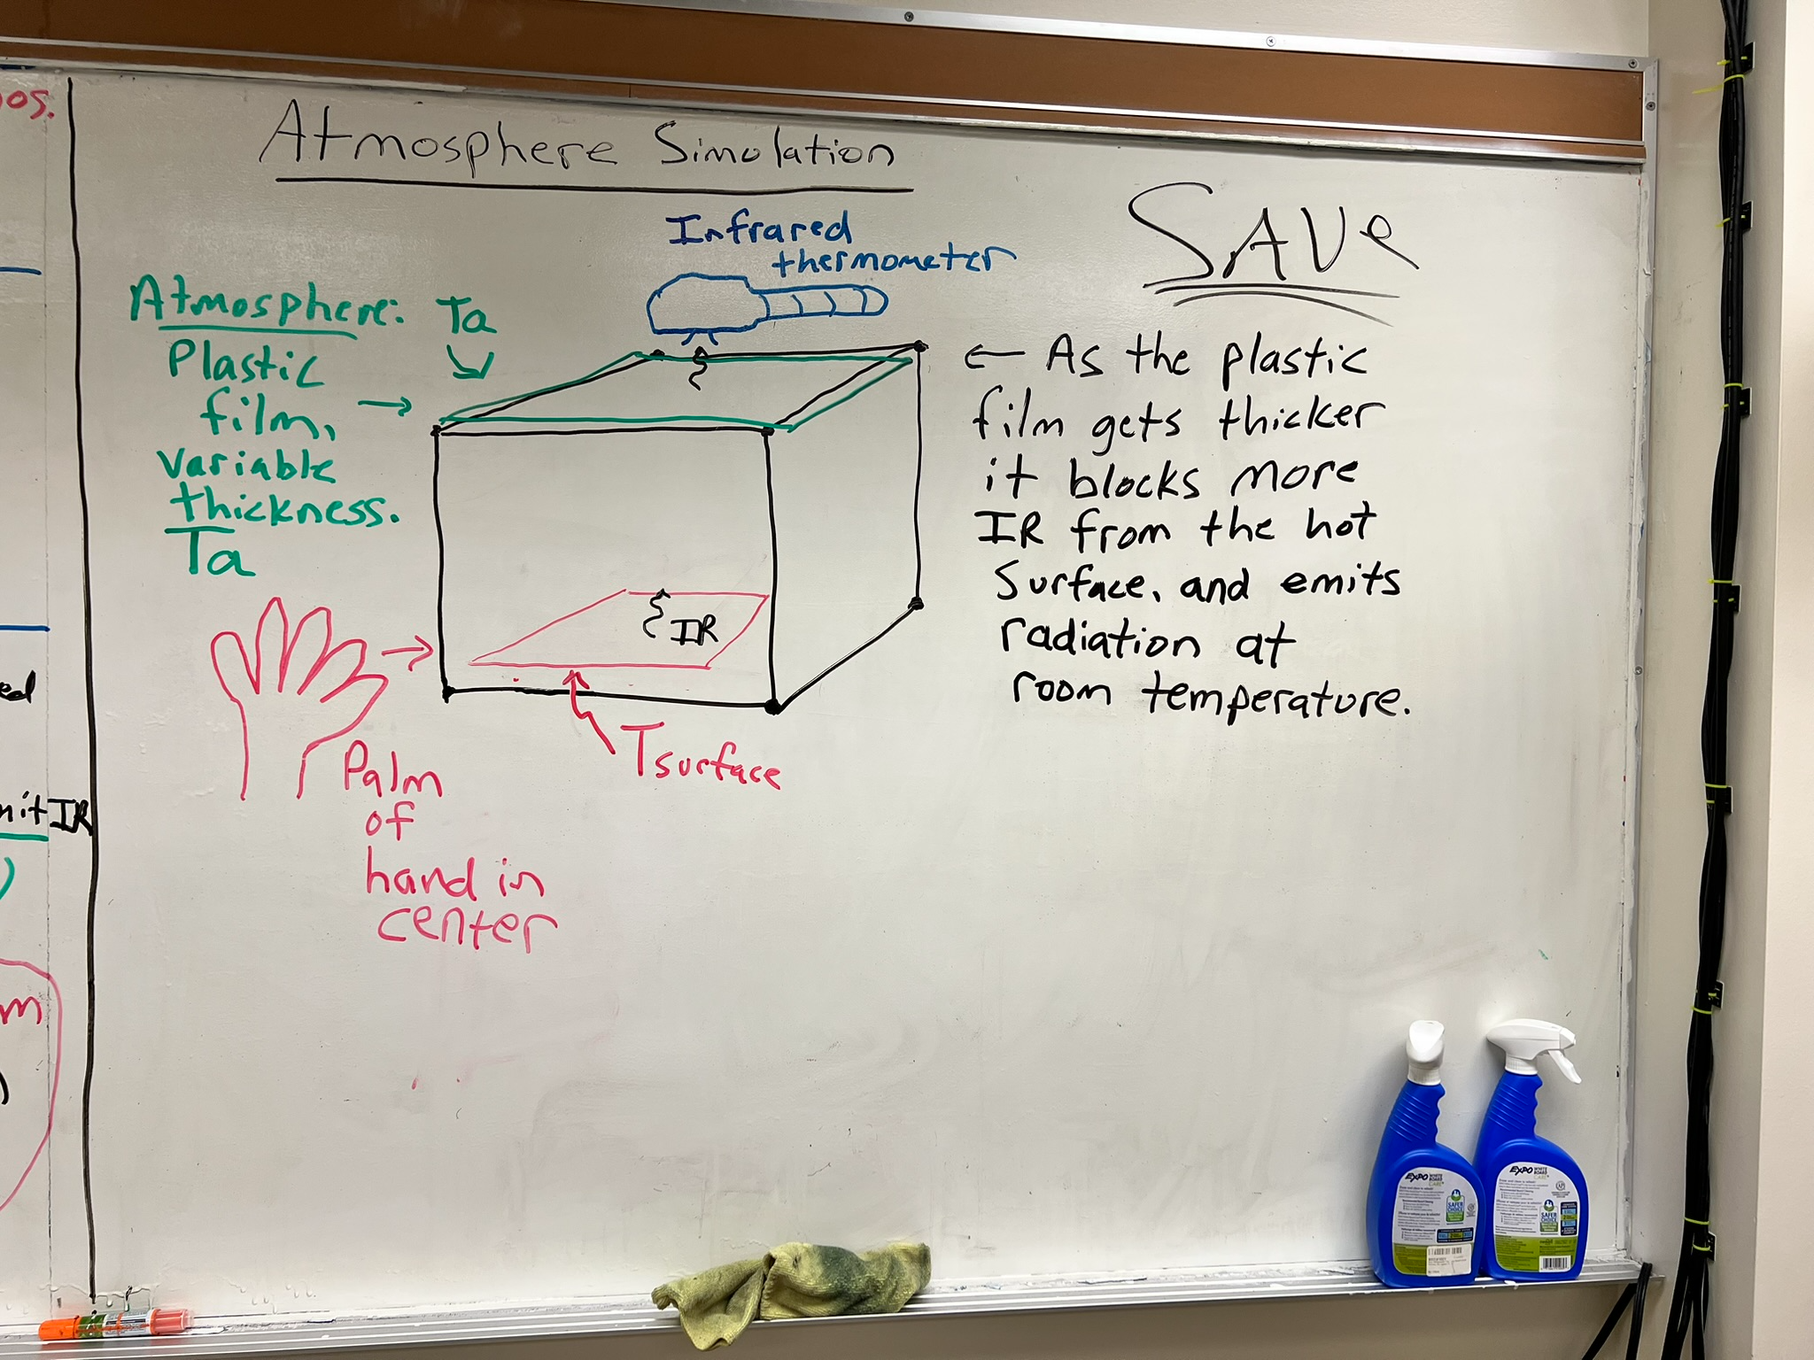
1 Layer Atmosphere Model Simulation

Slide 13
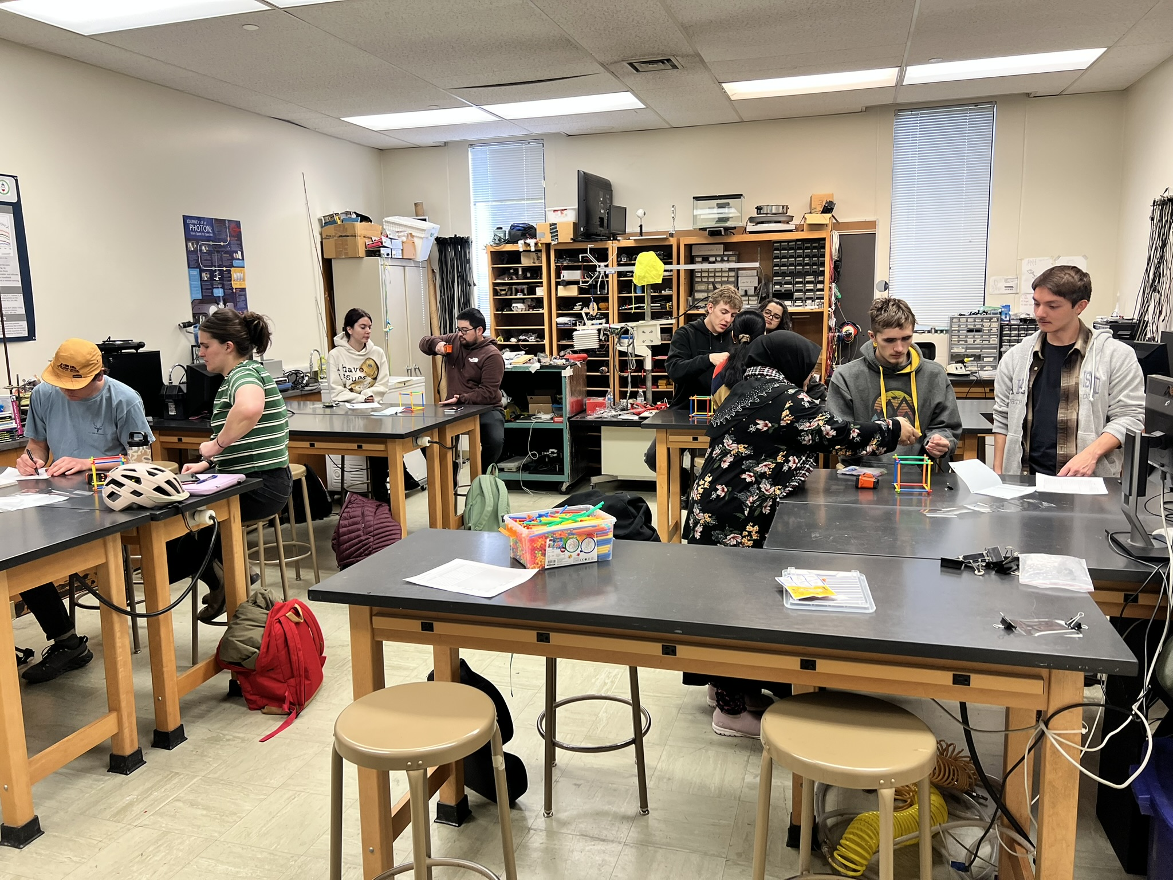
Lab Exercise

Slide 14
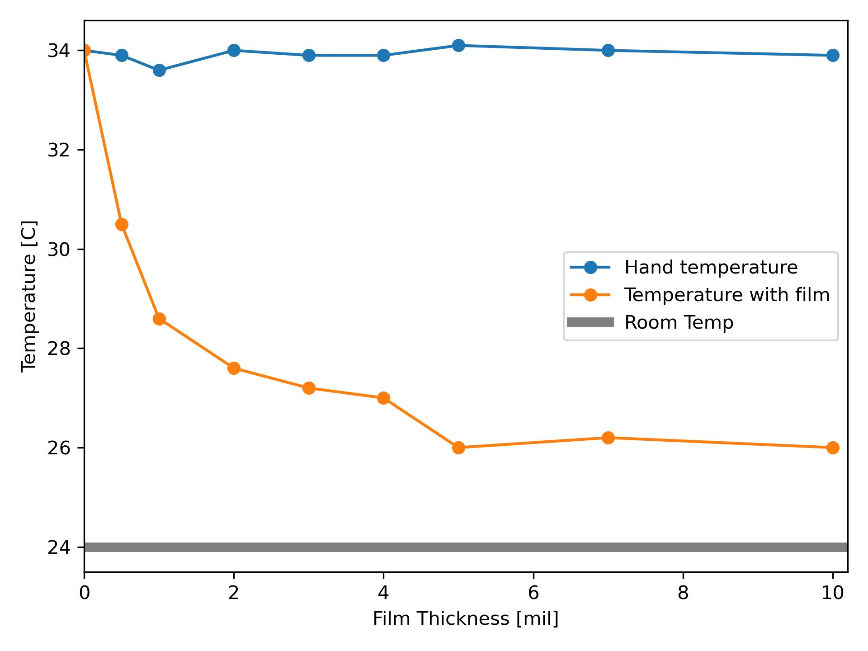
Results

Slide 15
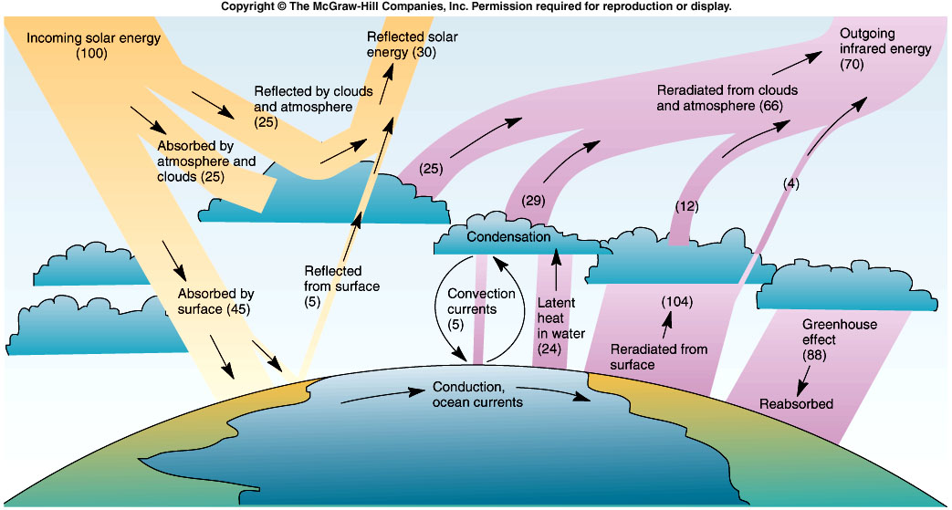
Global Energy Balance
Incoming = 45 +88 = 133
Outgoing = 104 + 24 + 5 = 133
From Cunningham & Cunningham, 2004, Fig. 9.2
Notes:
15

Slide 16
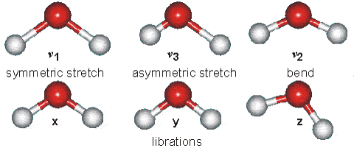
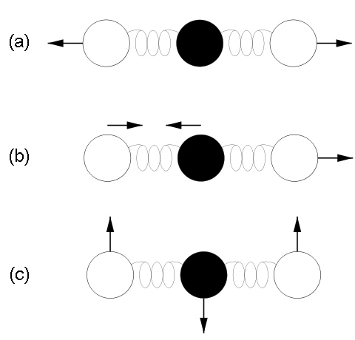



Some Energy States of Water Molecules
Atmospheric molecules lead very active ‘lives’ due to thermal and electromagnetic energy exchange, especially in the IR.
http://www.lsbu.ac.uk/water/vibrat.html
... of Carbon Dioxide Molecules
Vibration modes of carbon dioxide. Mode (a) is symmetric and results in no net displacement of the molecule's "center of charge", and is therefore not associated with the absorption of IR radiation. Modes (b) and (c) do displace the "center of charge", creating a "dipole moment", and therefore are modes that result from EM radiation absorption, and are thus responsible for making CO2 a greenhouse gas.
“15 um motion”

Slide 17
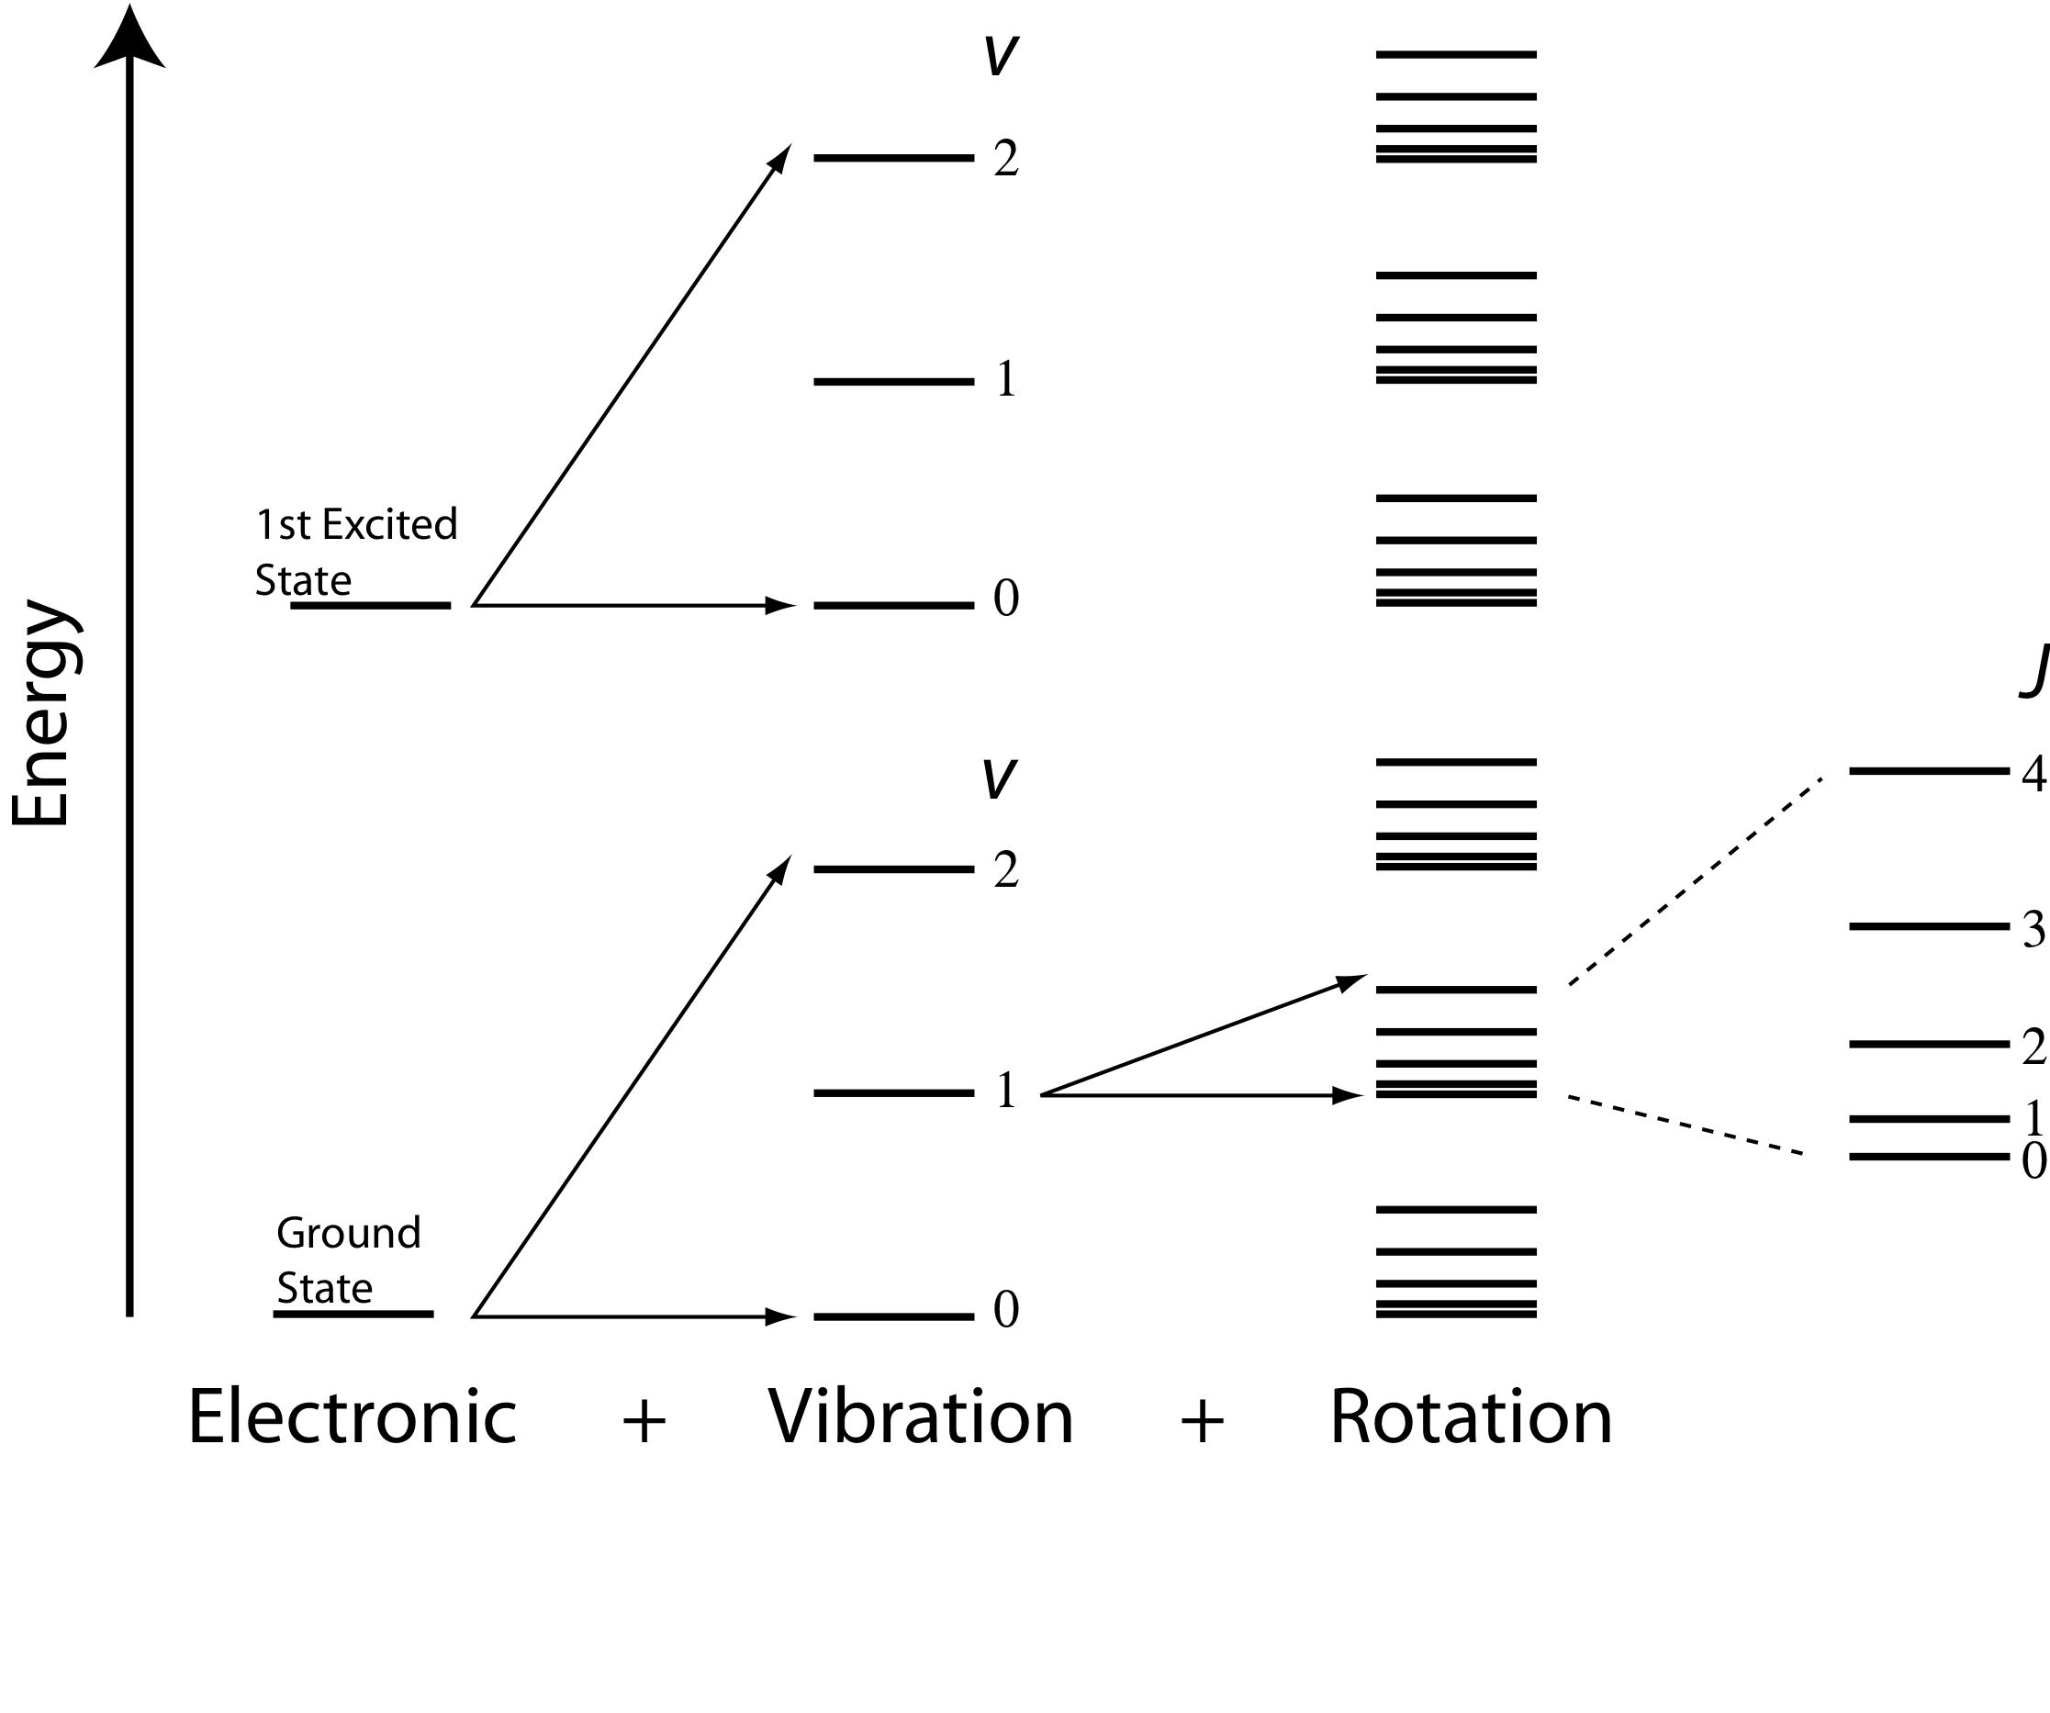
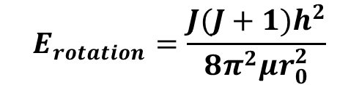
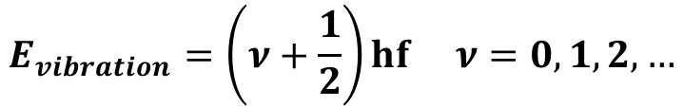
Energy Transitions in Molecules
$$E_{rotation}=\frac{J(J+1)h^{2}}{8π^{2}μr_{0}^{2}}$$
$$E_{vibration}=\left(ν+\frac{1}{2}\right)hf ν=0,1,2,…$$

Slide 18
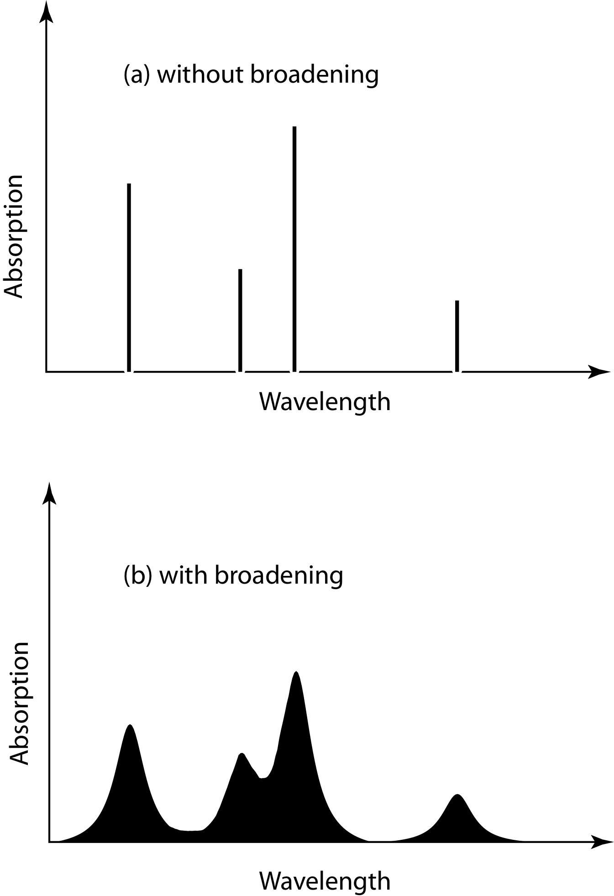
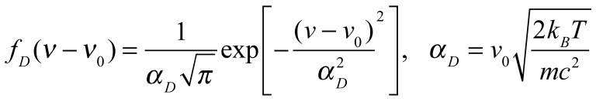
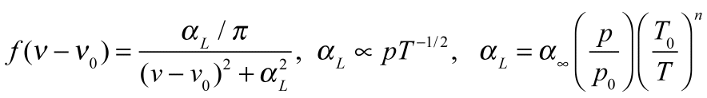
Line Broadening
Natural Broadening: Finite time, finite widths (Heisenberg is uncertain about widths, certain they are not infinitely narrow!)
Doppler Broadening:
Molecules with relative motions due to thermal energy ‘see’ doppler shifts of the light. Important in the mesosphere.
Pressure Broadening: Lorentz line shape
Molecular collisions distort energy levels for absorption and emission. Emperically determined (by measurement). Very important for the troposphere and lower stratosphere.
frequency
frequency

Slide 19
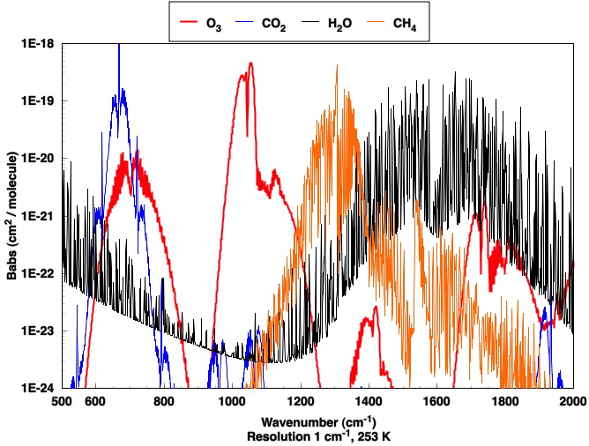
Absorption Per Molecule by Infrared Active Gases (Greenhouse Gases)
15 um
Window region
20 um
12.5 um
7.7 um
5 um

