Slide 1

Brief introduction of aerosol-cloud interactions
Cheng-Hsiang Chang, Ph.D. Candidate

Slide 2


About me
Background
B.S. Physics, National Chung Hsing University
MSc. Applied Physics, National Taiwan University
[M.S. Thesis: The Mass Spectrum of Hadrons with Strange and Charm in Lattice QCD with Domain-Wall Quarks.]
Ph.D. Candidate, Atmospheric Sciences, University of Nevada, Reno
Cheng-Hsiang Chang

Slide 3
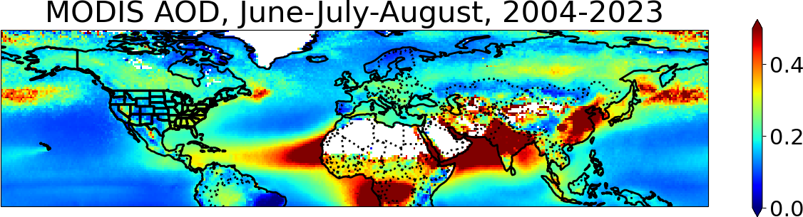
About me
Japan
Taiwan
Motivation: East Asia is one of the most polluted areas. I am interested in how these pollutants impact weather systems.

Slide 4
About me
Japan
Taiwan
Motivation: East Asia is one of the most polluted areas. I am interested in how these pollutants impact weather systems.
What brings you here?

Slide 5
About me
Japan
Taiwan
Motivation: East Asia is one of the most polluted areas. I am interested in how these pollutants impact weather systems.
What brings you here?
…To get a fresh breath.

Slide 6

https://www.ipcc.ch/assessment-report/ar6/
IPCC: Intergovernmental Panel on Climate Change
IPCC Sixth Assessment Report (IPCC AR6)
Assess the available scientific information on climate change.
“provide policymakers with regular assessments of the scientific basis of climate change, its impacts and future risks, and options for adaptation and mitigation.”
Notes:
For me, the IPCC report summarizes the state-of-the-art science study and the challenges we are facing now. It is like a bible in climate study.

Slide 7
Outline
What are aerosols? Where do they come from?
How do aerosols impact the atmosphere?
  Aerosol-radiation interactions
  Aerosol-cloud interactions
My ongoing project
  Data and method
  Preliminary results
Take-home points
Pickett fire in SF 2025.
(San Francisco chronicle)

Slide 8
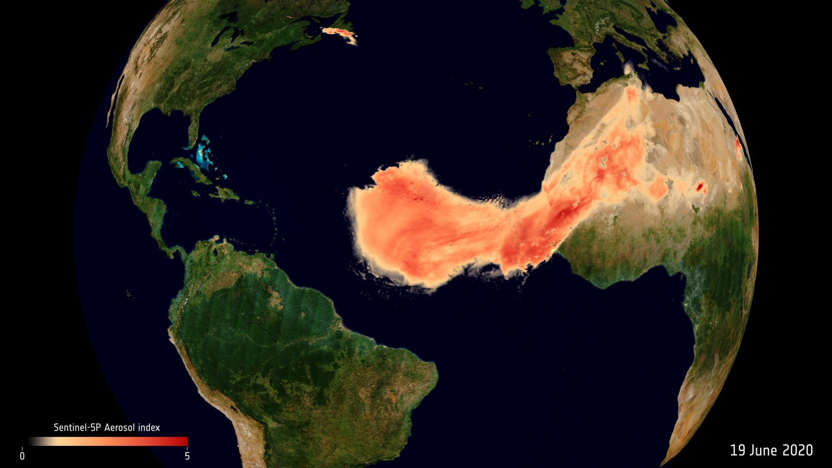
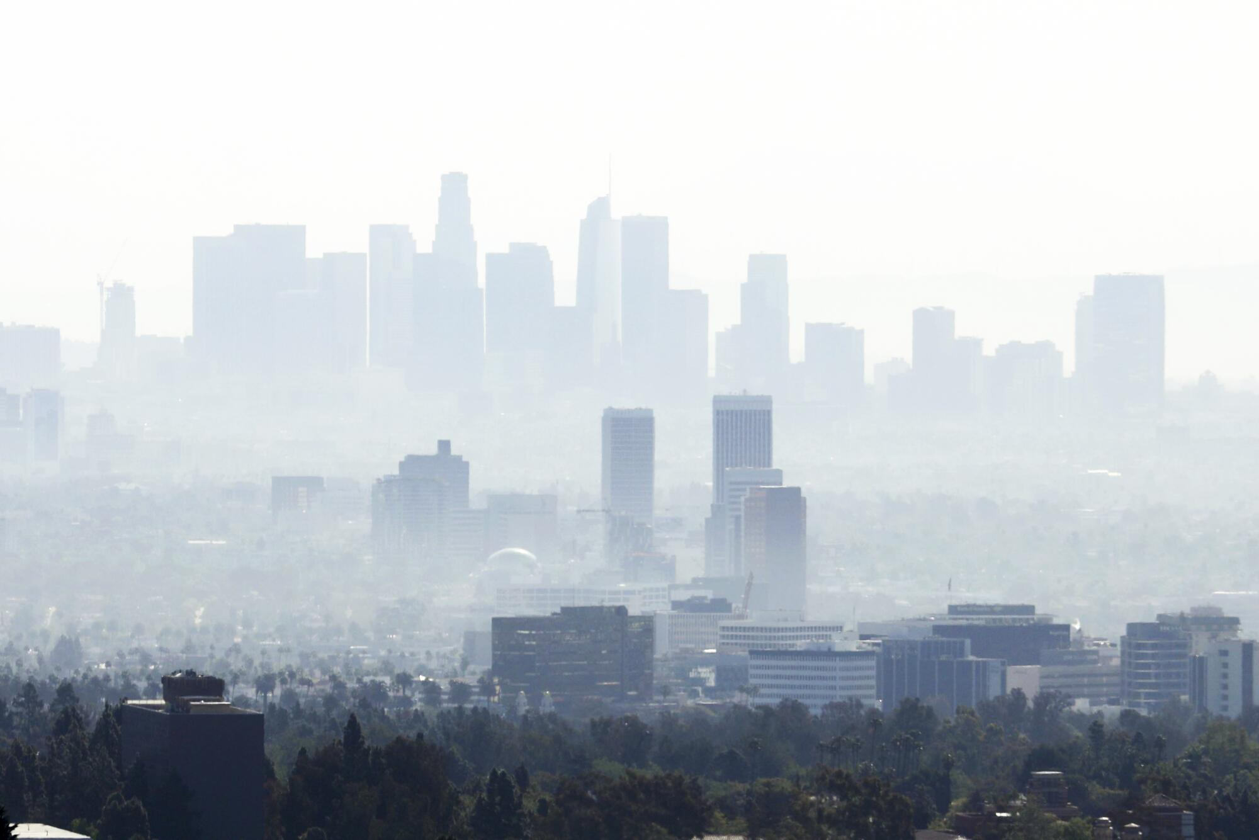
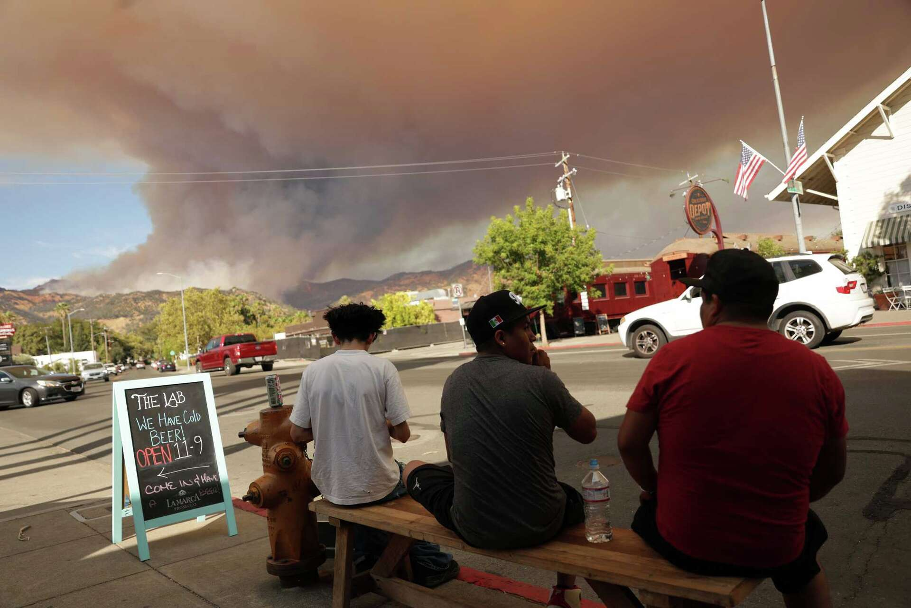
What are aerosols?
Where do they come from?
Aerosols are tiny particles floating in the air with a lifetime of around 2 to 15 days.
Contains modified Copernicus Sentinel data (2020), processed by ESA
The LA downtown skyline in 2021
(Genaro Molina / Los Angeles Times)
Pickett fire in SF 2025.
(San Francisco chronicle)

Slide 9
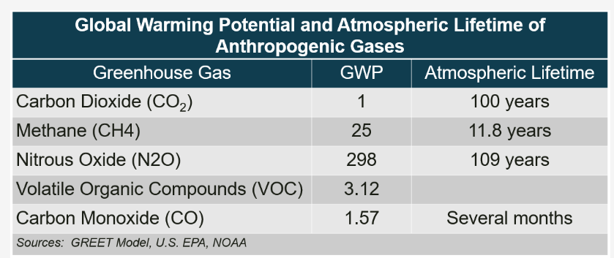
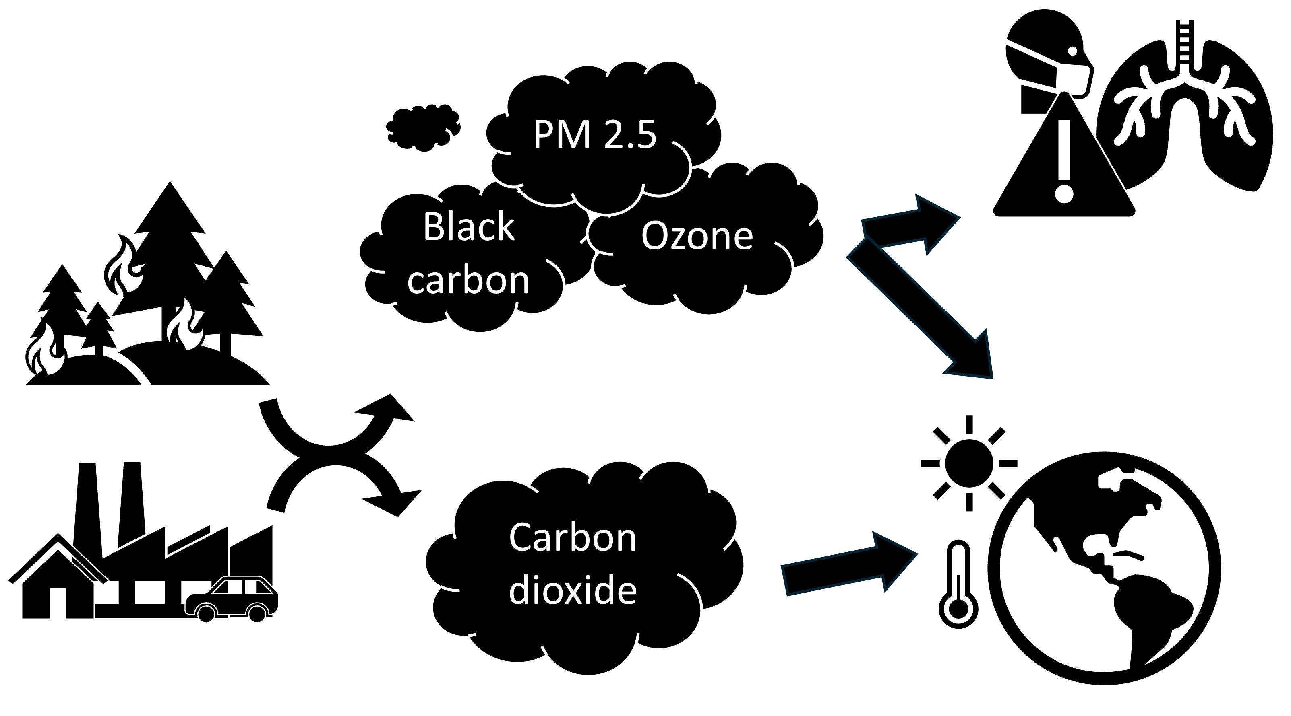
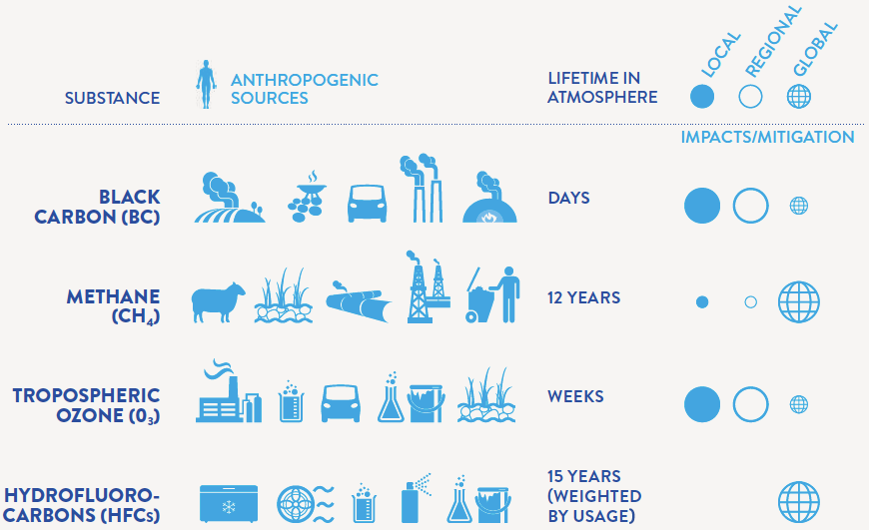
Source
Pollution
Effect
particles
particles
gas
gas
Two main human drivers of climate change:
Greenhouse gases: cause warming effect
Air pollution (aerosols): offset some warming
Figure source: https://www.c2es.org/content/short-lived-climate-pollutants/

Slide 10
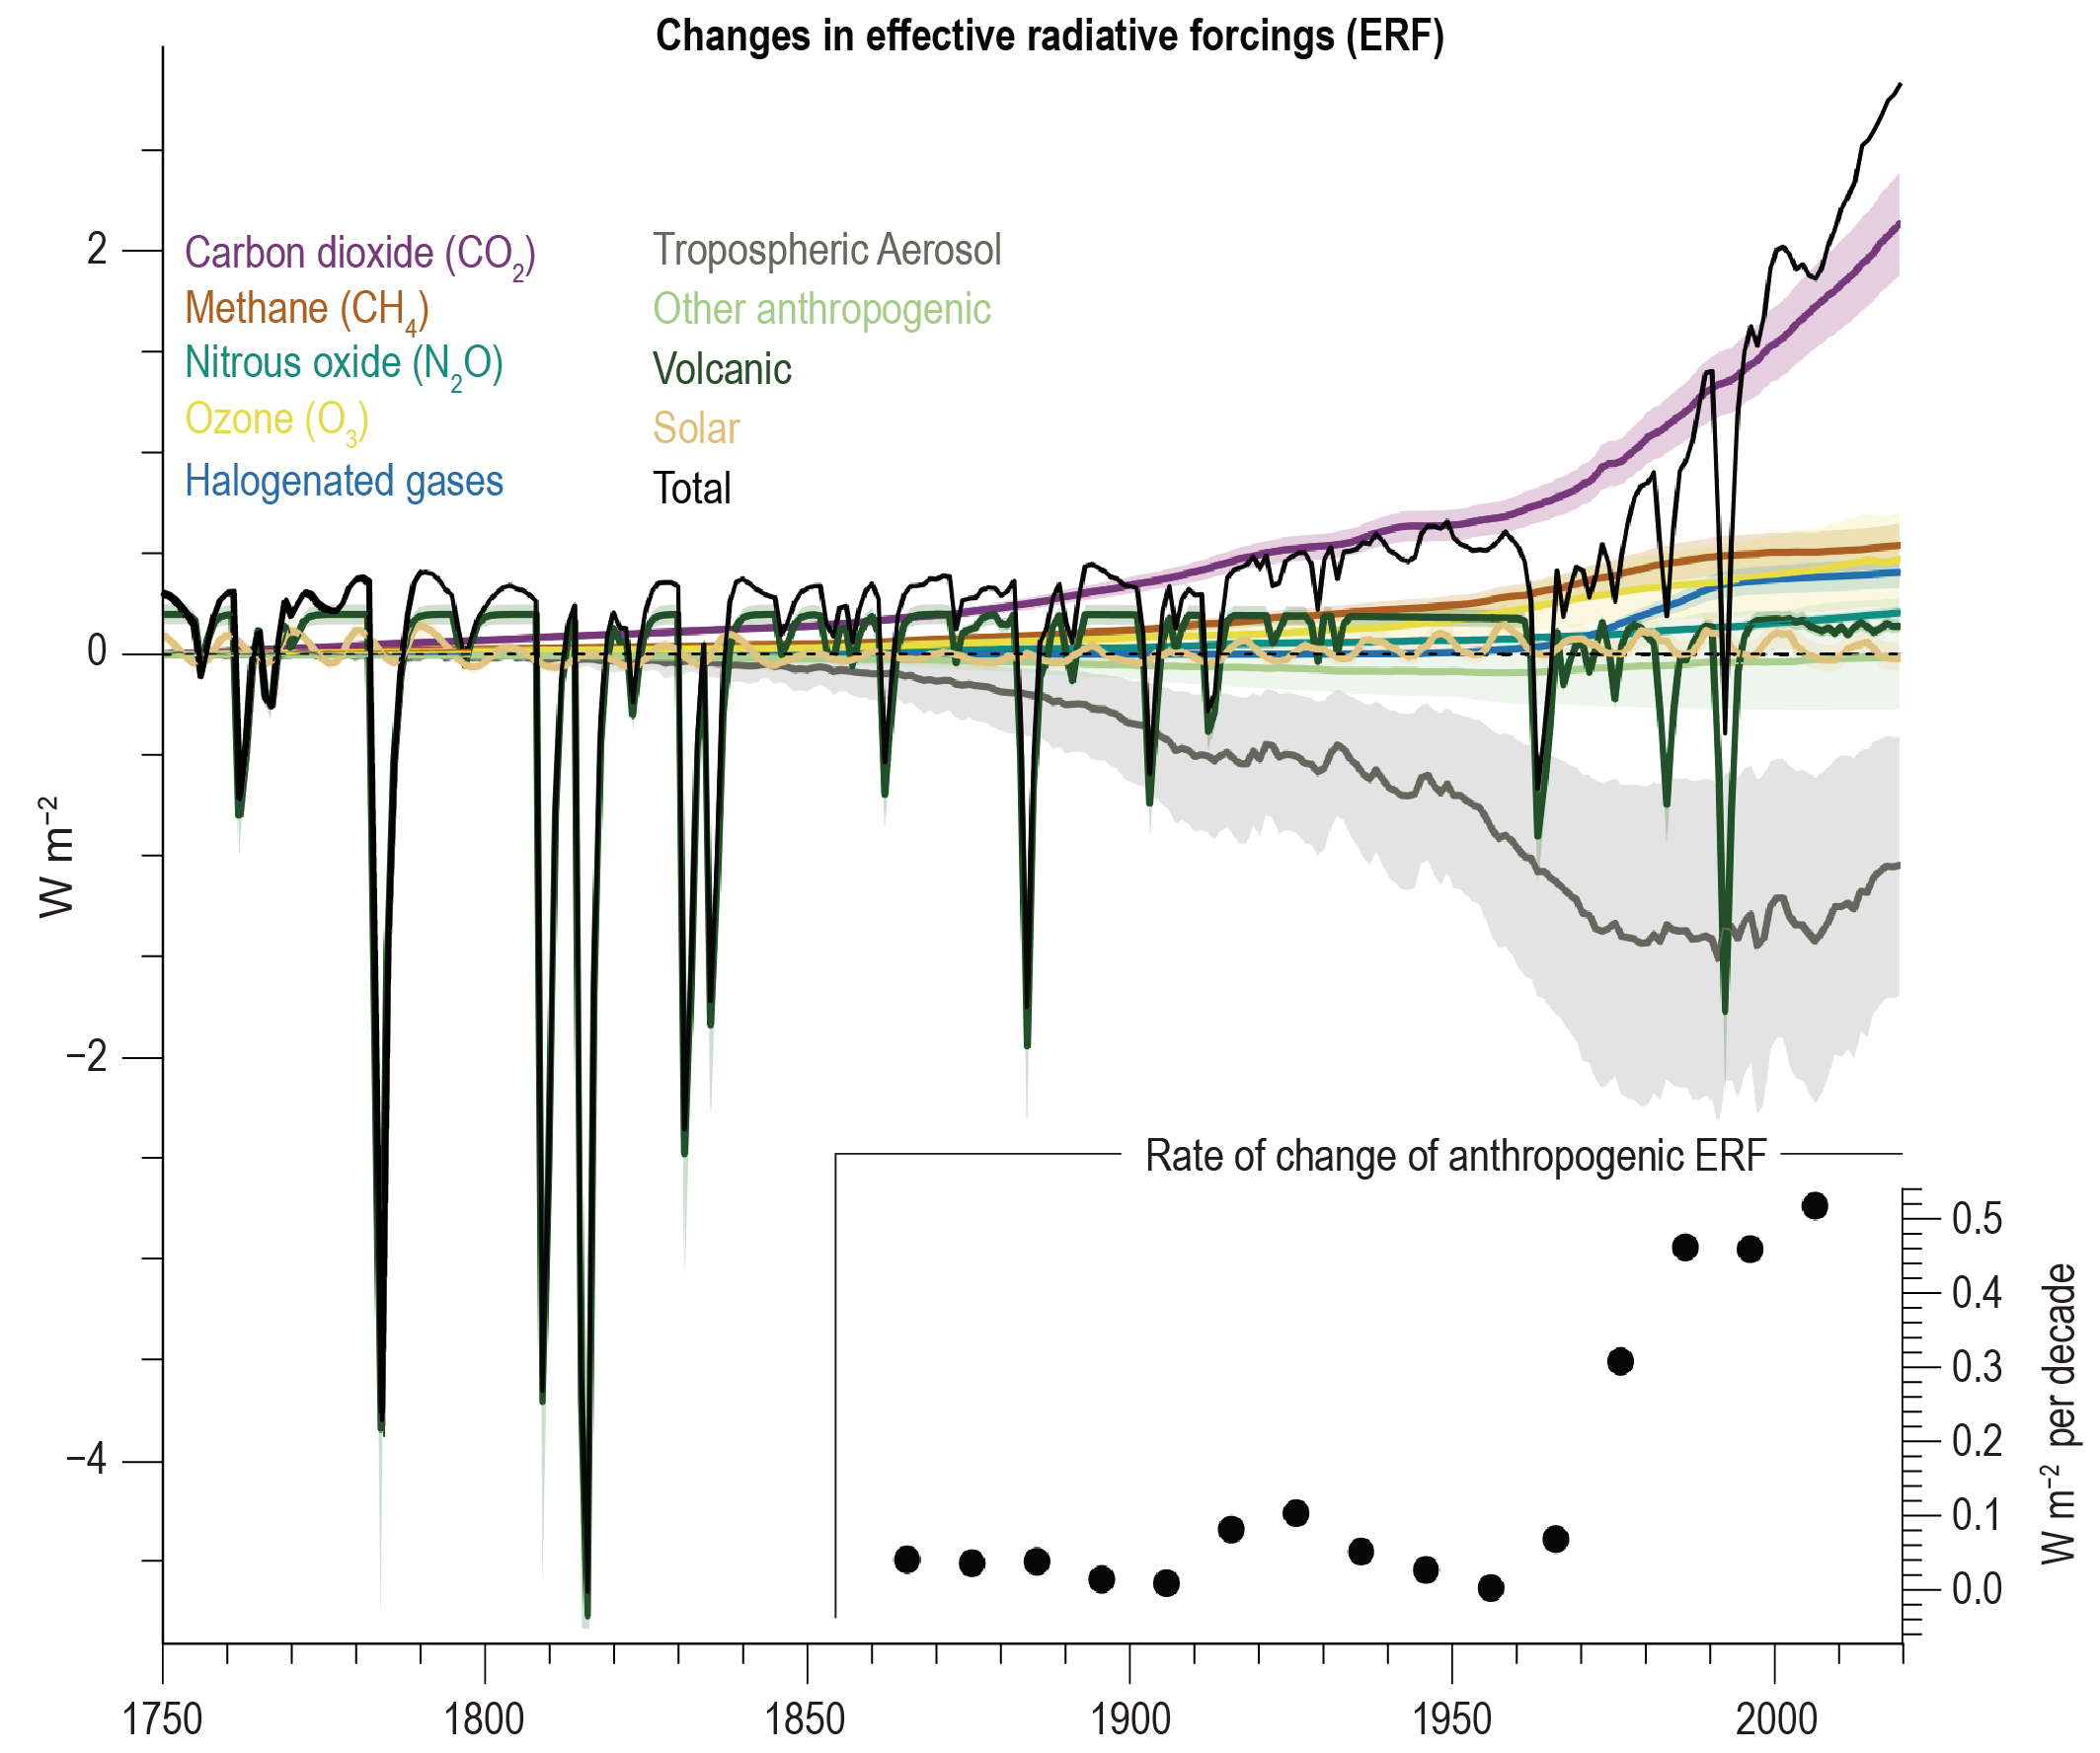
Climate Penalty of Air Quality Improvements
Effective radiative forcing (ERF):
the change in the net downward radiative flux at the TOA after the system has adjusted to the perturbation but excluding the radiative response to changes in surface temperature.
IPCC AR6:
(Global mean AOD &
Pollution emissions)
→ (aerosol cooling)
Notes:
https://www.ipcc.ch/report/ar6/wg1/figures/chapter-2/figure-2-10/

Slide 11
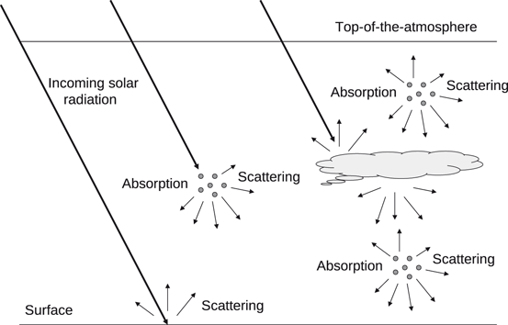
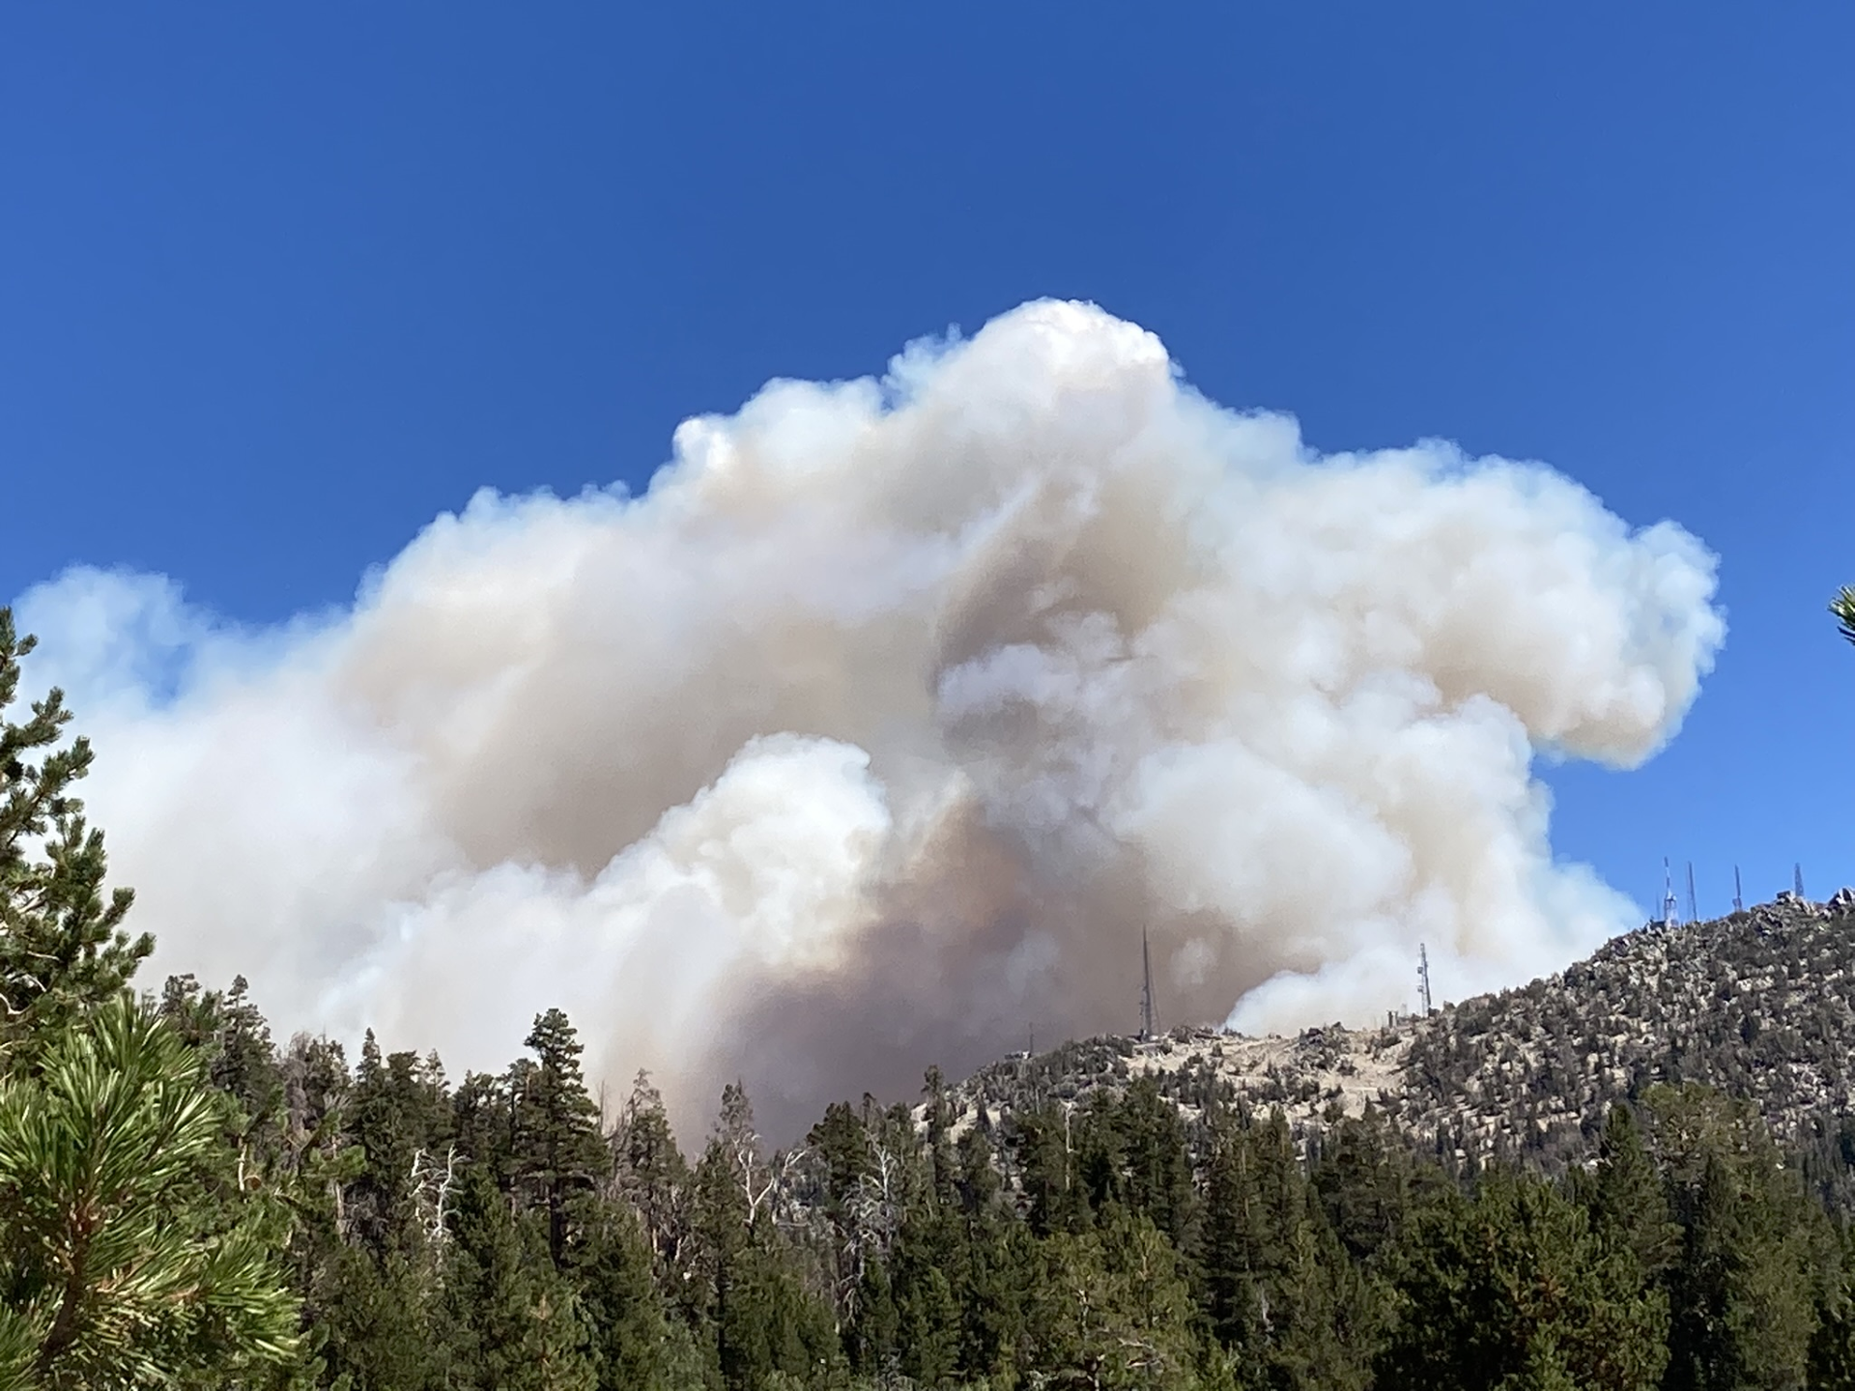
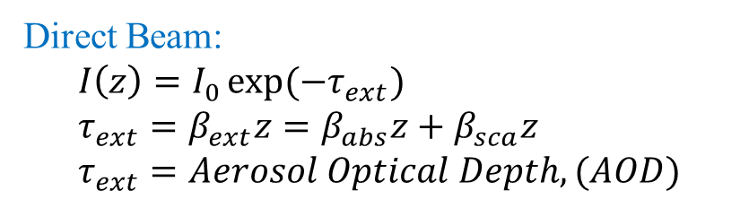
How do aerosols impact the atmosphere?
-- Aerosol-radiation interactions
Credit: Dr. Arnott’s PowerPoint
I₀
z
I(z)
Direct Beam:
$$I\left(z\right)=I_{0}\exp{(−τ_{ext})} \\ τ_{ext}=β_{ext}z=β_{abs}z+β_{sca}z \\ τ_{ext}=Aerosol Optical Depth, (AOD)$$
Boucher, O. (2015). Aerosol–Radiation Interactions. In: Atmospheric Aerosols. Springer, Dordrecht. https://doi.org/10.1007/978-94-017-9649-1_8
(Beer’s law)
* AOD is unitless.

Slide 12
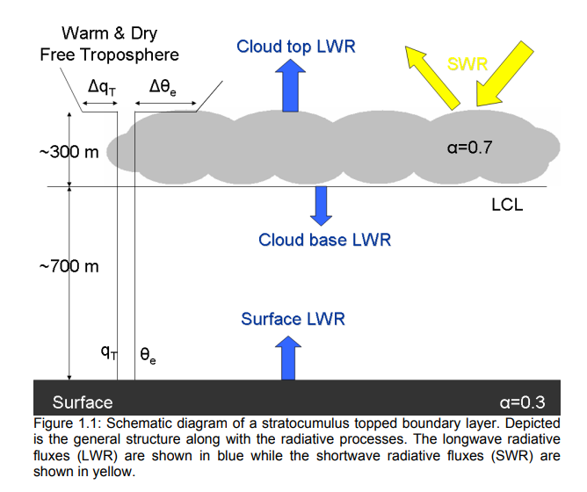
Supplementary
Ghate, V. P. (2009). Turbulence and mass-transports in stratocumulus clouds (Doctoral dissertation, University of Miami).

Slide 13
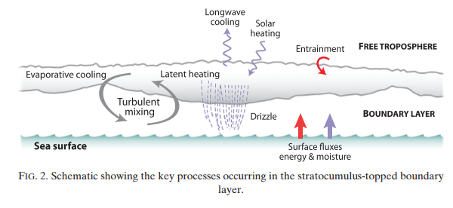

How do aerosols impact the atmosphere?
-- Aerosol-radiation interactions
Stratocumulus clouds:
Cover nearly 25% of the ocean surface
Provide the cooling effect by reflecting solar radiation
LW cooling
Turbulent mixing
Wood, R. (2012). Stratocumulus clouds. Monthly weather review, 140(8), 2373-2423.

Slide 14
How do aerosols impact the atmosphere?
-- Aerosol-radiation interactions
Absorbing aerosols reside above the cloud layer…
LW cooling
Turbulent mixing
Boucher, O. (2015). Aerosol–Radiation Interactions. In: Atmospheric Aerosols. Springer, Dordrecht. https://doi.org/10.1007/978-94-017-9649-1_8

Slide 15
How do aerosols impact the atmosphere?
-- Aerosol-radiation interactions
Absorbing aerosols reside above the cloud layer…
Temperature ↑
LW cooling
Turbulent mixing
Boucher, O. (2015). Aerosol–Radiation Interactions. In: Atmospheric Aerosols. Springer, Dordrecht. https://doi.org/10.1007/978-94-017-9649-1_8

Slide 16
How do aerosols impact the atmosphere?
-- Aerosol-radiation interactions
Absorbing aerosols reside above the cloud layer…
Temperature ↑
LW cooling
Dry air entrainment ↓
Turbulent mixing
Boucher, O. (2015). Aerosol–Radiation Interactions. In: Atmospheric Aerosols. Springer, Dordrecht. https://doi.org/10.1007/978-94-017-9649-1_8

Slide 17
How do aerosols impact the atmosphere?
-- Aerosol-radiation interactions
Absorbing aerosols reside above the cloud layer…
Temperature ↑
LW cooling
Dry air entrainment ↓
Turbulent mixing
Boucher, O. (2015). Aerosol–Radiation Interactions. In: Atmospheric Aerosols. Springer, Dordrecht. https://doi.org/10.1007/978-94-017-9649-1_8
Enhancing cloud coverage!

Slide 18
How do aerosols impact the atmosphere?
-- Aerosol-radiation interactions
Absorbing aerosols reside in the cloud layer…
Boucher, O. (2015). Aerosol–Radiation Interactions. In: Atmospheric Aerosols. Springer, Dordrecht. https://doi.org/10.1007/978-94-017-9649-1_8

Slide 19
How do aerosols impact the atmosphere?
-- Aerosol-radiation interactions
Absorbing aerosols reside in the cloud layer…
Temperature ↑
RH ↓
Boucher, O. (2015). Aerosol–Radiation Interactions. In: Atmospheric Aerosols. Springer, Dordrecht. https://doi.org/10.1007/978-94-017-9649-1_8

Slide 20
How do aerosols impact the atmosphere?
-- Aerosol-radiation interactions
Absorbing aerosols reside in the cloud layer…
Temperature ↑
RH ↓
Cloud burning off
Boucher, O. (2015). Aerosol–Radiation Interactions. In: Atmospheric Aerosols. Springer, Dordrecht. https://doi.org/10.1007/978-94-017-9649-1_8

Slide 21

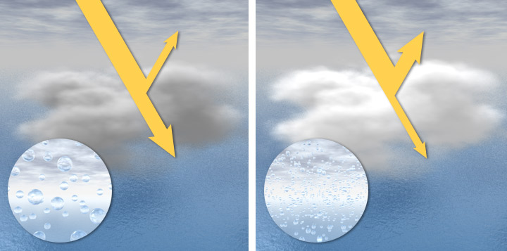
How do aerosols impact the atmosphere?
-- Aerosol-cloud interactions
Cloud albedo effect:
Aerosols serve as cloud condensation nuclei (CCN).
“Clouds in clean air are composed of a relatively small number of large droplets (left). Higher concentrations of aerosols can lead to a large number of small droplets (right). These clouds are typically more reflective (brighter). Original by Robert Simmon, NASA Earth Observatory.”
Notes:
https://earthobservatory.nasa.gov/features/Aerosols/page1.php

Slide 22
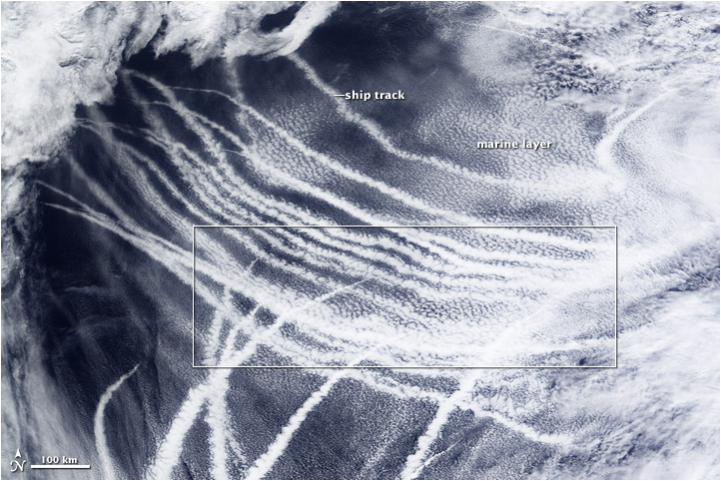


How do aerosols impact the atmosphere?
-- Aerosol-cloud interactions
Cloud albedo effect (example):
Cloud brightening
Notes:
https://earthobservatory.nasa.gov/features/Aerosols/page1.php (ship tracks)

Slide 23


How do aerosols impact the atmosphere?
-- Aerosol-cloud interactions
Cloud albedo effect
Cloud lifetime effect
Smaller cloud drop sizes
Enhanced cloud albedo
Longer cloud lifetime!!
suppress collision-coalescence
Notes:
https://earthobservatory.nasa.gov/features/Aerosols/page1.php (ship tracks)

Slide 24
Review of aerosol effects
Twomey
1974
Ackerman et al.,
2000
IPCC AR5
2013
IPCC AR6
2021
Albrecht
1989
IPCC AR4
2007
IPCC: The Intergovernmental Panel on Climate Change
1st indirect effect
2nd indirect effect
Semi-direct effect
Top of the atmosphere
Direct effects
Absorbing aerosols
Surface
Scattering & absorption of radiation
Unperturbed clouds
Cloud drop number concentration ↑
[Twomey effect]
[Cloud albedo effect]
Drizzle ↓
Cloud lifetime ↑
[Cloud lifetime effect]
Heating
Cloud burn-off
Figure adapted from IPCC AR4, 2007
Twomey 1974
Albrecht 1989
Ackerman et al., 2000

Slide 25
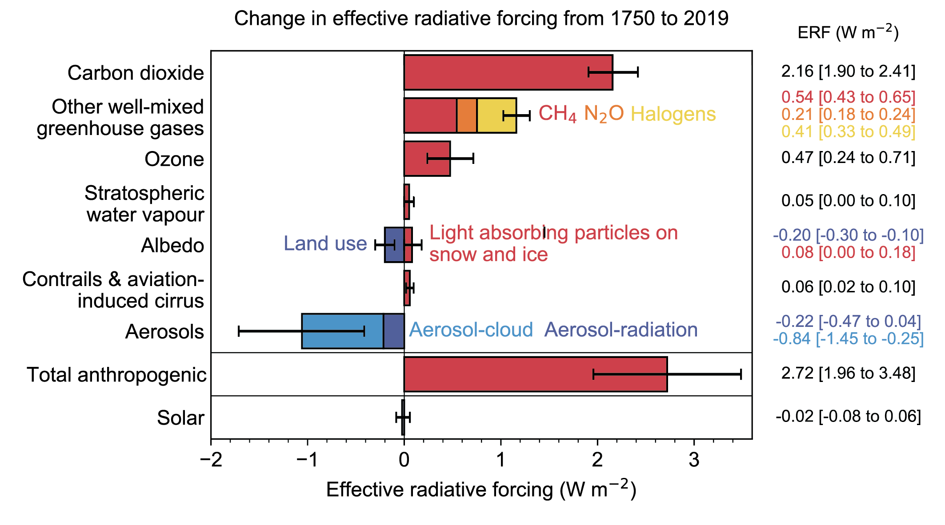
How do aerosols impact the atmosphere?
-- Aerosol-cloud interactions
IPCC AR6, 2021

Slide 26










Ongoing project: applying remote sensing to study aerosol-cloud interactions
Science questions:
How do aerosols distribute during Summer in North America? What are the aerosol species?
How do cloud properties vary with aerosol loading?

Slide 27
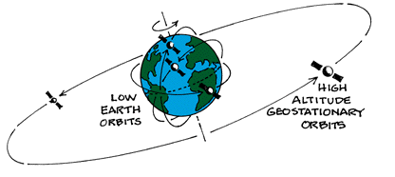
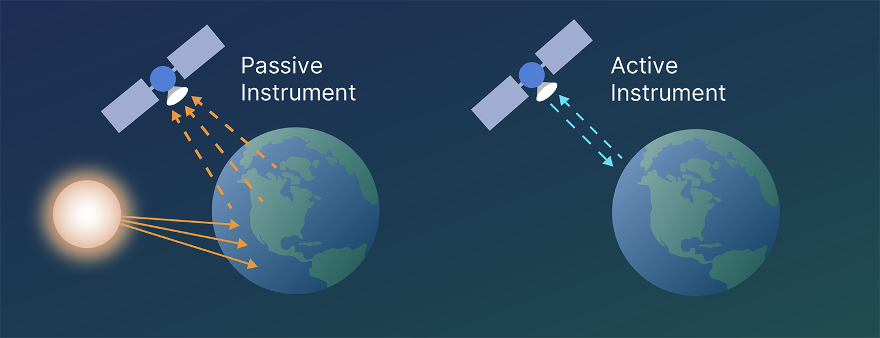
Data & methods
Objective: inspect aerosol behaviors during Summer in North America
… Using satellite observations is a good choice for my study
https://paos.colorado.edu/~fasullo/1060/resources/satellites.html
Geostationary orbits (GEO) & polar orbits
GEO: looking at the same location.
Polar: crossing the poles several times each day
Passive & Active remote sensing
Passive: using the reflected solar radiation.
Activate: emitting radiation and detecting the information
https://www.earthdata.nasa.gov/learn/earth-observation-data-basics/remote-sensing

Slide 28
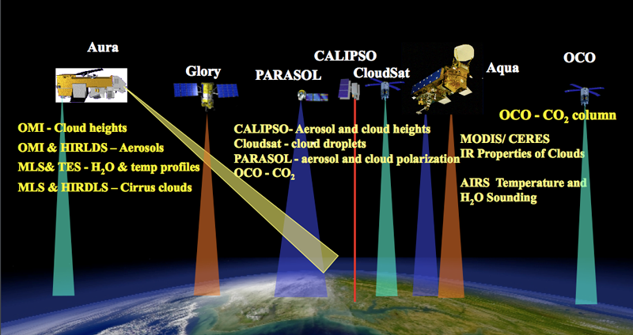

Data & methods
Moderate Resolution Imaging Spectroradiometer (MODIS) Aqua
Passive remote sensing
2-time passing per day
(1: 30 AM & 1:30 PM local time)
Provide AOD retrieved at 550 nm.
Recall Beer’s law
$$I\left(z\right)=I_{0}\exp{(−τ_{ext})} \\ τ_{ext}=β_{ext}z=β_{abs}z+β_{sca}z \\ τ_{ext}=Aerosol Optical Depth, (AOD)$$
Notes:
https://atrain.nasa.gov/ScienceFormationFlying.php
diagnose

Slide 29
Data & methods
Objective: inspect aerosol behaviors during Summer in North America
… I am interested in the most common patterns (spatial distributions).
For example,
One observed variable has the dimensions of time and space, such as AOD [time, latitude, longitude].
How to extract these patterns?
Strategy: applying a statistical tool called empirical orthogonal functions (EOF)
It decomposes the observed variable based on the frequency of the patterns.
Therefore,
AOD[time, latitude, longitude] patterns [latitude, longitude] + temporal index [time]
Notes:
https://atrain.nasa.gov/ScienceFormationFlying.php
diagnose

Slide 30
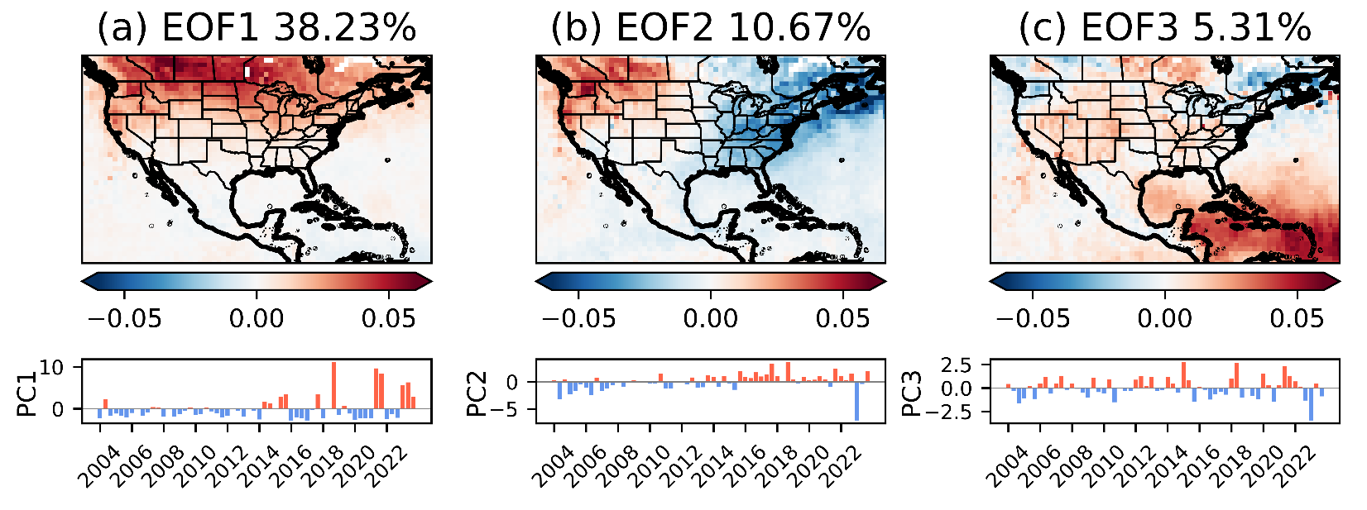
Preliminary results (EOF analysis)
Smoke events,
Trend in North America,
Dust transport
The first three EOF modes explained the bulk of the variance (>50%).
Notes:
Explained variance ratio: 38.23
Mode and PC should be interpreted together
PC would be referred as the time series
Got a lot of high peaks after 2015
Higher peaks mean that we can see the pattern more easily

Slide 31
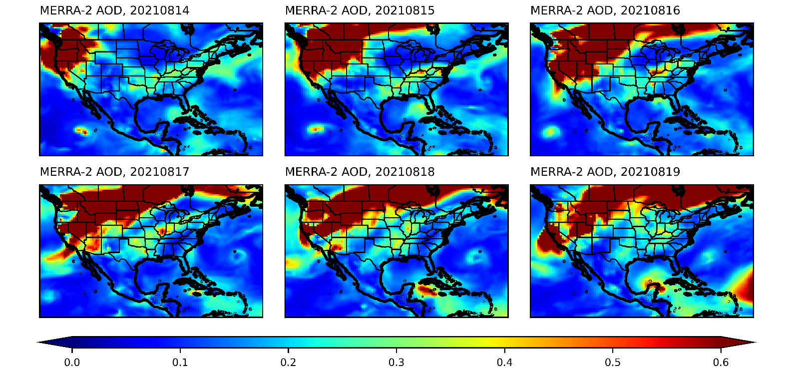
Future work
Detect the time when the aerosol is distributed similarly to the EOF patterns.
Inspect the cloud variability associated with these aerosol patterns.

Slide 32
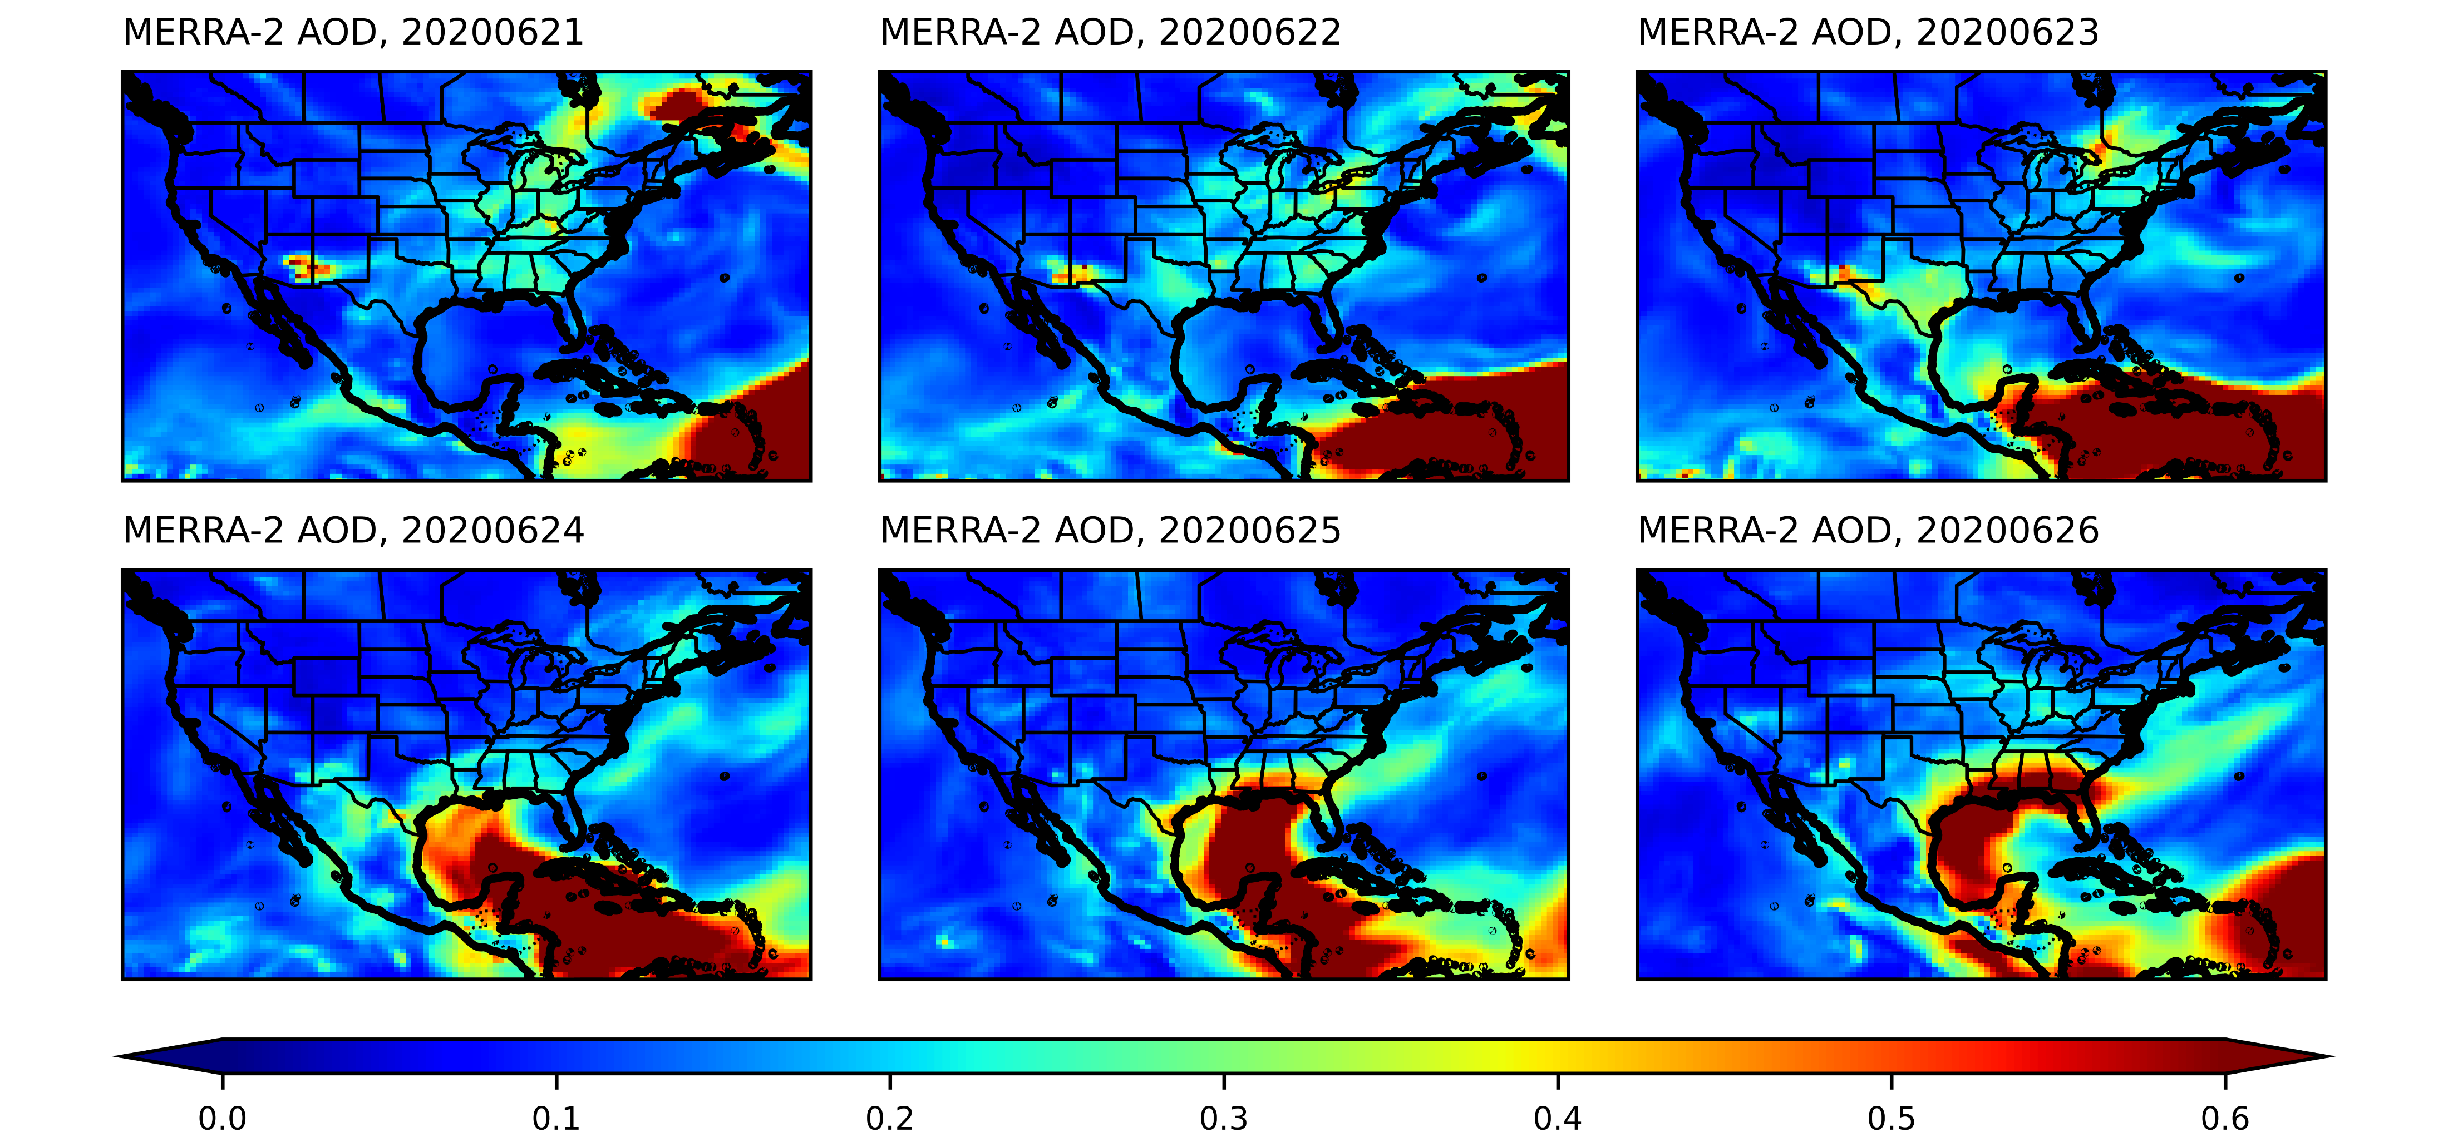
Future work
Detect the time when the aerosol is distributed similarly to the EOF patterns.
Inspect the cloud variability associated with these aerosol patterns.

Slide 33


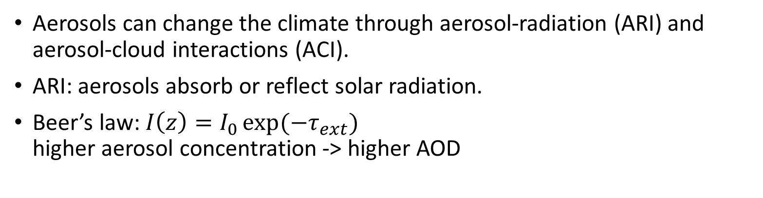
Take-home points
Aerosols can change the climate through aerosol-radiation (ARI) and aerosol-cloud interactions (ACI).
ARI: aerosols absorb or reflect solar radiation.
Beer’s law: $I\left(z\right)=I_{0}\exp{(−τ_{ext})}$
higher aerosol concentration -> higher AOD
ACI: aerosols serve as cloud condensation nuclei.
ACI is the most uncertain element for global climate models to estimate effective radiative forcing.

Slide 34
Take-home points
Aerosols can change the climate through aerosol-radiation (ARI) and aerosol-cloud interactions (ACI).
ARI: aerosols absorb or reflect solar radiation.
Beer’s law: $I\left(z\right)=I_{0}\exp{(−τ_{ext})}$
higher aerosol concentration -> higher AOD
Any Questions?
ACI: aerosols serve as cloud condensation nuclei.
ACI is the most uncertain element for global climate models to estimate effective radiative forcing.

Slide 35
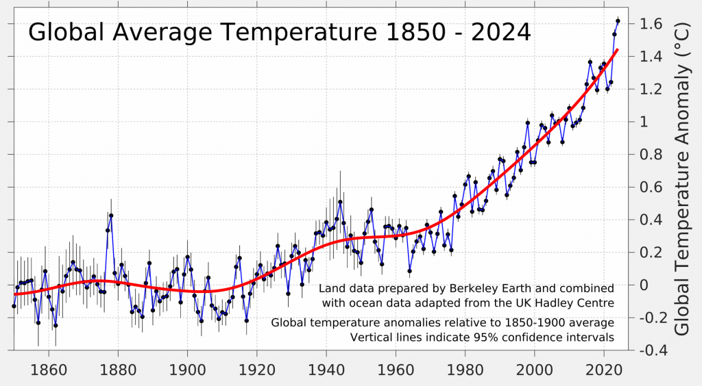
Supplementary
Notes:
In case someone doesn't believe in climate change or global warming.

Slide 36

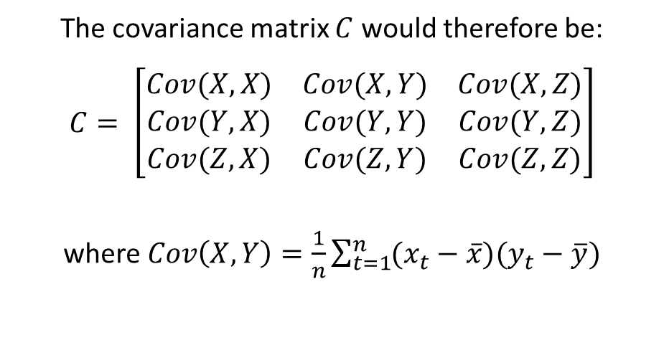
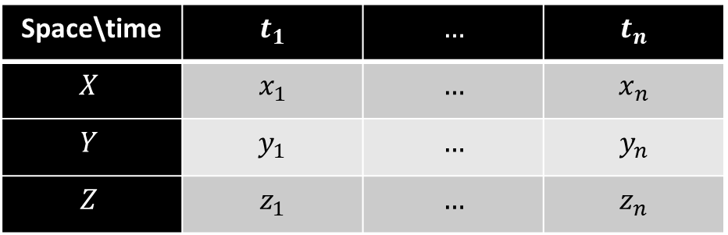
Empirical Orthogonal Function (EOF) analysis
Solve the eigen problem of a covariance matrix (𝐶).
The EOF modes (with spatial dimensions) are the eigen vectors.
The explained variance ratio is the eigenvalue divided by the sum of all eigenvalues.
The principal component (PC) is the time series that uses the original data projected onto the EOF modes.
Consider a dataset with $3$ spatial and $n$ temporal dimensions as an example:
Space\time | $$t_{1}$$ | $$…$$ | $$t_{n}$$
$$X$$ | $$x_{1}$$ | $$…$$ | $$x_{n}$$
$$Y$$ | $$y_{1}$$ | $$…$$ | $$y_{n}$$
$$Z$$ | $$z_{1}$$ | $$…$$ | $$z_{n}$$
The covariance matrix $C$ would therefore be:
$$C= \left[\begin{matrix}Cov(X,X) & Cov(X,Y) & Cov(X,Z) \\ Cov(Y,X) & Cov(Y,Y) & Cov(Y,Z) \\ Cov(Z,X) & Cov(Z,Y) & Cov(Z,Z)\end{matrix}\right]$$
where $Cov\left(X,Y\right)=\frac{1}{n}\sum_{t=1}^{n}{(x_{t}−\overline{x})(y_{t}−\overline{y})}$
Notes:
Example: https://www.geeksforgeeks.org/covariance-matrix/

Slide 37
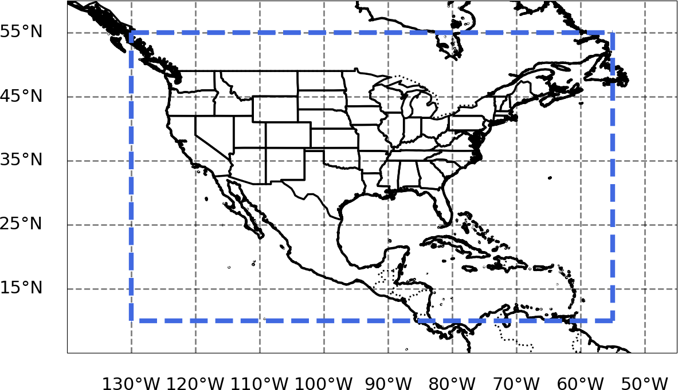
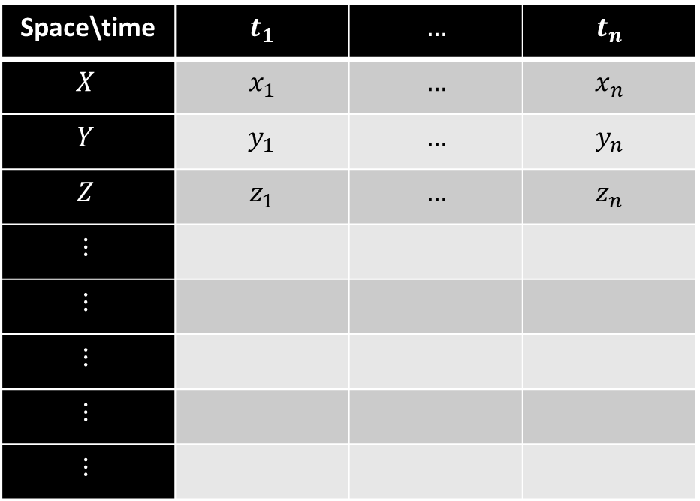

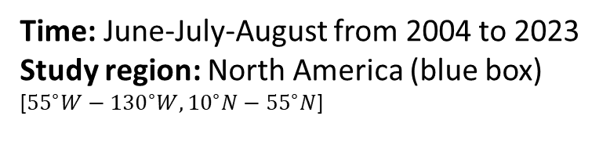
Empirical Orthogonal Function (EOF) analysis
Time: June-July-August from 2004 to 2023
Study region: North America (blue box)
[${55}^{∘}W−{130}^{∘}W, {10}^{∘}N−{55}^{∘}N$]
June 2004
$$⋯$$
August 2023
Study
region
Space\time | $$t_{1}$$ | $$…$$ | $$t_{n}$$
$$X$$ | $$x_{1}$$ | $$…$$ | $$x_{n}$$
$$Y$$ | $$y_{1}$$ | $$…$$ | $$y_{n}$$
$$Z$$ | $$z_{1}$$ | $$…$$ | $$z_{n}$$
$$⋮$$
$$⋮$$
$$⋮$$
$$⋮$$
$$⋮$$
Notes:
Example: https://www.geeksforgeeks.org/covariance-matrix/
-130

