Slide 1
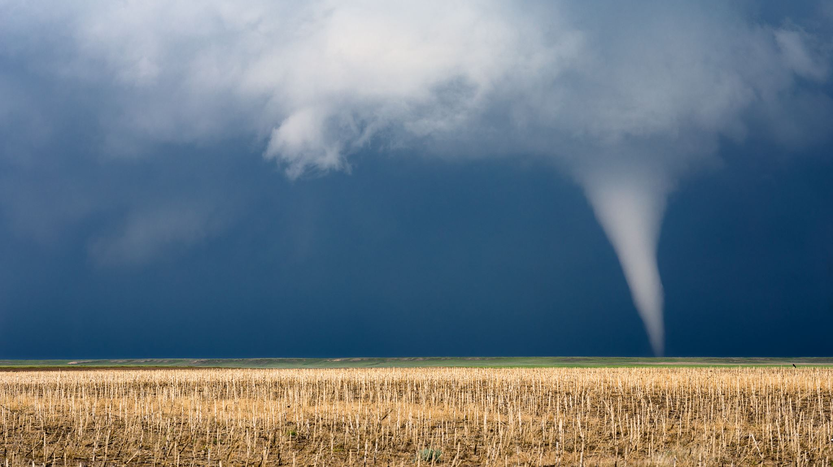
Tornado (EF5) that struck near Enderlin, North Dakota, USA.
Notes:
Describe what motivated you to choose your site.

Slide 2
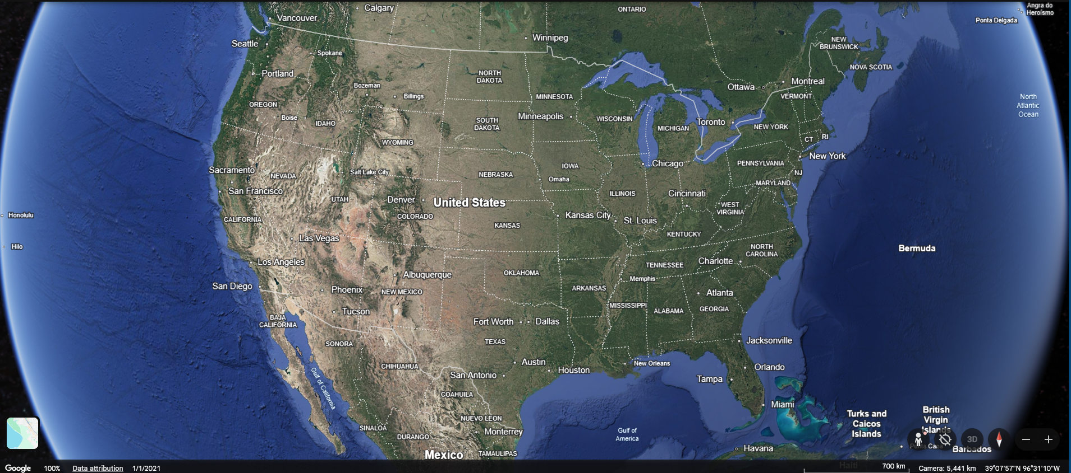
Tornado (EF5) that struck near Enderlin, North Dakota, USA.

Slide 3
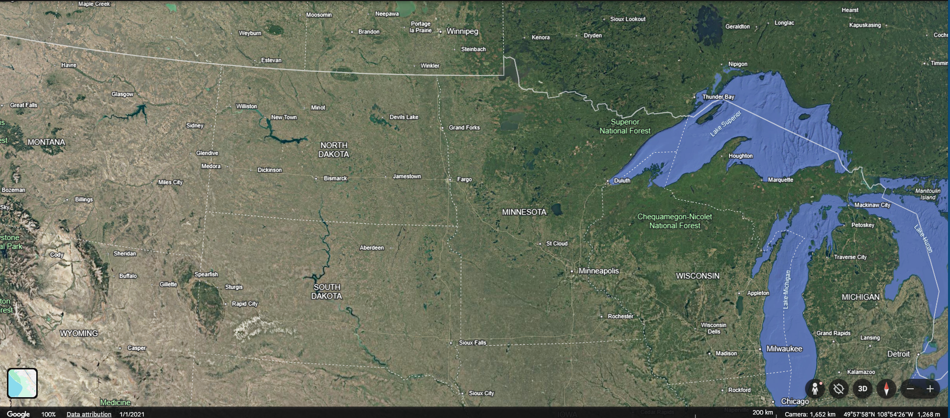
Tornado (EF5) that struck near Enderlin, North Dakota, USA.

Slide 4
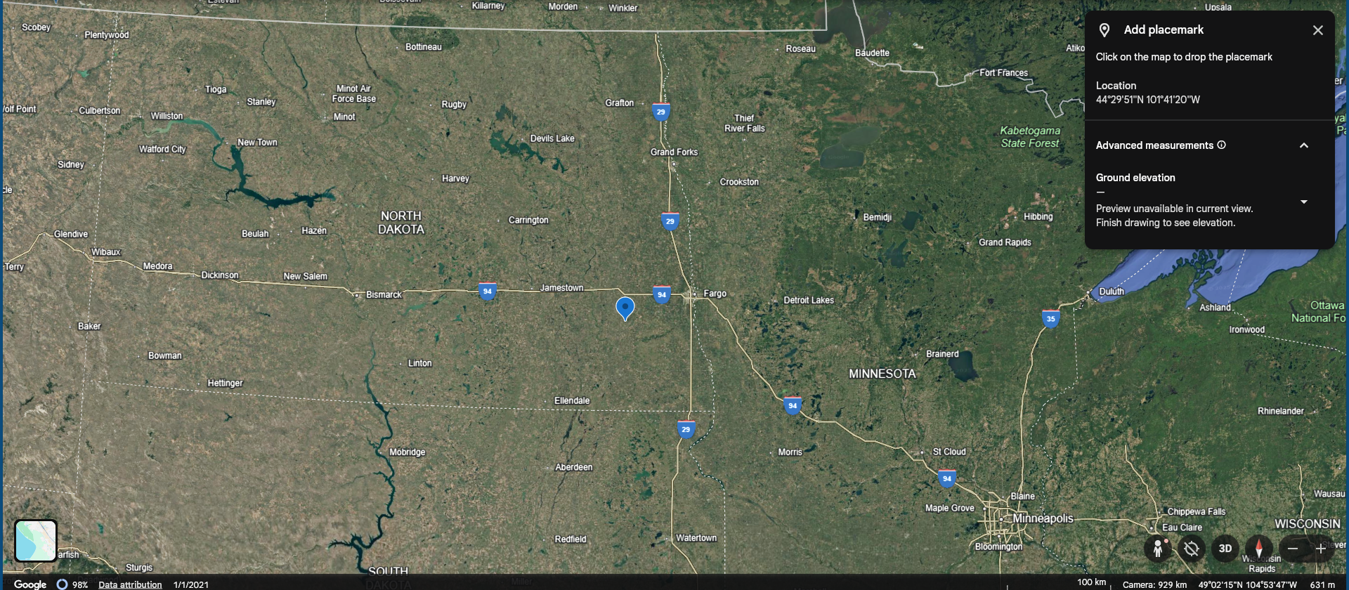
Tornado (EF5) that struck near Enderlin, North Dakota, USA.

Slide 5
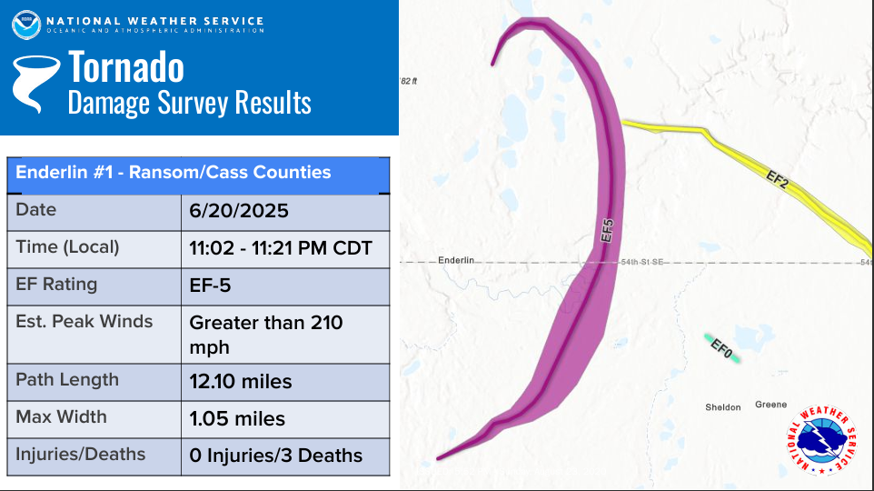
Tornado (EF5) that struck near Enderlin, North Dakota, USA., on June 20, 2025, between 11:02 and 11:21 PM CDT.
Notes:
PNS Top News Link PDF

Slide 6
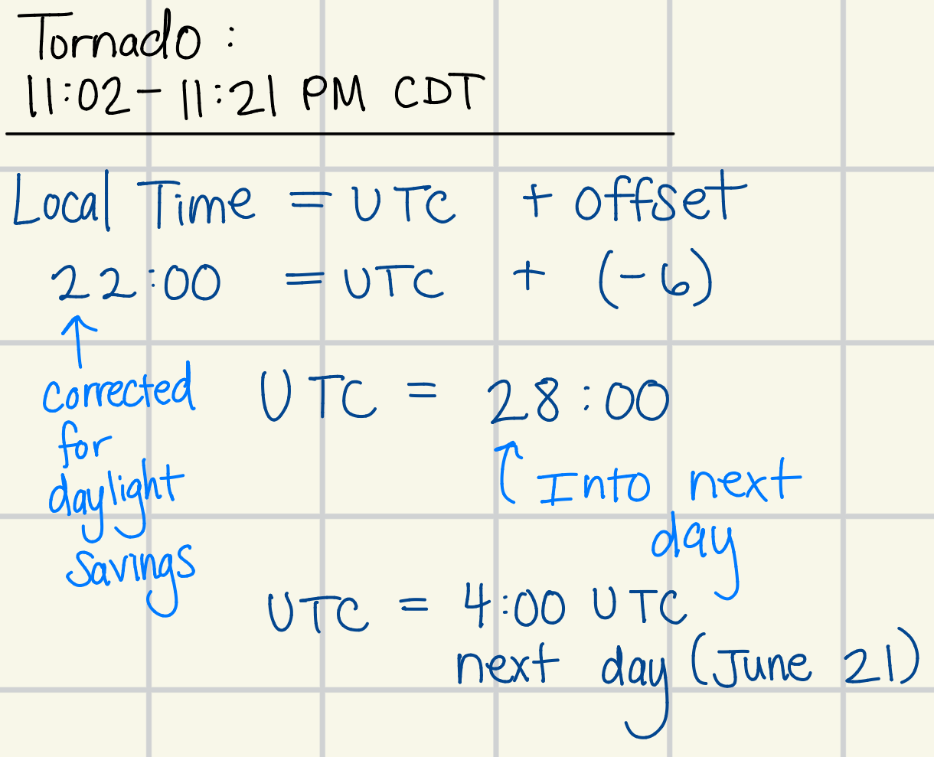

Slide 7
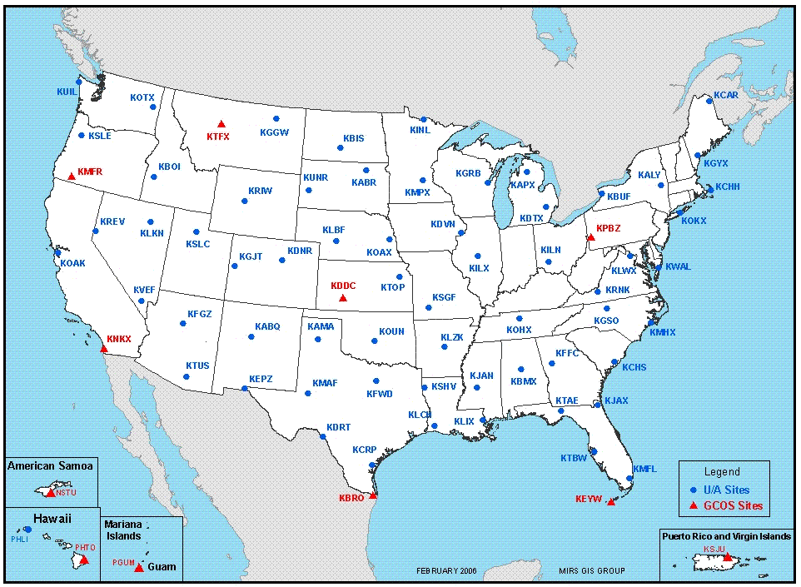
Tornado (EF5) that struck near Enderlin, North Dakota, USA., on June 20, 2025, between 11:02 and 11:21 PM CDT.
SOUNDING

Slide 8
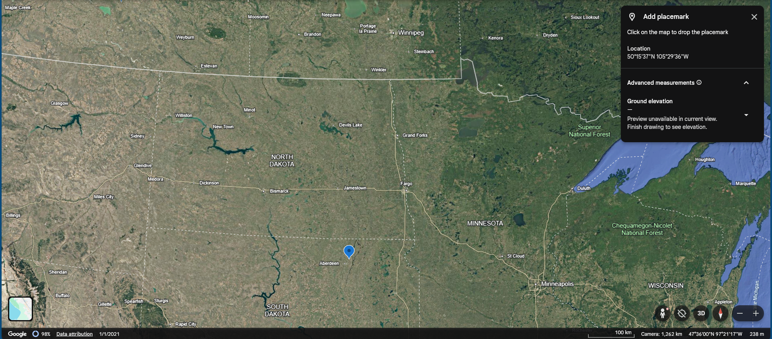
Tornado (EF5) that struck near Enderlin, North Dakota, USA., on June 20, 2025, between 11:02 and 11:21 PM CDT.
SOUNDING

Slide 9
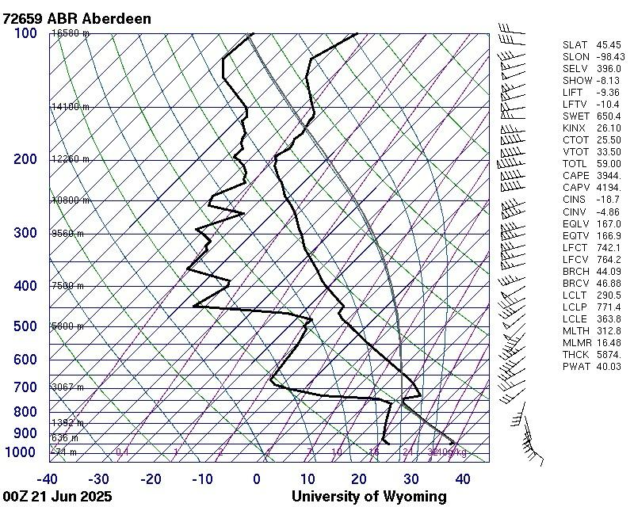
Tornado (EF5) that struck near Enderlin, North Dakota, USA., on June 20, 2025, between 11:02 and 11:21 PM CDT.
SOUNDING
Notes:
Present your skewT graph and its interpretation, including discussion of the wind speed and direction as a function of height; temperature, and dewpoint temperature; and the lifted air parcel.

Slide 10
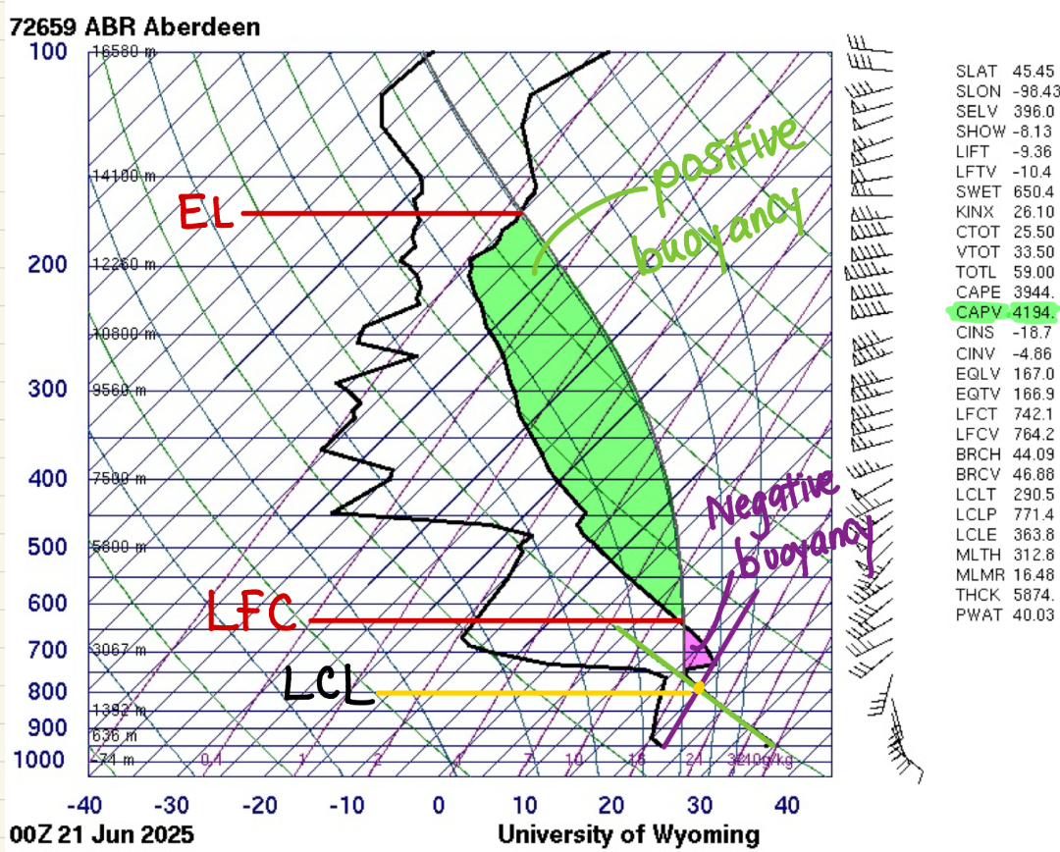
Tornado (EF5) that struck near Enderlin, North Dakota, USA., on June 20, 2025, between 11:02 and 11:21 PM CDT.
SOUNDING
Notes:
The LCL (Lifted Condensation Level) is the pressure level a parcel of air reaches saturation by lifting the parcel from a particular pressure level.

Slide 11
Tornado (EF5) that struck near Enderlin, North Dakota, USA., on June 20, 2025, between 11:02 and 11:21 PM CDT.
SOUNDING
CAPE, CIN, and precipitable water

Slide 12
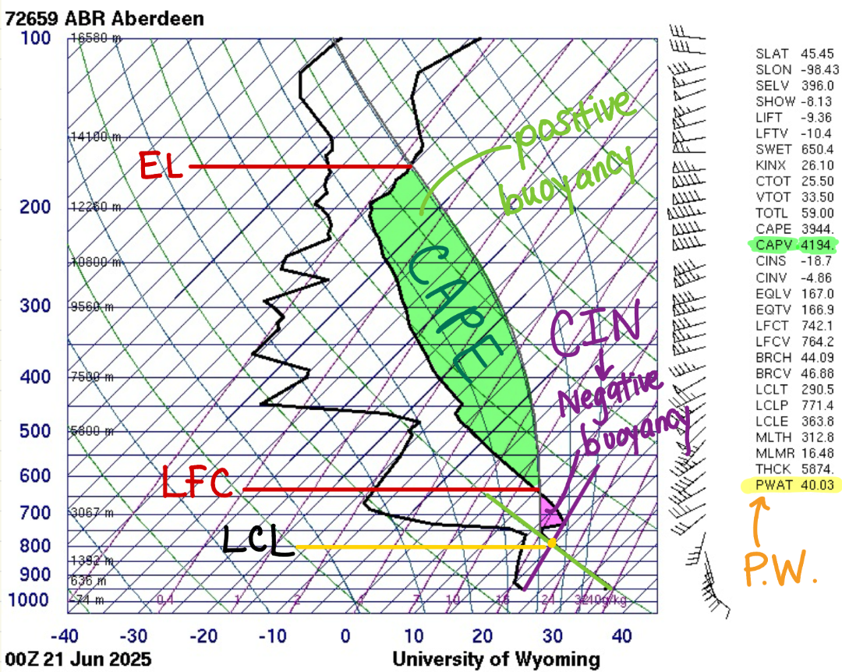
Tornado (EF5) that struck near Enderlin, North Dakota, USA., on June 20, 2025, between 11:02 and 11:21 PM CDT.
SOUNDING
CAPE, CIN, and precipitable water
Notes:
SKEW-T: A LOOK AT PW

Slide 13
Tornado (EF5) that struck near Enderlin, North Dakota, USA., on June 20, 2025, between 11:02 and 11:21 PM CDT.
SOUNDING
CAPE, CIN, and precipitable water
“In general, CAPE values of less than 1000J/kg represent weak instability, 1000 to 2500J/kg moderate instability, 2500-4000J/kg strong instability, and greater than 4000J/kg extreme instability.”
Notes:
Severe Weather Topics

Slide 14
Tornado (EF5) that struck near Enderlin, North Dakota, USA., on June 20, 2025, between 11:02 and 11:21 PM CDT.
SOUNDING
Convective Condensation Level (CCL)

Slide 15
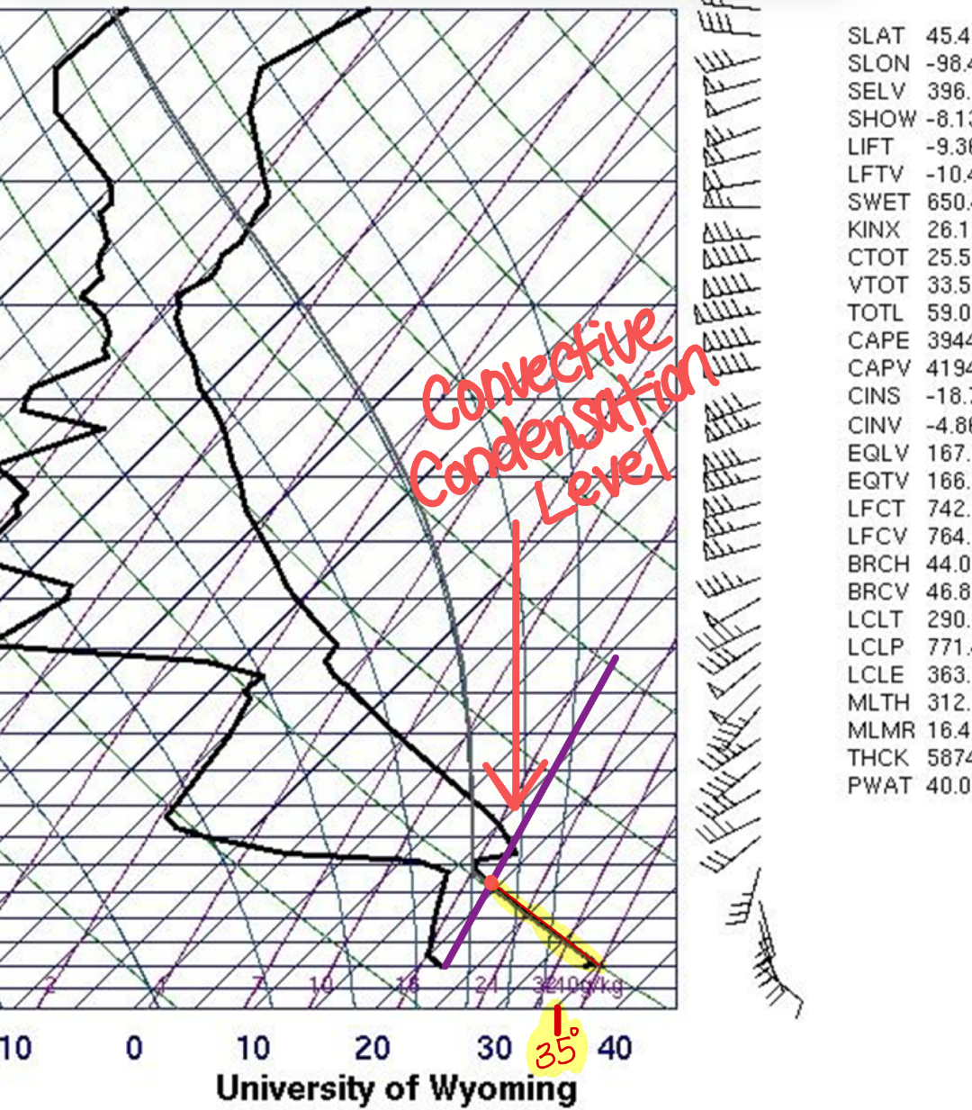
Tornado (EF5) that struck near Enderlin, North Dakota, USA., on June 20, 2025, between 11:02 and 11:21 PM CDT.
SOUNDING
Convective Condensation Level (CCL)

Slide 16
Tornado (EF5) that struck near Enderlin, North Dakota, USA., on June 20, 2025, between 11:02 and 11:21 PM CDT.
SOUNDING
Convective Condensation Level (CCL)
800 mb
35 C

Slide 17
Tornado (EF5) that struck near Enderlin, North Dakota, USA., on June 20, 2025, between 11:02 and 11:21 PM CDT.
SOUNDING
Maximum vertical updraft speed in m/s and mph

Slide 18
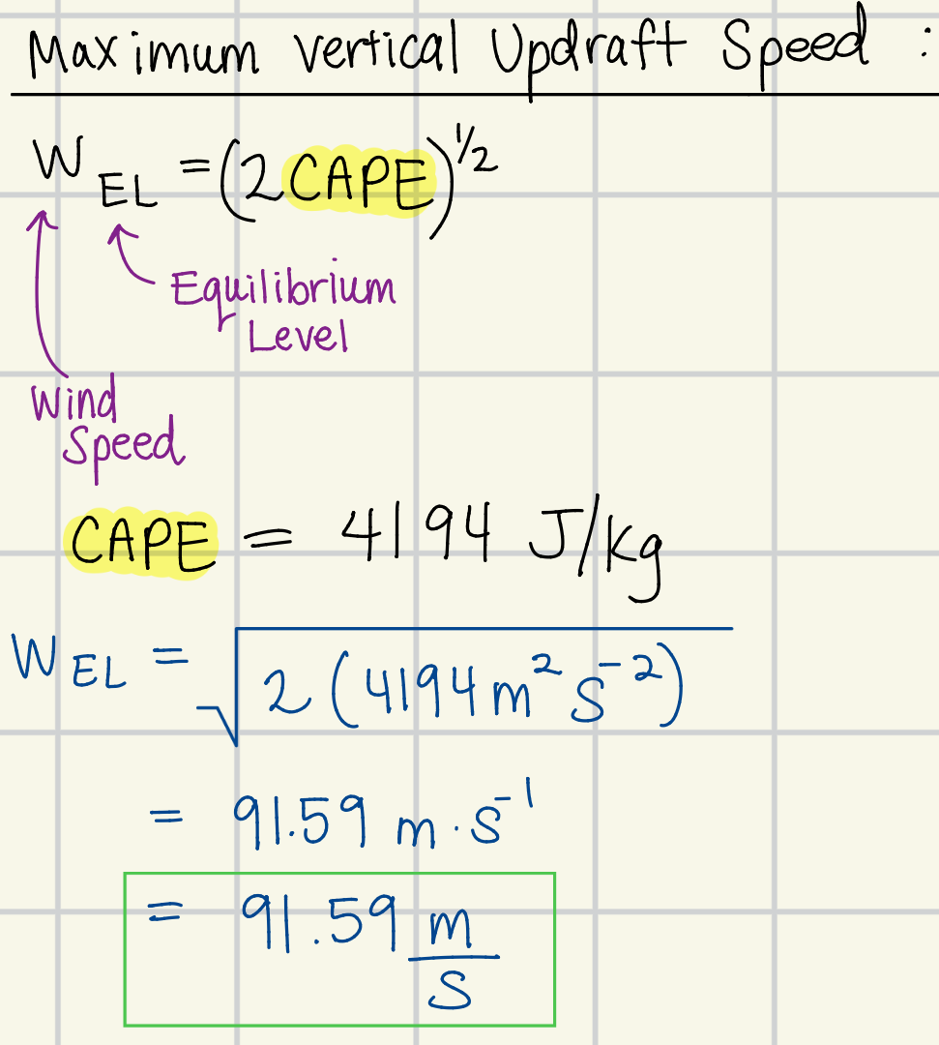
Tornado (EF5) that struck near Enderlin, North Dakota, USA., on June 20, 2025, between 11:02 and 11:21 PM CDT.
SOUNDING
Maximum vertical updraft speed in m/s and mph

Slide 19
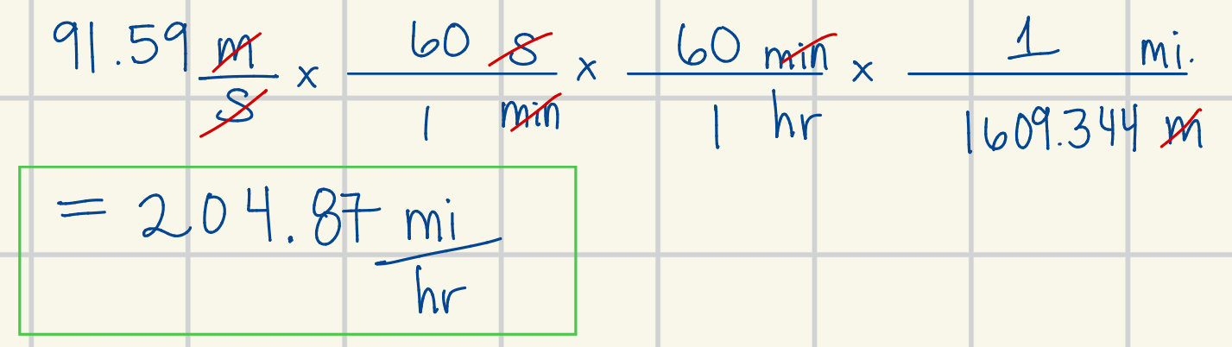
Tornado (EF5) that struck near Enderlin, North Dakota, USA., on June 20, 2025, between 11:02 and 11:21 PM CDT.
SOUNDING
Maximum vertical updraft speed in m/s and mph

Slide 20
Tornado (EF5) that struck near Enderlin, North Dakota, USA., on June 20, 2025, between 11:02 and 11:21 PM CDT.
SOUNDING
Maximum vertical updraft speed in m/s and mph
It should be noted that this equation is simplified and neglects:
The effects of water loading
Entrainment
As a result, this equation overestimates by a factor of 2.

Slide 21
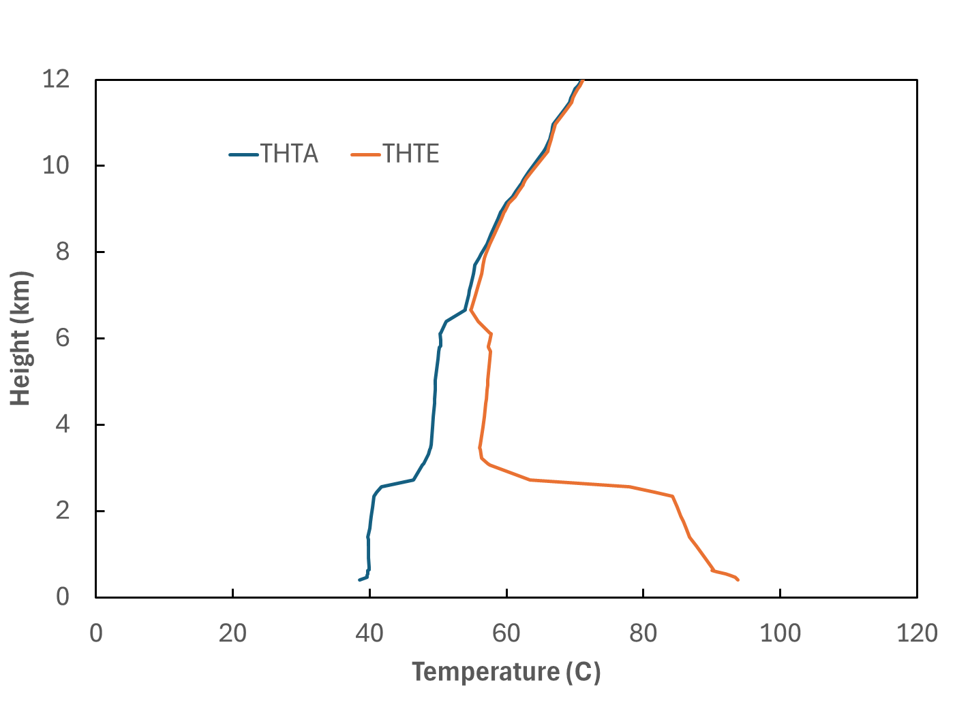
Tornado (EF5) that struck near Enderlin, North Dakota, USA., on June 20, 2025, between 11:02 and 11:21 PM CDT.
SOUNDING
Potential Temperature (THTA) and Equivalent Potential Temperature (THTE)
72659 ABR Aberdeen
00Z 21 JUN 2025

Slide 22
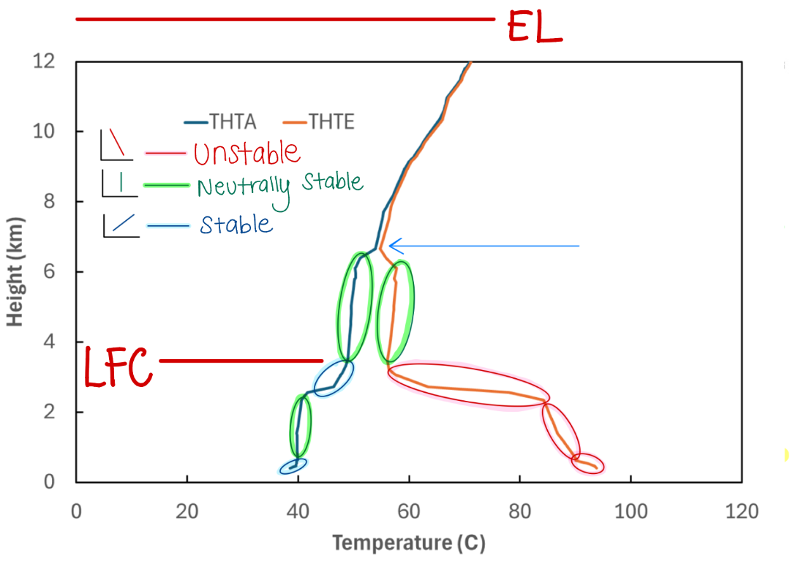
Tornado (EF5) that struck near Enderlin, North Dakota, USA., on June 20, 2025, between 11:02 and 11:21 PM CDT.
SOUNDING
Potential Temperature (THTA) and Equivalent Potential Temperature (THTE)
72659 ABR Aberdeen
00Z 21 JUN 2025
Notes:
** convectively unstable regions.

Slide 23
Tornado (EF5) that struck near Enderlin, North Dakota, USA., on June 20, 2025, between 11:02 and 11:21 PM CDT.
SOUNDING
Potential Temperature (THTA) and Equivalent Potential Temperature (THTE)
72659 ABR Aberdeen
00Z 21 JUN 2025
Convectively Unstable Regions
Notes:
** convectively unstable regions.

Slide 24
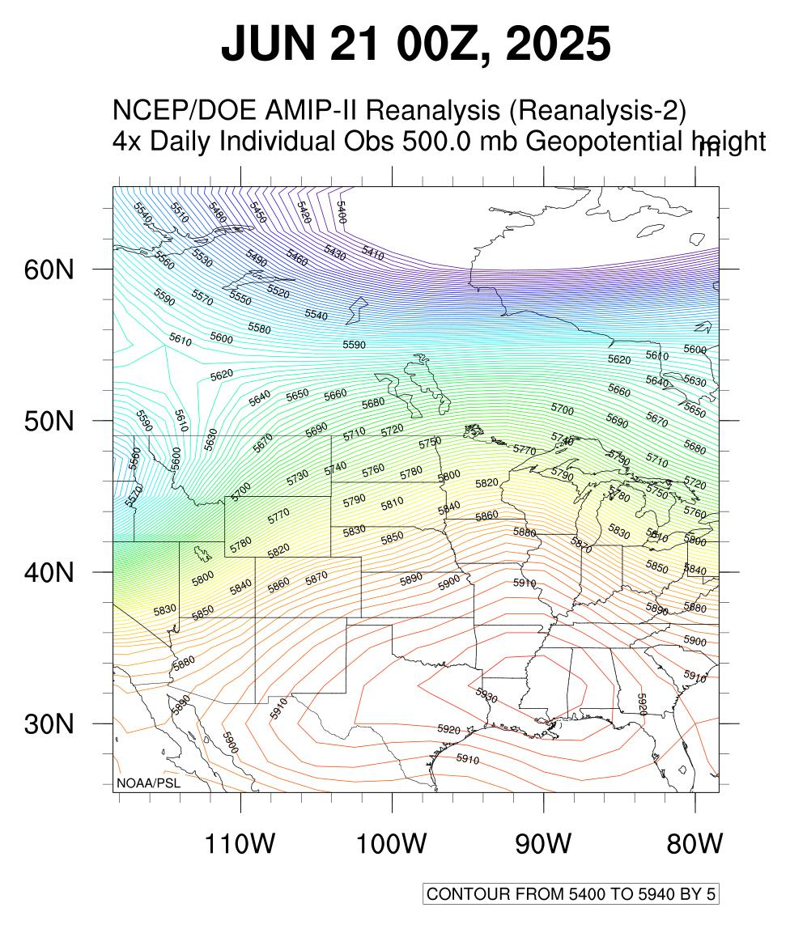
Tornado (EF5) that struck near Enderlin, North Dakota, USA., on June 20, 2025, between 11:02 and 11:21 PM CDT.
REANALYSIS DATA
500 mb Height Map
72659 ABR Aberdeen
00Z 21 JUN 2025

Slide 25
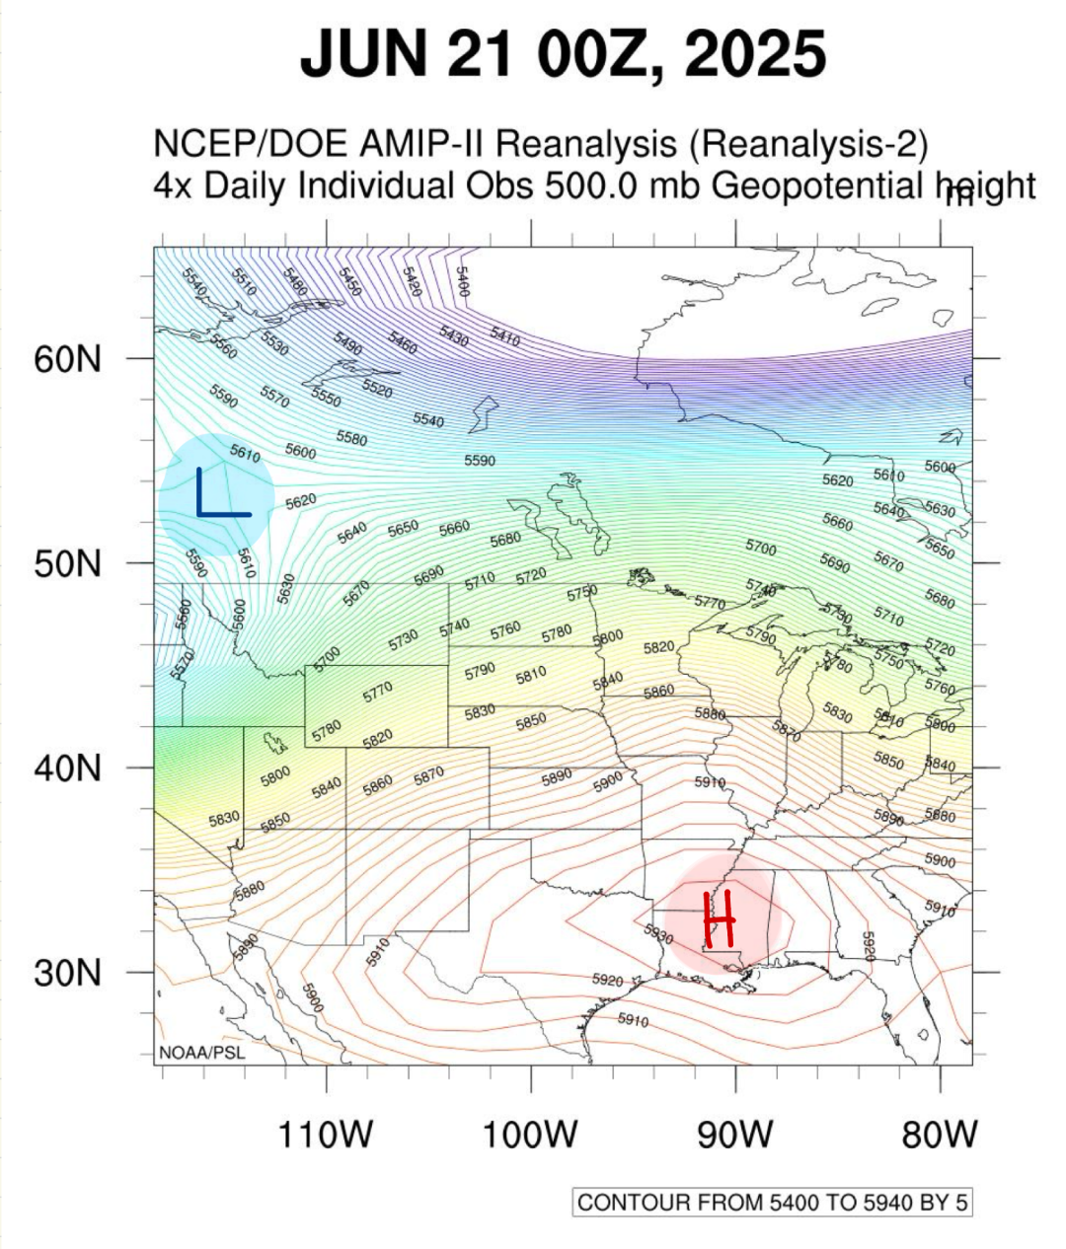
Tornado (EF5) that struck near Enderlin, North Dakota, USA., on June 20, 2025, between 11:02 and 11:21 PM CDT.
REANALYSIS DATA
500 mb Height Map
72659 ABR Aberdeen
00Z 21 JUN 2025

Slide 26
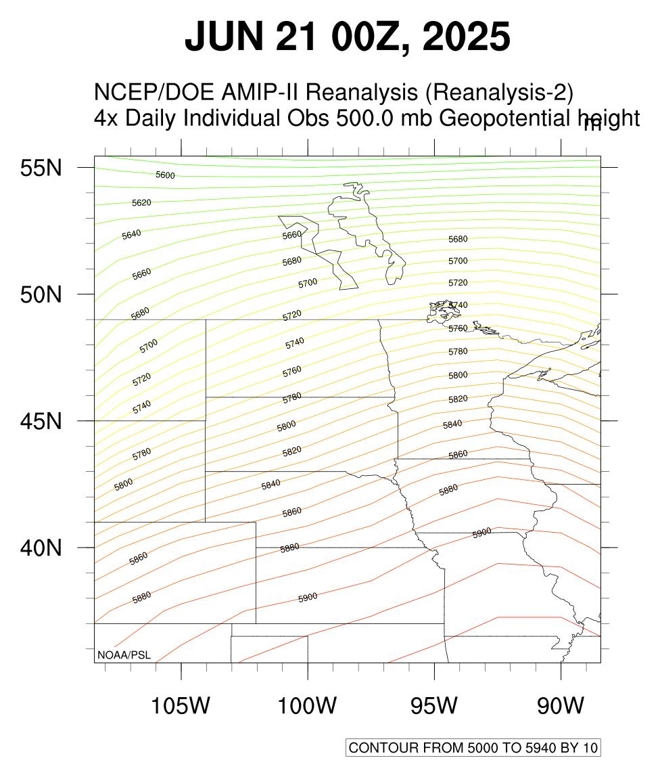
Tornado (EF5) that struck near Enderlin, North Dakota, USA., on June 20, 2025, between 11:02 and 11:21 PM CDT.
REANALYSIS DATA
500 mb Height Map
72659 ABR Aberdeen
00Z 21 JUN 2025

Slide 27
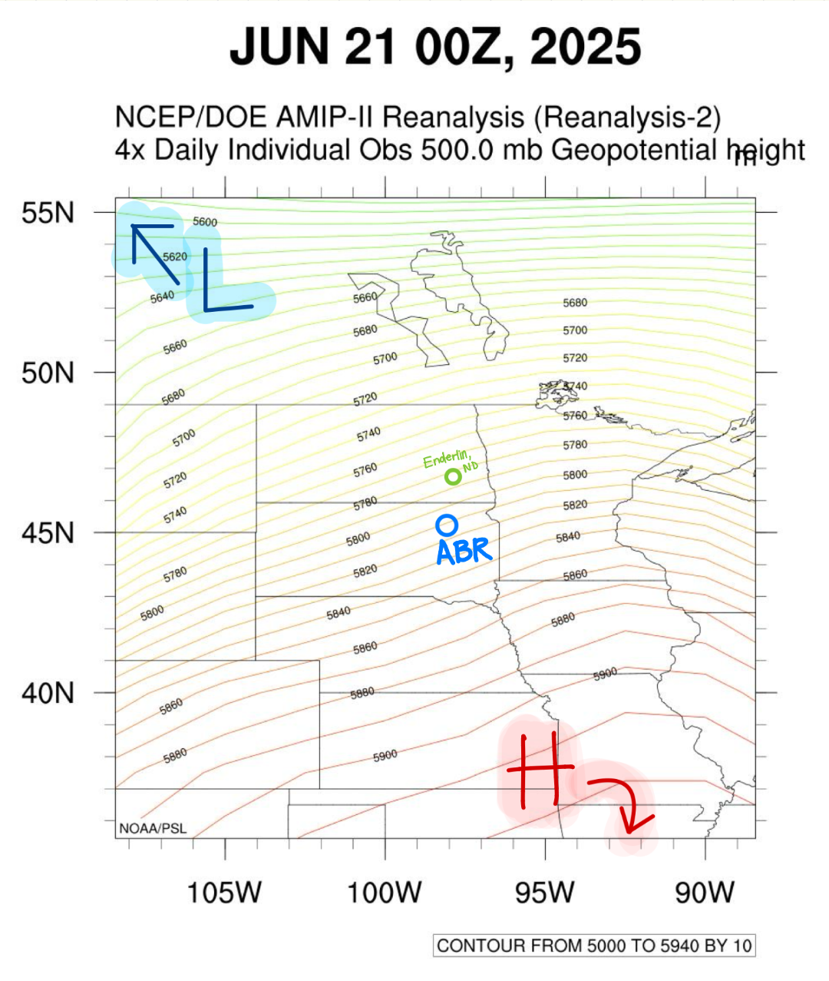
Tornado (EF5) that struck near Enderlin, North Dakota, USA., on June 20, 2025, between 11:02 and 11:21 PM CDT.
REANALYSIS DATA
500 mb Height Map
72659 ABR Aberdeen
00Z 21 JUN 2025
Left hand points towards the low, and right hand points towards the high; your nose points in the direction of the wind.

Slide 28
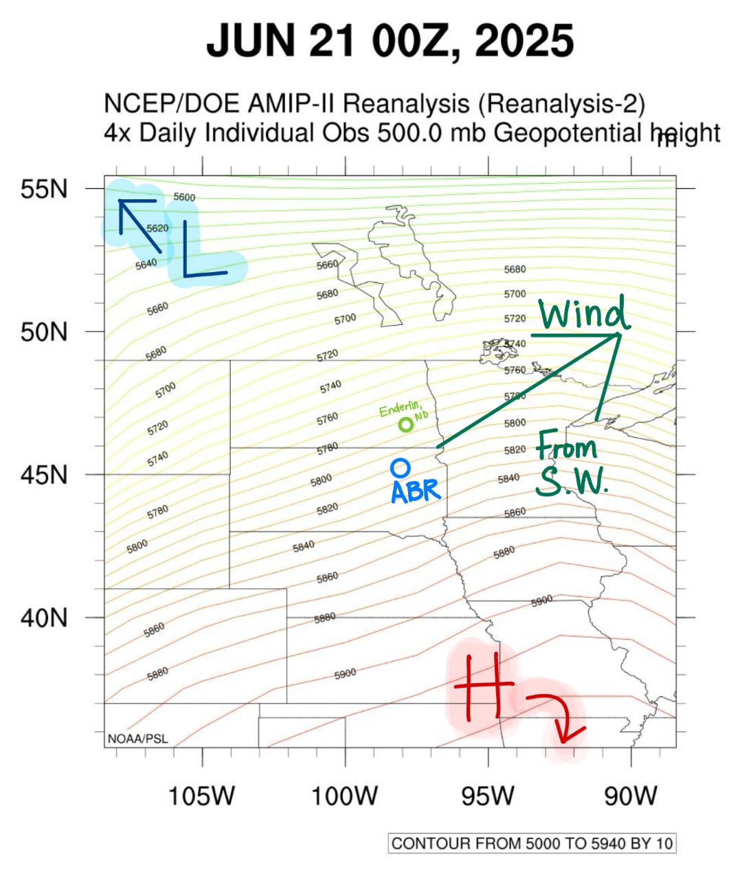
Tornado (EF5) that struck near Enderlin, North Dakota, USA., on June 20, 2025, between 11:02 and 11:21 PM CDT.
REANALYSIS DATA
500 mb Height Map
72659 ABR Aberdeen
00Z 21 JUN 2025
Left hand points towards the low, and right hand points towards the high; your nose points in the direction of the wind.

Slide 29
Tornado (EF5) that struck near Enderlin, North Dakota, USA., on June 20, 2025, between 11:02 and 11:21 PM CDT.
REANALYSIS DATA
500 mb Height Map
72659 ABR Aberdeen
00Z 21 JUN 2025
Wind Speed

Slide 30
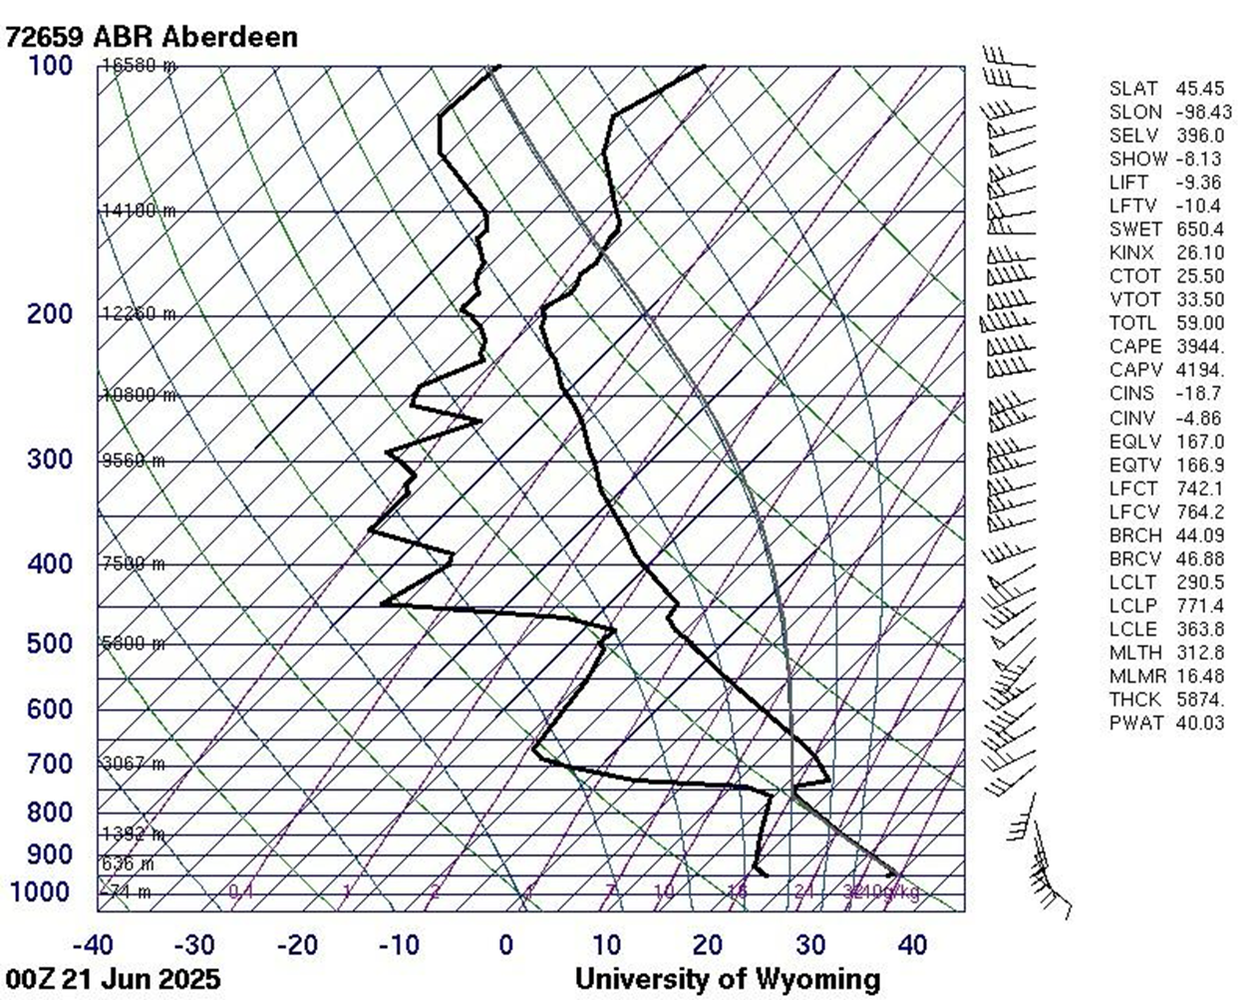
Tornado (EF5) that struck near Enderlin, North Dakota, USA., on June 20, 2025, between 11:02 and 11:21 PM CDT.
REANALYSIS DATA
72659 ABR Aberdeen
00Z 21 JUN 2025

Slide 31
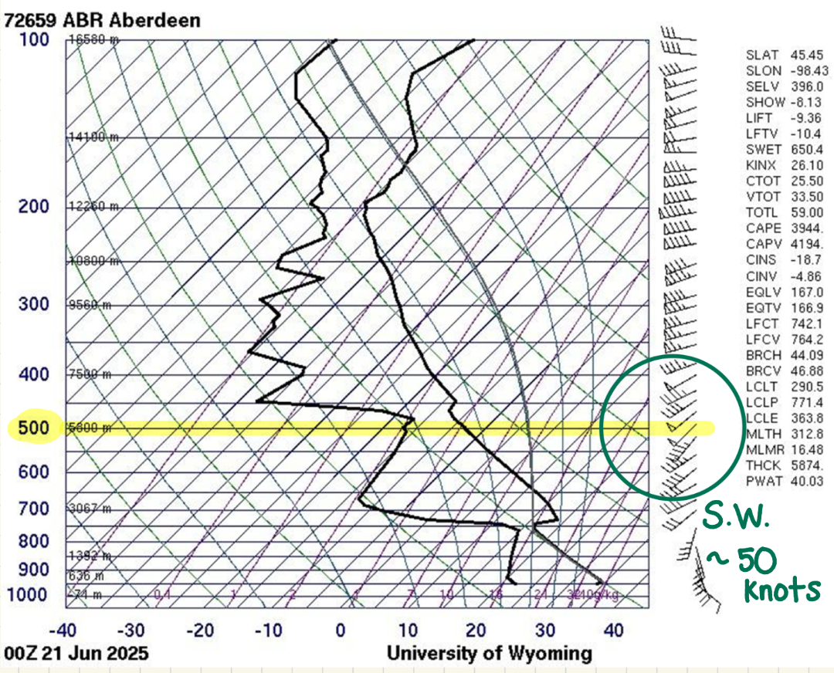
Tornado (EF5) that struck near Enderlin, North Dakota, USA., on June 20, 2025, between 11:02 and 11:21 PM CDT.
REANALYSIS DATA
500 mb on Sounding
72659 ABR Aberdeen
00Z 21 JUN 2025

Slide 32
Tornado (EF5) that struck near Enderlin, North Dakota, USA., on June 20, 2025, between 11:02 and 11:21 PM CDT.
REANALYSIS DATA
500 mb on Sounding
72659 ABR Aberdeen
00Z 21 JUN 2025
50 Knots = 57.54 mph

Slide 33
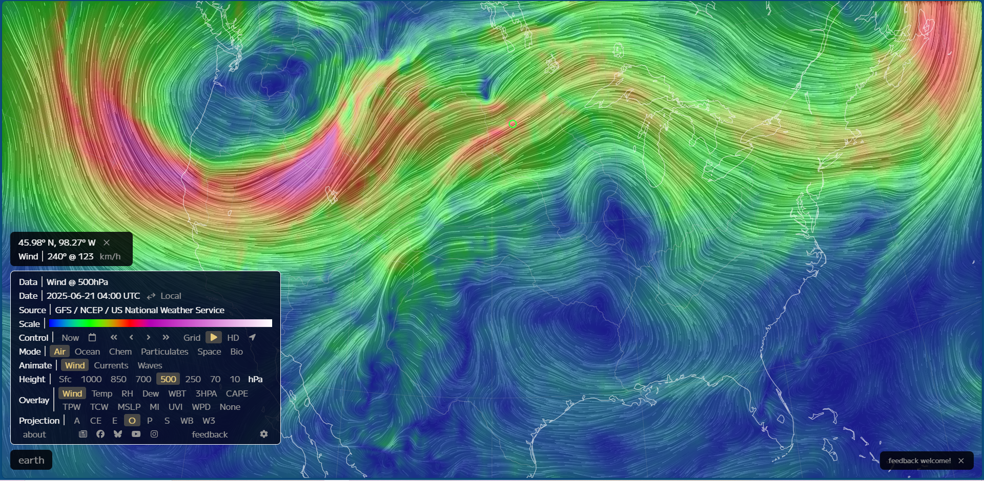

Slide 34
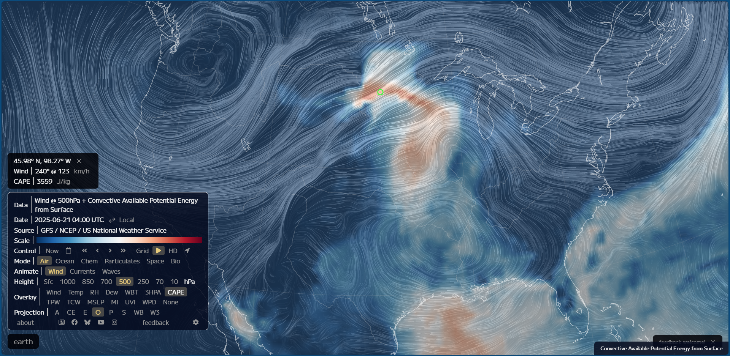

Slide 35
Tornado (EF5) that struck near Enderlin, North Dakota, USA., on June 20, 2025, between 11:02 and 11:21 PM CDT.
REANALYSIS DATA
Sounding Wind Speed Maxima and Minima
72659 ABR Aberdeen
00Z 21 JUN 2025

Slide 36
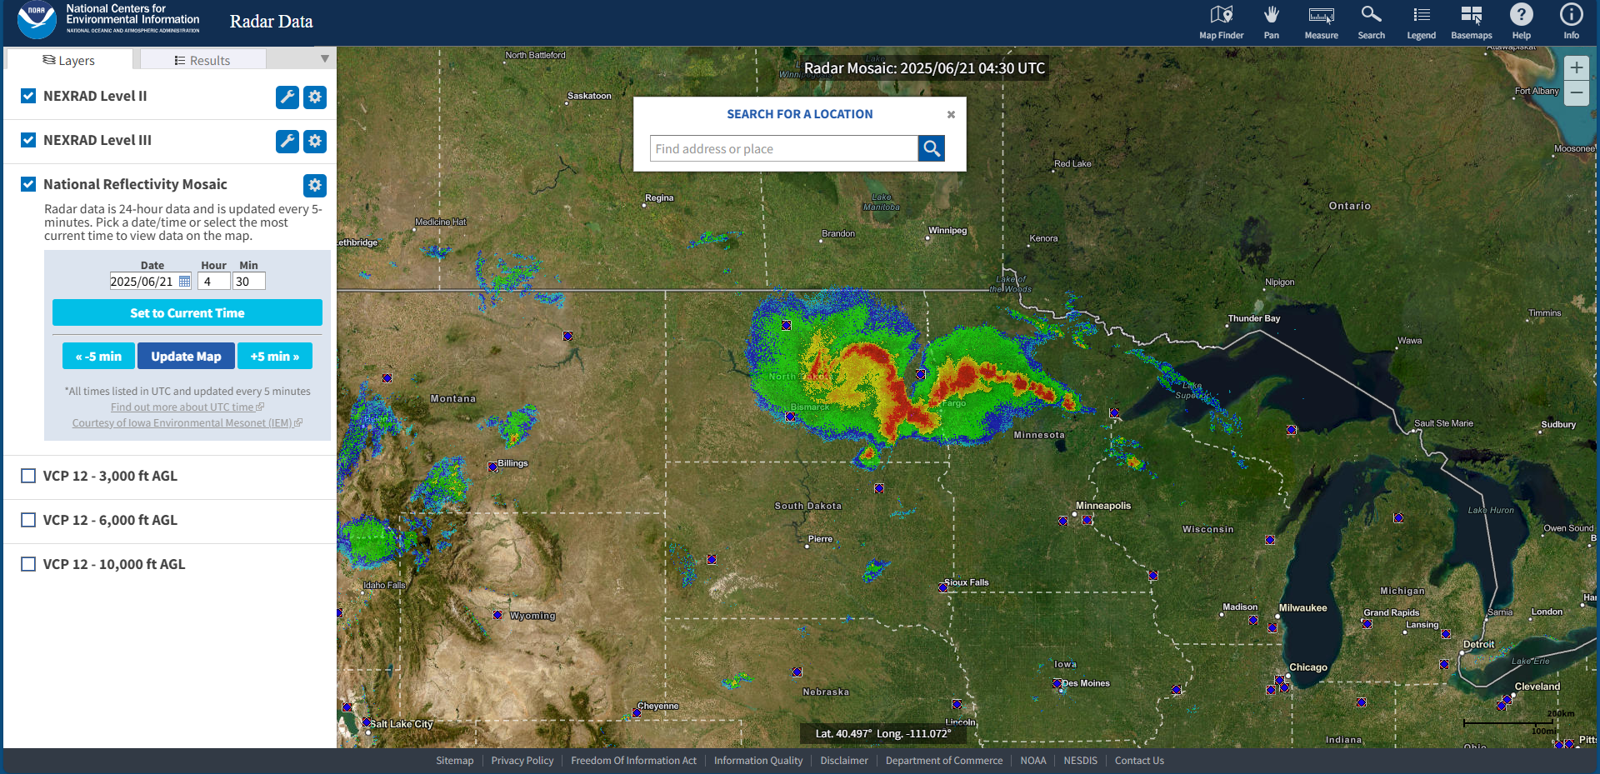
Tornado (EF5) that struck near Enderlin, North Dakota, USA., on June 20, 2025, between 11:02 and 11:21 PM CDT.

Slide 37
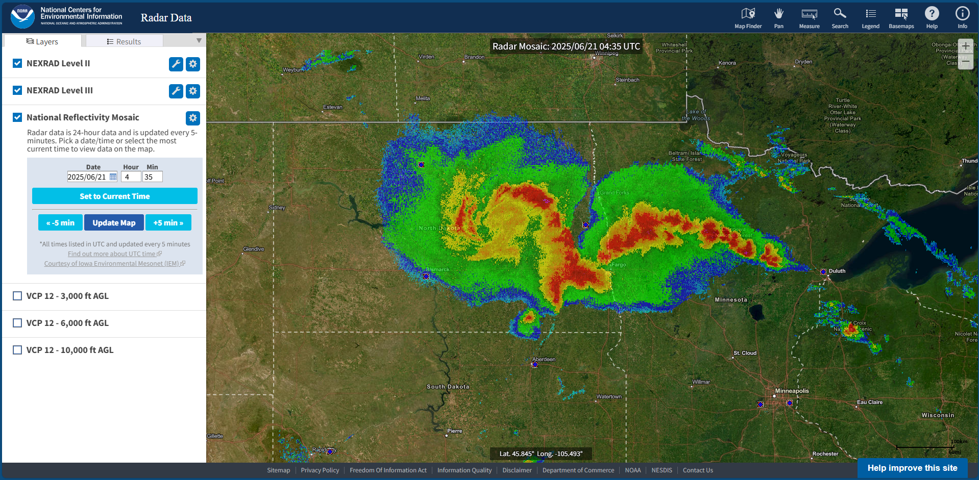
Tornado (EF5) that struck near Enderlin, North Dakota, USA., on June 20, 2025, between 11:02 and 11:21 PM CDT.

Slide 38
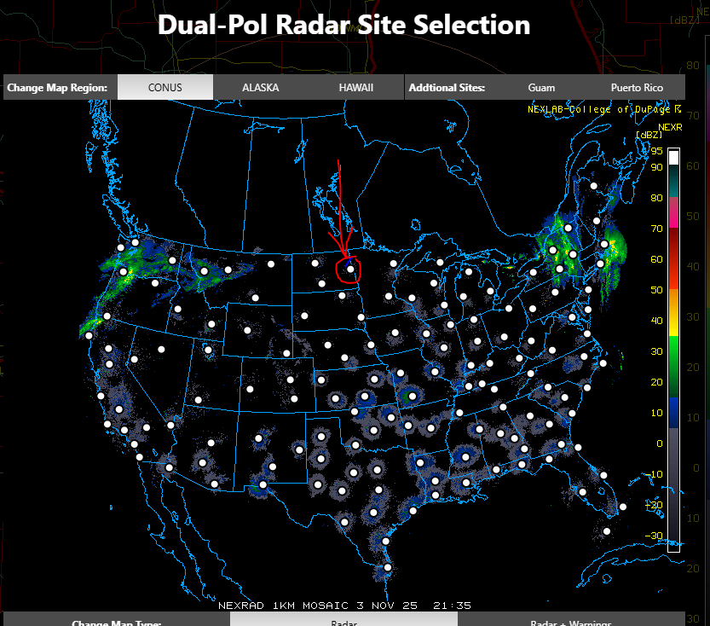
Tornado (EF5) that struck near Enderlin, North Dakota, USA., on June 20, 2025, between 11:02 and 11:21 PM CDT.
RADAR
Notes:
COD NEXRAD: LOT

Slide 39
Tornado (EF5) that struck near Enderlin, North Dakota, USA., on June 20, 2025, between 11:02 and 11:21 PM CDT.
RADAR
KMVX – Grand Forks, ND
Notes:
COD NEXRAD: LOT

Slide 40
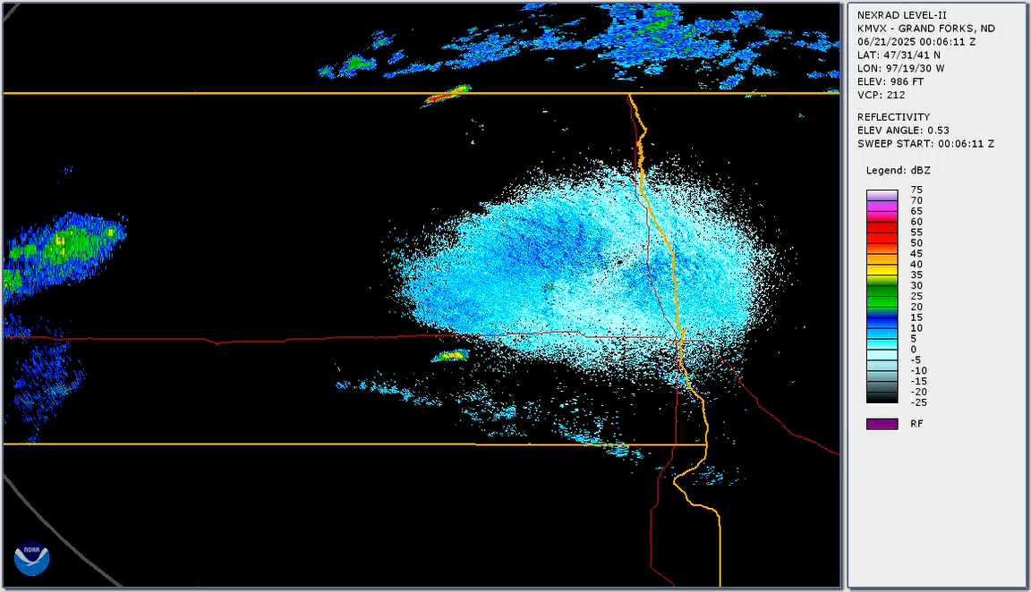

Slide 41
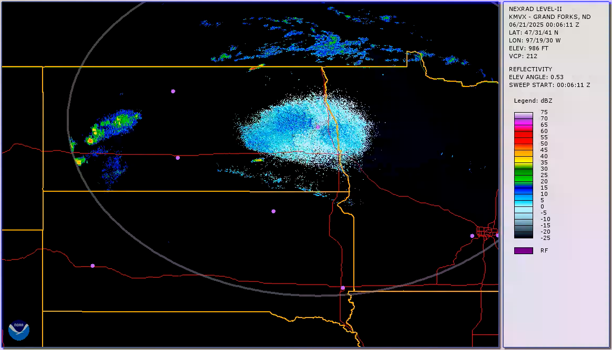

Slide 42
Tornado (EF5) that struck near Enderlin, North Dakota, USA., on June 20, 2025, between 11:02 and 11:21 PM CDT.
Geostationary Operational Environmental Satellite (GOES) Infrared Imagery

Slide 43
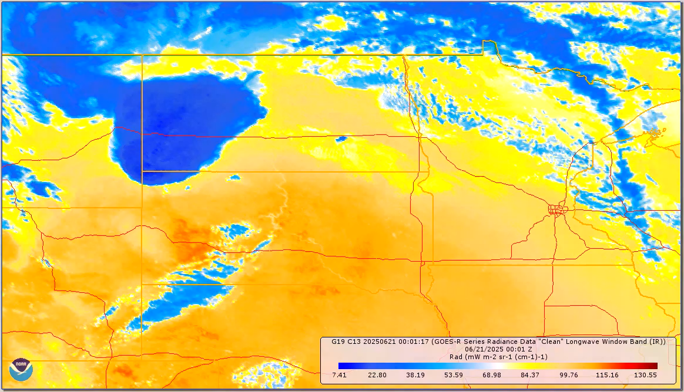

Slide 44
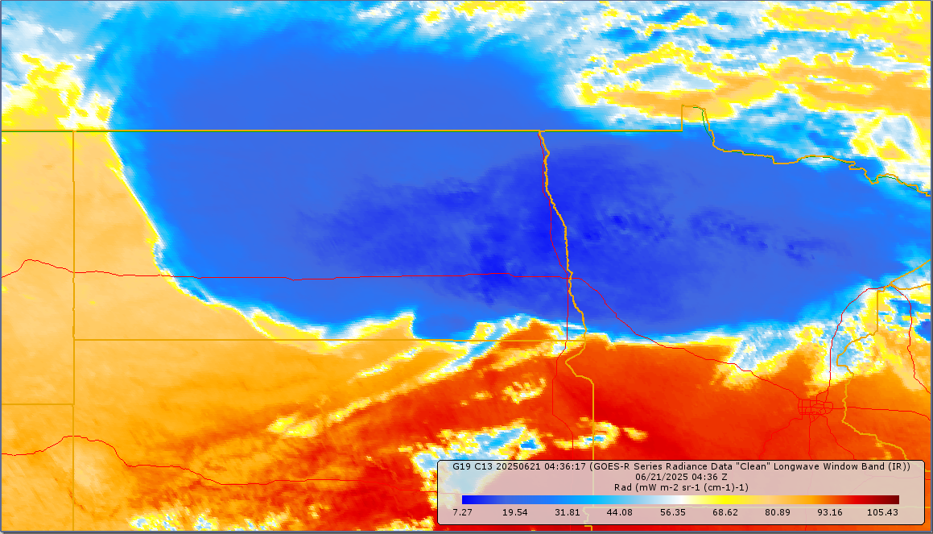
Tornado (EF5) that struck near Enderlin, North Dakota, USA., on June 20, 2025, between 11:02 and 11:21 PM CDT.
Geostationary Operational Environmental Satellite (GOES) Infrared Imagery

Slide 45
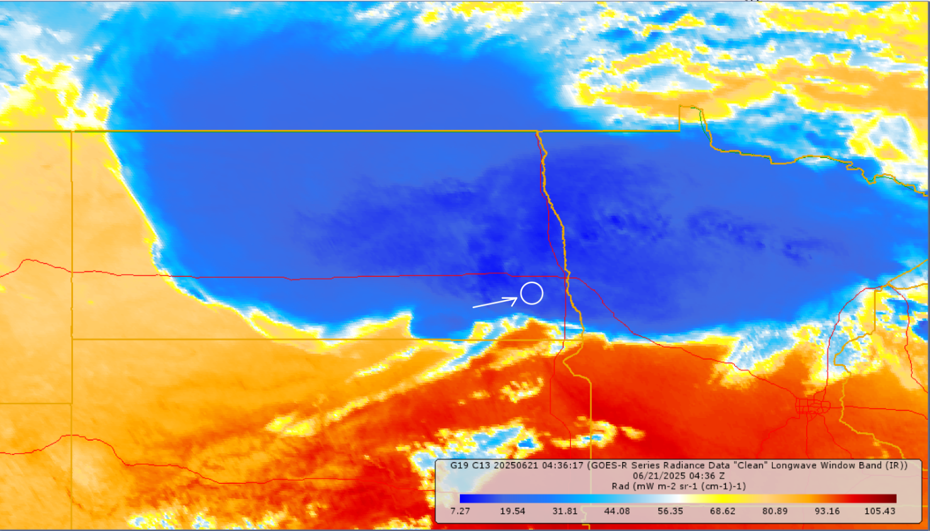
Tornado (EF5) that struck near Enderlin, North Dakota, USA., on June 20, 2025, between 11:02 and 11:21 PM CDT.
Geostationary Operational Environmental Satellite (GOES) Infrared Imagery
13.492 mW m-2 sr-1 (cm-1)-1

Slide 46
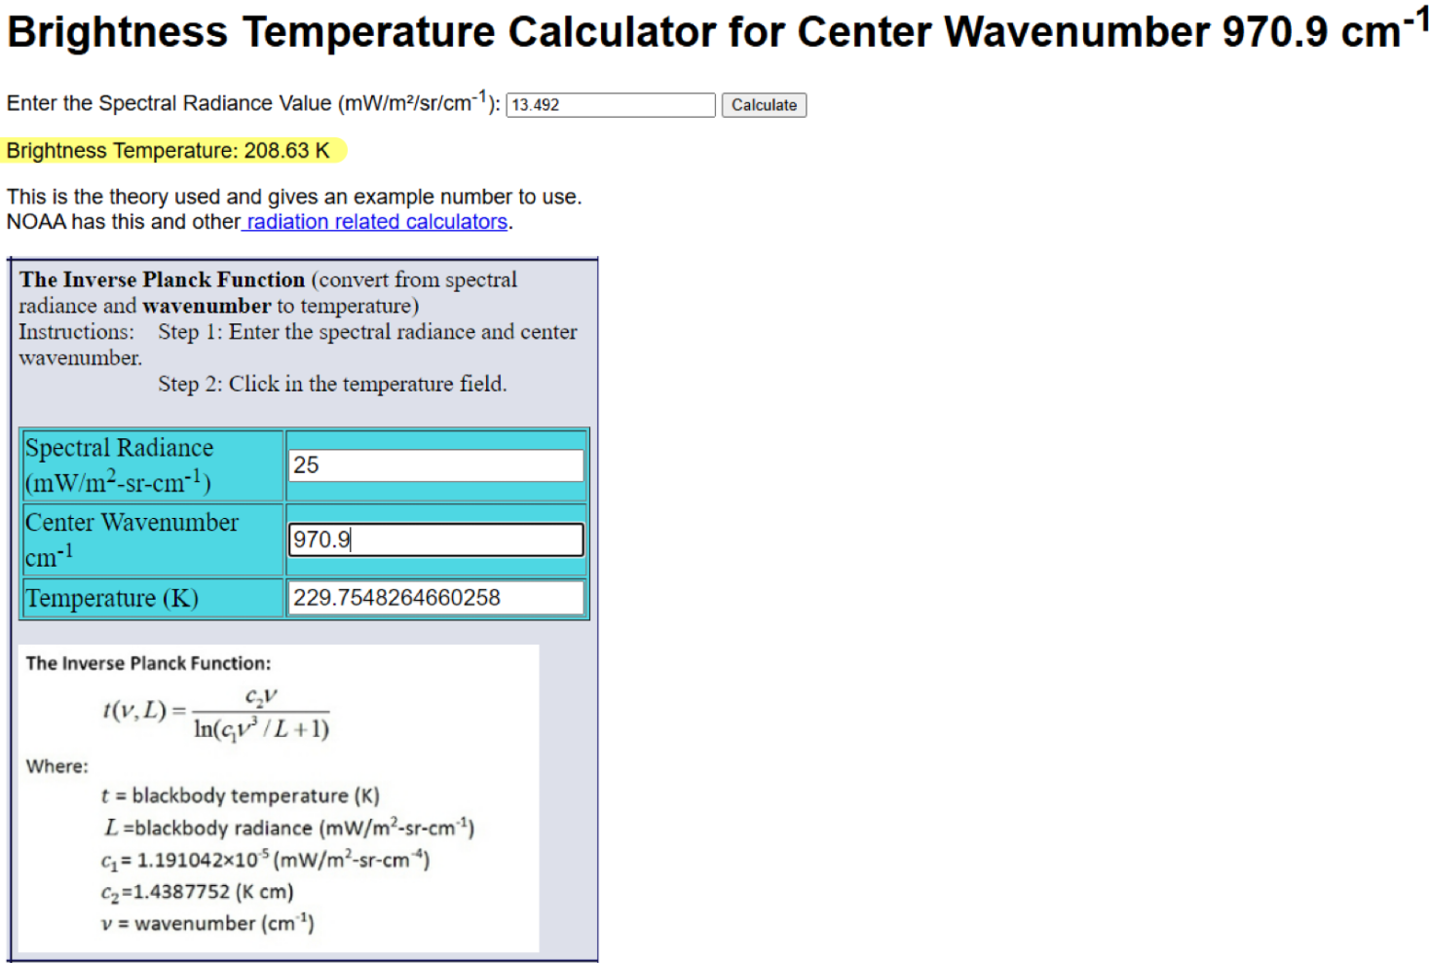
Tornado (EF5) that struck near Enderlin, North Dakota, USA., on June 20, 2025, between 11:02 and 11:21 PM CDT.
Geostationary Operational Environmental Satellite (GOES) Infrared Imagery
13.492 mW m-2 sr-1 (cm-1)-1

Slide 47
Tornado (EF5) that struck near Enderlin, North Dakota, USA., on June 20, 2025, between 11:02 and 11:21 PM CDT.
Geostationary Operational Environmental Satellite (GOES) Infrared Imagery
13.492 mW m-2 sr-1 (cm-1)-1
208.63 Kelvin =
-84.14° Fahrenheit

Slide 48
Tornado (EF5) that struck near Enderlin, North Dakota, USA., on June 20, 2025, between 11:02 and 11:21 PM CDT.
Table of Values
Equivalent potential temperature θ_{E} for the averaged air parcel for the first 200 meters of the sounding, the starting point of the lifted air parcel from the surface. | 92.55 C
Lifting condensation level height and pressure. | 2000 m 771.4 mb
Level of free convection in meters and pressure value for it. | ~ 4000 m 742.1 mb
Tropopause height in meters and the pressure value for it. | 12260 m 200 mb
Equilibrium level height and pressure. | ~ 13000 m 175 mb
Your CAPE value in Joules/kg. | 4194 J/kg
Your calculated vertical velocity, w, in meters/second and mph at the equilibrium level based on use of your CAPE value. | 91.59 m/s 204.87 mph
Your precipitable water amount in mm units. | 40.03 mm
500 mb wind direction from the sounding and inferred from the 500 mb level graph. | From the SW
Convective condensation level pressure. | 800 mb
Convective temperature. | 35 C

Slide 49
Tornado (EF5) that struck near Enderlin, North Dakota, USA., on June 20, 2025, between 11:02 and 11:21 PM CDT.
Video of Tornado
Watch: Doorbell camera captures glimpse of giant wall cloud | LiveNOW from FOX

