Slide 1
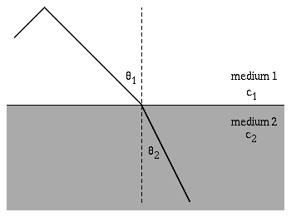
Sound Propagation in The Ocean And Atmosphere
Snell’s Law: Refraction. Trace velocity matching principle (wavefront continuity) governs ray paths. Note that the wavelength is shorter in the slower medium.
From http://www.kettering.edu/physics/drussell/Demos/refract/refract.html.

Slide 2
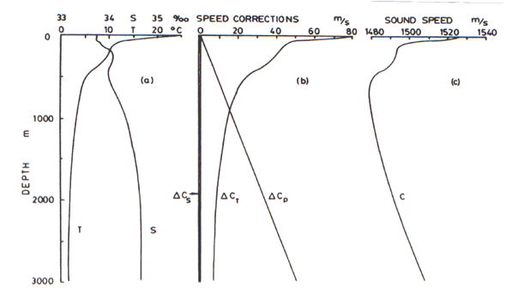
Sound Speed Profile in the Ocean

Slide 3
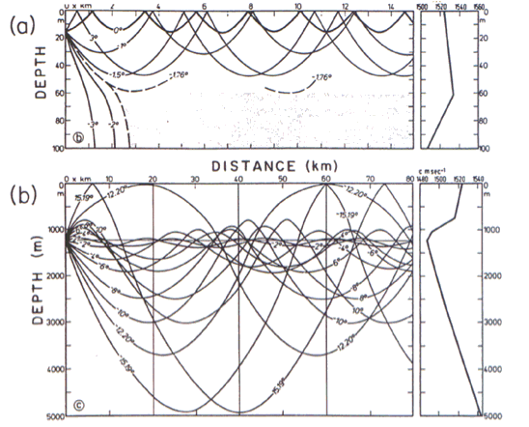
Sound Ray Paths in the Ocean

Slide 4
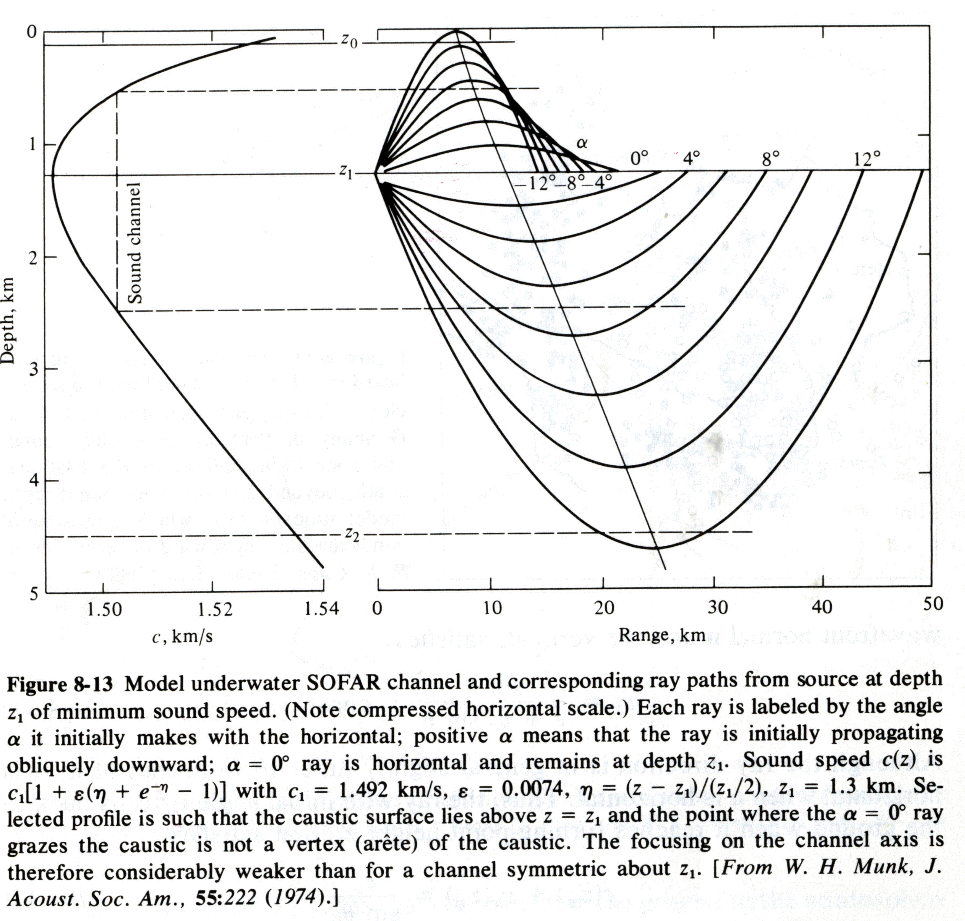
Details of Sound in the SOFAR Channel In the Ocean

Slide 5
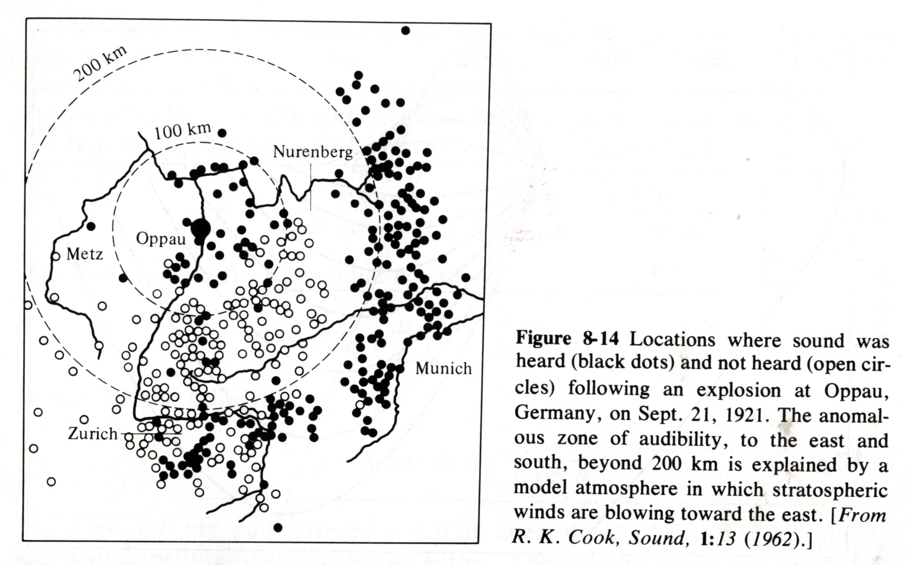
Baffling Blast Noise Observations: Zones of Silence

Slide 6
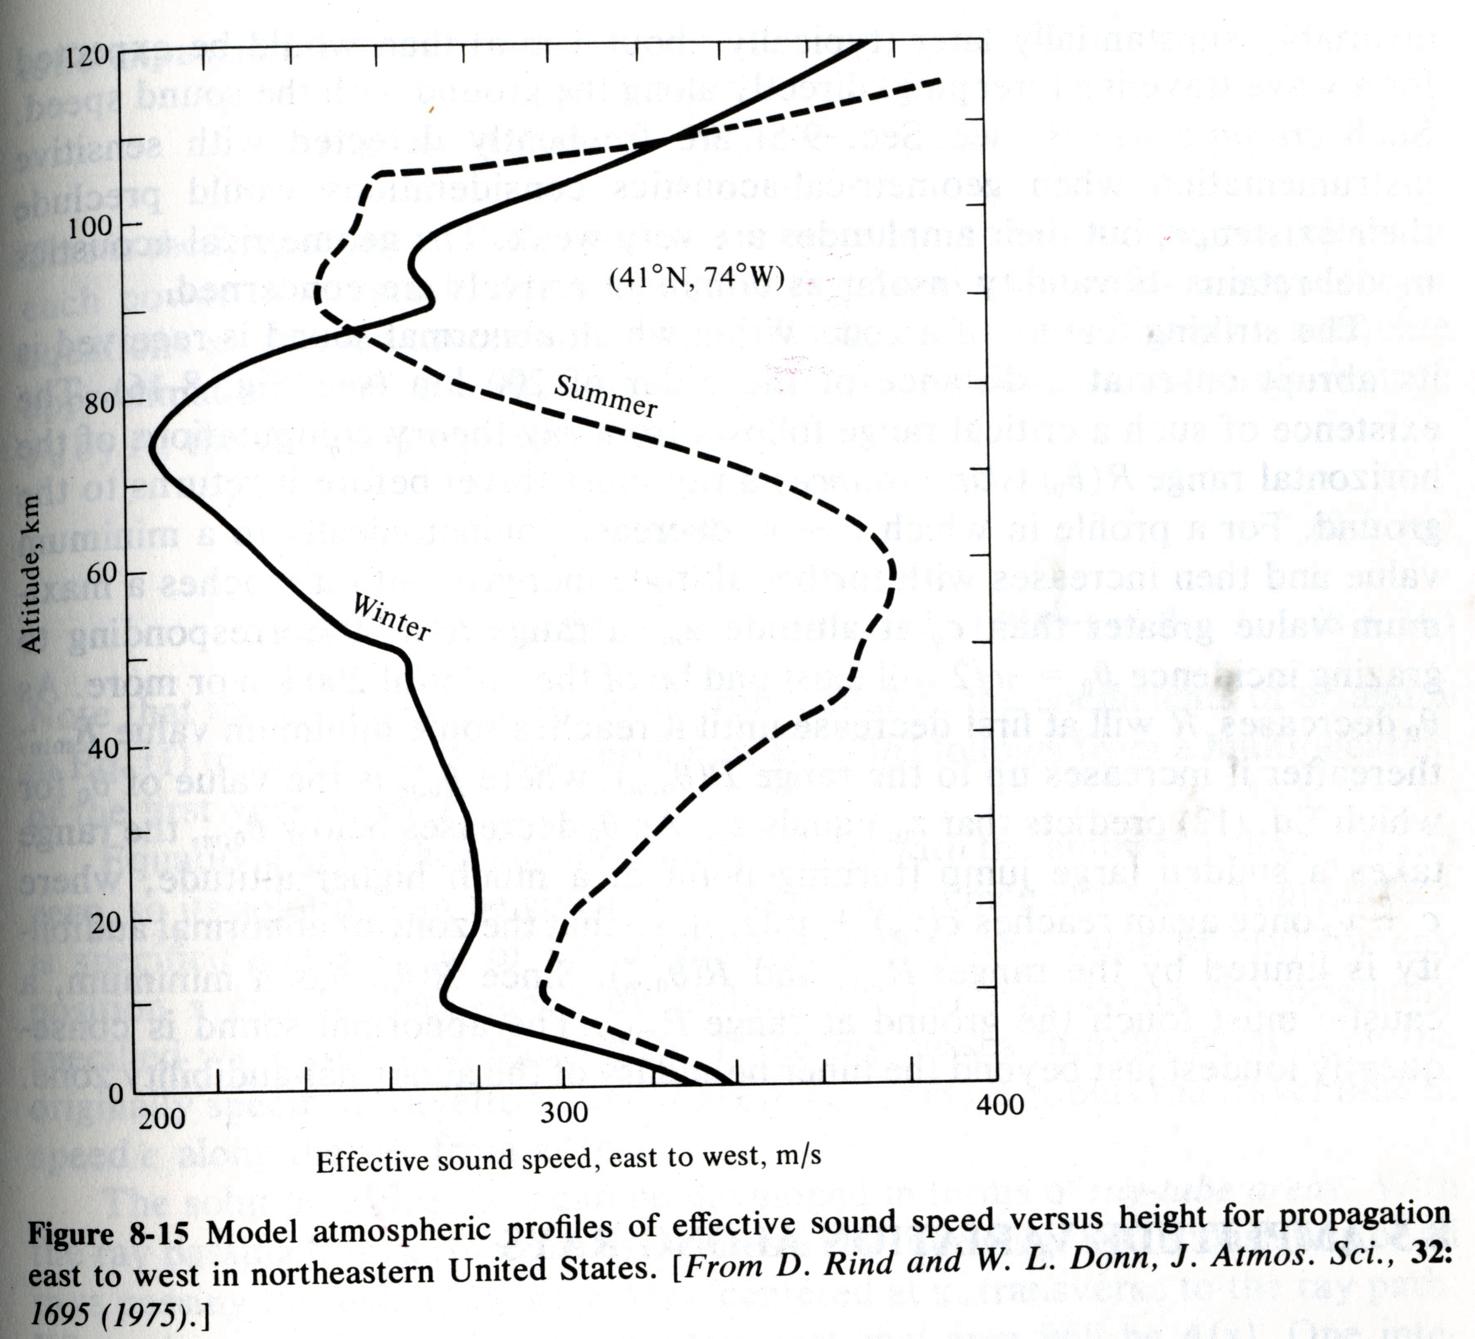
Sound Speed Profile for the Atmosphere

Slide 7
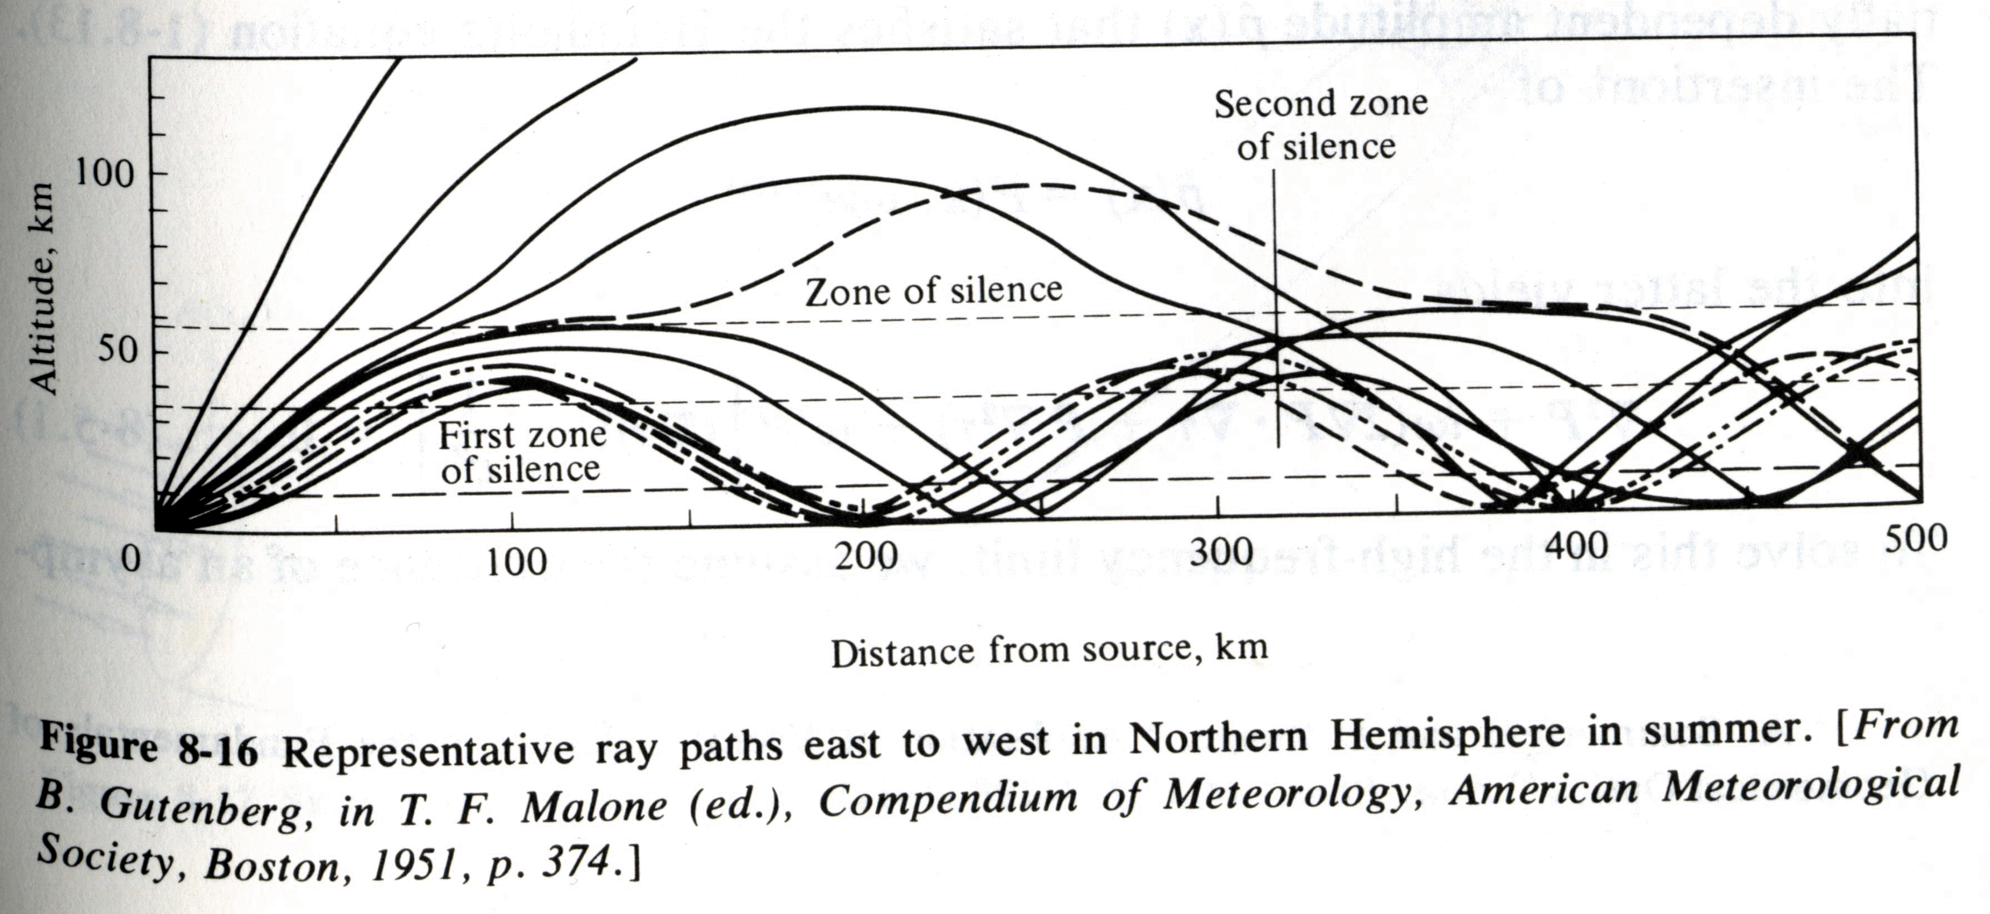
Long Range Sound Propagation Simulation For Blast
From Pierce, Advanced Acoustics.

Slide 8
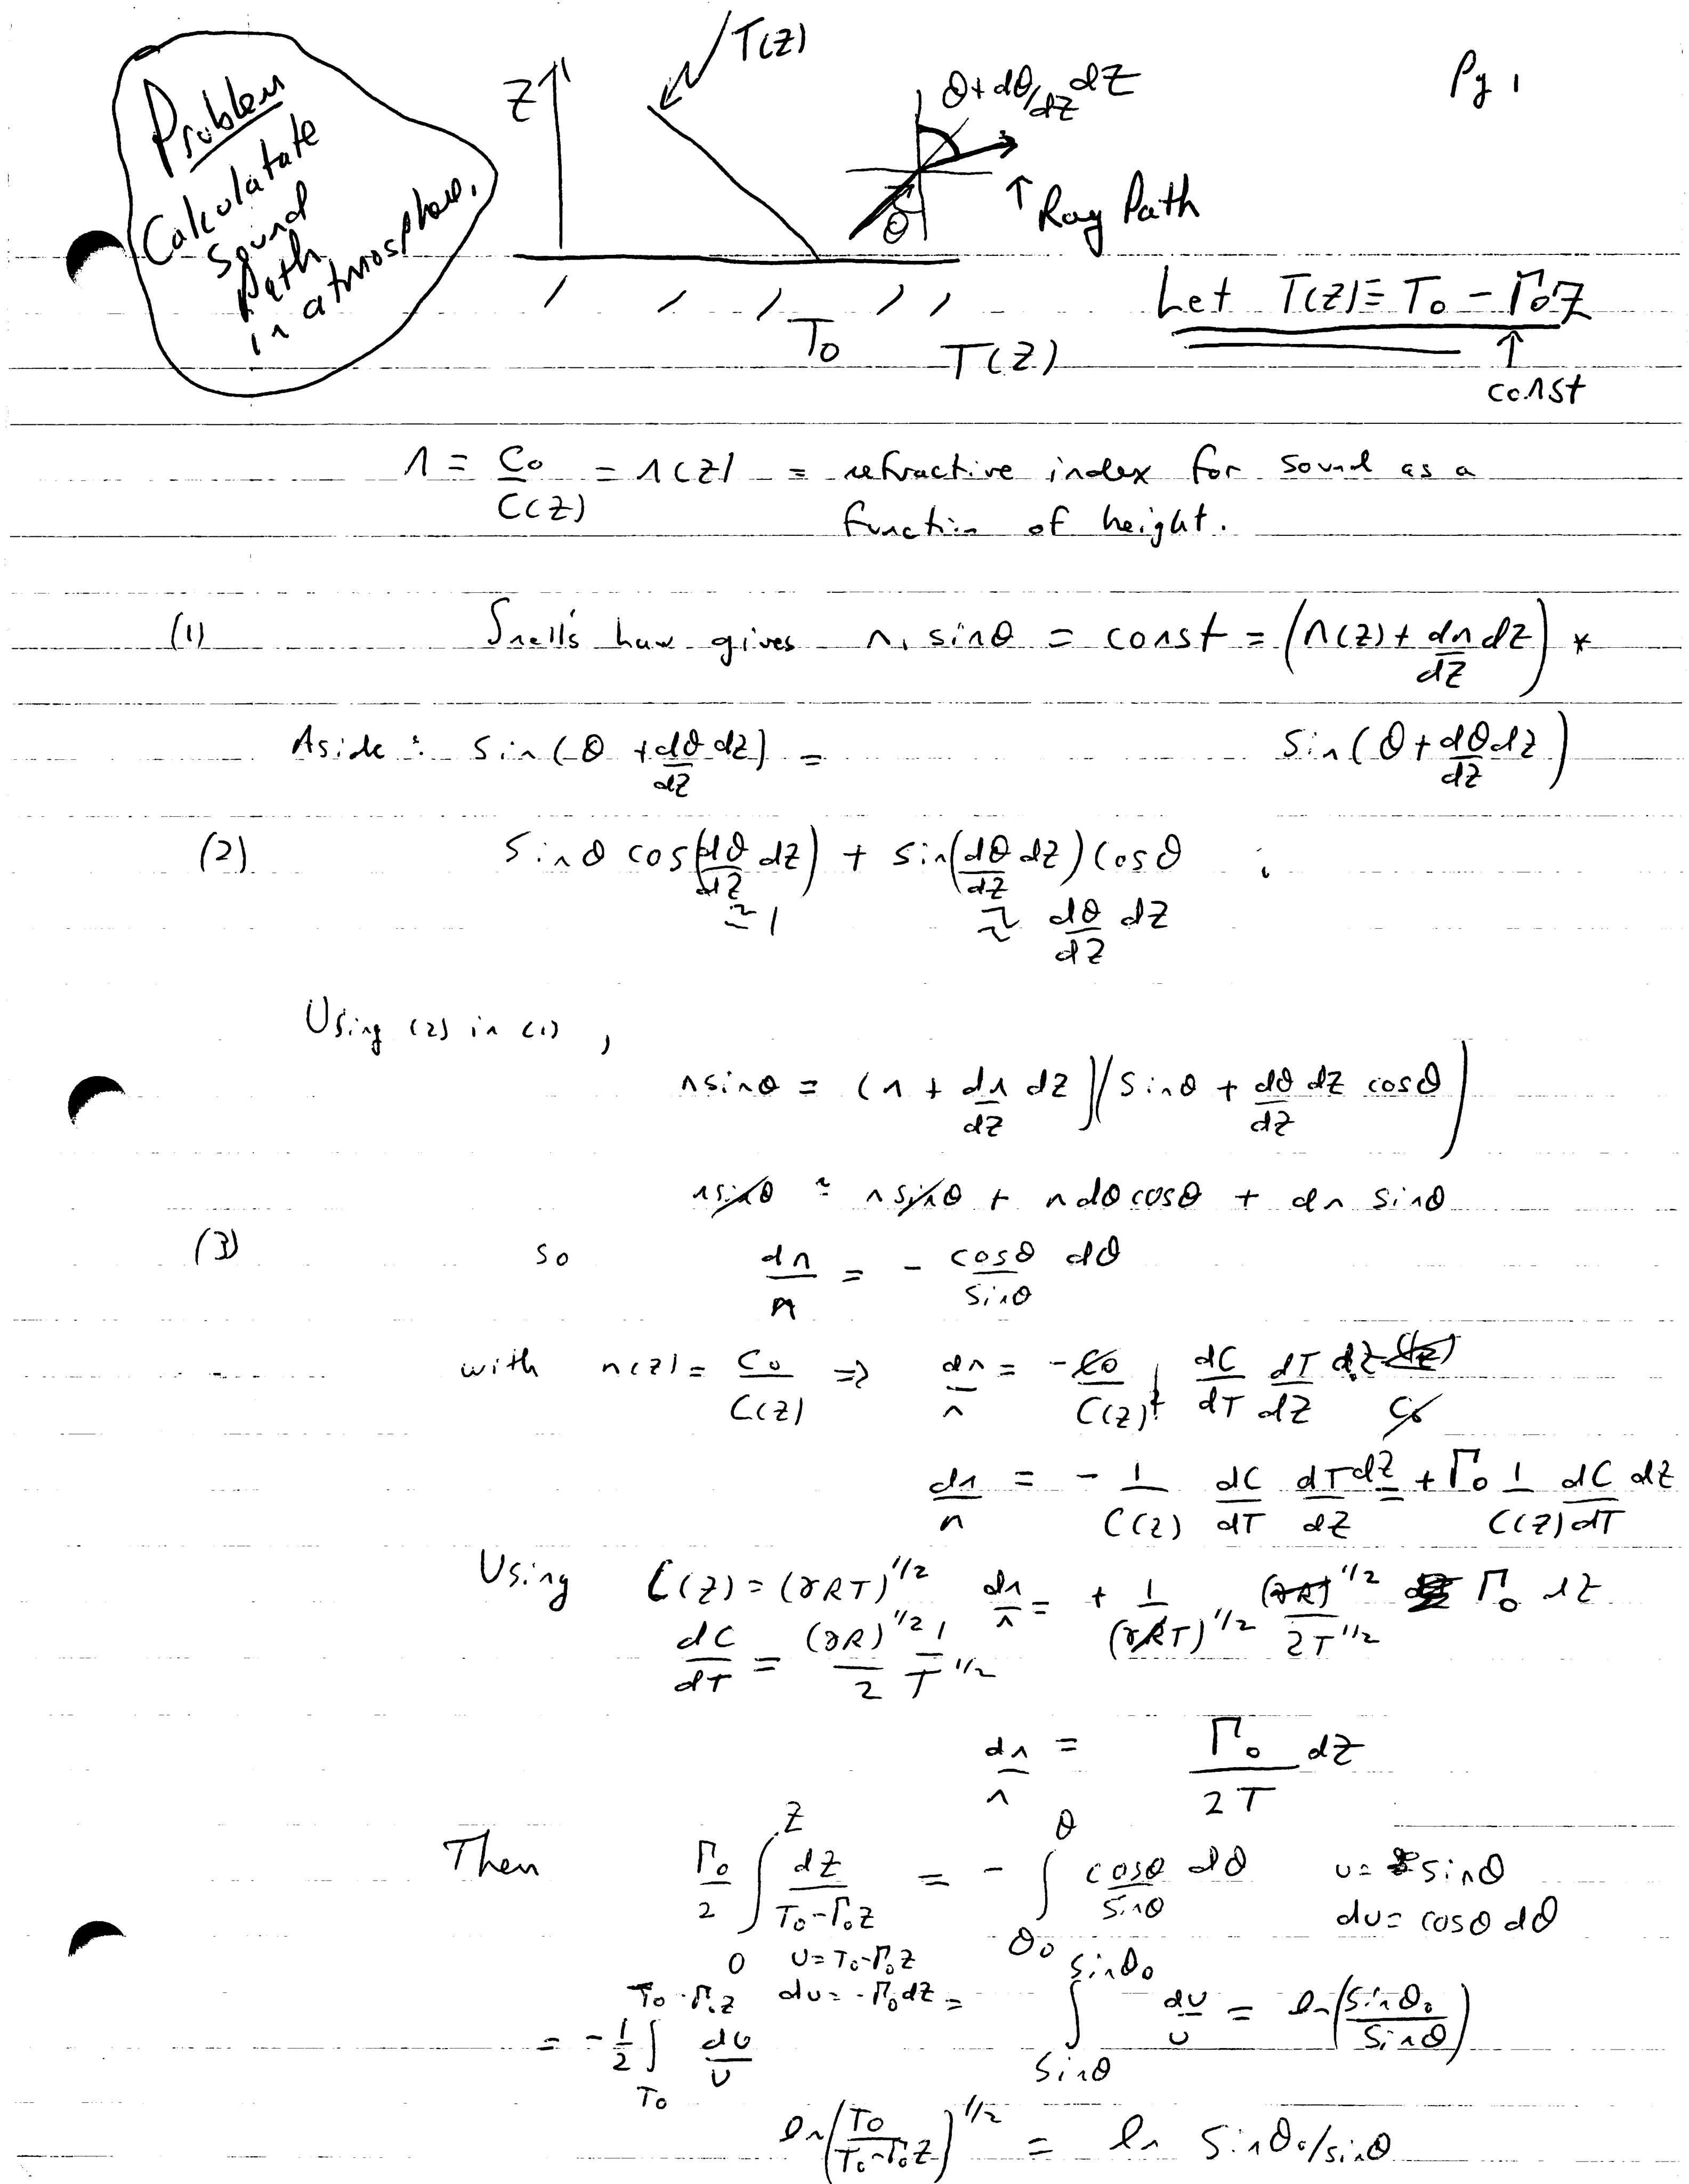
Model pages 1 and 2

Slide 9
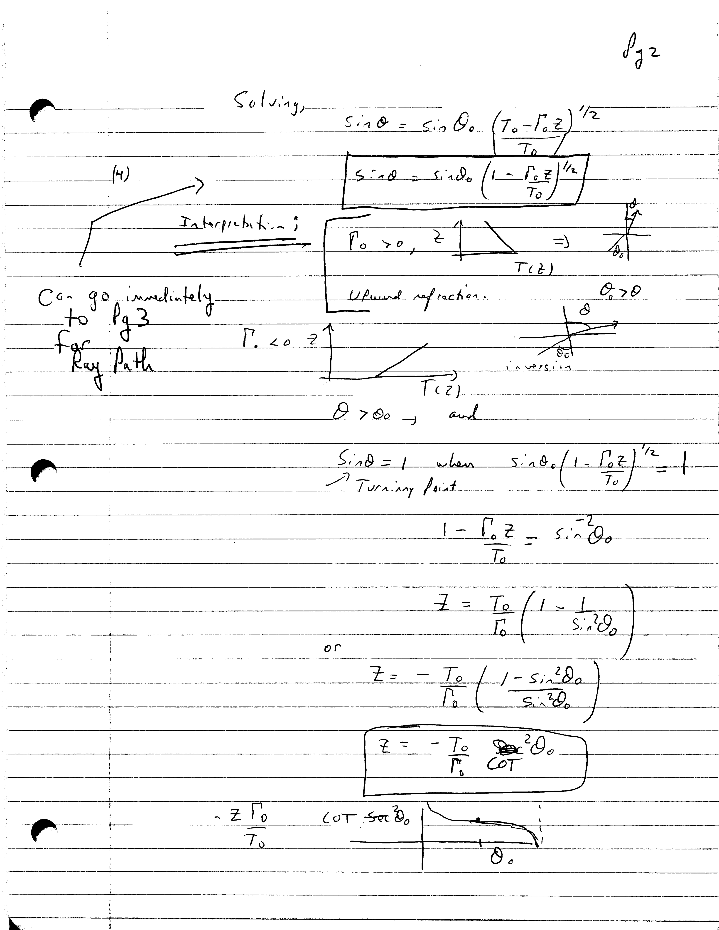
Model Page 2

Slide 10
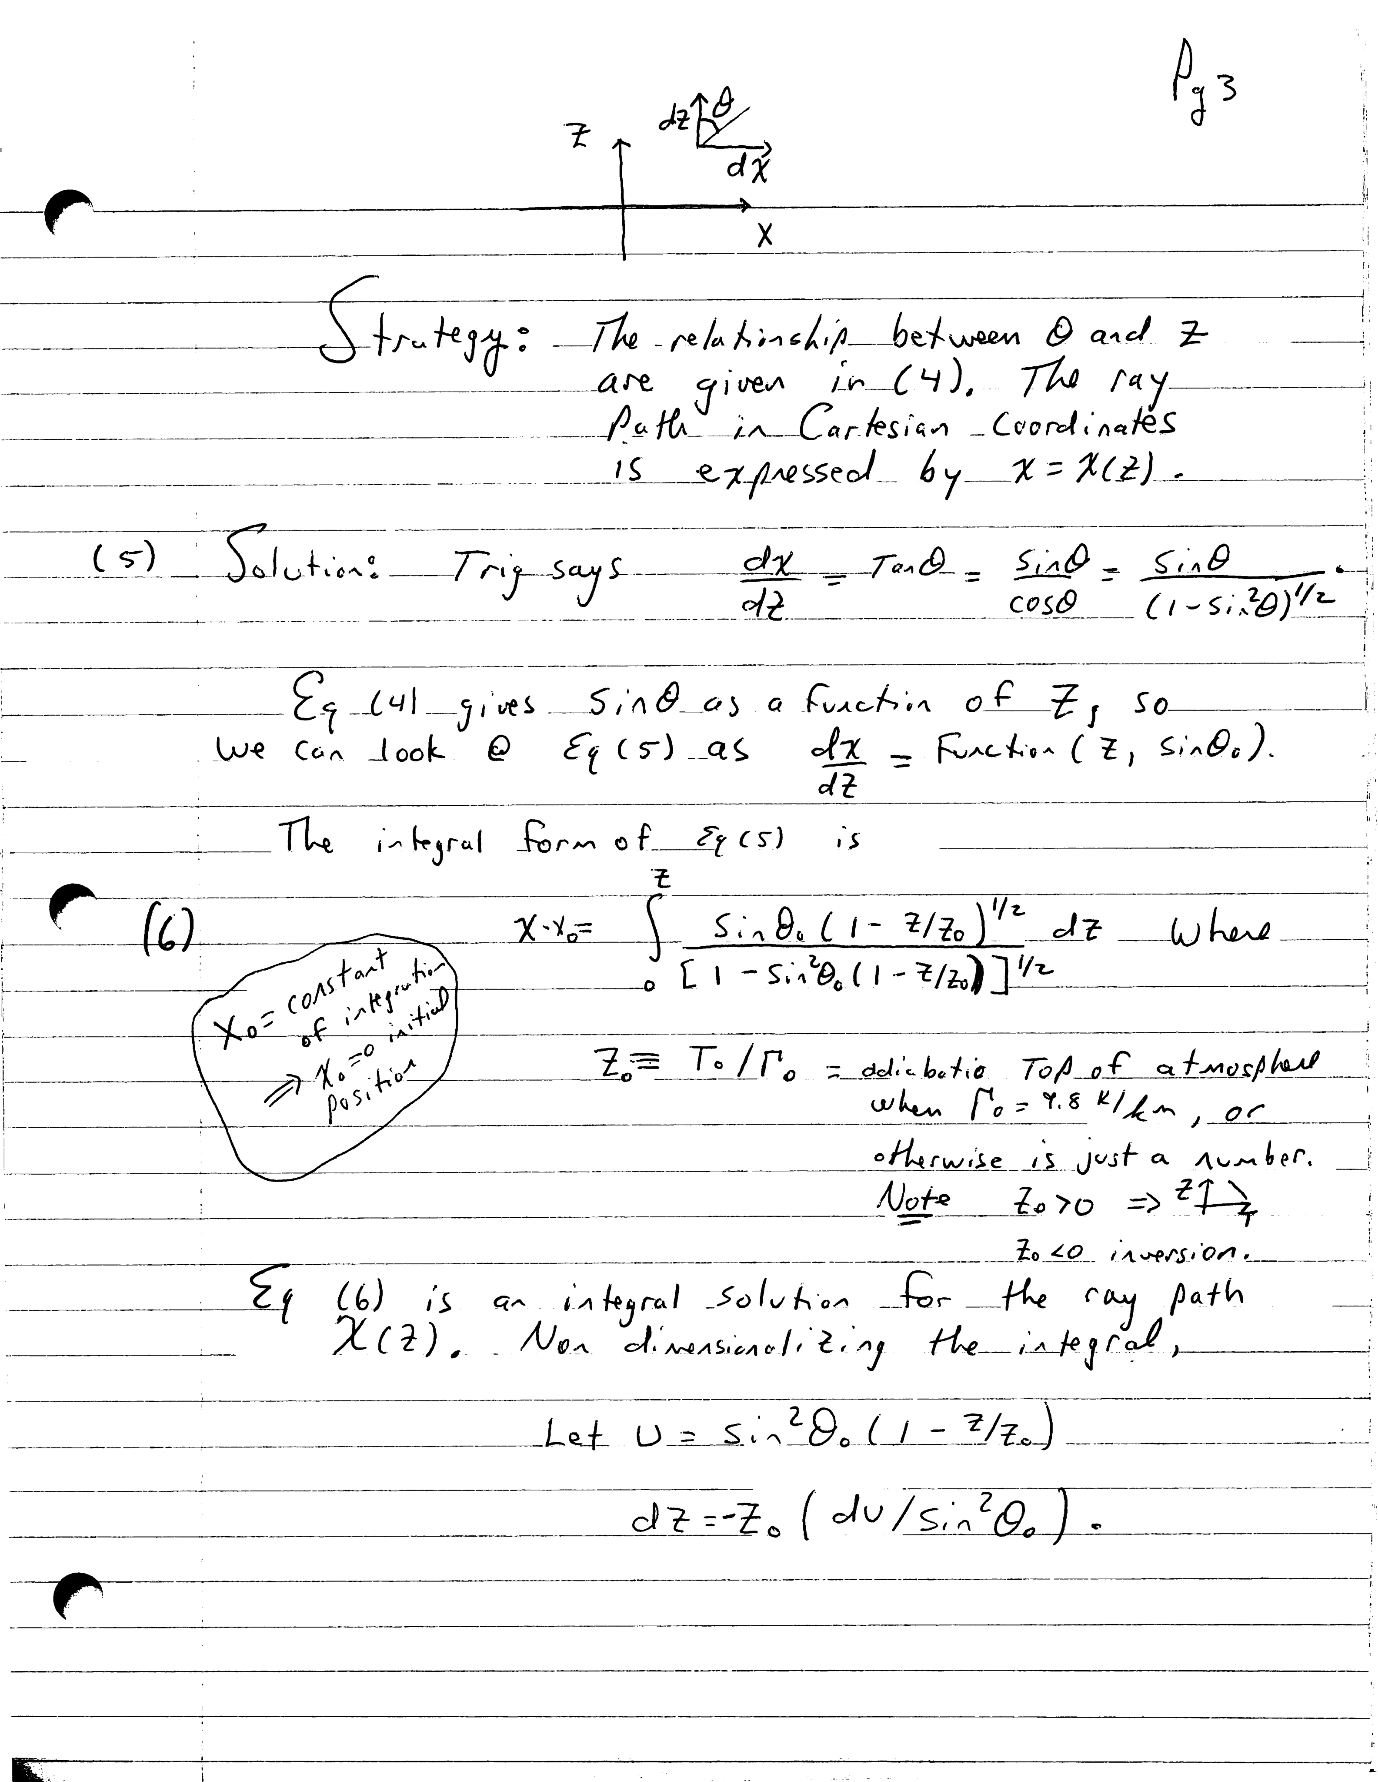
Model Page 3

Slide 11
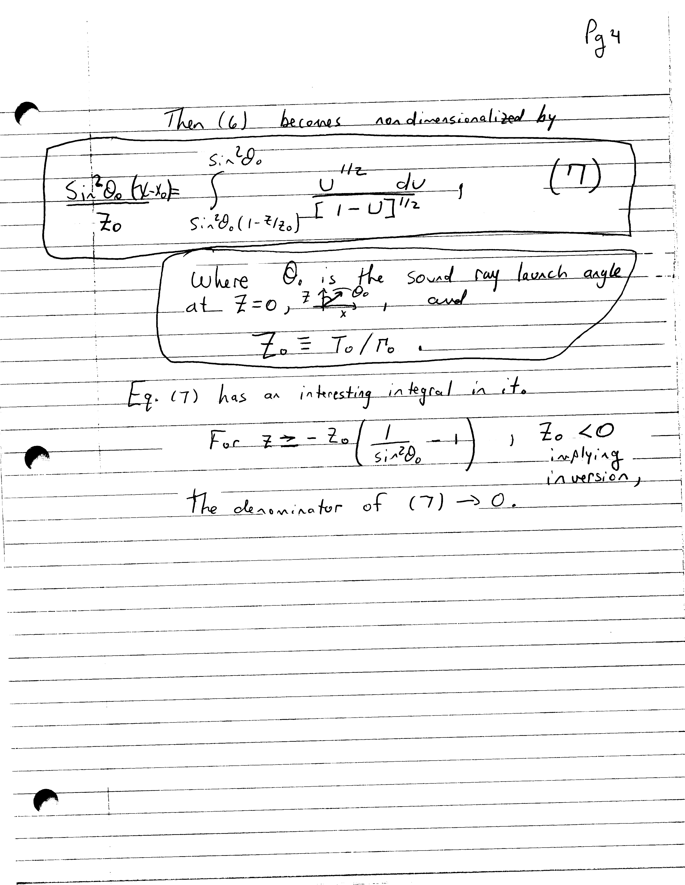
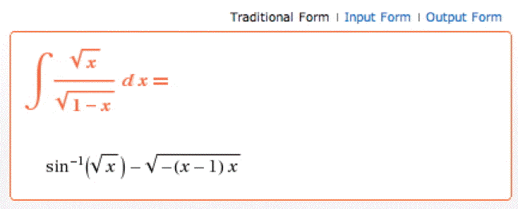
Model Page 4
Mathematica
On line.
http://integrals.wolfram.com/index.jsp

