Slide 1
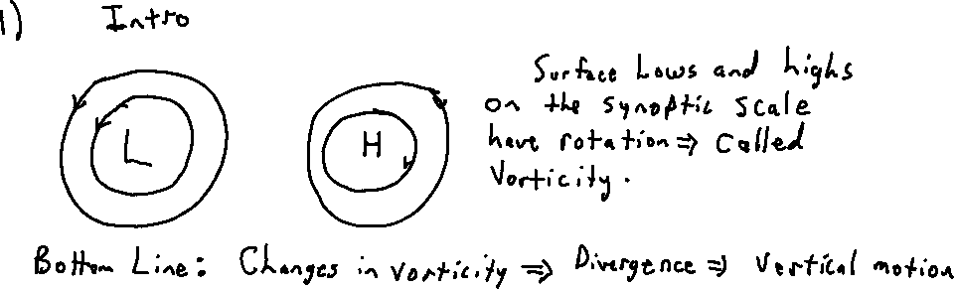
Rotation and Vorticity:

Slide 2
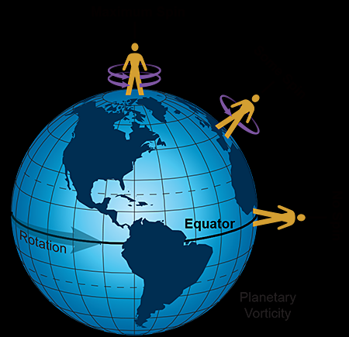

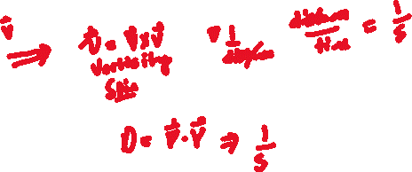
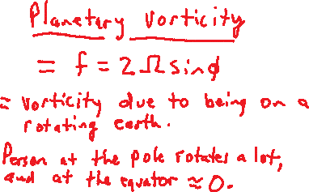
Chapter 5 Vorticity and Divergence: Summary of where were headed
Total vorticity = (Planetary + Relative) vorticity. Relative vorticity = (shear + curvature) vorticity.
Vorticity > 0, cyclonic in NH, counter clockwise
From the NWS Jetstream

Slide 3
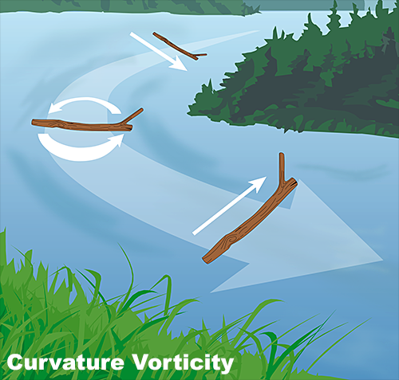
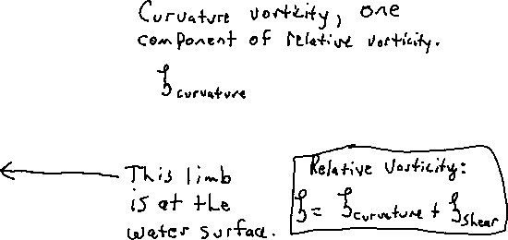
Curvature vorticity part of relative vorticity

Slide 4
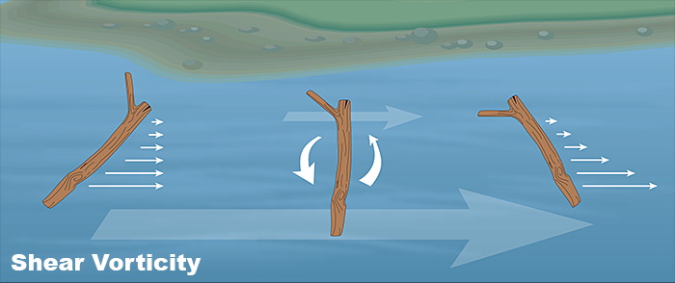

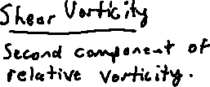

Slide 5
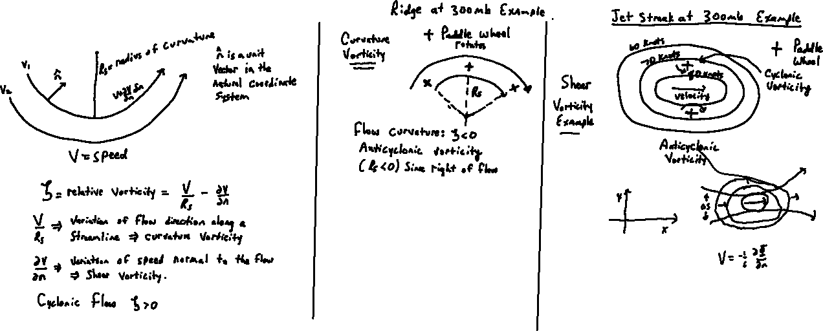
Quantitative look at types of relative vorticity
dn
If V2 > V1,
dV/dn=(V1-V1)/dn < 0.

Slide 6
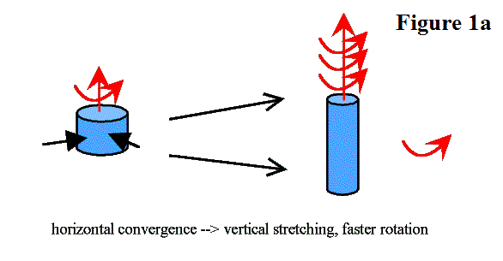
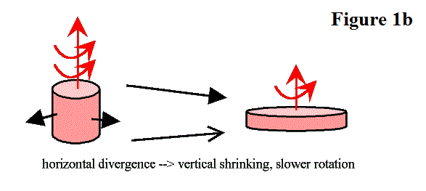
Relation between vorticity and divergence near the surface
Where we are headed: From Jeff Haby: https://www.weather.gov/source/zhu/ZHU_Training_Page/Miscellaneous/vorticity/vorticity.html

Slide 7
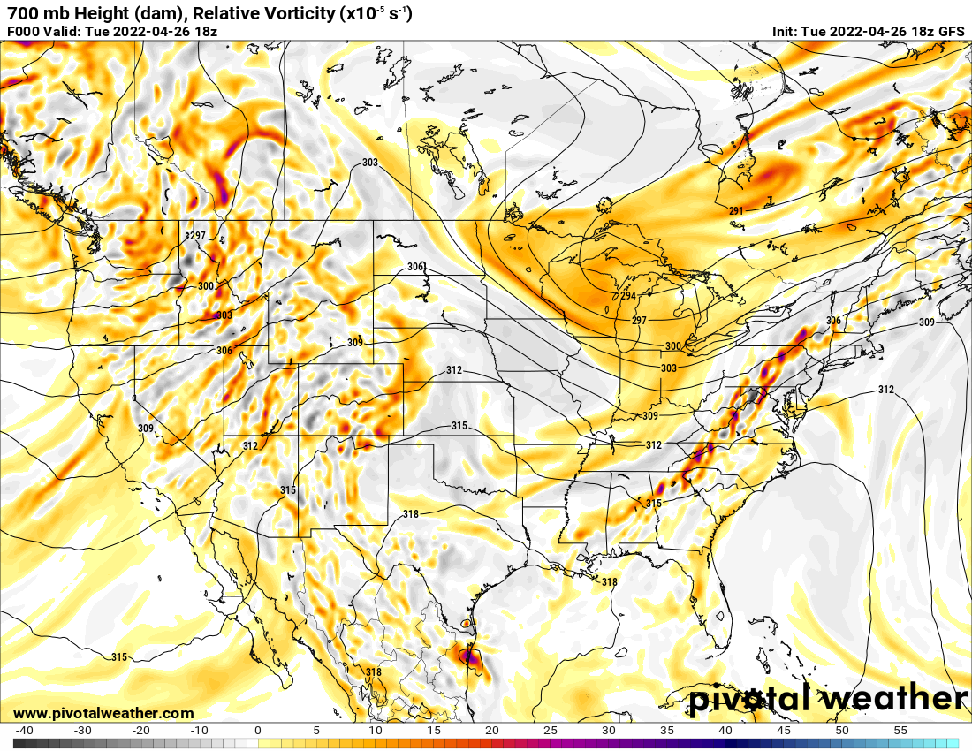
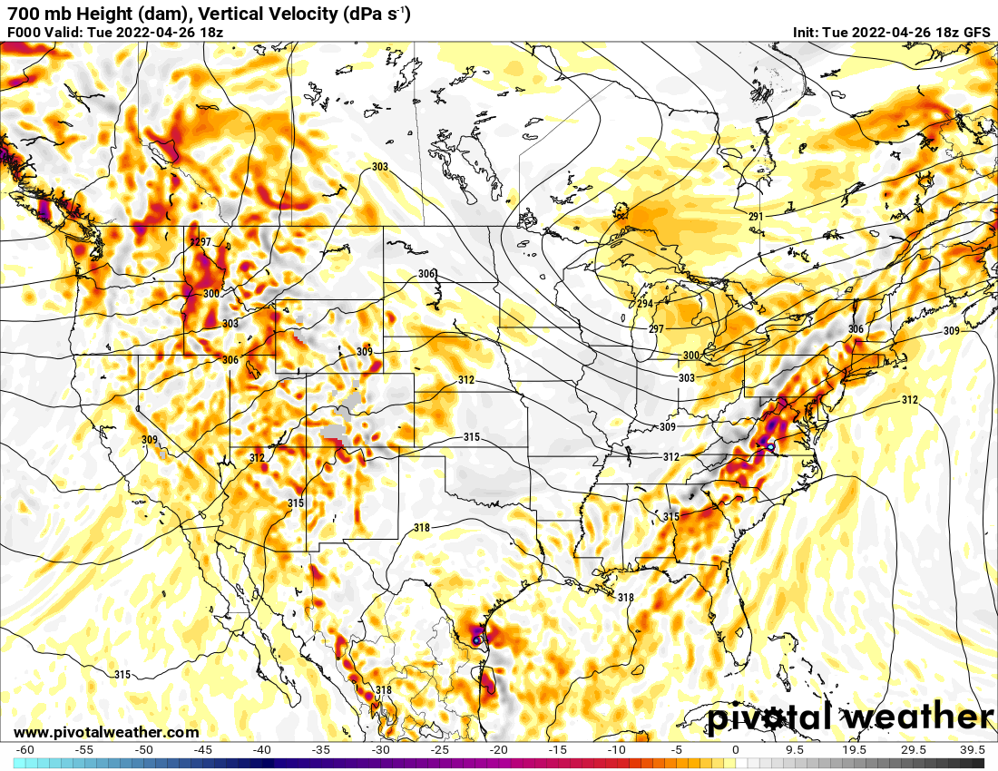


Example from Pivotal Weather

Slide 8
Skip to slide 13, section circled near the bottom.

Slide 9
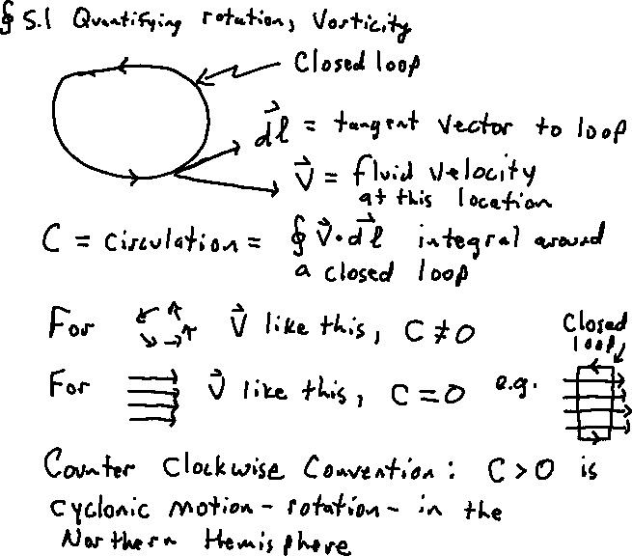
Define Circulation

Slide 10
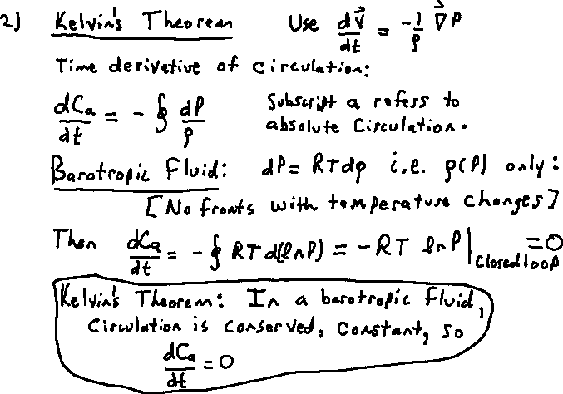
Kelvin’s Circulation Theorem: In a barotropic inviscid fluid, the circulation around a closed loop that moves with the fluid is a constant. Circulation is not created or destroyed.
In the atmosphere this is related to Rossby waves through the potential temperature due to the total vorticity remaining the same when air oscillates north and south of an initial latitude while conserving the sum of planetary and relative vorticity. They are played off against each other.

Slide 11
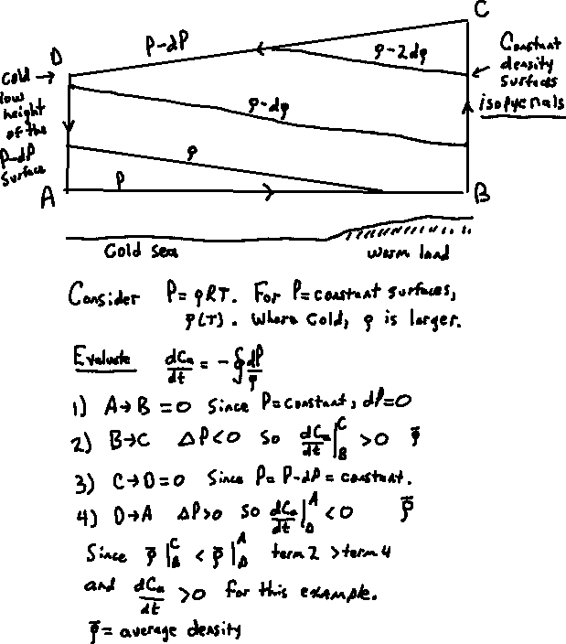

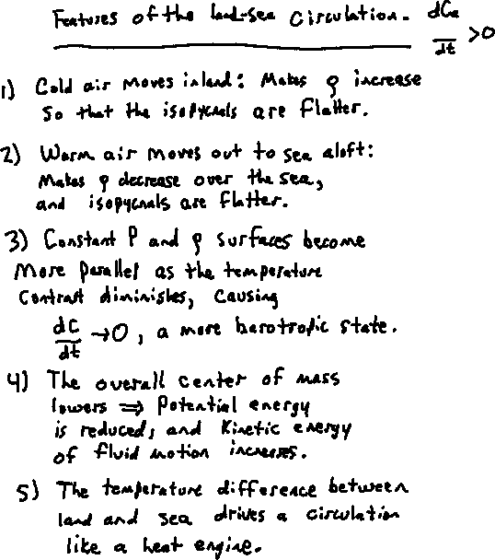
Circulation in a Baroclinic Fluid: Land Sea Boundary.

Slide 12
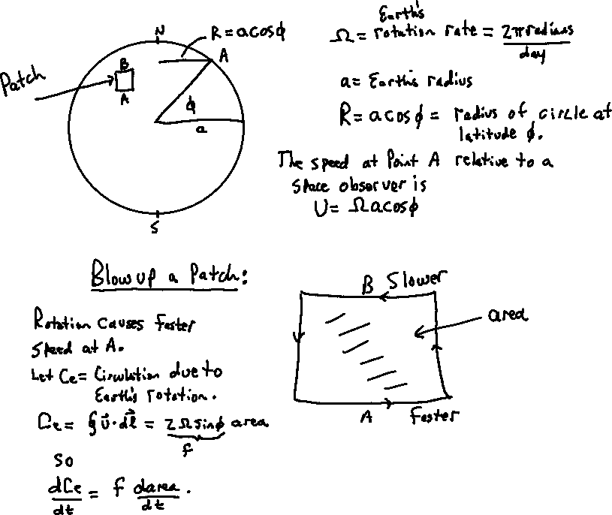
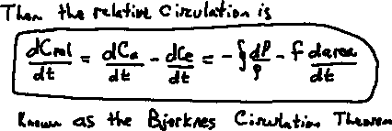
Circulation, Earth’s Rotation

Slide 13
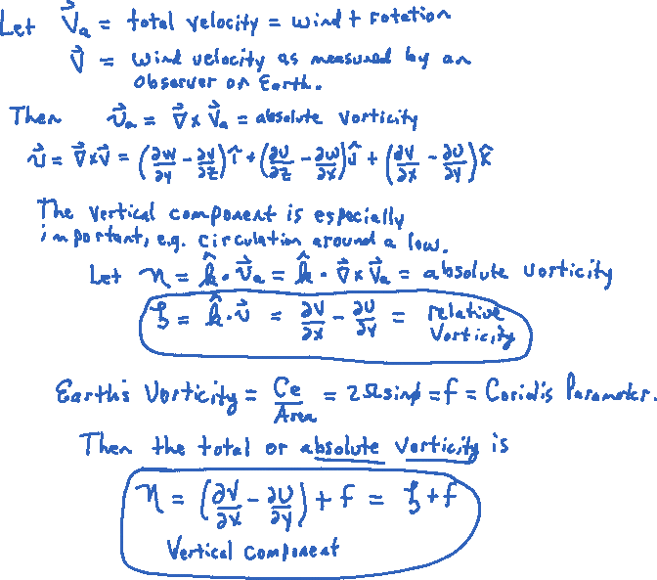

Section 5.2 Vorticity= dC/dArea, What is vorticity?

Slide 14
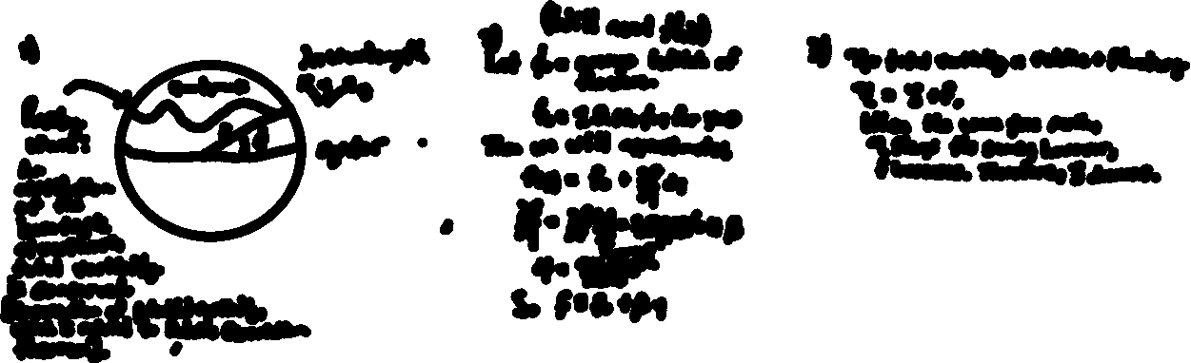
Rossby Wave Example (a first look).
Known as the Beta plane approximation.
Can also have Rossby waves in a baroclinic atmosphere where there are fronts and strong temperature contrasts in the horizontal direction.

Slide 15
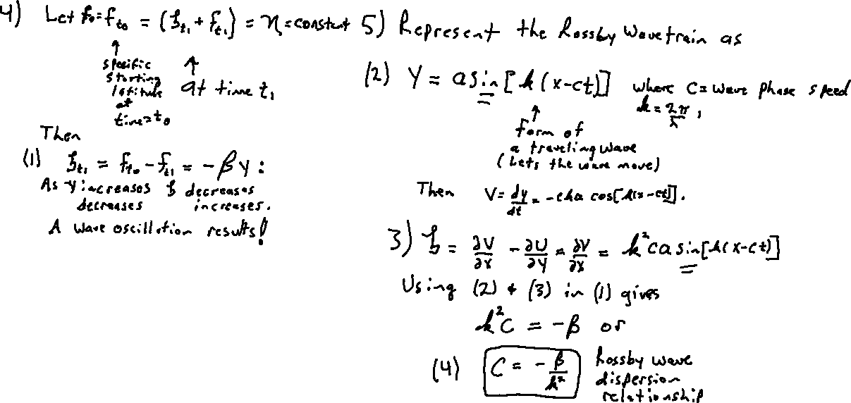
Developing the theory of Rossby waves

Slide 16
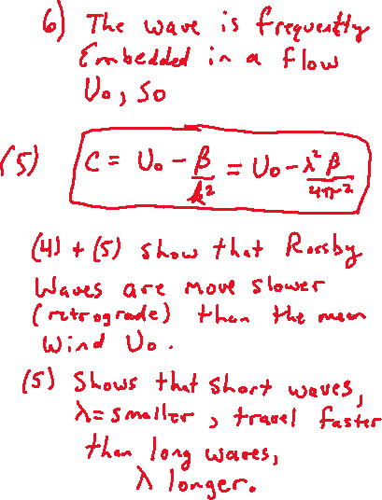

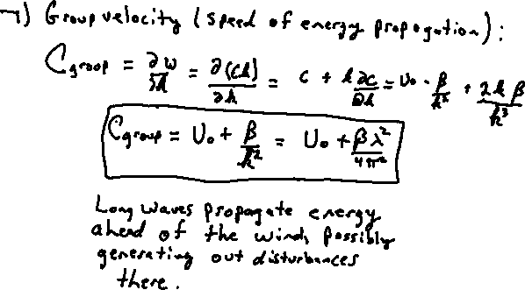
Aside: Phase and Group Velocity

Slide 17
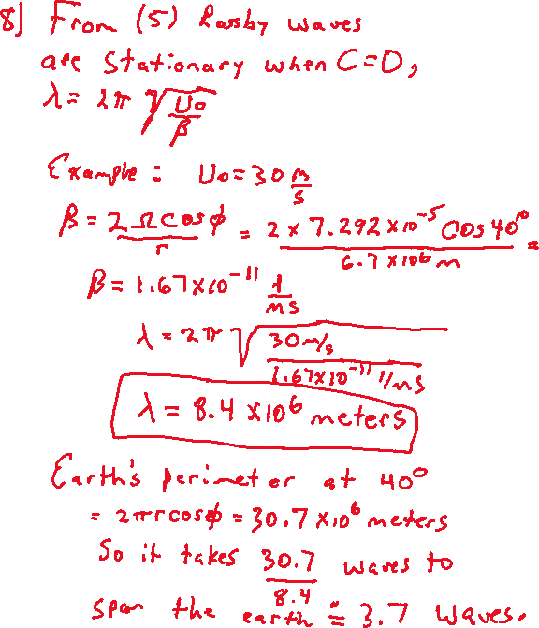
This is the theory for free Rossby waves. The can also be forced by persistent features like the Rocky Mountains and the Himalaya Mountains (lee side trough).

Slide 18
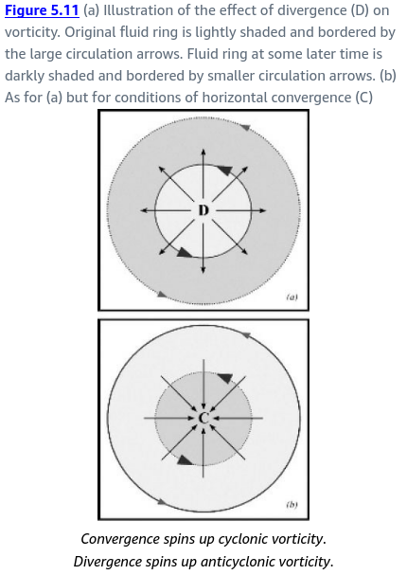
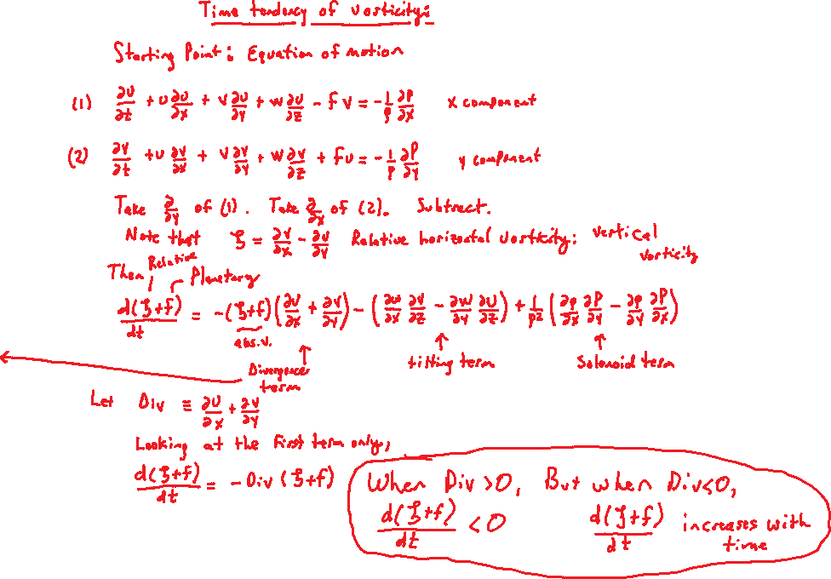

Relationship between divergence and vorticity details.

Slide 19
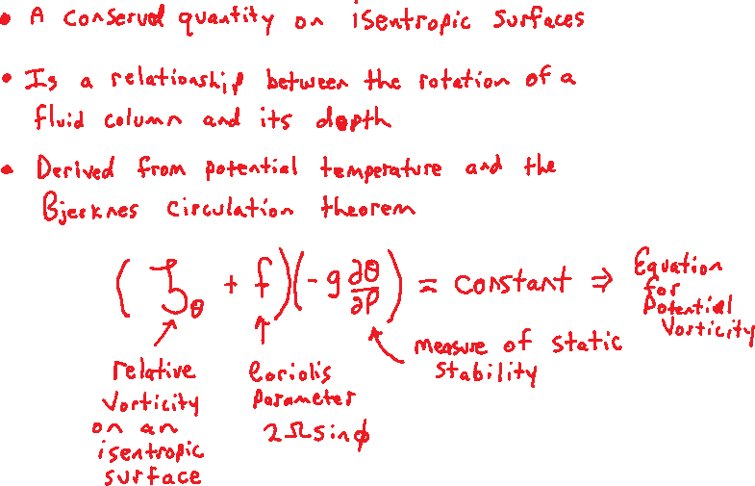
Potential Vorticity In Short

Slide 20
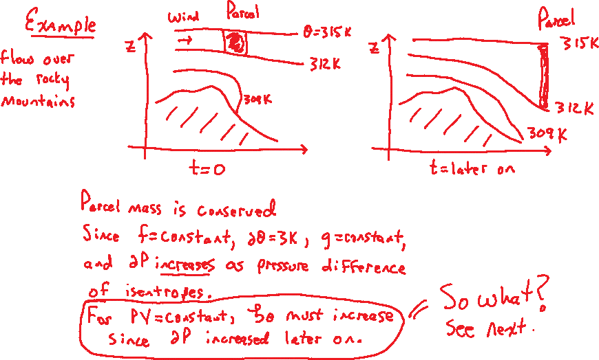
Example

Slide 21
Move back to Slide 9, circulation, or Go to Potential Vorticity Details (already in notebook)

